Slide 1
Kata Containers @Arm:
Latest progress on arm64
Penny Zheng & Jianyong Wu
Opensource software
Nov.4 2019

Slide 2
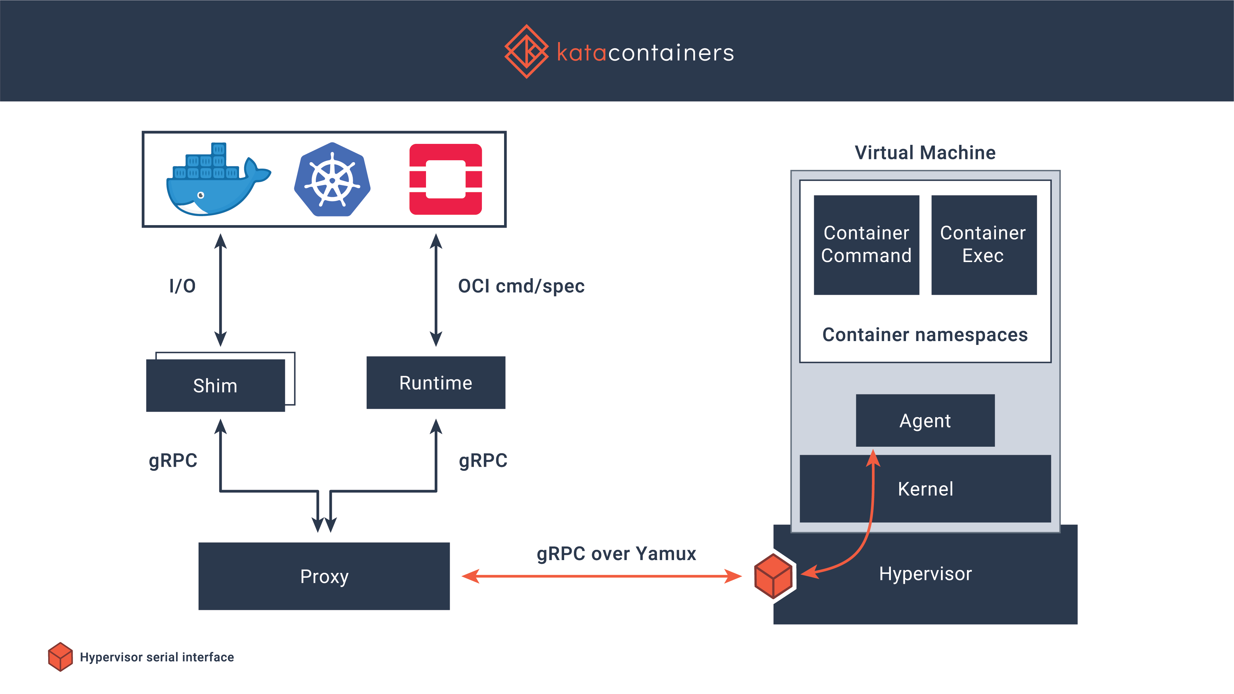
Kata-container

Slide 3
Agenda
PTP_KVM on kata for arm64
Status update
  virtio-fs
Next steps
  Firecracker
  Performance Metrics

Slide 4
PTP_KVM
What is ptp_kvm?
  A kernel feature used for time sync between VM and host in high precision .
  Traditional time sync: NTP (network time protocol) provides dozens to thousands of microseconds time sync precision.
  PTP_KVM can provide time sync precision in order of nanosecond.
Why we need ptp_kvm for kata?
  Time is not accurate within Kata containers.
  End to end traces will yield wrong/inconsistent results.
  https://github.com/kata-containers/runtime/issues/1279
Status for Arm at kernel side
  Currently, ptp_kvm.ko only support x86 in kernel.
  Need to enable ptp_kvm in Linux kernel for arm64.
？
kata
kata
kata
kata
kata
….
host
runc
runc
runc
runc
runc
….
host
Notes:
Ptp_kvm for kata, time drift

Slide 5
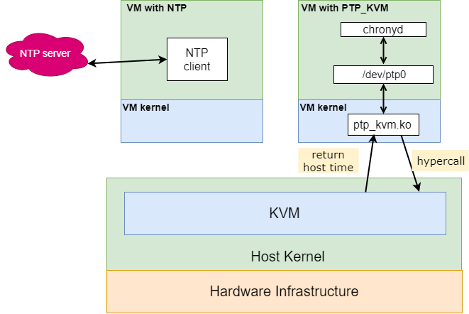
PTP_KVM inside

Slide 6
PTP_KVM in kata
chronyd
/dev/ptp0
ptp_kvm.ko
Host kernel

Slide 7
PTP_KVM status in kata for arm64
To use this feature, both guest kernel in kata and host kernel need to apply a patch.
It is ready to use PTP_KVM for kata part.
You need to apply a patch to your host kernel (v4.19-v5.0) before use it.
  Find the patch in [1]
PTP_KVM enablement for kernel on arm64 is ongoing. See [2]
  [1] https://github.com/kata-containers/packaging/blob/master/kernel/patches/4.19.x/0001-4.19-enable-ptp_kvm-for-arm64-in-kata.patch
  [2] https://patchwork.kernel.org/cover/11208961/

Slide 8
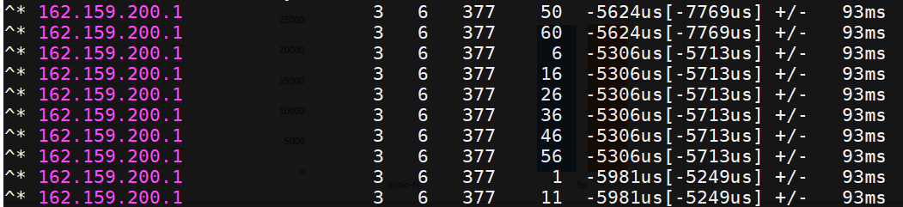
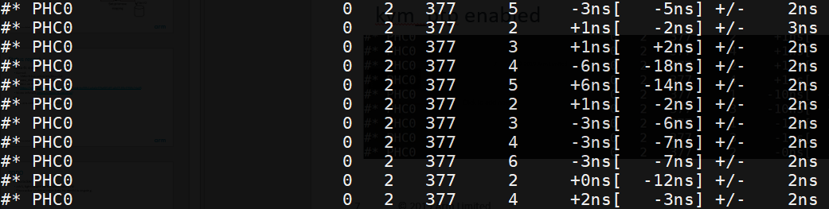
Test data for PTP_KVM in kata for arm64
Time sync data using NTP in kata
Time sync data using kvm_ptp in kata
Notes:
highlight

Slide 9
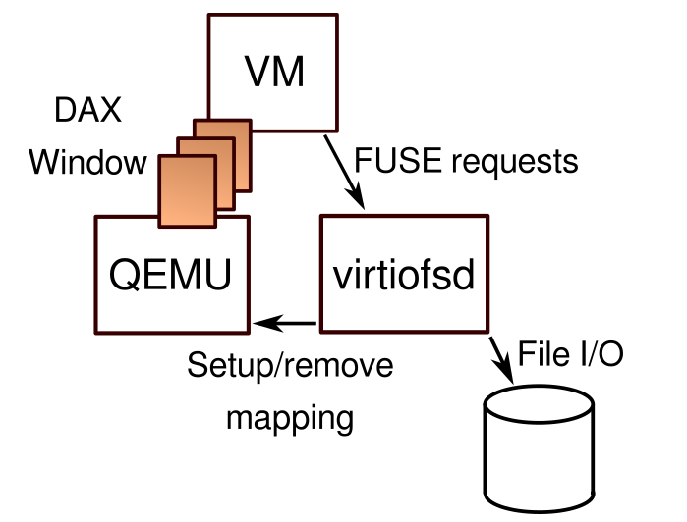
Status update
Virtio-fs
  A shared file system that lets virtual machines access a directory tree on the host. Unlike existing approaches, it is designed to offer local file system semantics and performance.
  internal tests show it will significantly improve the file system performance in kata for arm64 compare with 9p.
  Not yet ready for kata community.
https://virtio-fs.gitlab.io/design.html
Notes:
x/y

Slide 10
Status update
Virtio-fs status:
  Kernel:
    Virtio-fs was added into linux-5.4
    zone_device was not enabled for arm64
  Qemu: under review
    https://git.qemu.org/?p=qemu.git;a=commit;h=98fc1ada4cf70af0f1df1a2d7183cf786fc7da05
  More info see https://virtio-fs.gitlab.io/
Notes:
K8s more info

Slide 11
Next steps
Firecracker
  AWS, lightweight VMM, faster, microVM
  Firecracker enablement in kata for arm64 is ongoing.
Performance metrics
  CPU
  FS
  Network

