Slide 1
Operators - The Future of Kubernetes
Hands-On Workshops On Operators and Tekton
Krishna Venkata
Laxmikanth Vajinapally
Shabrinath Motamary

Slide 2
Agenda
Stateless Vs StateFul
What is an Operator?
Operator Framework
Operators Types
Best Practices
Hands-on Go Based Operator
What is Tekton ?
Tekton CRDs
Hands-On Tekton Pipeline

Slide 3
Stateless Vs Stateful Applications
Stateless
Kubernetes provides powerful in built features to deploy stateless applications e.g. Web Apps
Can be destroyed, relocated and upgrade easily.
Service Exposes deployments.
Stateful
Requires domain Knowledge to Deploy, Manage and Scale e.g. Databases.
Application specific notions of clustering and interconnectivity.
Coordination for authorization and authentication of members.
Coordination while scaling in and out.
Complex application specific Backup, Healing and life cycle management

Slide 4
Kubernetes Doesn’t and Operators Does
This is where Operators Come in, all the cons of Stateful can be achieved by Operators.
Operators fill the gap of the application specific things that Kubernetes can’t do.
Operators extend Kubernetes functionality.
Human experience as code.
Focus on desired state.
Complex, Manual Operational tasks become a single line of Config.

Slide 5
What is Operator?
“An Operator is a method of packaging, deploying and managing a Kubernetes application. A Kubernetes application is an application that is both deployed on Kubernetes and managed using the Kubernetes APIs and kubectl tooling.”

Slide 6
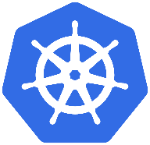
Custom Resources Definition
Application knowledge
Custom Controller
Operator

Slide 7
Application Knowledge
Deploy
Upgrades
Scale
Backup
Self-Heal/Repair

Slide 8
Operator Interaction With Kubernetes
Operators take advantage of Custom Resource Definition(CRD).
CRD’s are extensions of the Kubernetes API to register new Resource.
Creating a Custom Resource(CR) from CRD’s.
Operator monitors for new CR request, acknowledges and creates the CR.
It Can be used like any other native Kubernetes Resource.

Slide 9
When to Choose Creating A Operator?
Business logic is required.
Application uses a declarative API.
Automation that watches for updates of Kubernetes object.
Create or update resources using Kubernetes API.

Slide 10
Etcd Operator
Cluster A has 3 Running Pods
Name: summit-etcd-0 Version 2.9.1
Name: summit-etcd-1 Version 2.9.2
Name: summit-etcd-1 Version 2.9.1
Desired = False
Difference in Configuration
Version should be 2.9.2
Cluster
Clean, Backup Cluster
Upgrade to 2.9.2
Observe
Analyze
Act

Slide 11
Operator Framework
Operator SDK
Supports developers in bootstrapping and building an Operator based on their expertise without requiring knowledge of Kubernetes API complexities
Operator Lifecycle Manager
Helps you to install, update, and generally manage the lifecycle of all of the operators (and their associated services) running across your clusters
Operator Metering
Metering records historical cluster usage, and can generate usage reports showing usage breakdowns by pod or namespace over arbitrary time periods

Slide 12
Operator Types Using Operator SDK
Operator Type | What the SDK generates | What you need to define
Go Operator | General go program structure Boilerplate code to talk to the Kubernetes API Boilerplate code to watch for Kubernetes objects of interest An entry point to the reconciliation loop | Custom objects via CRDs Control loop logic in Go
Ansible Operator | A Go program that runs an Ansible playbook or role every time a certain type of object is detected / modified | Custom objects via CRD
Helm Operator | A Go program that reads a helm chart and deploys all its resources Watch statements to detect changes in the custom objects specification, re-deploying all resources with updated values | The location / repository of the helm chart

Slide 13
Maturity Models of Operators

Slide 14
Project Layout For Go Based Operator SDK
File/Folders | Purpose
cmd | Contains manager/main.go which is the main program of the operator. This instantiates a new manager which registers all custom resource definitions under pkg/apis/... and starts all controllers under pkg/controllers/... .
pkg/apis | Contains the directory tree that defines the APIs of the Custom Resource Definitions(CRD). Users are expected to edit the pkg/apis/<group>/<version>/<kind>_types.go files to define the API for each resource type and import these packages in their controllers to watch for these resource types.
pkg/controller | This pkg contains the controller implementations. Users are expected to edit the pkg/controller/<kind>/<kind>_controller.go to define the controller's reconcile logic for handling a resource type of the specified kind.
build | Contains the Dockerfile and build scripts used to build the operator.
deploy | Contains various YAML manifests for registering CRDs, setting up RBAC, and deploying the operator as a Deployment.
go.mod go.sum | The Go mod manifests that describe the external dependencies of this operator.
vendor | The golang vendor directory that contains local copies of external dependencies that satisfy Go imports in this project. Go modules manages the vendor directory directly. This directory will not exist unless the project is initialized with the --vendor flag, or go mod vendor is run in the project root.

Slide 15
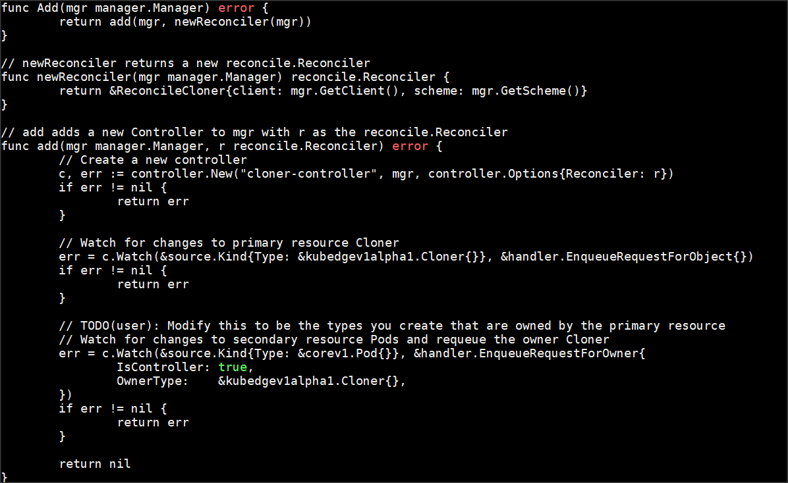
Watch

Slide 16
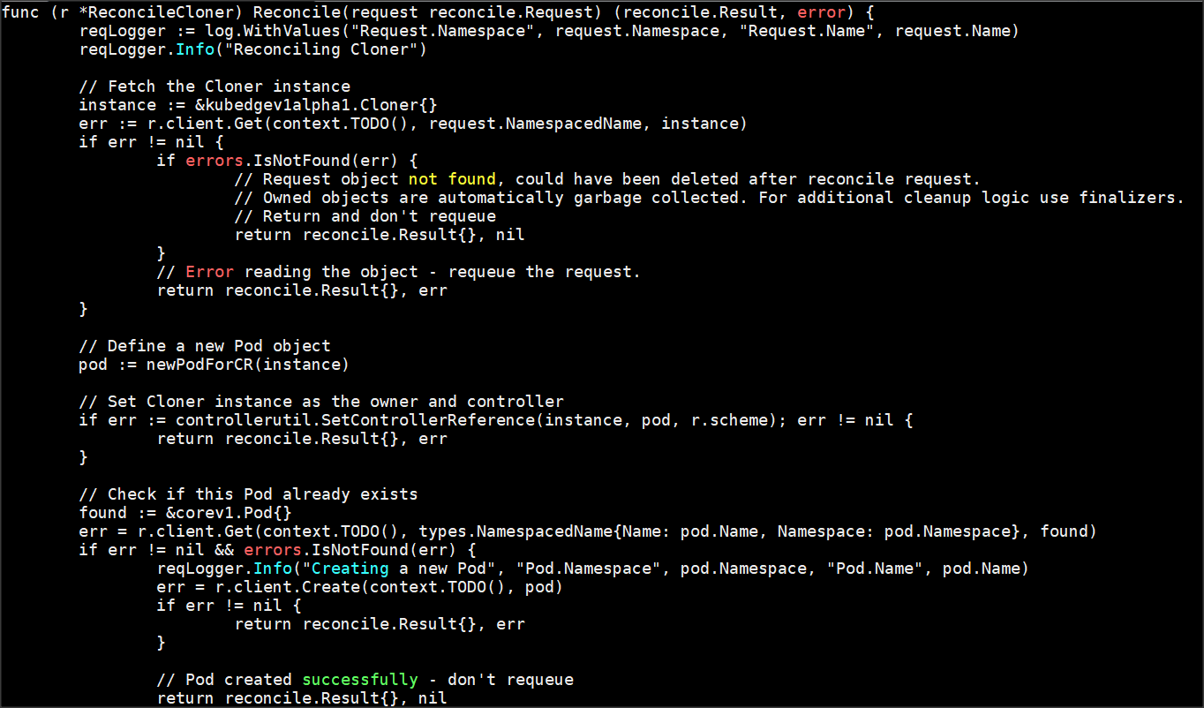
Reconcile

Slide 17
Operator Best Practices
Resource Reconciliation Cycle
Instance Validity
Instance Initialization
Instance Deletion
Resource Validation
Syntactic validation
Semantic validation
Validating a resource in the controller

Slide 18
..continued
Resource Initialization
Resource Ownership
Managing status

Slide 19
Operatorhub.io

Slide 20
Awesome Operators ..!!
Rook
Rook-Ceph
Rook-EdgeFS
Kube-Virt
Tomcat and Many More

Slide 21
Operators Hands-on Demo
In this demo, we will build a GO-based Operator called Cloner. The project name is openinfra-summit. kind is kind: Cloner
Create a project using the operator-sdk command line.
Add a new CRD API.
Update cloner_types.go as required with custom Specs and Status to deploy our application Cloner.
Run generate k8s and openapi to update the generated code for that resource type.
Add a new Controller.
Register our new CRD with Kubernetes APIServer.
Setup RBAC and Deploy our new application called Cloner.

Slide 22
Operators Hands-On

Slide 23
Operator: Tekton
What is Tekton:
Tekton itself is an Operator.
Tekton is an open source framework to configure and run CI/CD pipelines within a Kubernetes cluster.
Tekton is deployed on Kubernetes.
Installation:
kubectl apply --filename https://storage.googleapis.com/tekton-releases/pipeline/previous/v0.7.0/release.yaml

Slide 24
Tekton: CRDs
Operator= CRDs + Domain specific knowledge + Controller
CRDs : Custom Resource Definitions
Extending Kubernetes APIs
Once installed, Users can create and access its objects using kubectl
Controller : Controllers act on Resources to maintains desired state.

Slide 25
Tekton: CRDs
Task
Pipeline
TaskRun
PipelineRun
PipelineResource

Slide 26
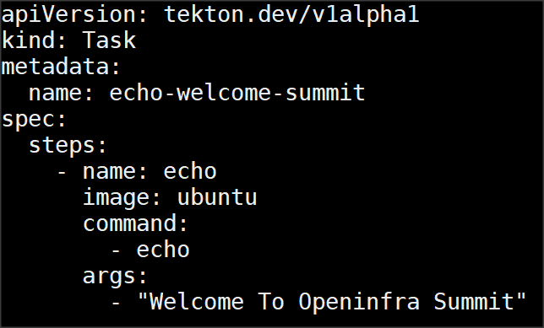
Task
Task:
Contains multiple steps
Steps are executed sequentially
Every Task is a Pod
Takes input and output parameters
Step:
Smallest Building block of a Task
Not a CRD
Each step is a container
Runs commands within the container

Slide 27
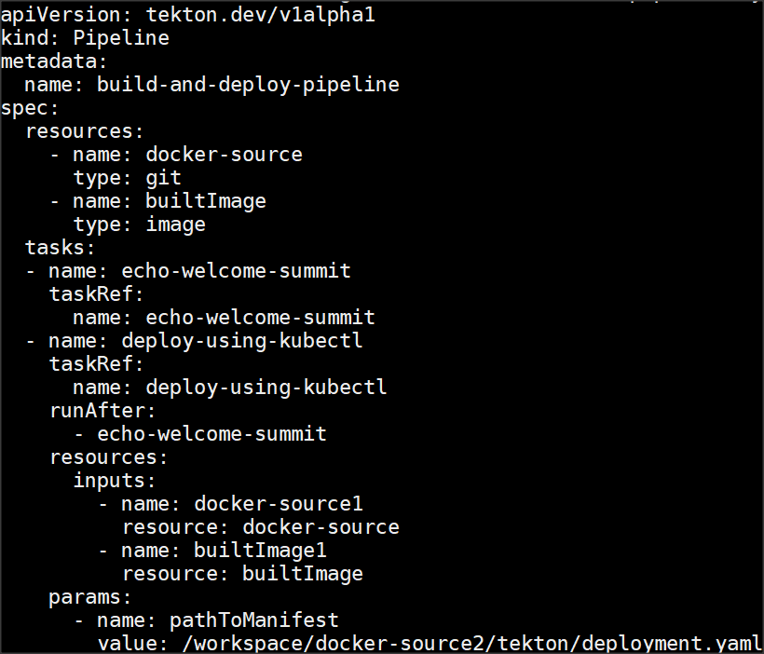
Pipeline
Tasks can be executed in any order using Pipeline
Links output and input of Tasks
Triggered using PipelineRuns
Task
Task
Task
Task
Task

Slide 28
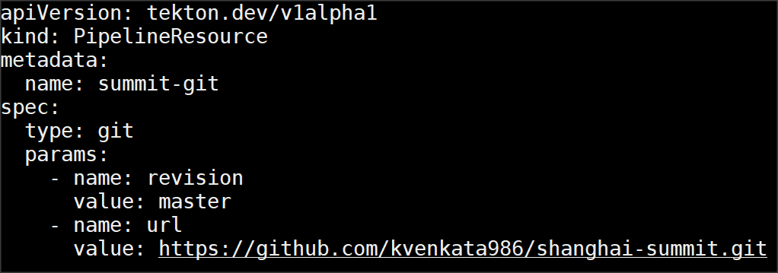
PipelineResource
Predefined input/output
Used as input and output of Tasks
Most common resource types are Git and Image

Slide 29
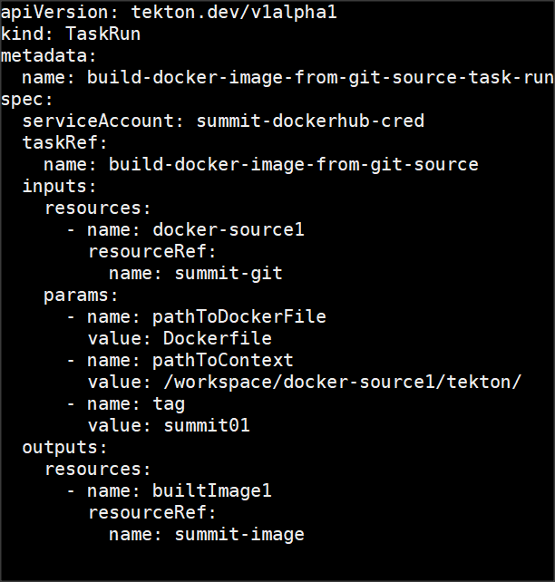
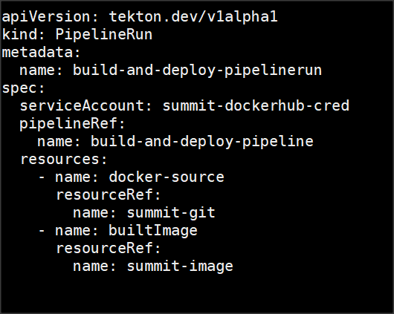
PipelineRun and TaskRun
PipelineRun and TaskRun are created to trigger Pipeline and Task respectively.
PipelineRun creation triggers creation of TaskRuns
PipelineRun uses PVC to share resources between Tasks

Slide 30
Tekton CRDs Overview
Task, Pipeline are declared once and re-used.
TaskRun, PipelineRun are used to invoke respective Tasks and Pipelines.
PipelineResource provides runtime info like Git repo, Image registry to Runs.
Pipeline Resource
Task
PipelineRun

Slide 31
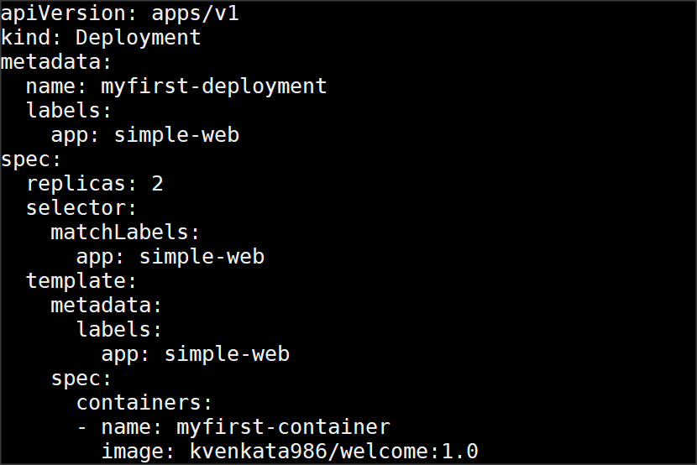
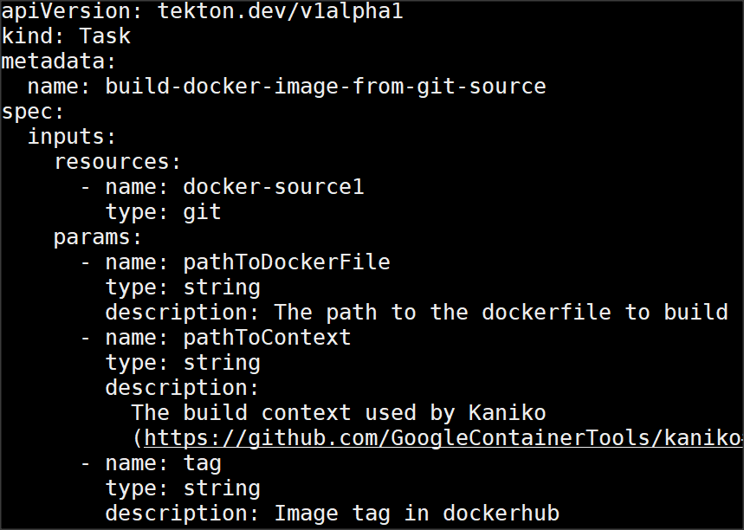
Tekton: CRDs
Tekton resources:
Task, Pipeline, PipelineRun, TaskRun etc
Native resources:
Pod, Deployment, Service, Ingress etc

Slide 32
Tekton Hands-On Demo
This pipeline demonstrates creating an container image from Dockerfile and pushing the newly created image to Dockerhub.
Overview of Steps Involved
Creating pipeline resources for Git repo and DockerHub
Creating Task
Creating TaskRun to invoke Task
Follow steps from: https://github.com/kvenkata986/shanghai-summit/tree/master/tekton

Slide 33
Tekton Pipeline Flow
PipelineResource
TaskRun
Task
PipelineResource

Slide 34
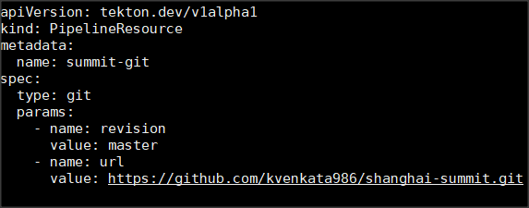
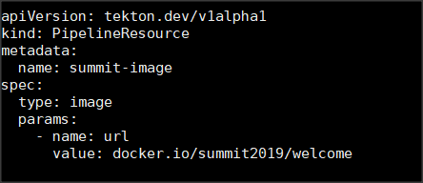
1.PipelineResource

Slide 35
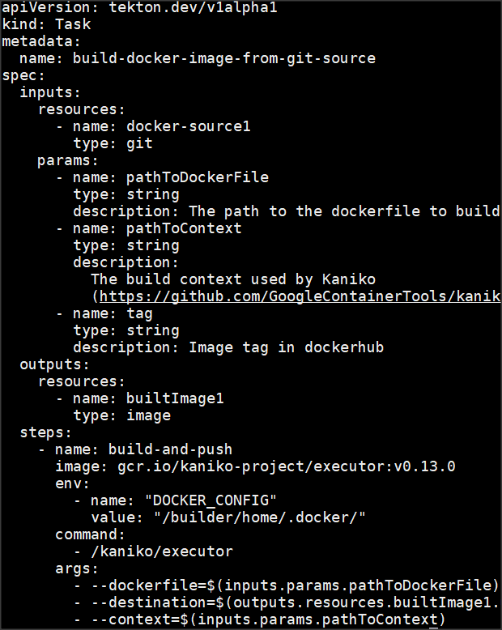
1.PipelineResource
2. Task

Slide 36
1.PipelineResource
3.TaskRun
2. Task

Slide 37
Tekton Hands-On

Slide 38
GitHub: https://github.com/kvenkata986/shanghai-summit Blog: https://kvenkata986.github.io

Slide 39
Questions ?
Thank You !

