Slide 1
NFV Orchestration by Airship – OVS-DPDK
Cheng Li, Intel
Georg Kunz, Ericsson
XiFa Sun, Inspur

Slide 2
Agenda
NFV Background
NFV Performance with DPDK
Deployment VNF by Airship
Enable OVS-DPDK in Airship/Openstack-Helm
Demo

Slide 3
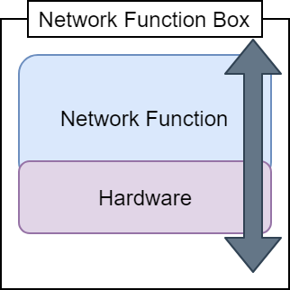
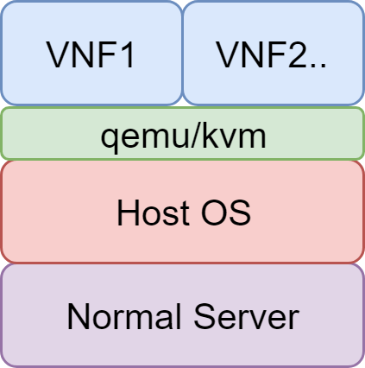
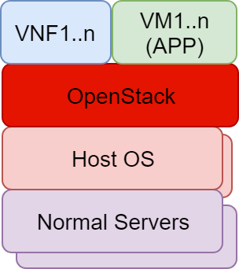
NFV Background
NFV and VNF
NFV, network function virtualization
VNF, virtual network function
+ Flexibility
+ Hardware Decoupled
- Performance

Slide 4
VNF performance improvement with DPDK
No memory copy between user space and kernel space
No frequently system calls
Poll-mode instead of Interrupts
Using hugepages

Slide 5
OpenStack already supports ovs-dpdk What’s the next things?
E2E

Slide 6
Support OVS-DPDK in Airship/Openstack-Helm
Contributors
in alphabetical order

Slide 7
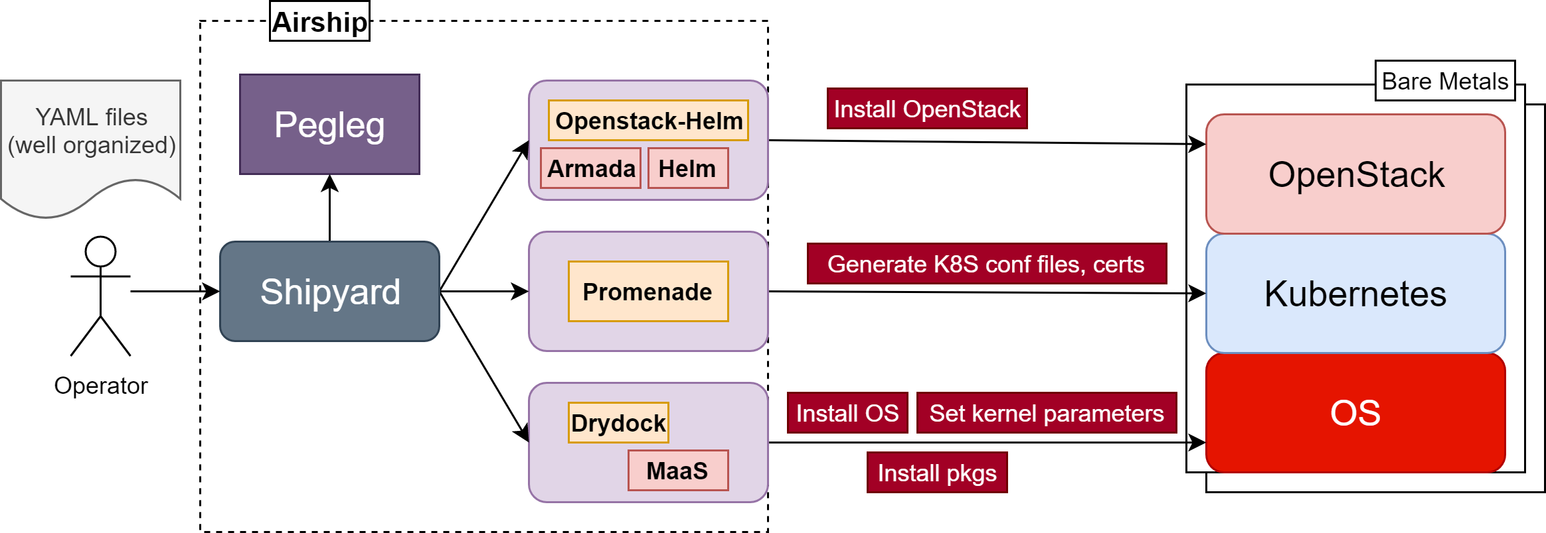
Airship – E2E deployment for OpenStack

Slide 8
New Parameters in Openstack-Helm
openstack-helm-infra/openvswitch
openstack-helm/neutron
New configuration parameters
New configuration parameters
OVS configuration
OVS agent configuration
ovs_dpdk:
enabled: false
socket_memory: 1024
hugepages_mountpath: /dev/hugepages
mem_channels: 4
lcore_mask: 0x1
pmd_cpu_mask: 0x4
ovs_dpdk:
enabled: false
driver: uio_pci_generic
nics:
- name: dpdk0
pci_id: '0000:05:00.0'
bridge: br-phy
migrate_ip: true
n_rxq: 2
pmd_rxq_affinity: "0:3,1:27"
ofport_request: 1
bridges:
- name: br-phy

Slide 9
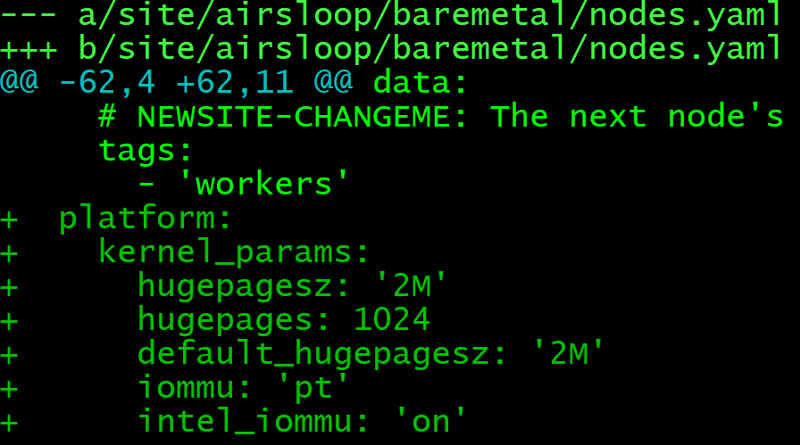
Airship Site YAMLs(1/2)

Slide 10
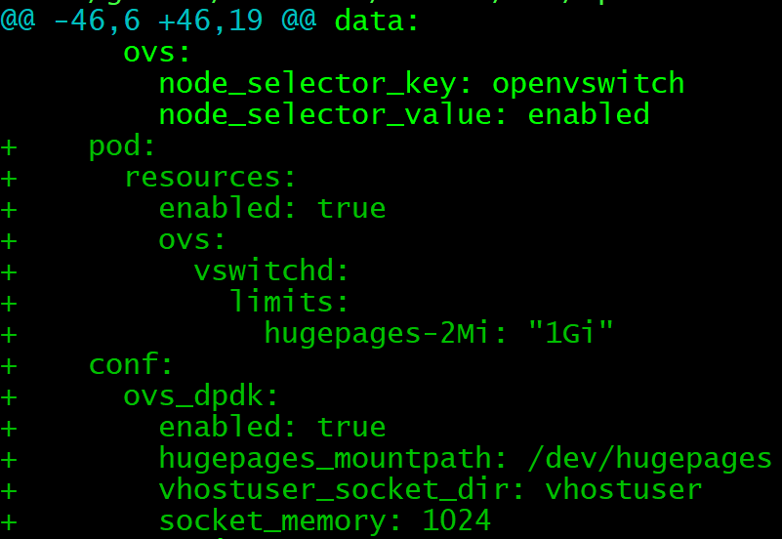
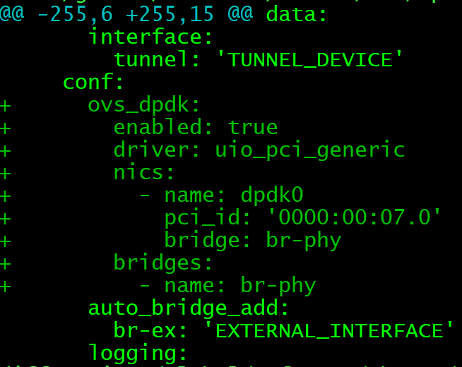
Airship Site YAMLs(2/2)
openstack-compute-kit/openvswitch.yaml
openstack-compute-kit/neutron.yaml

Slide 11
Demo
Two nodes env
Controller node to run Airship components
Compute node to run Openstack components

Slide 12
Future works
Add new ovs-dpdk parameters if needed

Slide 13
References
Airship
https://www.airshipit.org/
OpenStack-Helm
https://github.com/openstack/openstack-helm
OVS-DPDK
http://docs.openvswitch.org/en/latest/topics/dpdk/

Slide 14
Thank you
Questions

