Slide 1
Deploy and Manage Kubernetes Clusters in a Multicloud World
Miguel A. Figueroa
Software Architect, Customer Experience Cloud and Automation
April 30, 2019

Slide 2
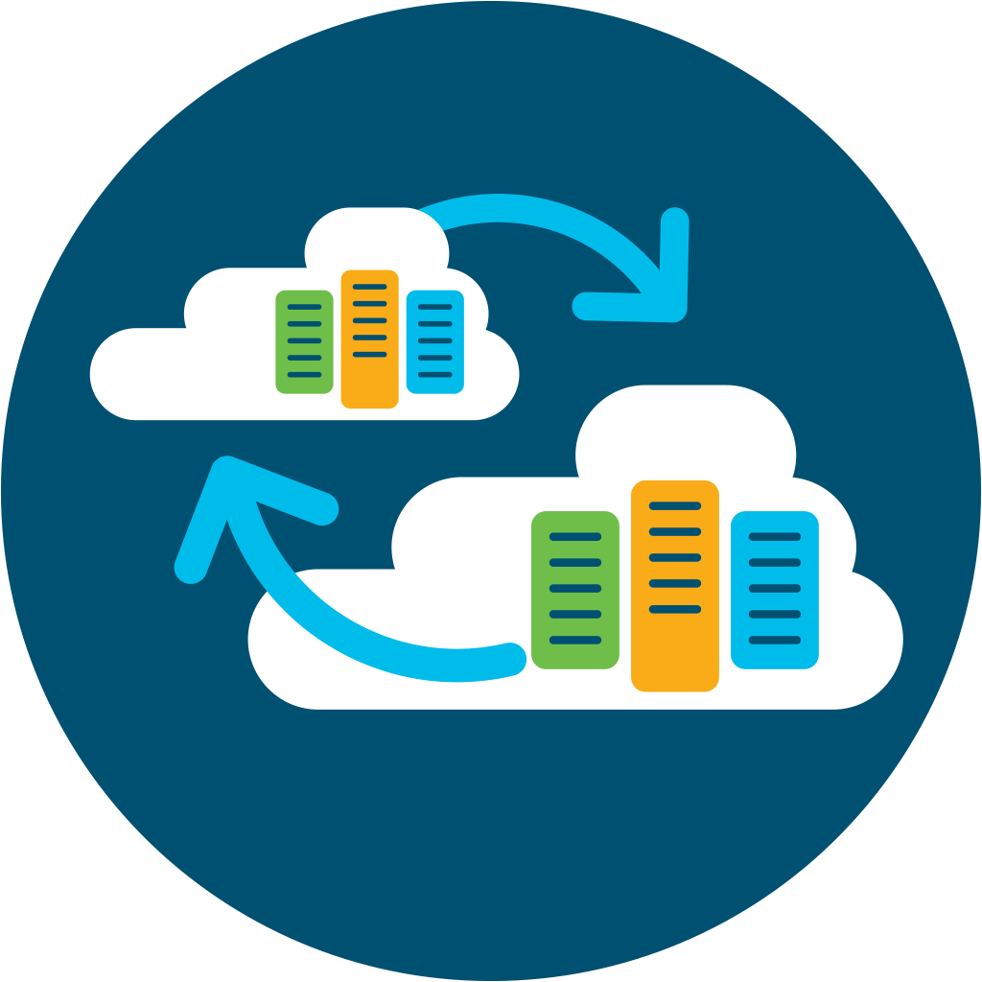
What is Multicloud?
A multicloud approach enables customers to consume applications and services from two or more clouds where at least one cloud is public.
2

Slide 3
Challenges to Move to Cloud
Plan/ Execute Cloud-first Strategy
Expertise & Skill-Set Requirements
Implement/ Adopt Cloud Technologies
Security & Compliance Requirements
Multivendor Services, Tools & Technologies
Post-Implementation Support & Management
Notes:
Speaker Notes:
However, there are many challenges customers face when navigating this multicloud world. It’s a world … dominated by multiple private and/or public cloud services from multiple providers. A world … with multiple departments and lines of businesses using multiple clouds and SaaS providers. Customers are struggling, as consuming multiple cloud services from multiple providers all with different technologies, tools, processes, and skill requirements is challenging.
Some of the key challenges customers face with multicloud adoption include:
Planning and executing on their cloud-first strategy
Implementing and adopting cloud technologies
Navigating multivendor cloud services
Deploying the right expertise and resources to manage multiple clouds Migrating workloads from a private cloud to a public cloud
Adhering to Compliance and security requirements
Driving post-implementation support and management

Slide 4
Top Customer Cloud use cases
Evolving
on-premises environment
Adopting
public cloud
Deploy and manage cloud applications
Cloud Governance
Develop Applications on/with the Cloud
Secure Multicloud Networking
Consistent Network Policy
IT as a Service
Implement
HA / DR
Notes:
Speaker Notes:
How IT uses cloud to accomplish the initiates.
The specific cloud-based actions the organization undertake in support of their cloud initiatives. These initiatives often

Slide 5
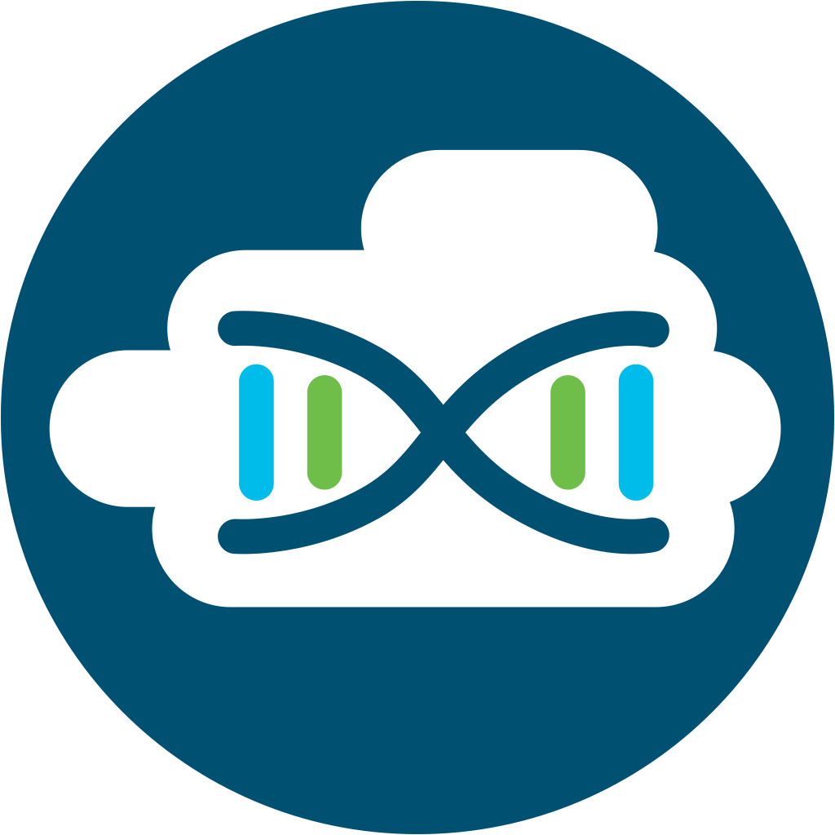

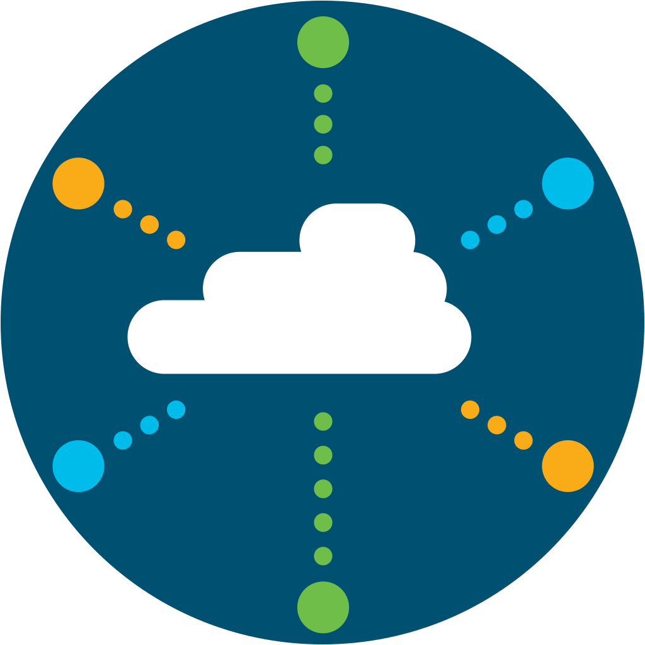
Multicloud Portfolio
Cloud
Advisory
Cloud
Connect
Cloud
Protect
Cloud
Consume
Cloud Migration
Cloud Connect
Cloud Protect
Cloud Consume
vEdge with Umbrella
CSR 1000v
Meraki vMX
  Umbrella
  AMP for Endpoints
  Meraki Systems
  Manager
  Cloudlock
  Tetration SaaS
  Stealthwatch Cloud
CloudCenter
AppDynamics
Cisco Container
Platform
  Cisco Cloud Infrastructure
On Premises
Colocation
ACI
Nexus
HyperFlex
UCS
Cisco DNA
ASA/NGFW
Intersight
CWOM
Public Cloud
Amazon Web Services
Google Cloud Platform
Microsoft Azure
Notes:
Cloud Advisory – Starting phase of Portfolio

Slide 6
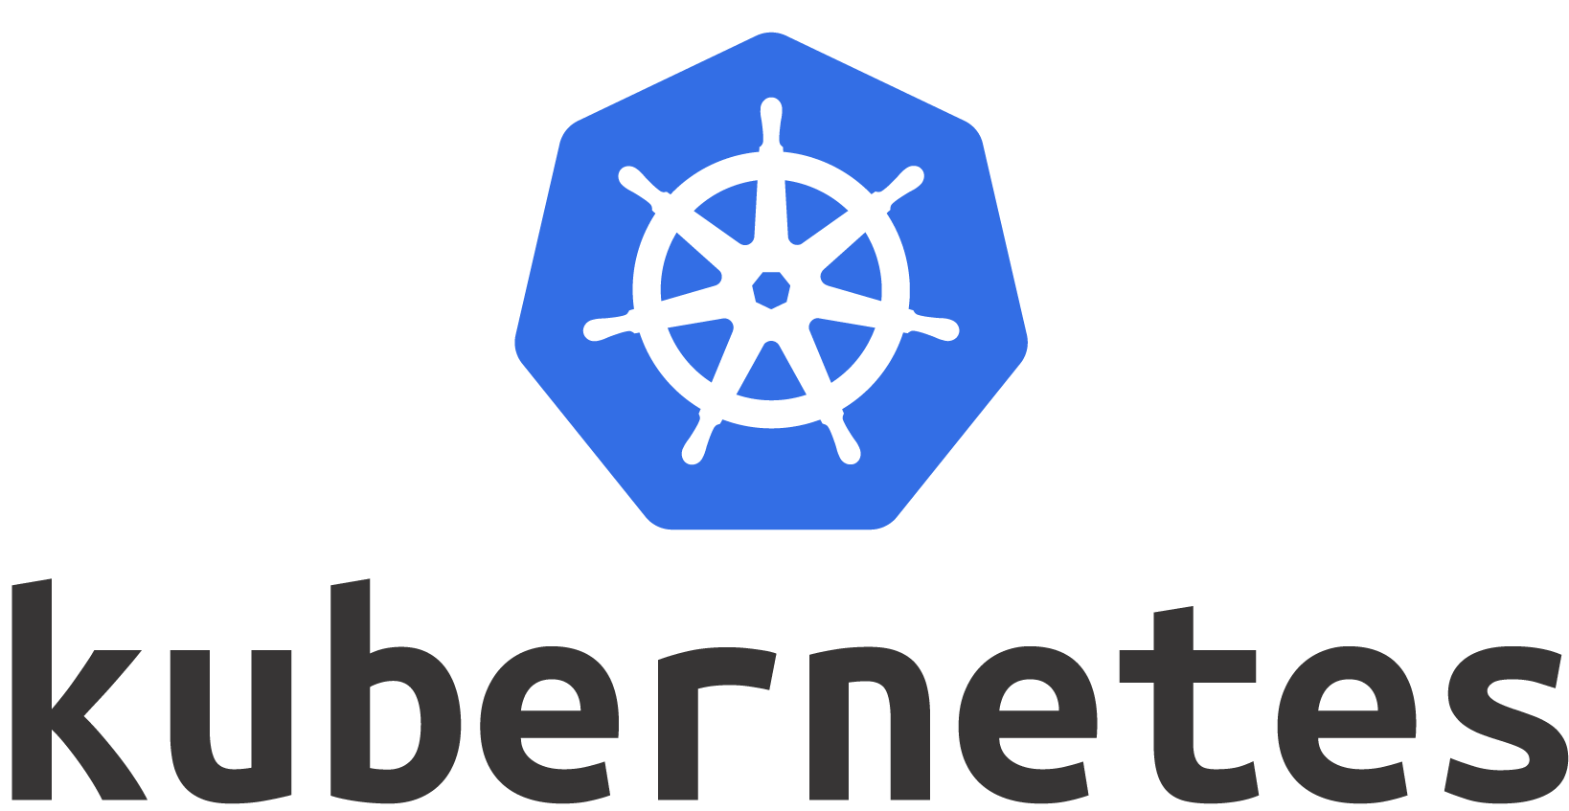
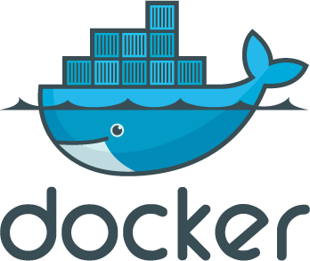
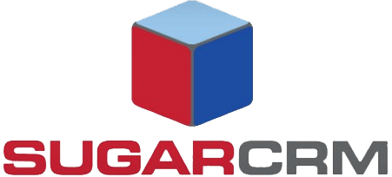
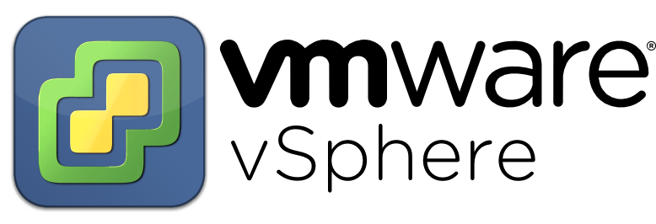
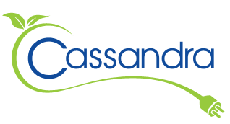

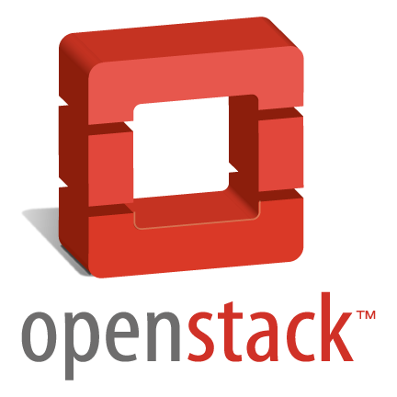


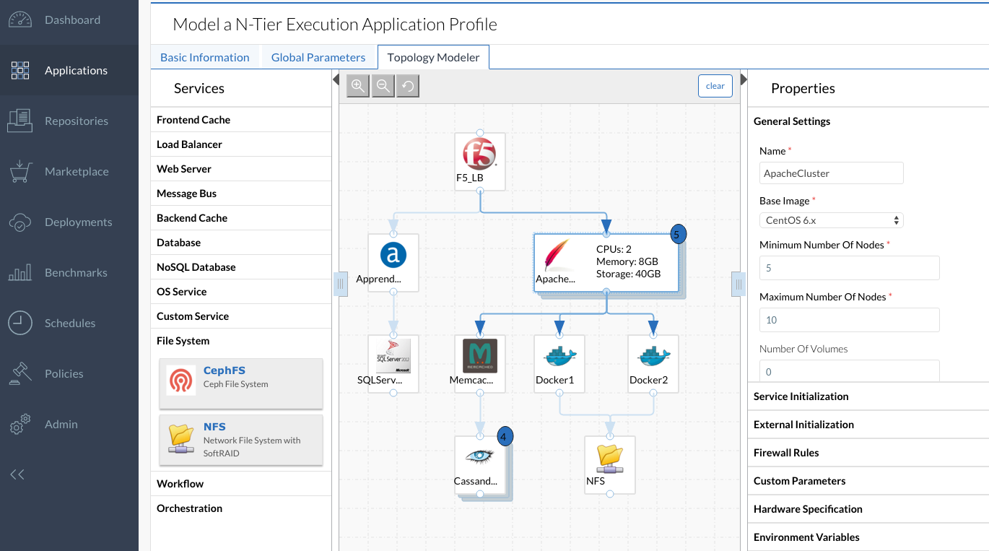

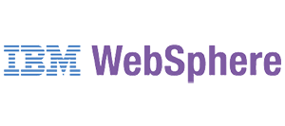
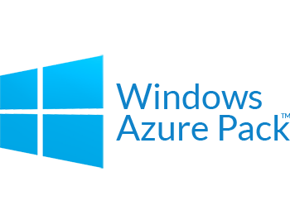
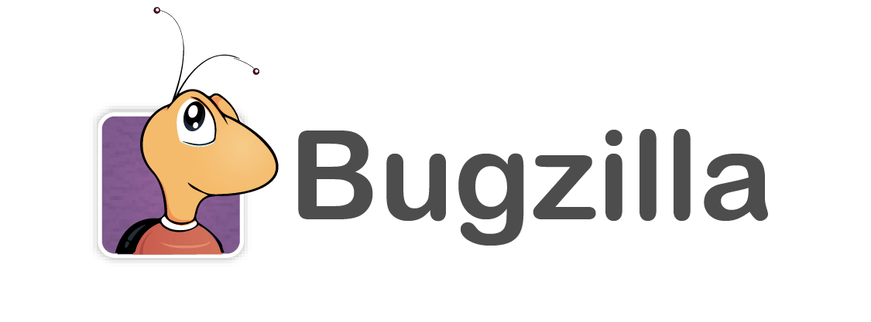
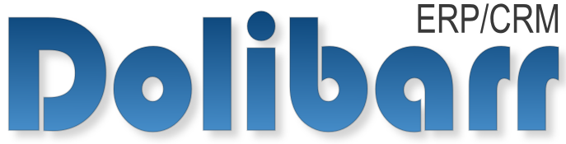
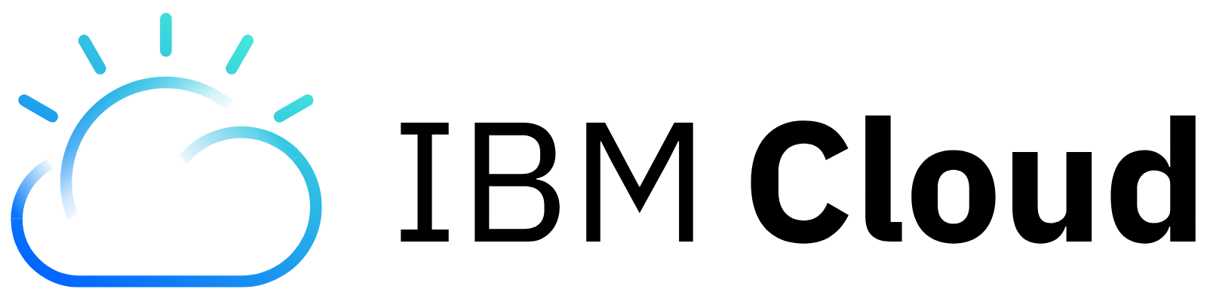
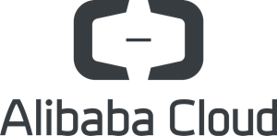
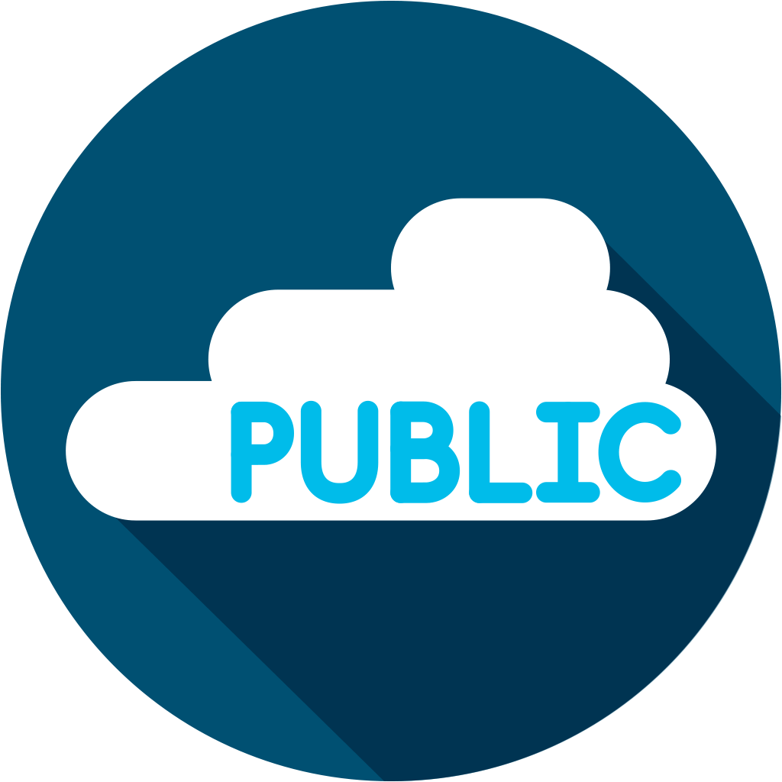
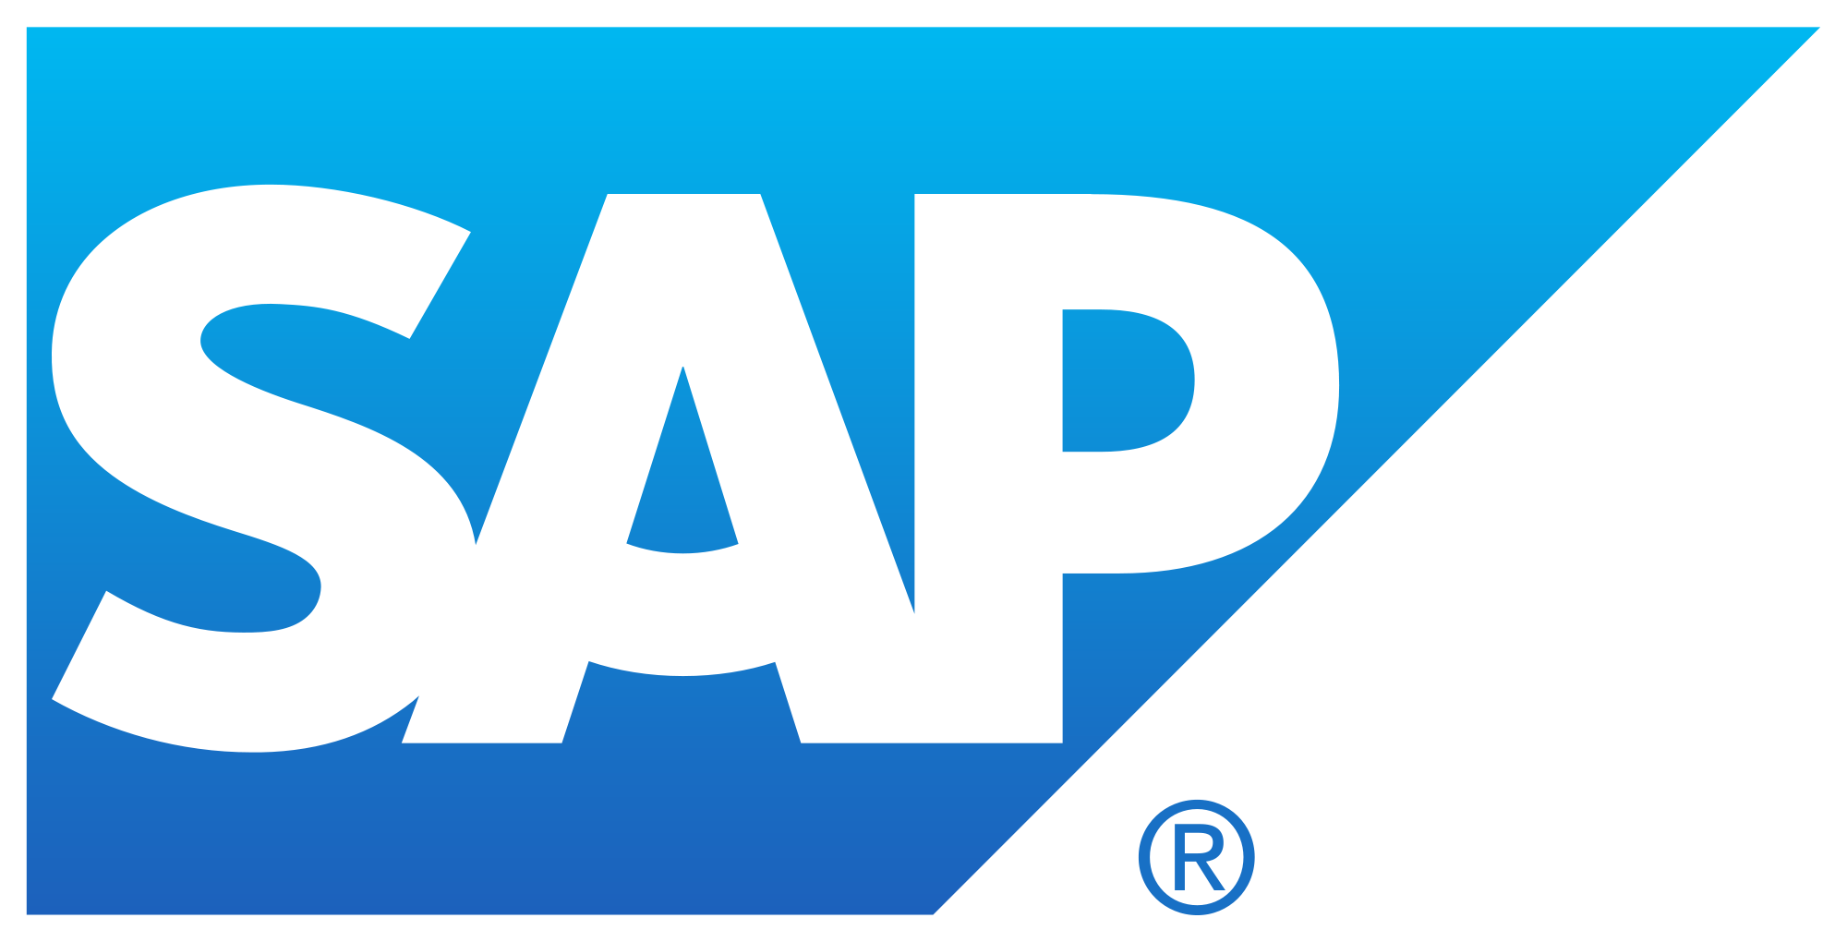

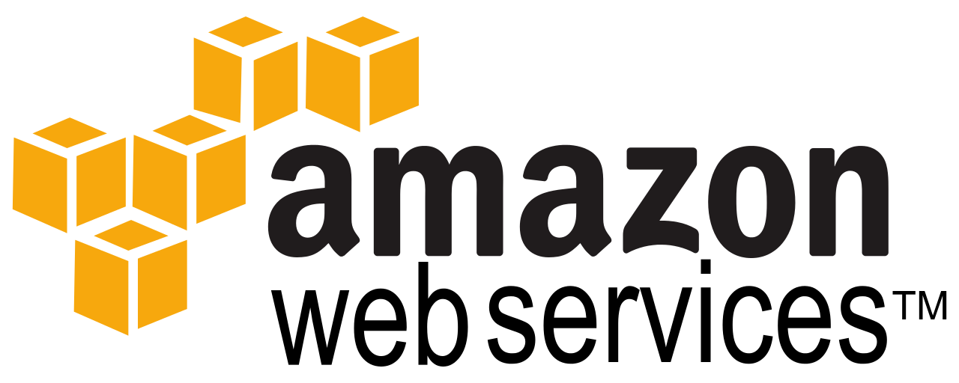
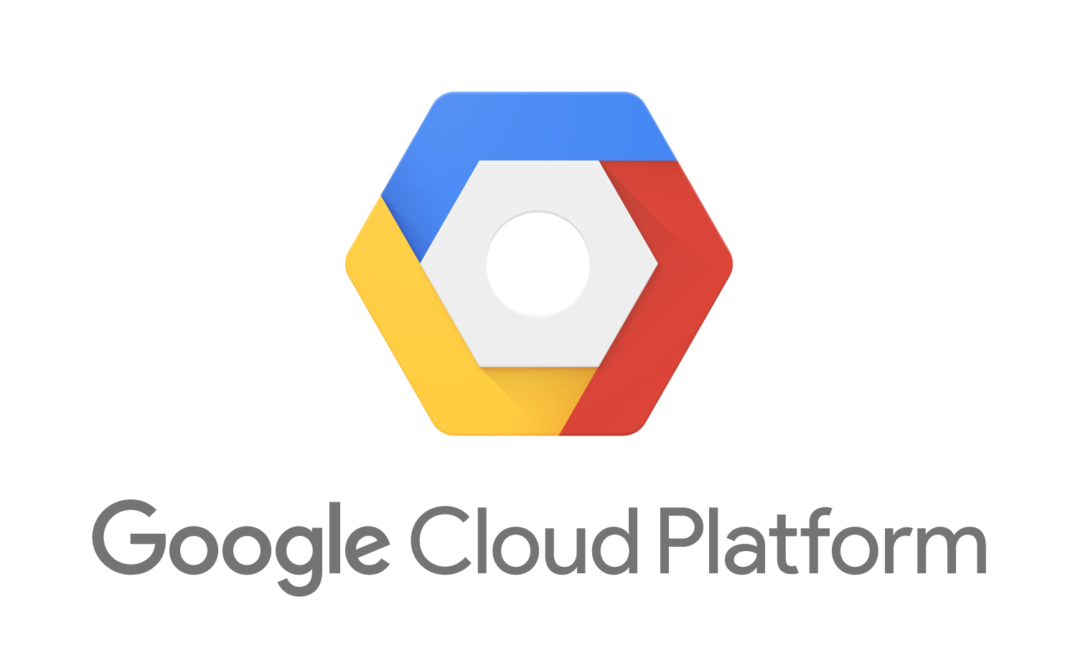
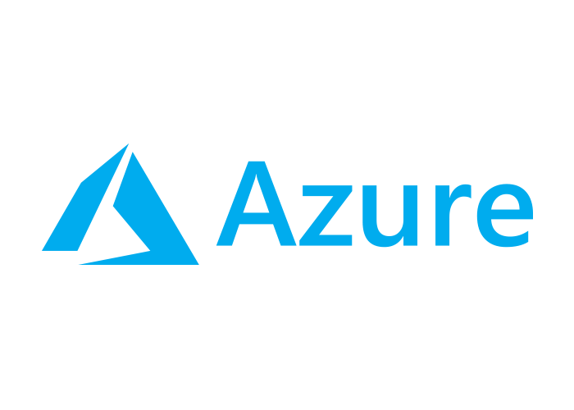
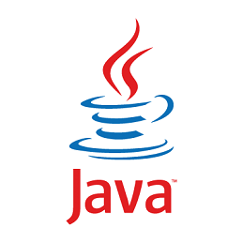

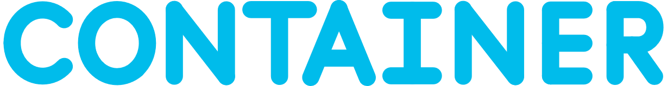
CloudCenter Suite
Multicloud management platform securely design, deploy, and optimize anywhere
Data
Center
DEPLOY
OPTIMIZE
DESIGN
Private Cloud
Public Cloud
End to End Lifecycle
One Integrated
Platform
New and Existing
Applications
Container
as Service
Notes:
CloudCenter Suite is unique in the industry
CloudCenter Suite abstracts the cloud. Assumes clouds are and will continue to all be different (APIs)
Application-centric approach.
You Model application profile once – then can deploy and manage anywhere.
One profile – combines application and infrastructure automation directives
And eliminates environment-specific automation that locks workloads into a single environment
Supports composite topologies – including OS images, containers, application and cloud services, and leverages investments Chef, Puppet, Salt
Graphical modeler – makes it easy to create a deployable Application Profile that is portable to any environment
No environment specific scripting, programming, or modifying the application code
Broad application support including
Popular types – n-tier, batch, cluster, parallel, distributed services etc.
Popular technologies – java, .net, node js etc.
New and existing
Commercial and custom
Simple and complex
Legacy and cloud native
Broad cloud support– pre-integrated support for
19+ datacenter, private and public clouds
That each have different infrastructure APIs
Meets the needs of most demanding service providers and enterprise IT organizations

Slide 7
CloudCenter Suite
What’s new
Workload Manager
Provides existing
CloudCenter functionality
Cost Optimizer
Provides public and private cloud cost visibility and optimization
Action Orchestrator
Enables workflow process orchestration and automation
Suite Admin
Administers modules, manages tenancy,
licensing, logging, RBAC, monitoring, authentication
Modular, microservices architecture

Slide 8
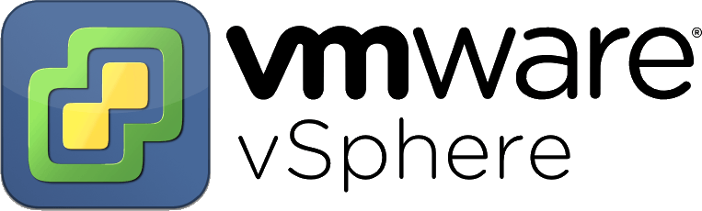

Cisco Container Platform Stack
BRKCLD-1153
Control Plane
Data Plane
Automation
Orchestration
Operations
Cluster 1 Workloads
Cluster 1 Ops
Cluster 2 Workloads
Cluster 2 Ops
Pod
Pod
Pod
Pod
Cluster/
Machine
Controllers
Pod
Pod
HX Connect
Cluster 1 Kubernetes
Cluster 2 Kubernetes
Control Plane Kubernetes
VM
VM
VM
VM
VM
VM
VM
VM
VM
VM
Storage (Hyperflex)
Hypervisor Layer (HyperFlex/VMW)
Compute Hardware (UCS)
Networking (e.g. Nexus 9K or other)
Kubernetes
Fluentd
Prometheus
Kibana
Hyperflex
Contiv

Slide 9

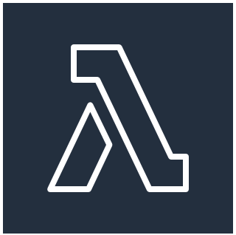
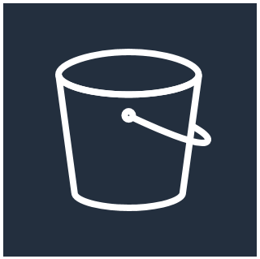
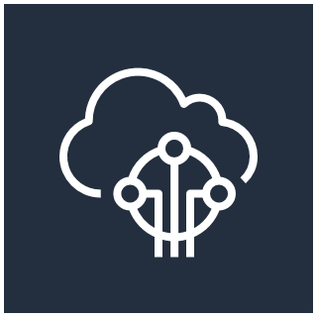
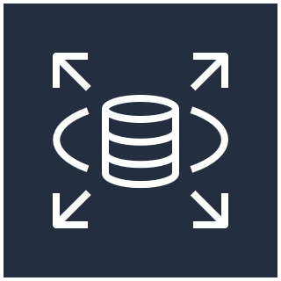
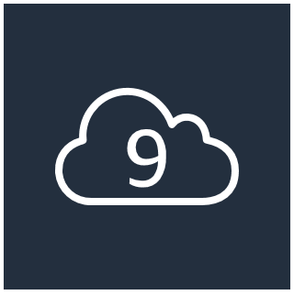
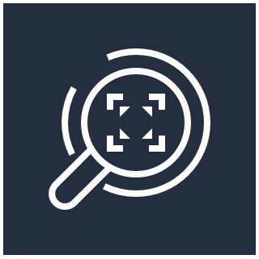
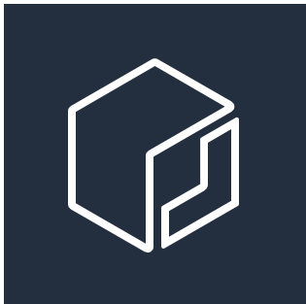
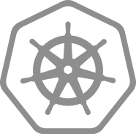
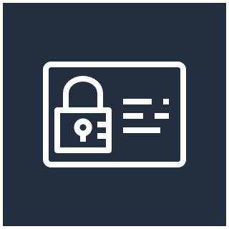
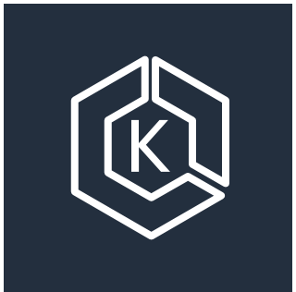
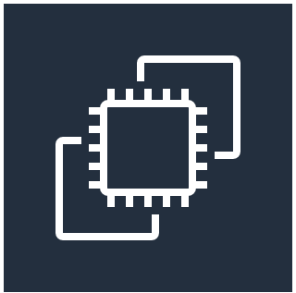
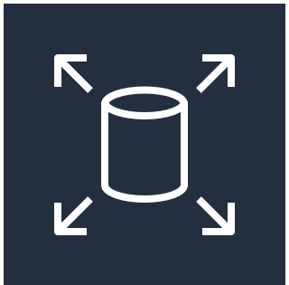

Cisco Hybrid Solution for Kubernetes on AWS
BRKCLD-1153
On-premises environment
Consistent, production-grade
environment
AppDynamics
Cisco Stealthwatch Cloud
Cisco CloudCenter
Elastic Container Registry
Cisco Container Platform
Identity and Access
Management (IAM)
Amazon EKS
Cisco HyperFlex / UCS
Cisco CSR1000v
EC2 / EBS
Cisco Nexus9K / ACI
VPC
Legend:
Optional
Mandatory

Slide 10

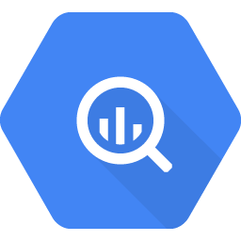
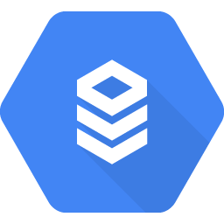
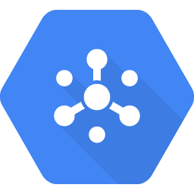


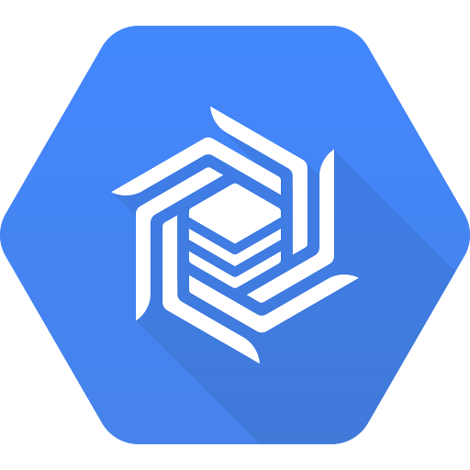
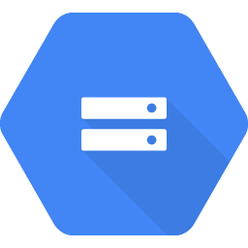
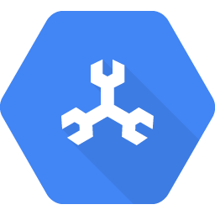

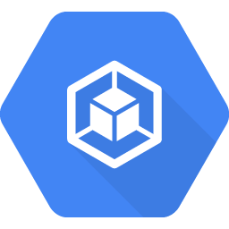

Cisco Hybrid Cloud Platform for Google Cloud
BRKCLD-1153
On-premises environment
Consistent environment
Cisco Stealthwatch Cloud
Existing
services
apps | data
BigQuery
Cloud SQL
Pub/Sub
Big Table
Cloud Storage
Cloud Spanner
Google Apigee
Open Service Broker
Cisco CloudCenter
Cisco Container Platform
Google
Kubernetes Engine
Istio
Cisco HyperFlex
Cisco Nexus9K / ACI
Cisco CSR1000v

Slide 11

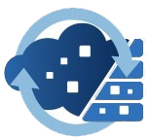
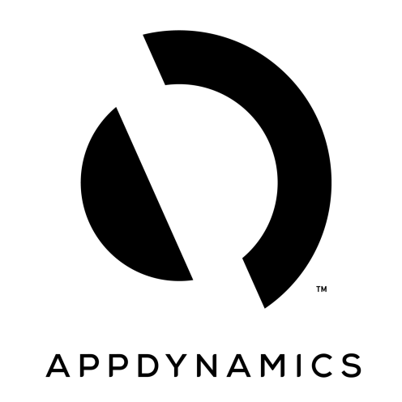
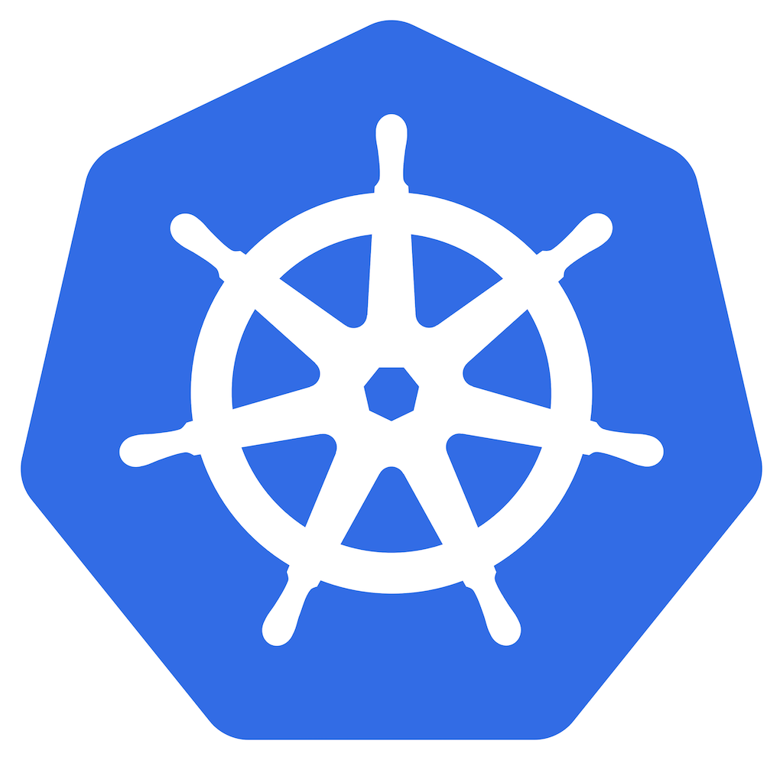

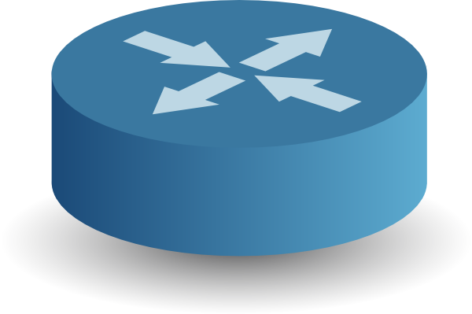




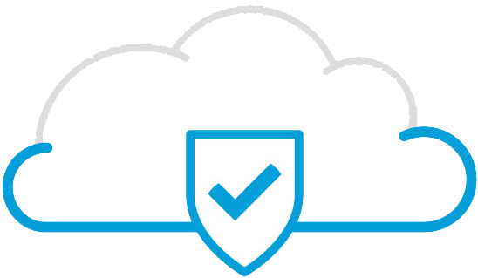

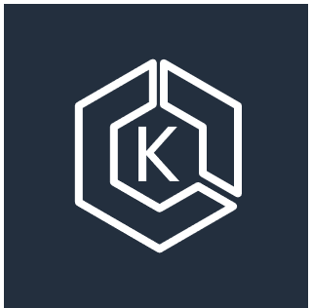

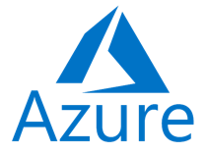











Multicloud Solutions – How to get Started
Prime Service Catalog
CloudCenter Suite
Action Orchestrator
AppDynamics
CloudCenter Suite
Cisco Container Platform (CCP)
AppDynamics
Stealthwatch Cloud
Cisco Container Platform (CCP)
CloudCenter Suite
CSR 1000v
CWOM/Turbonomic
AppDynamics
CloudCenter Suite
Cisco Container Platform (CCP)
AppDynamics
IAM
Stealthwatch Cloud
Tetration
Stealthwatch Cloud
Cisco Container Platform (CCP)
Umbrella
AMP4E
CSR 1000v
CSR 1000v
Amazon EKS
CSR 1000v
Elastic Container Registry
Istio
EC2 / EBS
Intersight
VPC
SAP Hub Data
SAP Hub Data
Kubernetes
VMware
Kubernetes
VMware
Kubernetes
VMware
Kubernetes
VMware
ACI
UCS
ACI
UCS
CCP
ACI
UCS
UCS
ACI
Private Cloud
Private Cloud
Private Cloud
Private Cloud
Multicloud
Portfolio
CHCP for Google Cloud
CHCP for SAP Datahub
Hybrid Solution for Kubernetes on AWS

Slide 12

In conclusion, IT and Ops get to be Oprah

