Slide 1
Results from the 2019 Diversity Survey
04.28.2019
Amy Marrich, O.A.T.
Diversity and Inclusion WG Chair

Slide 2
Diversity Survey by the Numbers
2015
537 Survey Participants
Over 2000 OpenStack Contributors
2019
151 Survey Participants
Over 1250 OpenStack Contributors
Notes:
The number of contributers is the approximate number of unique code committers and reviewers taking overlap into consideration.
The number of contributors almost halved with the number of respondents to the survey falling over half

Slide 3
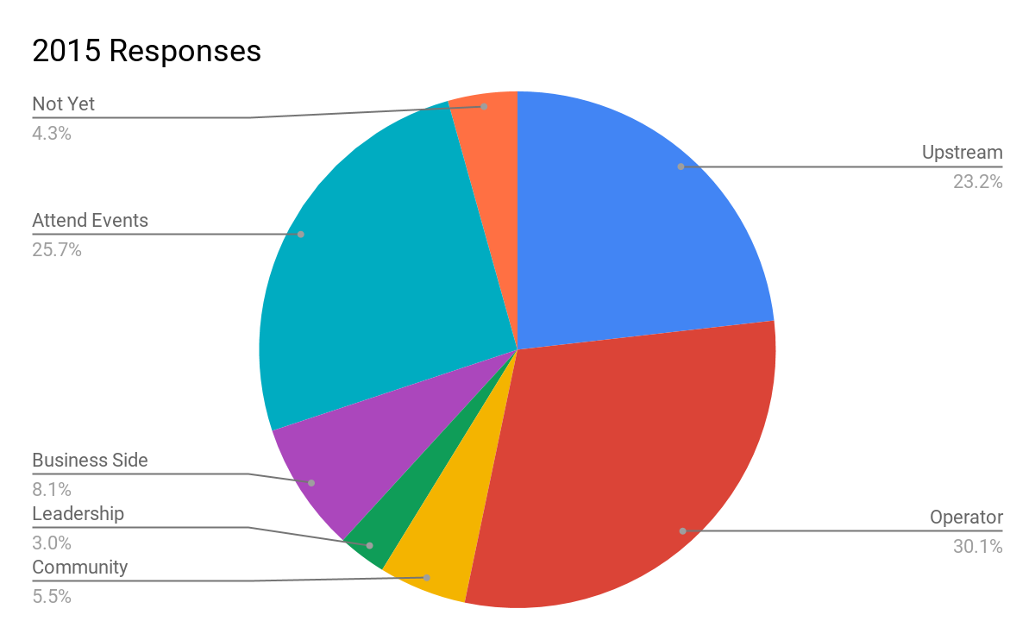
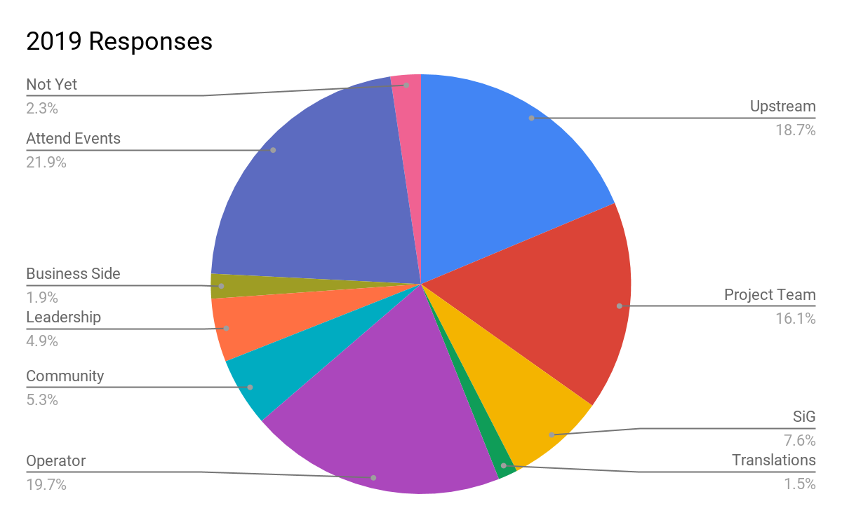
What are the ways you participate?
Notes:
Upstream - Contributing/reviewing code or documentation upstream
Project Team - Participation in project teams (participation in meetings, Design Summits, PTG's)
SiG - Participation in SIGs
Translations - Translating Code and Documentation
Operator - Using or running the software
COmmunity - Community organizer (Ambassador, User Group Leader or coordinator, community managers)
Leadership - Serving on the Board, Committees or working groups (i.e., Tech Committee, Product, Enterprise, Legal, etc.)
Business side - Business development, sales or marketing for a company in the ecosystem
Attend Events - Attending Summits or community events
Not Yet - None yet, but I'd like to

Slide 4
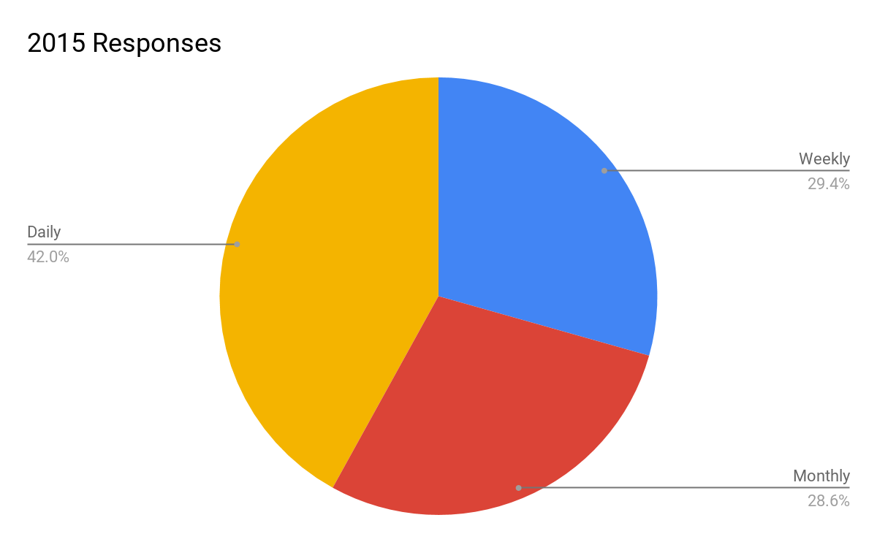
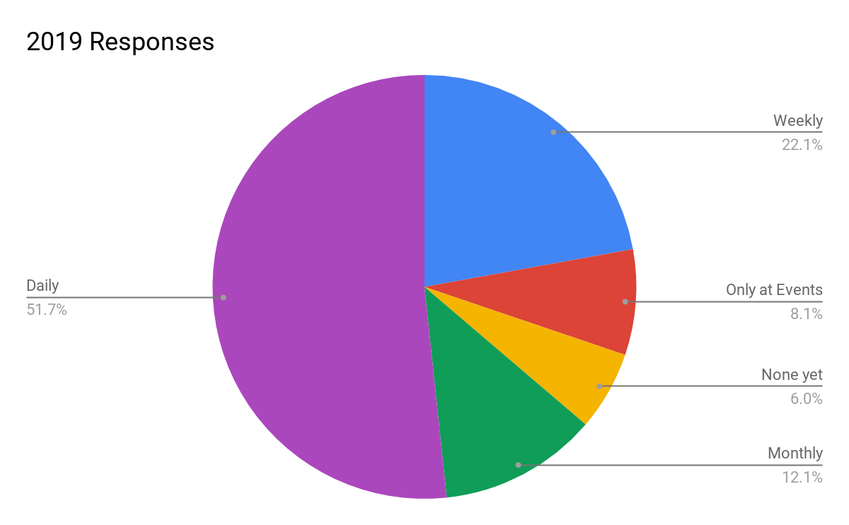
How Often Do You Interact?
Notes:
Upstream - Contributing/reviewing code or documentation upstream
Project Team - Participation in project teams (participation in meetings, Design Summits, PTG's)
SiG - Participation in SIGs
Translations - Translating Code and Documentation
Operator - Using or running the software
COmmunity - Community organizer (Ambassador, User Group Leader or coordinator, community managers)
Leadership - Serving on the Board, Committees or working groups (i.e., Tech Committee, Product, Enterprise, Legal, etc.)
Business side - Business development, sales or marketing for a company in the ecosystem
Attend Events - Attending Summits or community events
Not Yet - None yet, but I'd like to

Slide 5
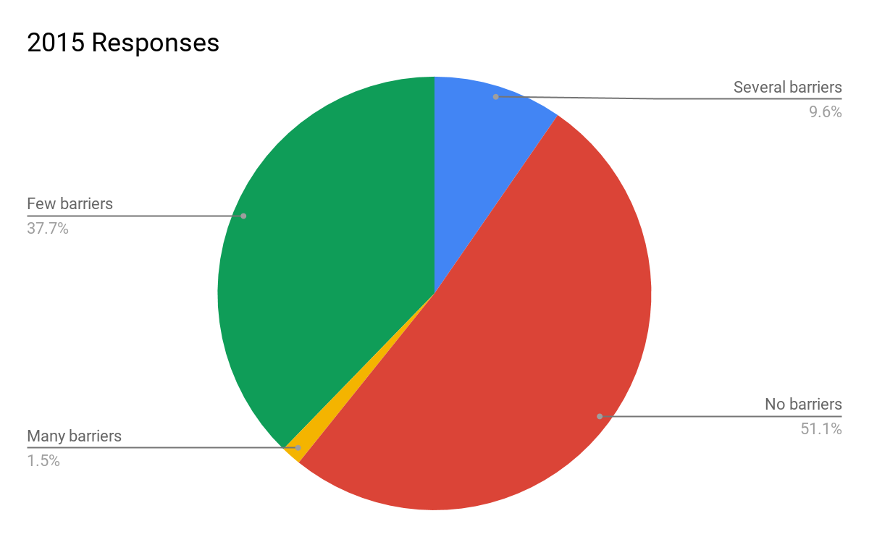
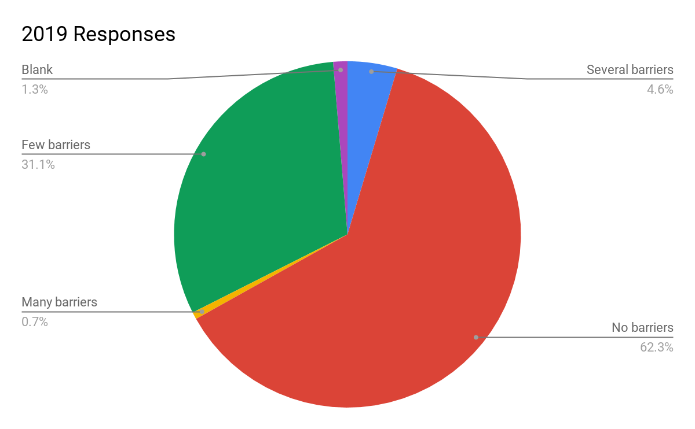
Do You Face Any Barriers to Participate?
Notes:
Upstream - Contributing/reviewing code or documentation upstream
Project Team - Participation in project teams (participation in meetings, Design Summits, PTG's)
SiG - Participation in SIGs
Translations - Translating Code and Documentation
Operator - Using or running the software
COmmunity - Community organizer (Ambassador, User Group Leader or coordinator, community managers)
Leadership - Serving on the Board, Committees or working groups (i.e., Tech Committee, Product, Enterprise, Legal, etc.)
Business side - Business development, sales or marketing for a company in the ecosystem
Attend Events - Attending Summits or community events
Not Yet - None yet, but I'd like to

Slide 6
2019 What Barriers Have You Faced?
Geography was mentioned in some context quite a few times.
Time Zones for Meetings
Distance from events as well as needing VISAs
Language Barriers
Technical Barriers
Assumed knowledge
Silos
Not easy to get started
Unclear expectations

Slide 7
2019 What Barriers Have You Faced?
Concerning Comments
Cliquish Project
Ageism
Toxic Masculinity

Slide 8
Top Countries Where Responders Reside
2015 Top 3 Countries
40.53% USA
9.85% India
4.92% UK
2019 Top 3 Countries
54.47% USA
6.50% UK
4.07% Canada, France Germany

Slide 9
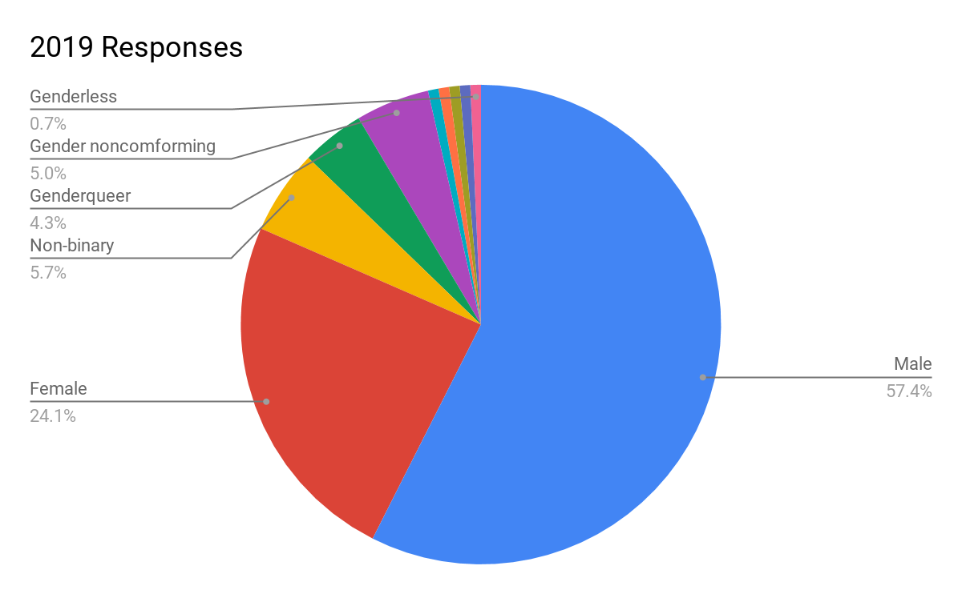
What is Your Gender Identity?
2015 Responders
83% Male
13% Female
Notes:
Upstream - Contributing/reviewing code or documentation upstream
Project Team - Participation in project teams (participation in meetings, Design Summits, PTG's)
SiG - Participation in SIGs
Translations - Translating Code and Documentation
Operator - Using or running the software
COmmunity - Community organizer (Ambassador, User Group Leader or coordinator, community managers)
Leadership - Serving on the Board, Committees or working groups (i.e., Tech Committee, Product, Enterprise, Legal, etc.)
Business side - Business development, sales or marketing for a company in the ecosystem
Attend Events - Attending Summits or community events
Not Yet - None yet, but I'd like to

Slide 10
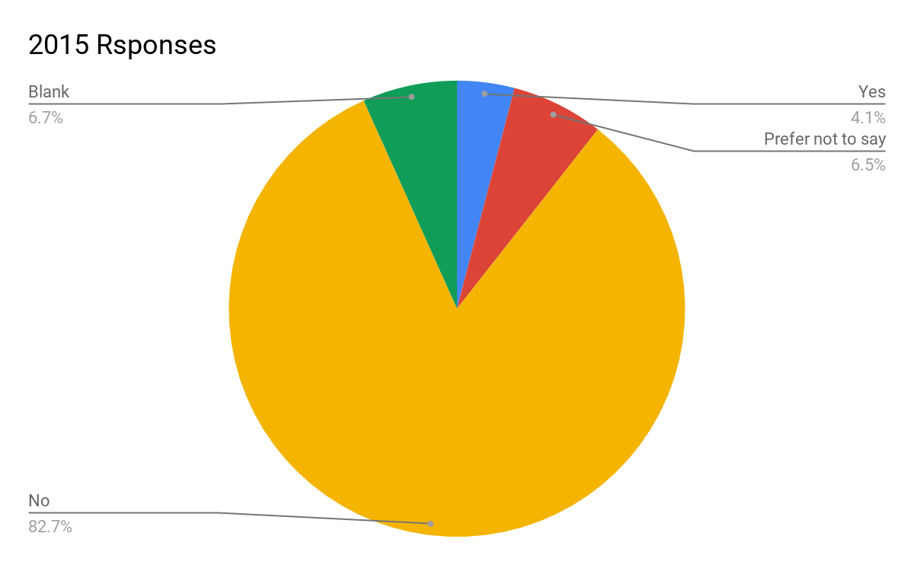
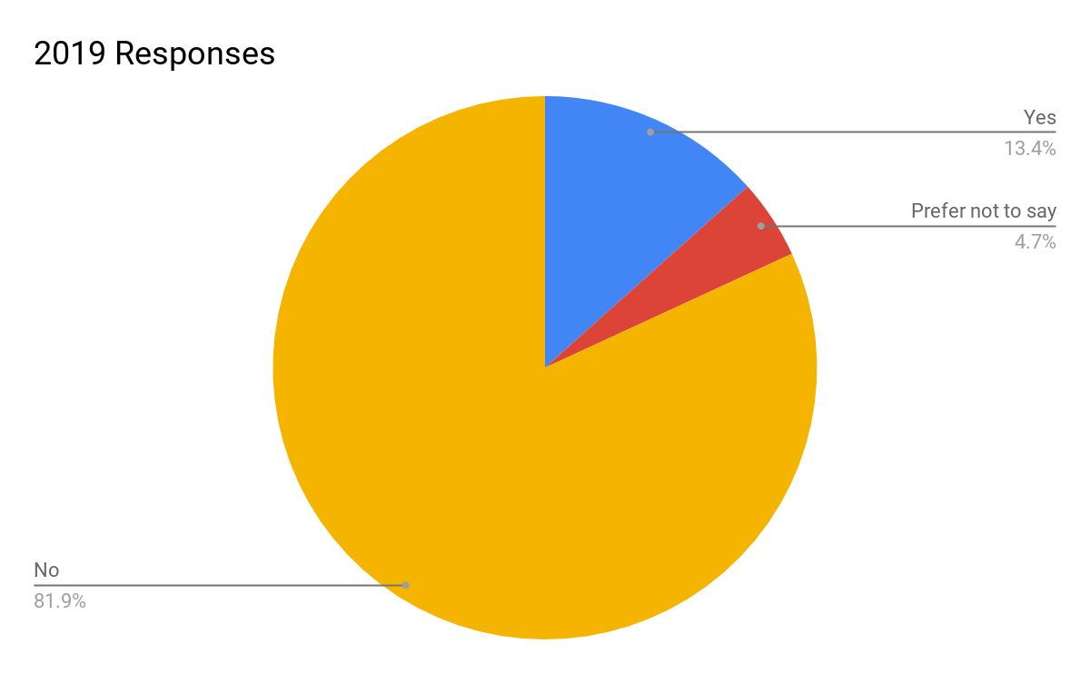
Do You Identify as Lesbian, Gay, Bisexual or Other?
Notes:
Upstream - Contributing/reviewing code or documentation upstream
Project Team - Participation in project teams (participation in meetings, Design Summits, PTG's)
SiG - Participation in SIGs
Translations - Translating Code and Documentation
Operator - Using or running the software
COmmunity - Community organizer (Ambassador, User Group Leader or coordinator, community managers)
Leadership - Serving on the Board, Committees or working groups (i.e., Tech Committee, Product, Enterprise, Legal, etc.)
Business side - Business development, sales or marketing for a company in the ecosystem
Attend Events - Attending Summits or community events
Not Yet - None yet, but I'd like to

Slide 11
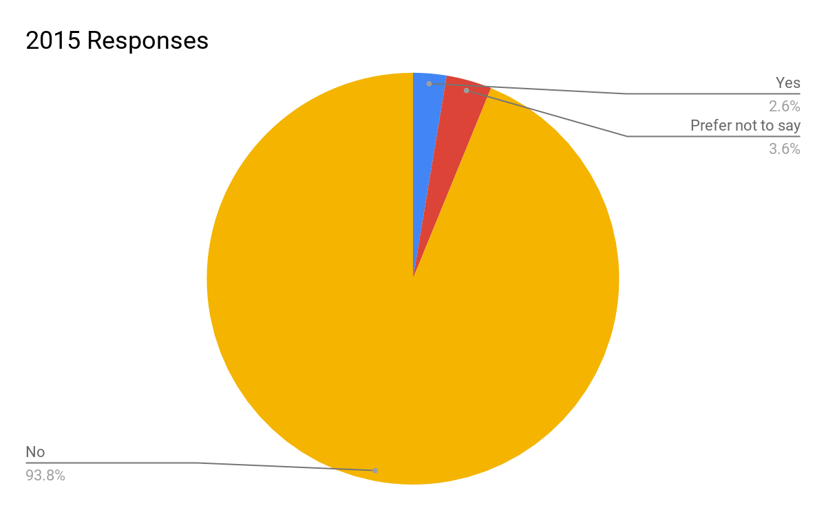
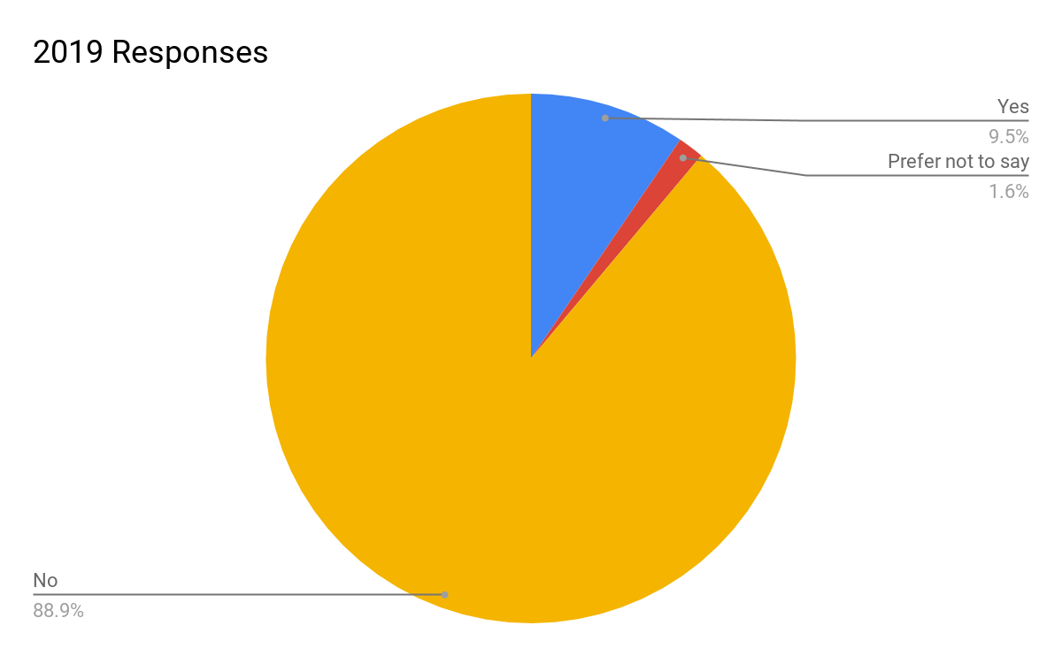
Religion Limiting Participation

Slide 12
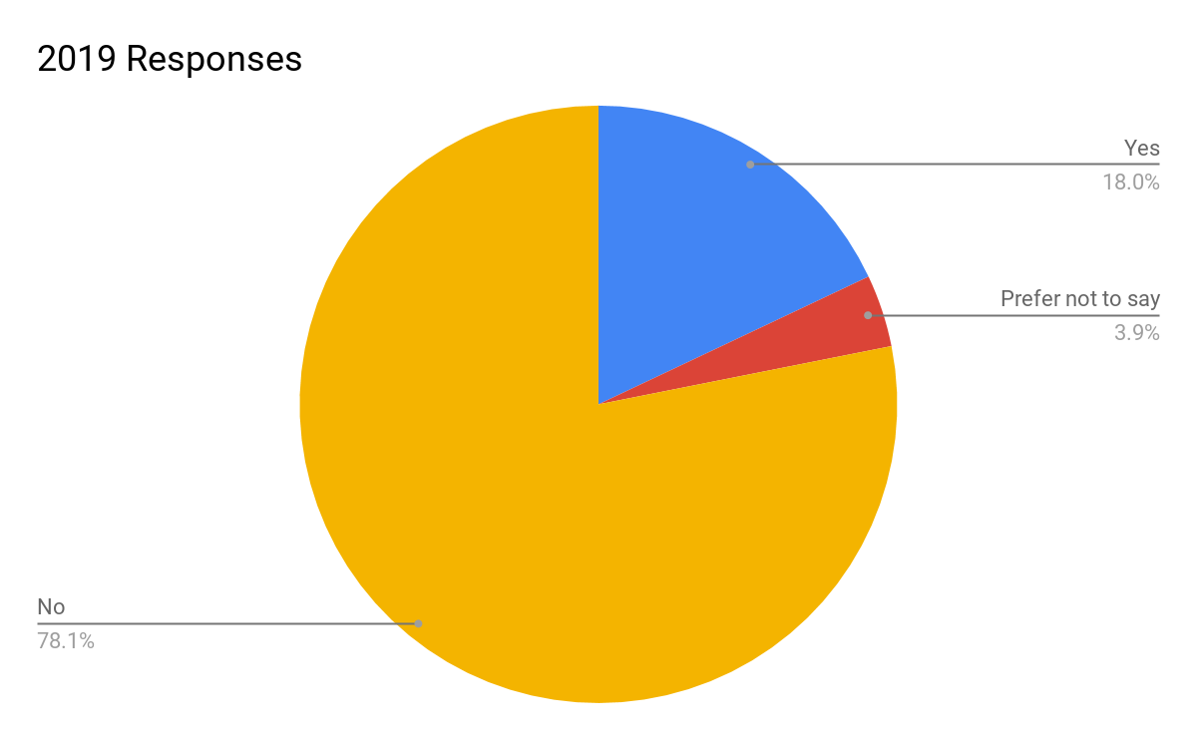
Identify as a Racial/Ethnic Minority Where Live

Slide 13
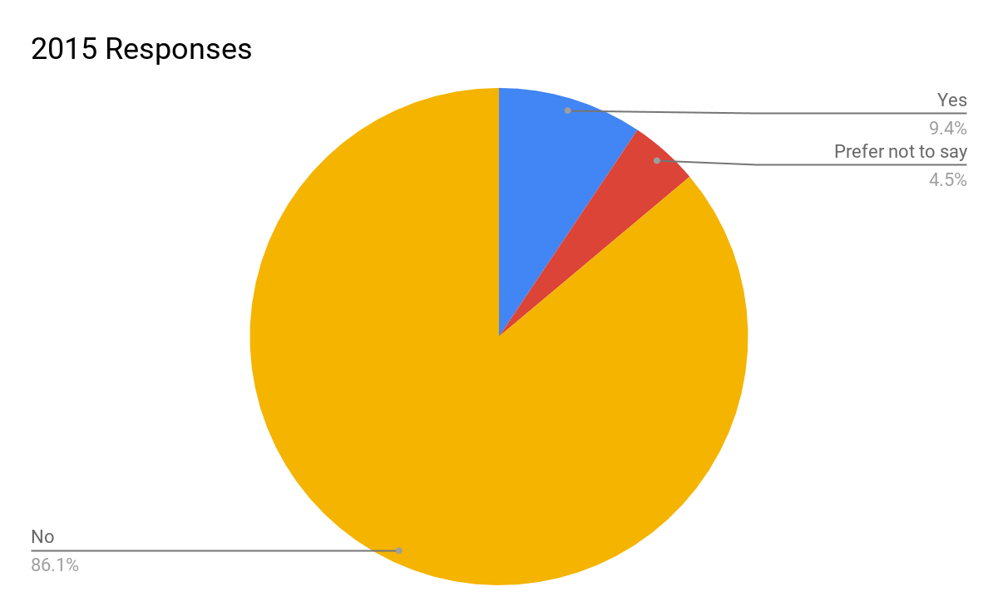
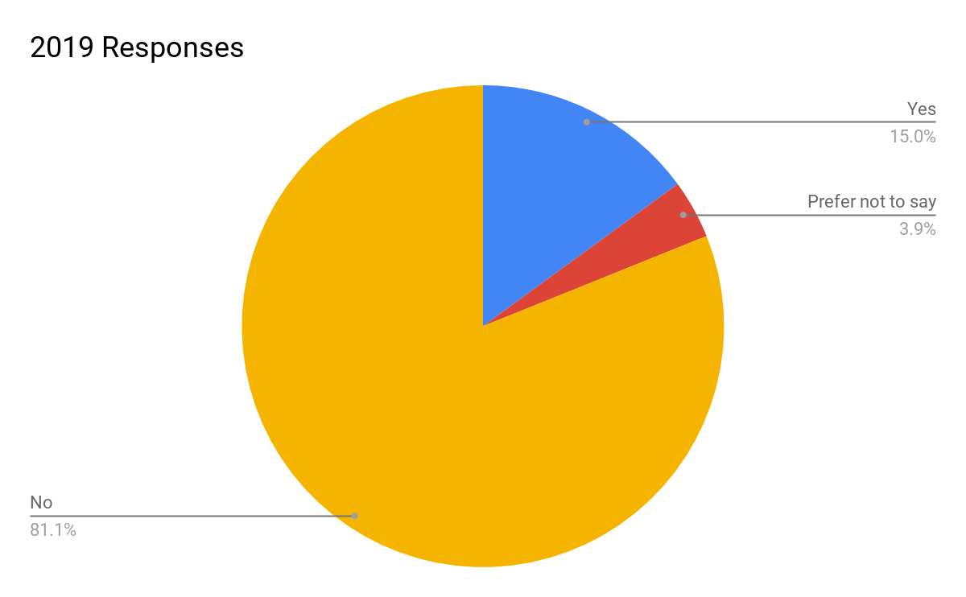
Identify as a Racial/Ethnic Minority in OpenStack

Slide 14
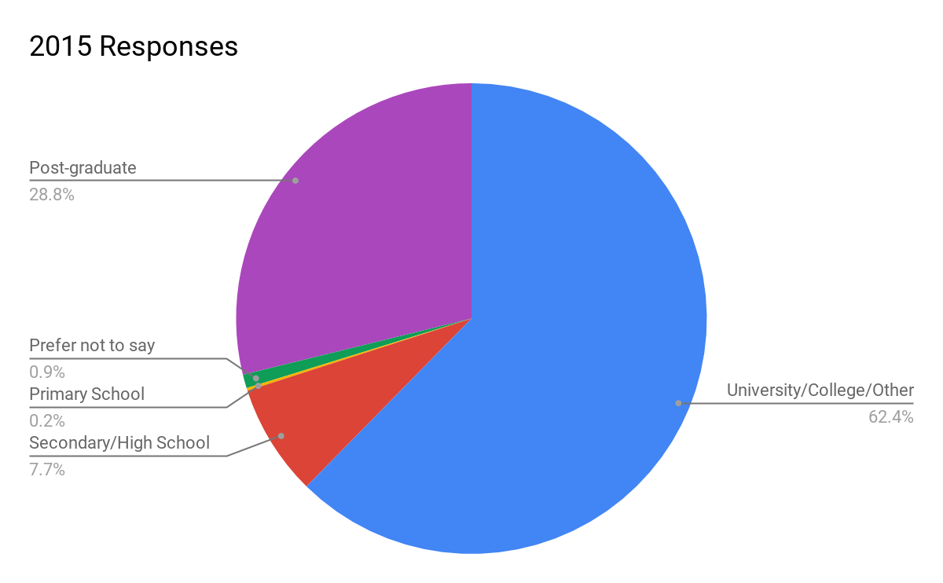
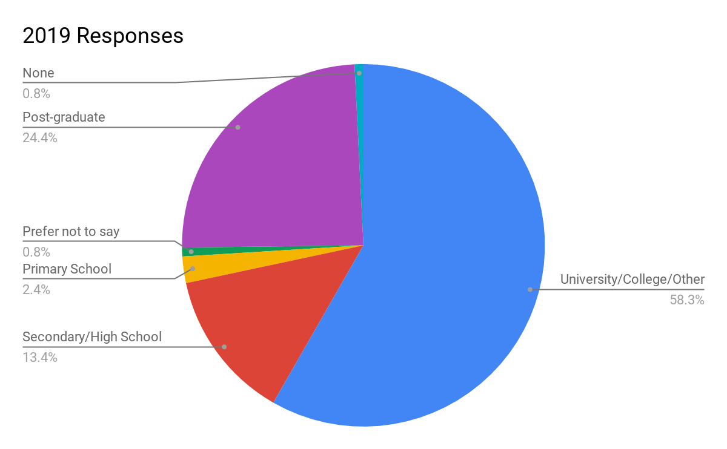
Highest Level of Education

Slide 15
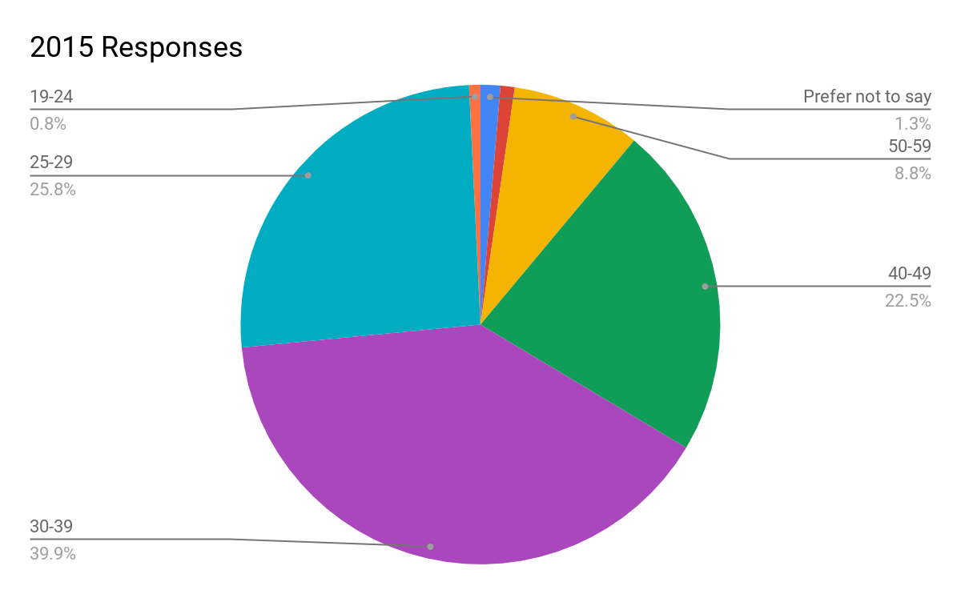
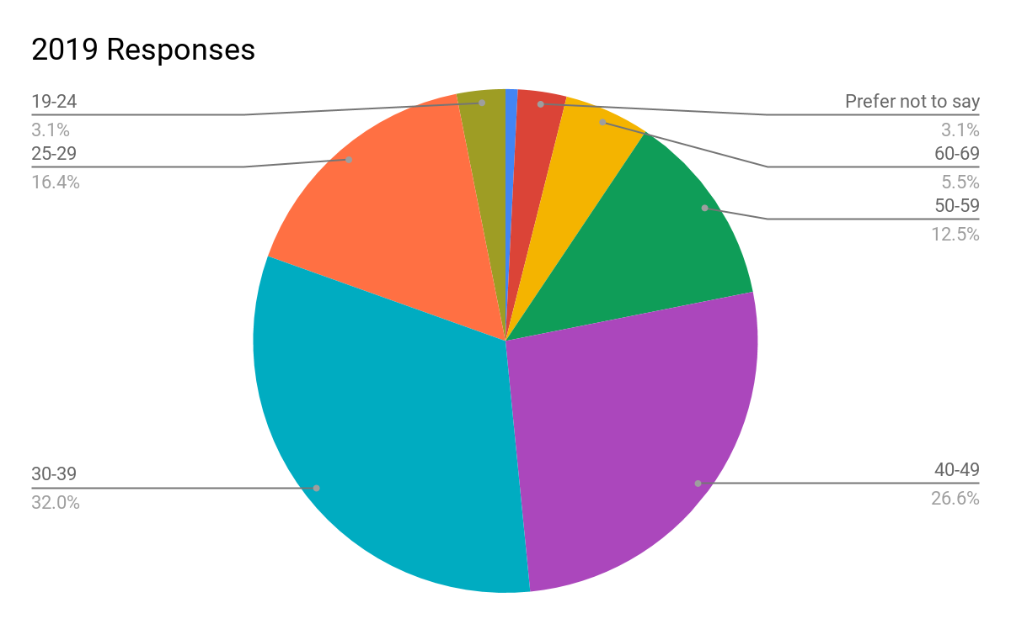
What is Your Age?

Slide 16
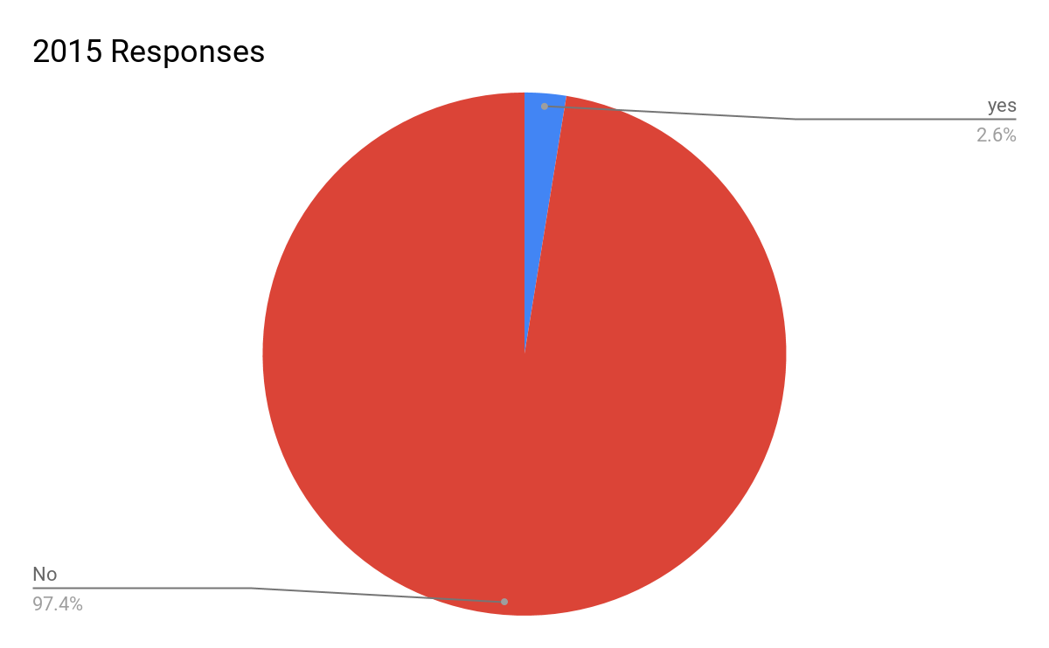
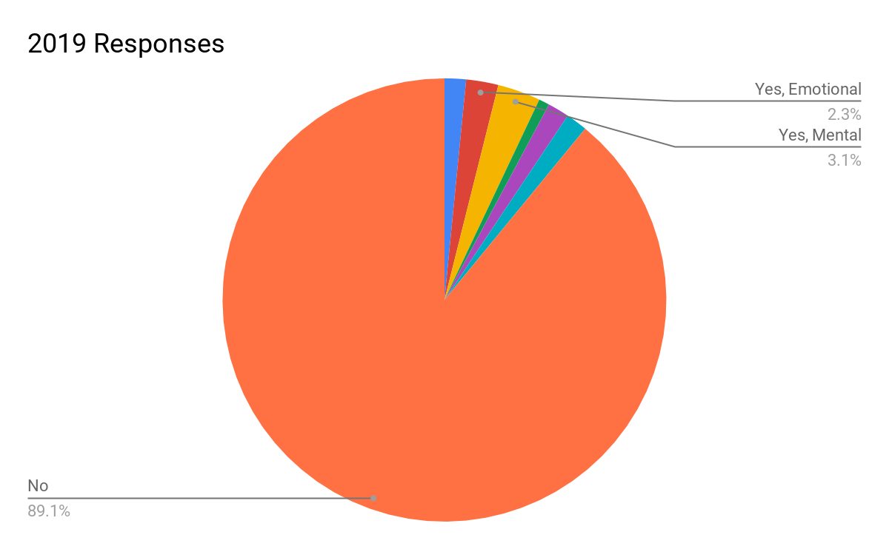
Do you Have a Disability?

Slide 17
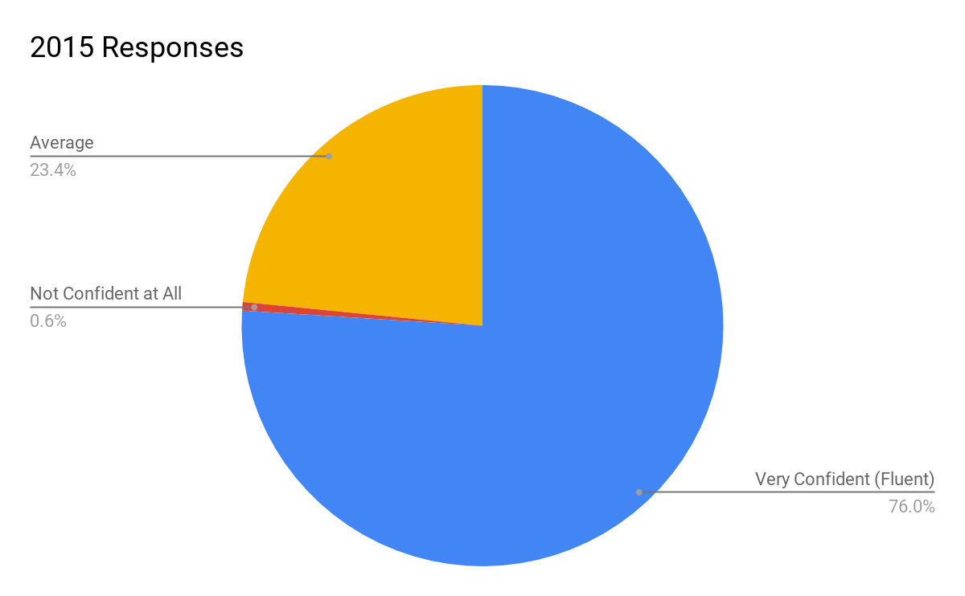
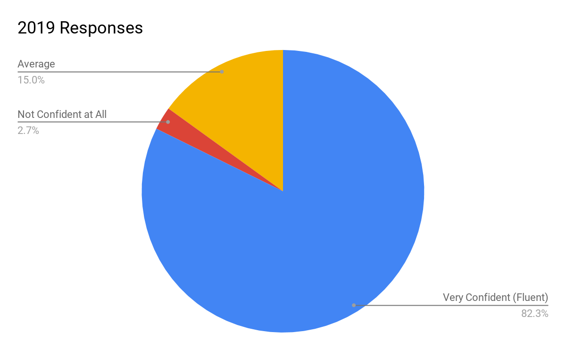
How Well Do You Work in English?

Slide 18
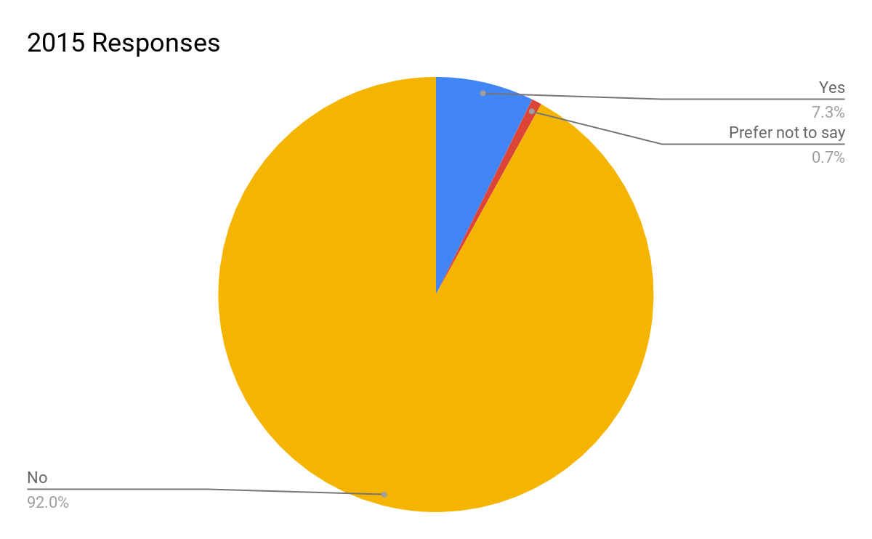
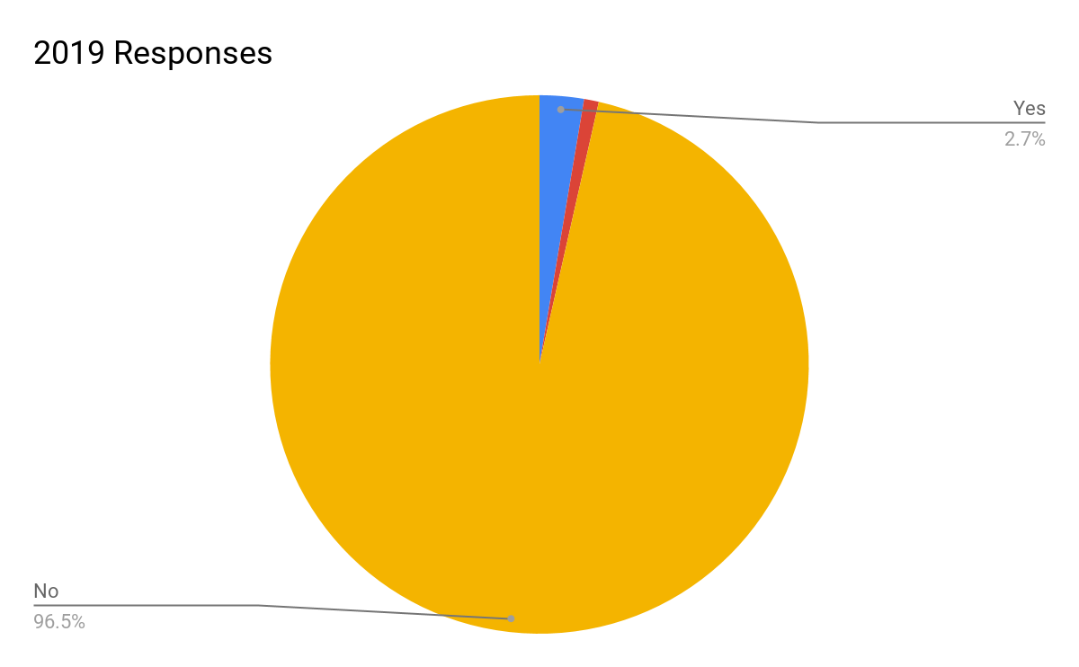
Has the Preference for English Affected Participation

Slide 19
What Else Should We Know?
In general, the comments were positive for diversity and including the larger gender list.
Someone noted Transgender was missing
Someone would have appreciated definitions
Some folks would like to keep to one set of open tools, IRC.
There were also some very negative comments as well which were disappointing.

Slide 20
Questions?
Thanks for your time.

