Slide 1
Database Workloads on Ceph --
Are We There Yet?
Paul Dardeau
Tushar Gohad
Open Infra Summit, Denver
April 30, 2019

Slide 2
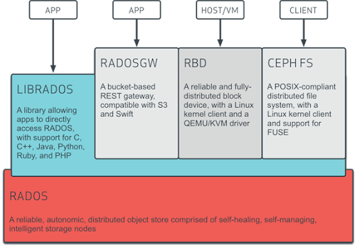
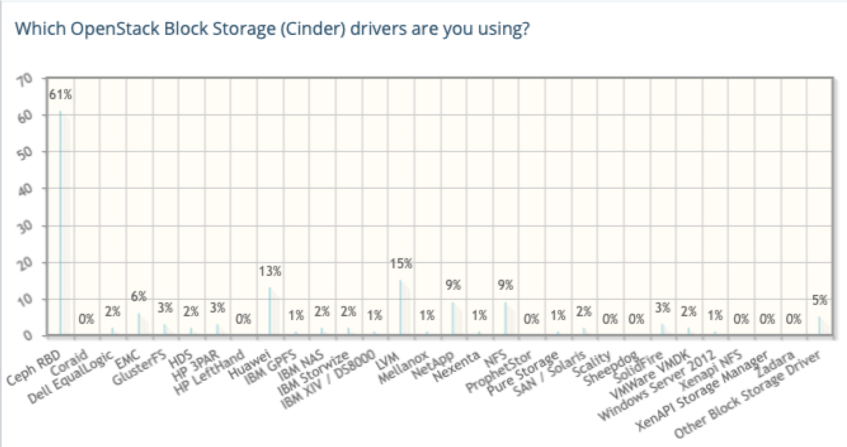
Ceph
Open-source, object-based scale-out storage
Object, Block and File in single unified storage cluster
Highly durable, available – replication, erasure coding
Runs on economical commodity hardware
13+ years of hardening, vibrant community
Scalability – CRUSH data placement, no single POF
Replicates and re-balances dynamically
Enterprise features – snapshots, cloning, mirroring
Most popular block storage for Openstack installs
Commercial support options from top ISVs
References: http://ceph.com/ceph-storage, http://thenewstack.io/software-defined-storage-ceph-way, https://www.openstack.org/analytics

Slide 3
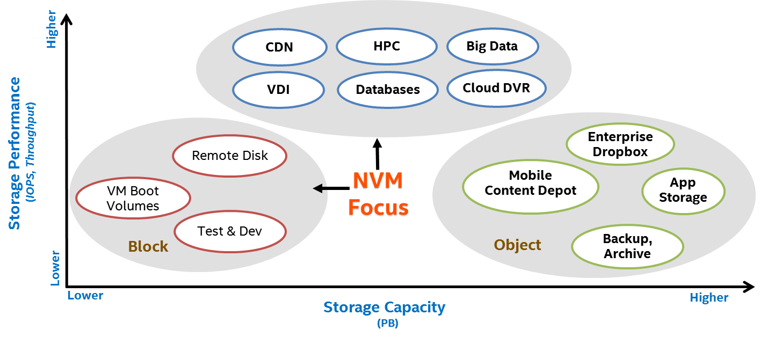
Ceph Workloads and All-Flash Focus
* NVM – Non-volatile Memory
Notes:
NVM -> Flash

Slide 4

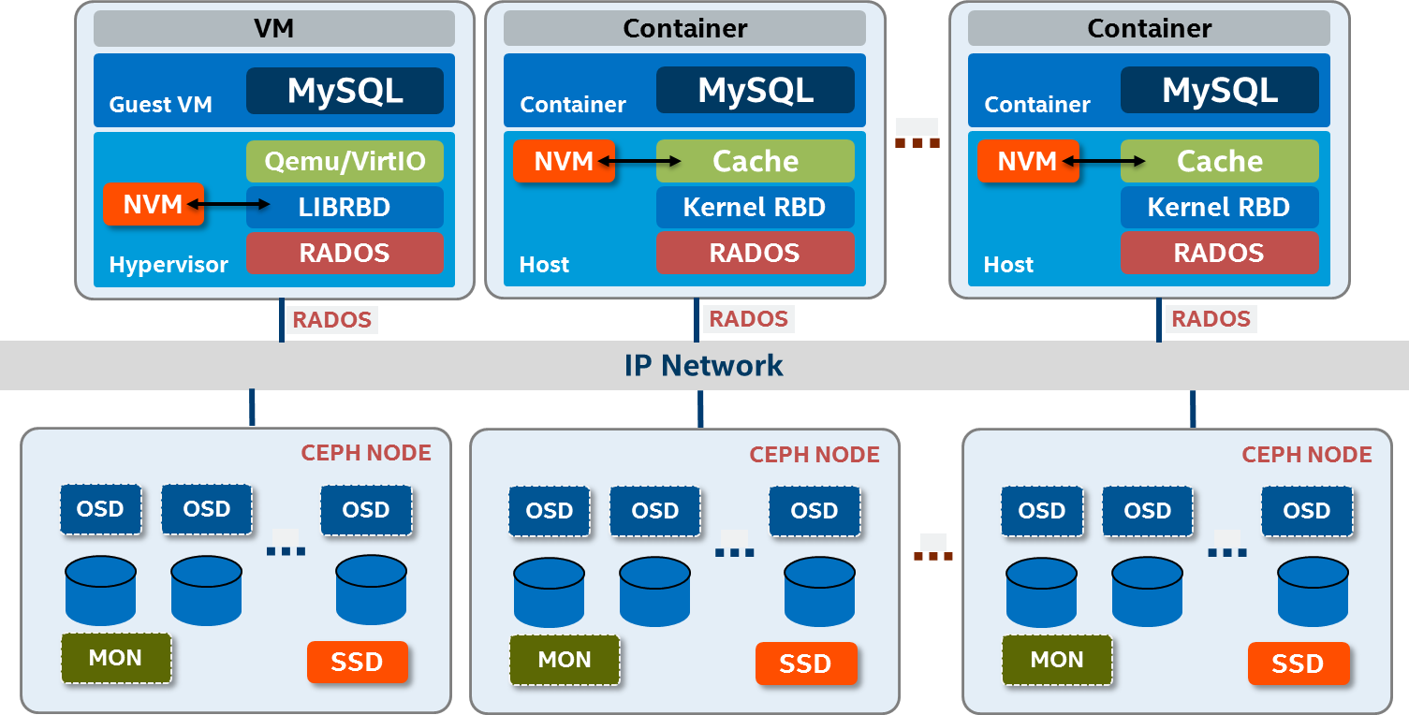
Ceph and PostgreSQL Integration Options
Bare Metal
PostgreSQL
PostgreSQL
PostgreSQL
Deployment Considerations:
Bootable Ceph RBD Volumes (OS and PostgreSQL install)
PostgreSQL RBD Volumes (all-in-one or separate)

Slide 5
Different Block Storage Configs
Highest Performance - all NVMe, Xeon Platinum CPUs
Lowest-latency
Highest write throughput
Most expensive
Lower maximum capacity per node
Cost-Optimized - all flash, NVMe journals, Xeon Gold CPUs
Good general purpose characteristics
Balanced cost, performance, capacity
Higher latency, lower cost, higher capacity
Today, we’re looking at Cost-Optimized configuration

Slide 6
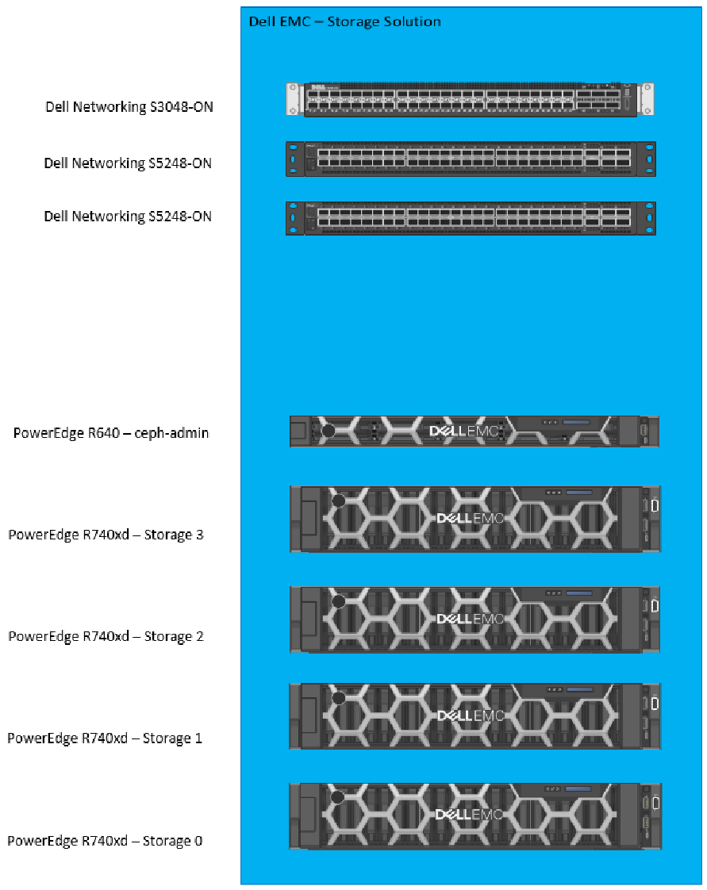
Test Environment Hardware - Ceph Cluster
Switches
Dell S3048-ON (cluster admin, iDRAC)
2x Dell S5248F-ON (48 port GbE, Ceph)
Admin Node
Dell PowerEdge R640, 2-socket Intel Gold 6126
4x Ceph Storage Nodes
Dell PowerEdge R740xd, 2-socket Xeon Gold 6152 (22C)
192GB RAM, HBA330 JBOD controller, BOSS
2x Intel XXV710 25GbE NICs
2.5” drive chassis, 24 front drive bays
16x Intel S4600 SATA SSD, 960GB, data drives (OSD)
4x Intel P4600 NVMe 1.6TB, journaling (WAL/RocksDB)
Notes:
No separate nodes for MONs (all Ceph daemon containerized/colocated)
Starting configuration; suitable for POCs; starting point for production (ideally 5 nodes); scale to multi-rack deployments

Slide 7
Test Environment Software and Configuration
4x Ceph Storage Nodes
RHEL 7.6, RHCS 3.2 (Luminous), BlueStore OSDs
Containerized (docker) Ceph daemons, MONs colocated with OSDs
16 OSDs per node (64 total), 4:1 ratio for data drives to NVMe
60TB raw storage, 20TB usable, 3x replication
2x dual-bonded 25GbE VLAN networks, fully fault tolerant, jumbo frames
1 Ceph pool (rbd), PGs=8192
10x Load Generation Nodes (PowerEdge R640)
RHEL 7.6
PostgreSQL 11.2, 5x DB server instances per node (50 total), untuned
250GB RBD data volume per DB server instance
40% (8TB) of cluster provisioned (24TB raw)

Slide 8
Considerable Tuning of Ceph Cluster
Ceph tuning
Finding 8192 as optimum PGs
Use recently published best practices
OS tuning
PID and file max
VM
Network stack read/write memory sizes
NUMA node PCIe slot assignments
Separate 25GbE NICs
Half of NVMe devices on each NUMA node
Separate BOSS and JBOD controller
Hardware replacements
Use P4600 NVMe instead of P4500
Reduce number of SSD drives (20 to 16; 5:1 to 4:1)
Use HBA330 instead of H740P controller
Final effect on 4KB random read:
Pre-tuning = 689,733 IOPS
Post-tuning = 1,493,349 IOPS
Gain = 116%

Slide 9
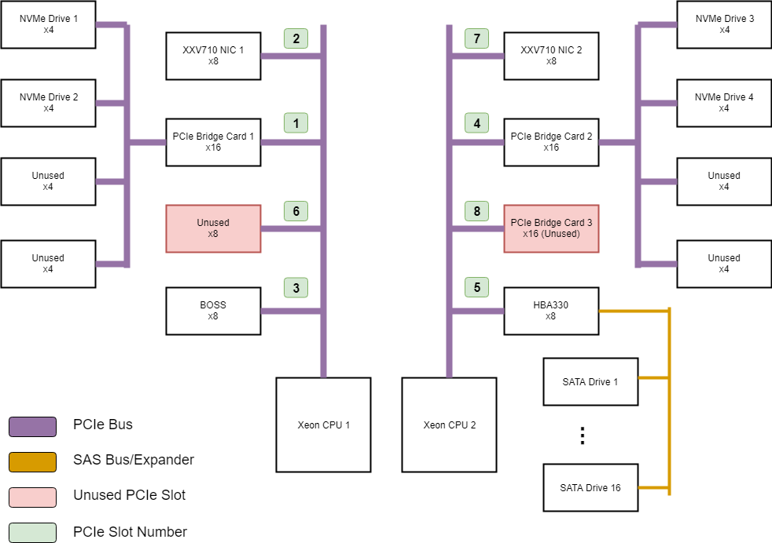
NUMA Considerations - PCIe Slot Assignments

Slide 10
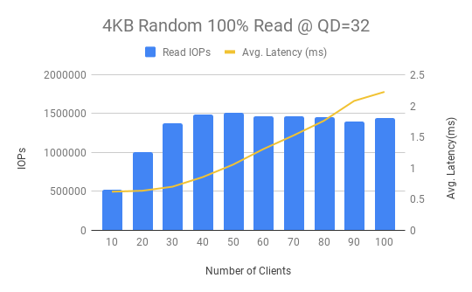
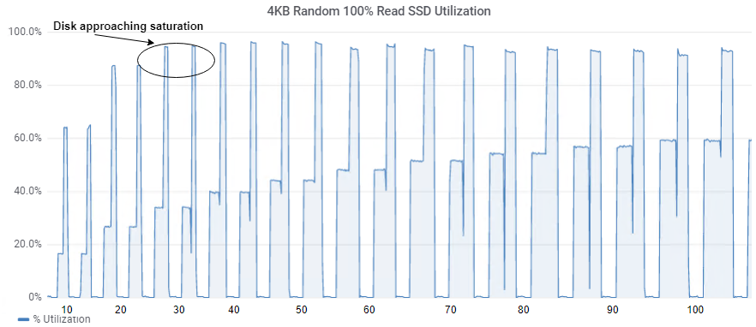
FIO Benchmarks - librbd - 4KB Random Read

Slide 11
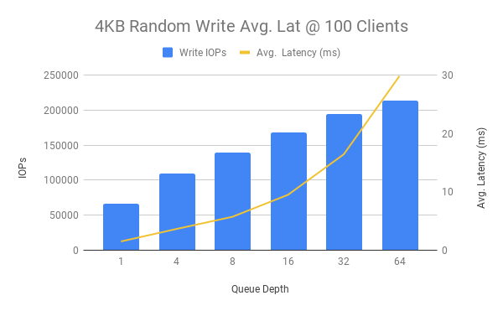
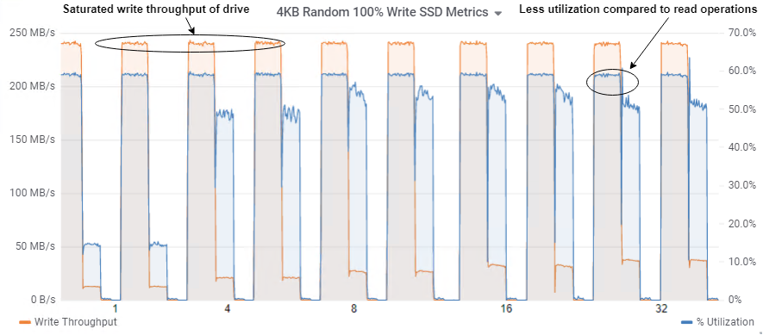
FIO Benchmarks - librbd - 4KB Random Write

Slide 12
Test Methodology - Sysbench
Configuration
PostgreSQL configured to run bare-metal
PostgreSQL configured with 25GB shared buffers
250GB krbd volumes for data
Sysbench configured to run bare-metal
Prepare x50
Populate 14,000,000 records in 32 tables
Each Run x50
5 minutes ramp (warmup) time
5 minutes run time (data collection)
Clear Ceph node caches between each test run:
Drop Linux system caches
Restart all OSDs
Programmatically start all sysbench processes concurrently
Run 1 sysbench process for each database server instance (50)
Run sysbench on same node as DB it’s paired with

Slide 13
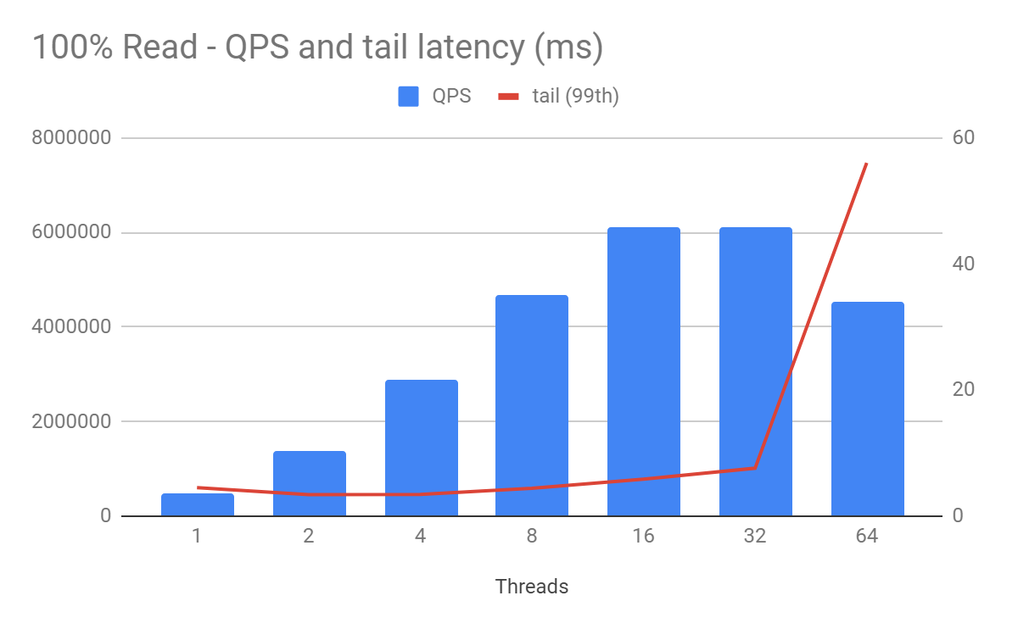
Performance Results - 100% Read

Slide 14
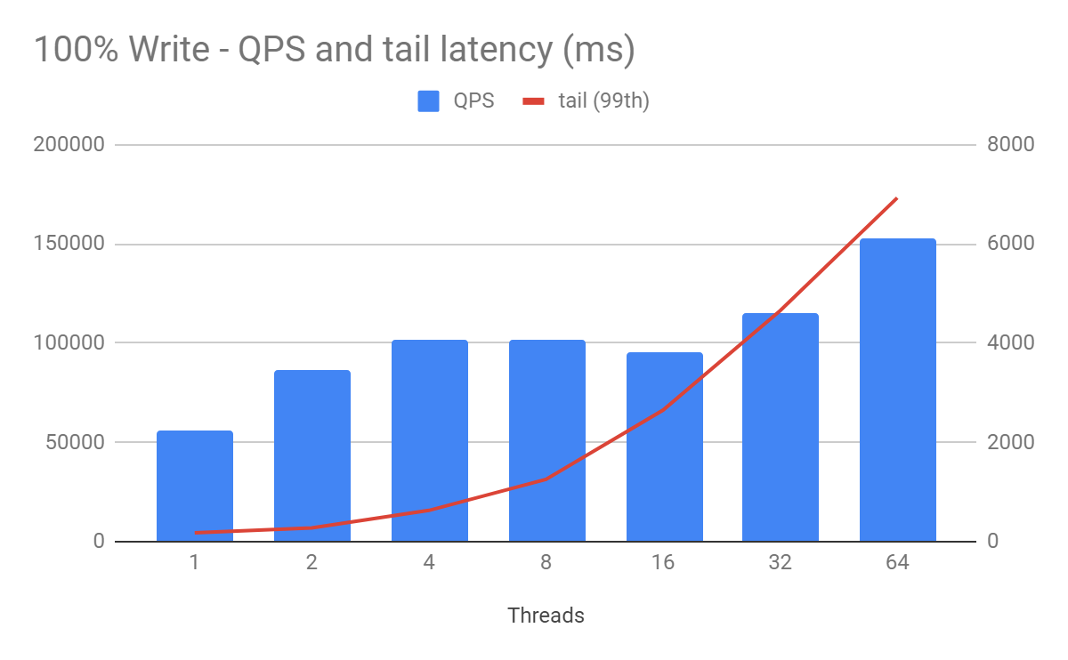
Performance Results - 100% Write

Slide 15
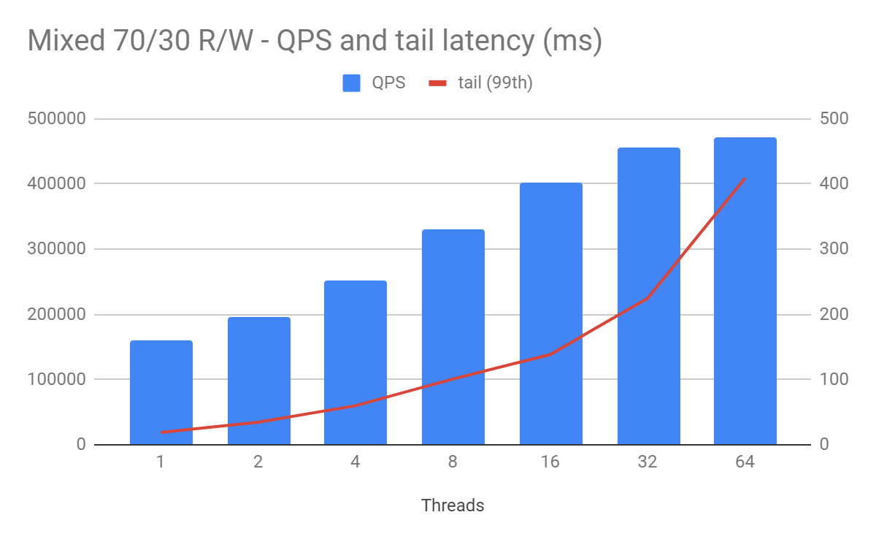
Performance Results - Mixed 70/30 (R/W)

Slide 16
Observations, Recommendations
Ceph is only getting better
FileStore to BlueStore
Ceph-deploy to ceph-ansible
Calamari, rhscons, to Ceph Dashboard (Grafana/Prometheus)
Can now deploy containerized and colocated daemons
Start slow, be deliberate (crawl, walk, run)
Understand drive failure, recovery and its impact on performance
Not fully turn-key (expect to build out some areas)
Don’t underestimate the importance of sizing and performance tuning
All-flash cost-optimized configuration is very good general purpose starting point.

Slide 17
Looking forward ...

Slide 18
High Performance All-NVMe Ready Architecture
4 Node, containerized/colocated Ceph daemons
Dual socket Xeon Platinum 8176 (Skylake, 28C)
2x Intel XXV710 25GbE NICs
Up to 12 Intel P4600 NVMe drives
2 or 4 OSDs per NVMe drive
Being optimized now, published RA in June 2019
Targeted for high performance, lowest-latency requirements

Slide 19
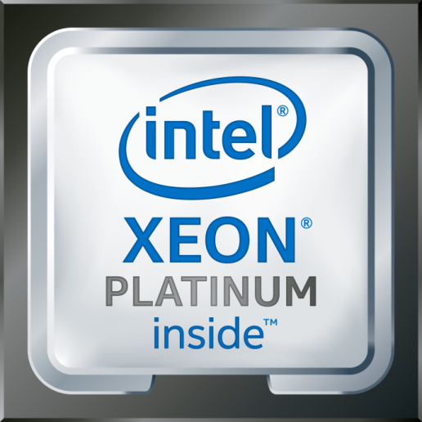
Next Generation Intel® CPUs
Leadership Performance
Security Mitigations¹
Intel® Optane™ DC Persistent Memory
Intel Deep Learning Boost (VNNI)
Higher Core Count, Frequencies
Optimized Frameworks & Libraries
1. No product or component can be absolutely secure

Slide 20
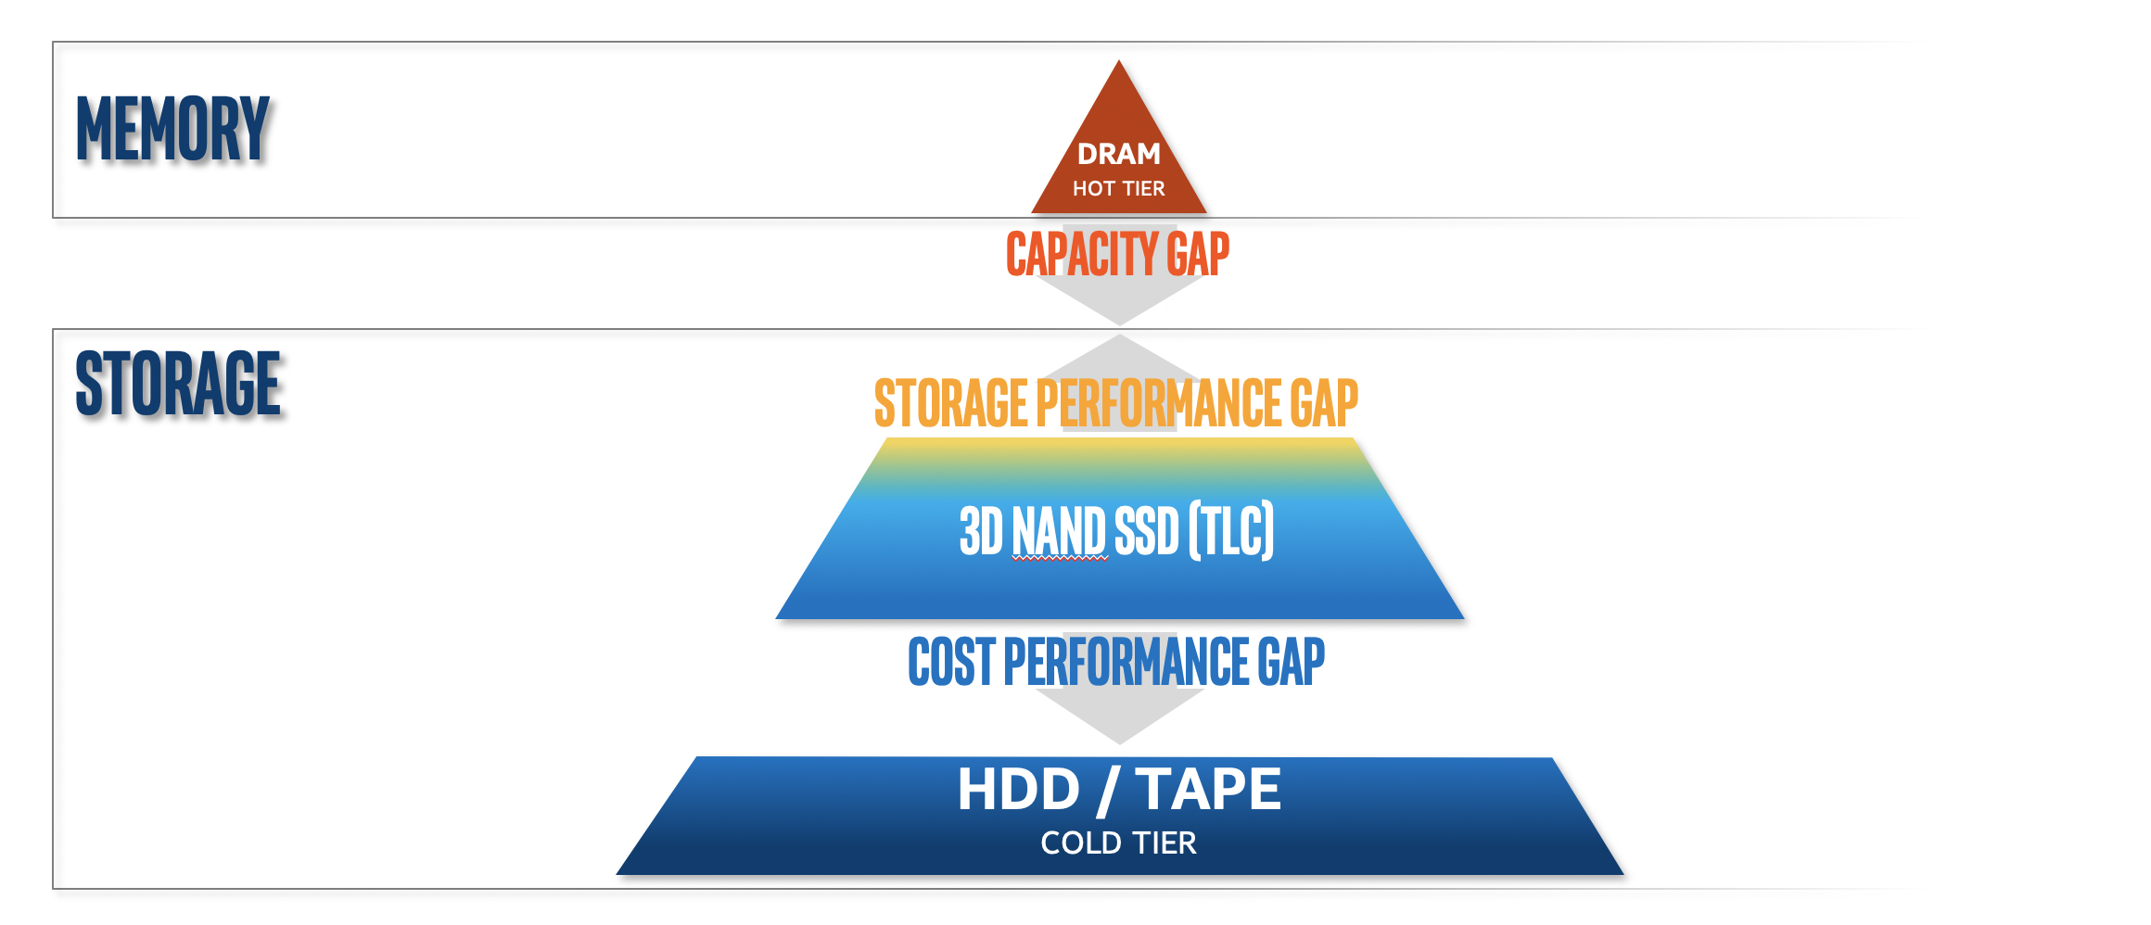
Gaps in Memory-Storage Hierarchy

Slide 21
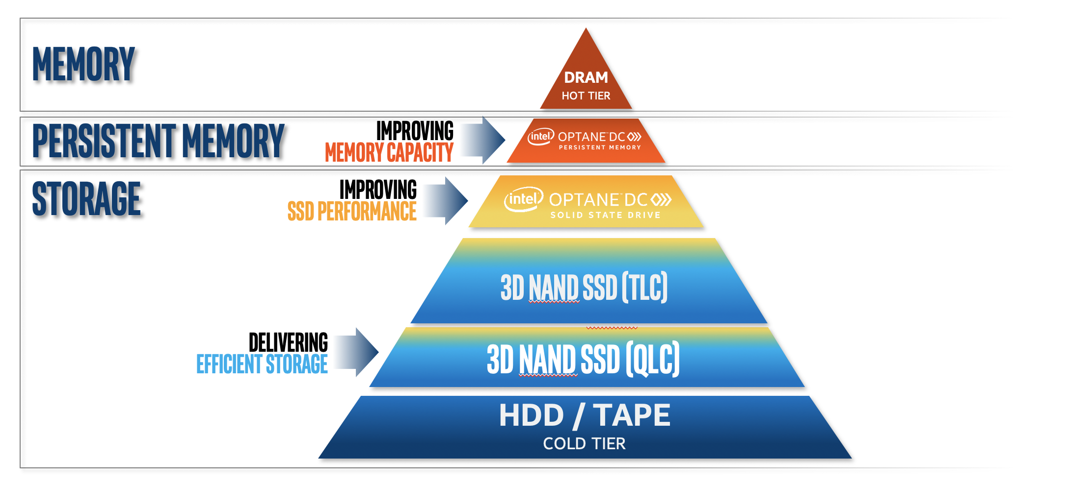
Gaps in Memory-Storage Hierarchy

Slide 22
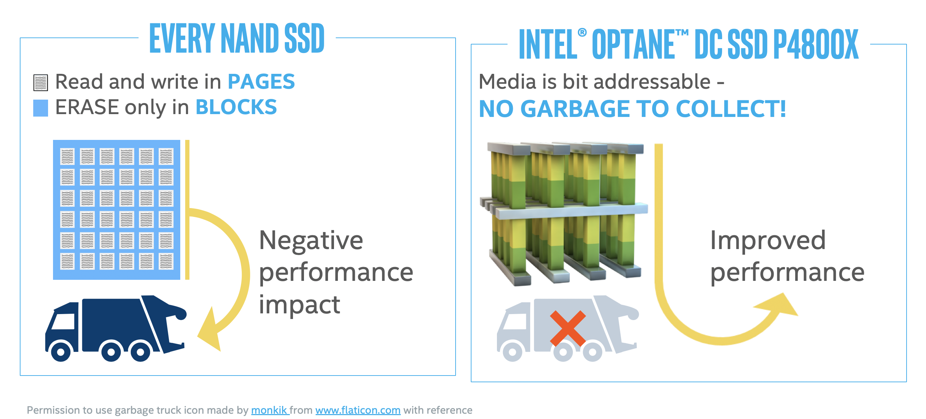
Intel® Optane™ DC SSDs Operate Differently than NAND
Notes:
Here’s another way to illustrate the difference between Intel Optane SSDs and NAND-based SSDs. NAND-based SSDs read and write in pages but erase only in blocks, usually in the background.
This creates a garbage collection process which negatively impacts performance.
However, Optane is bit addressable – you have the ability to write in place, without needing the ‘old’ data previously erased. So there's no garbage collection, which is one of the reasons Optane offers improved performance, especially for example read latency under write load.

Slide 23
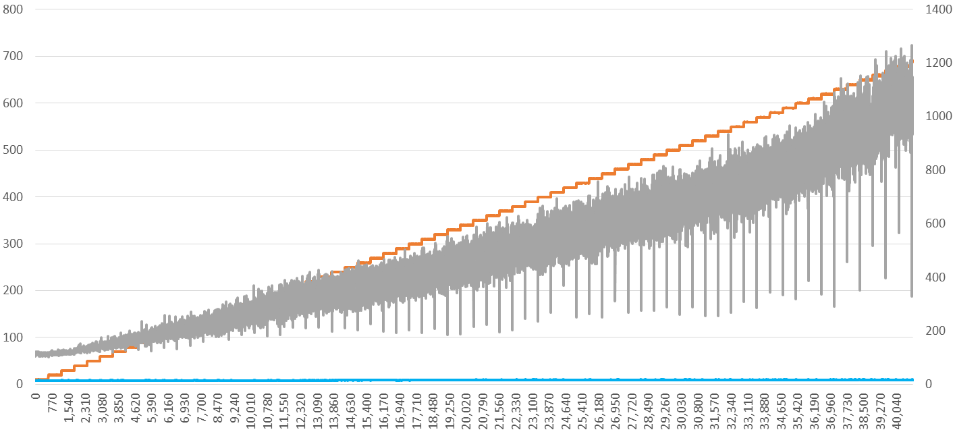

Intel® Optane™ - Lower and More Consistent Latency
Average Read Latency Under Random Write Workload
Random Write Pressure MB/s
Intel® SSD DC P4600
Intel® Optane™ SSD DC P4800X
Average Read
Response Time (µs)
Write Pressure
(MB/s)
63x
lower
8x
lower
Intel® Optane™ DC SSD
Time (Seconds)
1 Source – Intel-tested: Average read latency measured at queue depth 1 during 4k random write workload. Measured using FIO 3.1. Common Configuration - Intel 2U Server System, OS CentOS 7.5, kernel 4.17.6-1.el7.x86_64, CPU 2 x Intel® Xeon® 6154 Gold @ 3.0GHz (18 cores), RAM 256GB DDR4 @ 2666MHz. Configuration – Intel® Optane™ SSD DC P4800X 375GB and Intel® SSD DC P4600 1.6TB. Latency – Average read latency measured at QD1 during 4K Random Write operations using FIO 3.1. Intel Microcode: 0x2000043; System BIOS: 00.01.0013; ME Firmware: 04.00.04.294; BMC Firmware: 1.43.91f76955; FRUSDR: 1.43. SSDs tested were commercially available at time of test. The benchmark results may need to be revised as additional testing is conducted. Performance results are based on testing as of July 24, 2018 and may not reflect all publicly available security updates. See configuration disclosure for details. No product can be absolutely secure. Software and workloads used in performance tests may have been optimized for performance only on Intel microprocessors. Performance tests, such as SYSmark and MobileMark, are measured using specific computer systems, components, software, operations and functions. Any change to any of those factors may cause the results to vary. You should consult other information and performance tests to assist you in fully evaluating your contemplated purchases, including the performance of that product when combined with other products. For more complete information visit www.intel.com/benchmarks.
Notes:
As you can see on the left hand side this chart, we’re measuring write pressure, on the right hand side we have average read response time.
The orange staircase is write pressure that we're applying to the drive. So we're increasing that write pressure over time and you can see initially, Optane is 8x faster than NAND SSDs.
But as the write pressure increases, the NAND SSD gets dramatically slower in its reads, whereas Optane more or less stays consistent in reads, leading to up to 63x lower average read response time.
This is powerful proof that Intel Optane SSDs are an excellent metadata drive for CEPH cluster.

Slide 24
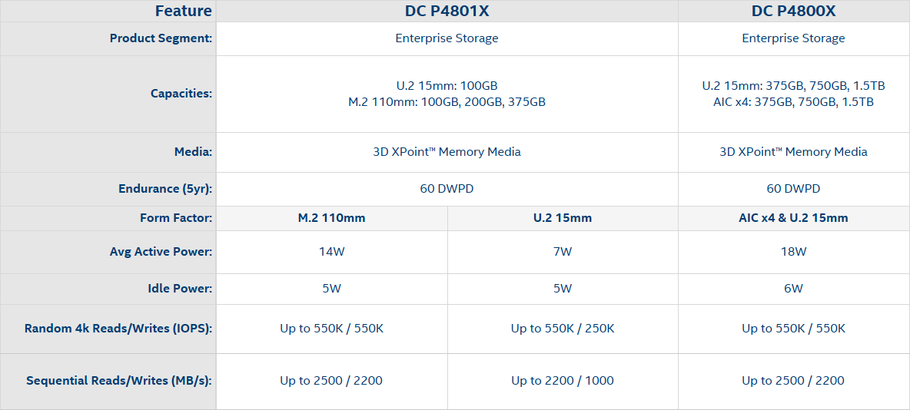

Intel® Optane™ SSDs
DC P4800X
DC P4801X
Results have been estimated or simulated using internal Intel analysis or architecture simulation or modeling, and provided to you for informational purposes. Any differences in your system hardware, software or configuration may affect your actual performance. ¹See Product Specification for availability details
*Other names and brands may be claimed as the property of others.

Slide 25
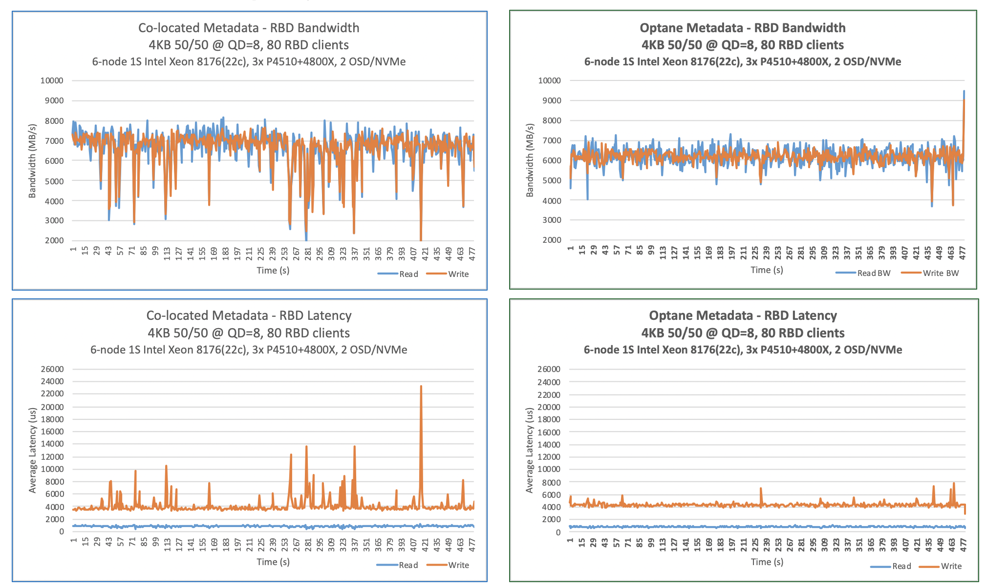
Ceph Bluestore Metadata – Collocated on data disk vs On Optane 4KB Random 50/50, QD=8
Better Latency
Consistency
With Optane for Ceph Metadata

Slide 26
Next-Gen Cost-Optimized Solution
Cascade Lake Processors = better core density at the same cost
3D-NAND P4320 QLC SSDs = better storage density at a lower price point
Optane P4800X SSDs for metadata = more IOPS, consistent latency
 |  | 5x Ceph Storage Nodes (Skylake + P4500 + P4600) | 5x Ceph Storage Nodes (Cascade Lake + P4320 + Optane)
CPU | SKU | Intel Xeon® Gold 6152 | Intel Xeon® Gold 6252
 | # of Cores | 2x 22 | 2x 24
 | Core Frequency | 2.1 GHz | 2.1 GHz
 | Cache Size | 1 MB L2, 30.25 MB L3 | 1MB L2, 35.75 MB L3
Memory | Total System Memory | 384 GB | 384 GB
Network | Bandwidth | 25x2 GbE | 25x2 GbE
Storage | OS Disk | Intel SSD DC S3610 1.5 TB | Intel SSD DC S3610 1.5 TB
 | Data | 6x Intel SSD DC P4500 4 TB (Data) | 6x Intel SSD DC P4320 8 TB (Data)
 | Metadata | Intel SSD DC P4600 2 TB (WAL/DB) | Intel SSD DC P4800X 375 GB (WAL/DB)
Cluster Configuration | Ceph Release | 13.2.4 Mimic | 13.2.4 Mimic
 | Number of OSDs/Disk | 2 | 2
 | Replication | 2x | 2x
 | Effective Capacity | 40TB | 80TB

Slide 27
Next-Gen Performance Solution
Cascade Lake Processors = better core density at the same cost
3D-NAND P4510 TLC SSDs = 40% better write performance, higher endurance
Optane P4800X SSDs for metadata = more IOPS, consistent latency
 |  | 5x Ceph Storage Nodes (Skylake + P4500 + P4600) | 5x Ceph Storage Nodes (Cascade Lake + P4510 + Optane)
CPU | SKU | Intel Xeon® Gold 6152 | Intel Xeon® Gold 6252
 | # of Cores | 2x 22 | 2x 24
 | Core Frequency | 2.1 GHz | 2.1 GHz
 | Cache Size | 1 MB L2, 30.25 MB L3 | 1MB L2, 35.75 MB L3
Memory | Total System Memory | 384 GB | 384 GB
Network | Bandwidth | 25x2 GbE | 25x2 GbE
Storage | OS Disk | Intel SSD DC S3610 1.5 TB | Intel SSD DC S3610 1.5 TB
 | Data | 6x Intel SSD DC P4500 4 TB (Data) | 6x Intel SSD DC P4510 4 TB (Data)
 | Metadata | Intel SSD DC P4600 2 TB (WAL/DB) | Intel SSD DC P4800X 375 GB (WAL/DB)
Cluster Configuration | Ceph Release | 13.2.4 Mimic | 13.2.4 Mimic
 | Number of OSDs/Disk | 2 | 2
 | Replication | 2x | 2x
 | Effective Capacity | 40TB | 40TB

Slide 28


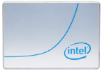


Gen-over-Gen Performance Improvements
Up to 3.4X
Relative to Baseline
Up to 1.7X
Relative to Baseline
Latest Gen Performance Solution
Latest Gen
Cost
Optimized Solution
Baseline
+
Intel® SSD DC P4600
+
Intel® SSD DC P4500
+
Intel® Optane™ SSD
+
P4320
+
P4800X
+
P4510
Intel® Xeon® Gold 6152 Processor + Intel® SSD DC P4600 + Intel® SSD DC P4500
2nd Intel® Xeon® Gold 6252 Processor + Intel® Optane™ SSD DC P4800X + Intel® SSD D5-P4320
2nd Gen Intel® Xeon® Gold 6252 Processor + Intel® Optane™ SSD DC P4800X + Intel® SSD DC P4510
Performance results are based on testing by Intel as of 2/20/2019 and may not reflect all publicly available security updates. See configuration disclosure for details. No product or component can be absolutely secure. Software and workloads used in performance tests may have been optimized for performance only on Intel microprocessors. Performance tests, such as SYSmark and MobileMark, are measured using specific computer systems, components, software, operations and functions. Any change to any of those factors may cause the results to vary. You should consult other information and performance tests to assist you in fully evaluating your contemplated purchases, including the performance of that product when combined with other products. For more complete information visit www.intel.com/benchmarks. Configurations: See next slide

Slide 29
Gen-over-Gen Performance Improvements
2.4X*
1.37X*
1.23X*
1.23X*
1.26X*
1.13X*
BASELINE
Xeon Gold 6152 + Intel® SSD DC P4600 + Intel® SSD DC P4500
2nd Gen Intel® Xeon Gold 6252
+ Intel® Optane™ SSD DC P4800X + Intel® SSD D5-P4320
2nd Gen Intel® Xeon Gold 6252
+ Intel® Optane™ SSD DC P4800X + Intel® SSD DC P4510
IO Sizes
4KB
16KB
1MB
4KB
16KB
1MB
* Performance numbers are relative to Baseline
Performance results are based on testing by Intel as of 2/20/2019 and may not reflect all publicly available security updates. See configuration disclosure for details. No product or component can be absolutely secure. Software and workloads used in performance tests may have been optimized for performance only on Intel microprocessors. Performance tests, such as SYSmark and MobileMark, are measured using specific computer systems, components, software, operations and functions. Any change to any of those factors may cause the results to vary. You should consult other information and performance tests to assist you in fully evaluating your contemplated purchases, including the performance of that product when combined with other products. For more complete information visit www.intel.com/benchmarks. Configurations: See next slide

Slide 30
Next-Gen Cost-Optimized
Next-Gen Performance
4KB RANDOM
LATENCY Improvements
4KB RANDOM
LATENCY Improvements
BASELINE
READ
Same
17%
14%
19%
+
P4600
WRITE
19%
25%
26%
11%
+
READ/WRITE
(70/30)
P4500
11%
25%
22%
10%
Intel® Xeon® Gold 6152 Processor + Intel® SSD DC P4600 + Intel® SSD DC P4500
Relative to BASELINE
Relative to BASELINE
+
P4800X
+
P4320
+
P4800X
+
P4510
2nd Gen Intel® Xeon® Gold 6252 Processor + Intel® Optane™ SSD DC P4800X + Intel® SSD D5-P4320
2nd Gen Intel® Xeon® Gold 6252 Processor + Intel® Optane™ SSD DC P4800X + Intel® SSD DC P4510
Performance results are based on testing by Intel as of 2/20/2019 and may not reflect all publicly available security updates. See configuration disclosure for details. No product or component can be absolutely secure. Software and workloads used in performance tests may have been optimized for performance only on Intel microprocessors. Performance tests, such as SYSmark and MobileMark, are measured using specific computer systems, components, software, operations and functions. Any change to any of those factors may cause the results to vary. You should consult other information and performance tests to assist you in fully evaluating your contemplated purchases, including the performance of that product when combined with other products. For more complete information visit www.intel.com/benchmarks. Configurations: See next slide

Slide 31
Back to the question ...

Slide 32
Are we there yet?
Yes, we’re there for vast majority of use cases
Some special cases could be challenging (outer edges)
Very good performance
Solid foundation and keeps getting better
Vibrant community

Slide 33
Performance Improvements Pipeline
Client side caching
Read-only and Crash-consistent Write-back Caching for block/object
first sets of RO cache PRs merged upstream
Crimson OSD
OSD re-architecture ( Seastar, DPDK, SPDK primitives – poll mode, lock-light )
Red Hat and Intel leading
Single threaded OSD, Seastar messenger prototypes in master
Block Client performance improvements
Intel team leading RBD improvements for multithreading

Slide 34
Questions, comments, sarcasm? :)

Slide 36
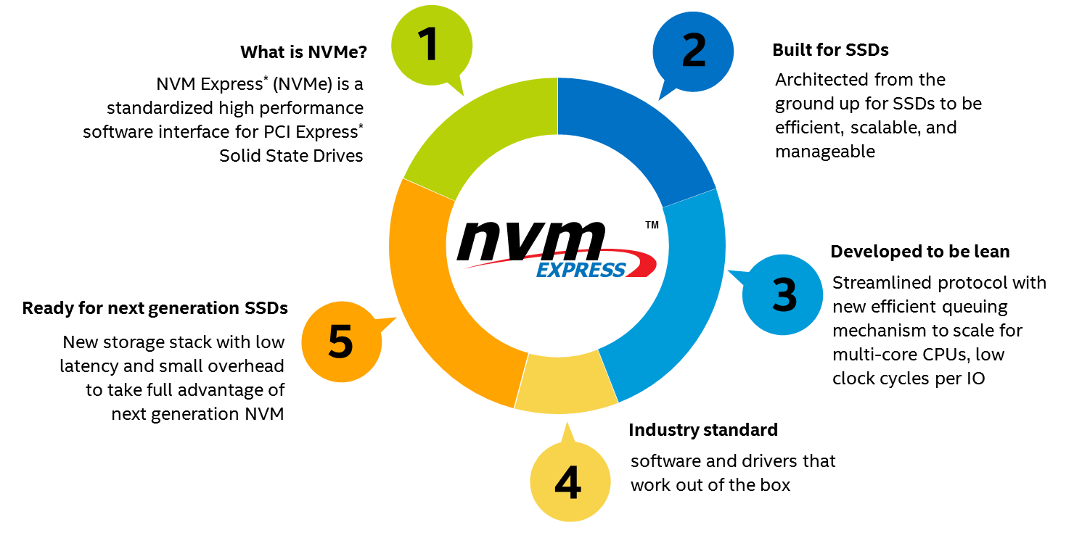
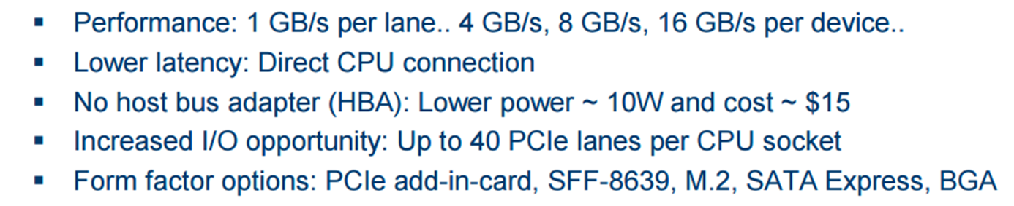
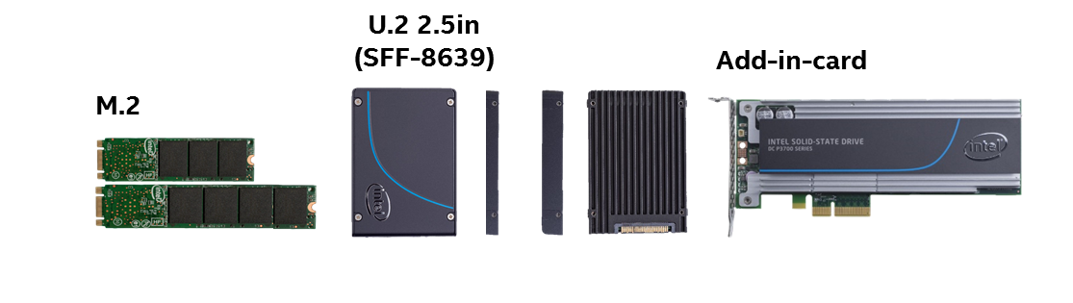
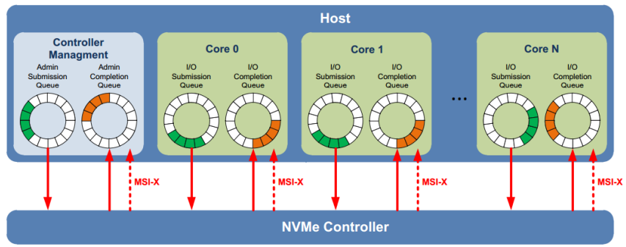
NVM Express (NVMe) Standardized interface for non-volatile memory, http://nvmexpress.org
Source: Intel. Other names and brands are property of their respective owners. Technology claims are based on comparisons of latency, density and write cycling metrics amongst memory technologies recorded on published specifications of in-market memory products against internal Intel specifications.
Notes:
NVM Express is an interface specification optimized for PCI Express® based storage solutions, such as solid-state drives. The NVMe 1.0 specification defines a scalable architecture that unlocks the potential of PCIe-based SSDs. With a throughput improvement of 6x and reduced storage latency over 6 Gbps SATA SSD, the Intel SSD PCIe Family increases processor utilization while scaling to meet demand.
NVM Express revolutionizes storage by delivering faster access to data and lowering latency and power consumption. NVM Express reduces latency, is achieved by eliminating the delay associated with memory adapters and optimizing the storage protocol that has limited SSD performance until now. NVMe reduces the number of layers in the storage protocol stack. Storage commands are processed with 60% fewer processor cycles and 60% less latency. These freed up processing cycle can now be used for real application workload, improving the efficiency of the processor.
NVMe delivers higher input/output operations per second (IOPS) and reduces power consumption for a lower total cost of ownership.
Segway: Intel sets itself apart from others by delivering the PCIe Family optimized for today’s mixed workload applications

Slide 37
Databases, NVMe SSDs and Ceph
Why Databases?
Databases among top-3 workloads on Openstack, Kubernetes
(#1-2 host databases too)
Why NVMe SSDs?
High IOPS
Low, dependable latency
DBA-friendly Ceph feature-set
Shared, elastic storage pools
Snapshots (full and incremental) for easy backup
Copy-on-write cloning
Flexible volume resizing
Live Migration
Async Volume Mirroring

