Slide 1
IEEE 1588 Precision Time Protocol (PTP) on StarlingX
Notes:
Introductions:
Matt Peters – Software Architect – Wind River – StarlingX Networking Technical Lead
Alex Kozyrev – Software Engineer – Wind River – StarlingX Contributing Member

Slide 2
Agenda
StarlingX Overview
PTP Operation and Edge Use-Cases
StarlingX PTP Architecture and Software
StarlingX PTP Demo
Q&A

Slide 3
StarlingX Overview
01
A Fully Featured Cloud For The Distributed Edge

Slide 4
Reliability
Scalability
Small Footprint
Ultra-low Latency
Edge Security
Lifecycle Management
Notes:
Driving factors for StarlingX at the Edge:
Reliability – fault detection and recovery
Scalability – 1 to 1000 nodes
Small Footprint – hardware that has tight resource constraints
Ultra-low Latency – deterministic and tunable performance
Edge Security – tamper protections - no physical security
Lifecycle Management - simplified deployment and operations with full system management

Slide 5
Edge Virtualization Platform
StarlingX provides a deployment-ready, scalable, highly reliable Edge infrastructure software platform
Services from the StarlingX platform focus on:
Easy deployment
Low touch manageability
Rapid response to events
Fast recovery
Think control at the Edge, control between IoT and Cloud, control over your containers and virtual machines.
Notes:
Tested and released as a complete stack, consisting of several open source projects:
CentOS – curated distribution, tuned for the Edge
Kubernetes – cloud-native containerized workloads
Ceph – persistent storage cluster for Kubernetes and OpenStack
OpenStack – management and orchestration of virtualized workloads
StarlingX specific services designed for easy deployment and manageability:
Configuration Management – Manages Installation and Commissioning, Hardware Discovery and Node Configuration
Host Management – LCM of physical servers (w/BMC): monitoring, fault detection, reporting and recovery of hardware
Service Management – Manages high availability of critical infrastructure and cluster services: monitoring, fault detection, reporting of services
Software Management – Automated deploy of software updates for security and/or new functionality
Fault Management – Framework for infrastructure services to raise and persist alarm and event data
Infrastructure Orchestration – Orchestration of infrastructure service operations (node maintenance, migrating workloads, coordinated software delivery)

Slide 6
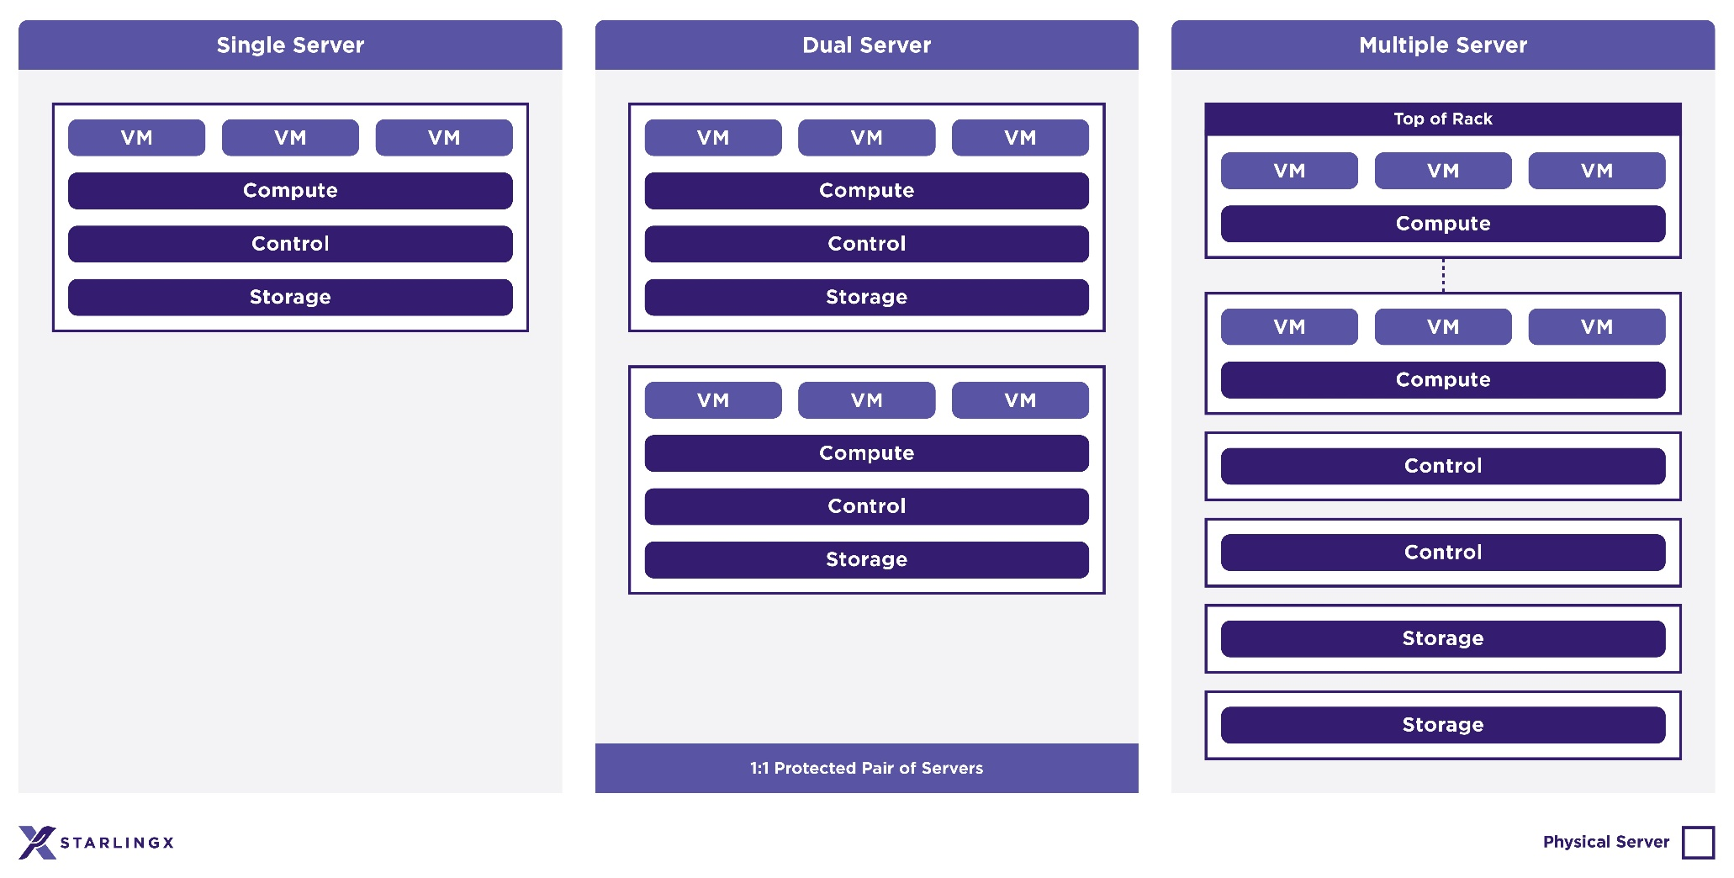
Scalability
Single Server Runs all functions
Dual Server Redundant design
Multiple Server Full resilient and geographically distributable
Notes:
The architecture is designed to scale based on the needs of the particular Edge computing environment. The same platform can run on:
Single Server - combined controller, compute, networking and storage functions
Dual Server – redundant deployment of all-in-one server model
Multiple Server
Controller, Compute, Networking and Storage functions all running on independent servers,
2x Node HA Controller Node Cluster
2-100x Compute Node Cluster
OPTIONAL 2-9 Node CEPH Storage Node Cluster
L3 Networking services distributed across compute nodes.
Distributed Cloud - Distributed edge deployment possible to the Edge of all deployment models

Slide 7
PTP Operation and Edge Use-Cases
02
IEEE 1588 Precision Time Protocol

Slide 8
IEEE 1588 is designed for local systems requiring accuracies beyond those attainable using NTP.
John Eidson
IEEE Instrumentation & Measurement Society
Notes:
John Eidson - led the IEEE 1588-2002 standardization effort

Slide 9
IEEE 1588 Precision Time Protocol
IEEE Standard for a Precision Clock Synchronization Protocol for Networked Measurement and Control Systems
Features
A real-time clock synchronization protocol of a distributed system of devices.
Designed to operate over a local area network (LAN), typically Ethernet.
Capable of achieving sub-microsecond accuracy when deployed with supporting network hardware devices.
Ability to sync clocks of varying precision, resolution and stability and automatically select the best time source.
Minimal administration is required – initializes and synchronizes automatically.
Low resource requirements – suitable for embedded systems or micro controllers.
History
IEEE 1588 2002 (PTP v1 - Superseded)
IEEE 1588 2008 (PTP v2 - Active)
IEEE 1588 2019 (PTP v2.1 - Future)
Backward compatible with PTPv2
Improved flexibility, robustness, security and accuracy (sub-ns accuracy)
Notes:
Local network operation
Sub-microsecond accuracy w/ hardware device support
Handles clocks with varying quality
Minimal administration
Low resource requirements

Slide 10
PTP Architecture and Operation
Hierarchical master-slave topology of heterogenous systems
High precision clock source(s) distributed to other systems using standard, low cost Ethernet
NIC and Network switch time-stamping to reduce network and stack jitter (propagation delay)
State negotiated automatically between independent network ports of devices
Multicast or Unicast Operation
Grandmaster Clock
High Precision Clock Source
M
Best Master Clock Algorithm
Boundary Clock
S
M
Hardware Timestamping
Transparent Clock
Protocol Message Exchange
M
Master
S
S
S
S
Slave
Slave Clocks
Notes:
Typically deployed with a hierarchical topology
Distribution of high precision clock source (e.g. GPS)
Operates at the port level between devices
Multicast or Unicast messaging

Slide 11
PTP versus NTP
 | NTP | PTP
Synchronization Accuracy | Sub-microseconds accuracy | Millisecond accuracy
Update Interval | Minutes | Seconds
Mode of Operation | Clients pull time from server | Master pushes time to slaves
Spatial Extent | LAN/WAN | LAN
Hardware Requirements | None, public NTP servers leverage hardware implementation | Hardware support required for higher accuracy, but not mandated
Error Source | Switches, port contention with data and OS stack delay | Switches and port contention with data
Notes:
Explain why PTP is more accurate than NTP
The main reason is the hardware support and taking switches delay into account
But that requires more configuration and not as good in WAN scenario

Slide 12
PTP Edge Use-Cases
PTP has gained significant adoption across many industries, enabling high precision clock synchronization using off-the-shelf equipment.
Applications and Use-Cases
Factory Automation and Industrial IoT
Robotic Control and Coordination
Power Plants – Smart Substations
Telecommunications / Cellular – High Density 5G Networks
Financial – High Precision Trading
Time Sensitive Networking – Multiplexing and Determinism over Ethernet
Many industries are developing their own IEEE PTP Profile to align on requirements and inter-operability
Notes:
High adoption rate
Industries standardizing PTP profiles
Automation: Coordination between automation components (software or hardware)
Financial: High degree of accuracy of timestamps and reconcile transactions with other financial institutions (regulated)
5G: Networks based on Time Division Duplex (TDD)
TSN: Scheduling and delivery deadlines

Slide 13
StarlingX PTP Architecture and Software
03
IEEE 1588 Precision Time Protocol (PTP) on StarlingX

Slide 14
PTP Deployment Architecture
Grandmaster Clocks
External high precision time source for the PTP network, usually based on GNSS/GPS
Boundary Clocks
StarlingX Controller Nodes
Synchronize their clocks to a Grandmaster Clock via OAM Network
Serve as a time source to all other nodes
May become Grandmaster Clock if external Grandmaster Clock is not configured or lost
Slave Clocks
StarlingX Compute/Storage Nodes
Synchronize their clocks to StarlingX Controller Nodes via Management Network
Grandmaster
Clock(s)
Clock Source
M
Master
S
Slave
M
OAM Network
Boundary
Clocks
controller-0
controller-1
S
S
M
M
Management Network
Compute
Hosts
compute-0
compute-1
S
S
S
compute-2
Notes:
External Grandmaster clocks for the best accuracy.
Source as a time source for StarlingX controller nodes.
BMC alghorithm automatically promotes one of controller node to the GM.
- No external GM is needed for time synchronization among StarlingX nodes.

Slide 15
PTP Implementation in StarlingX
LinuxPTP is an implementation of the Precision Time Protocol (PTP) according to IEEE standard 1588 for Linux.
http://linuxptp.sourceforge.net
StarlingX leverages LinuxPTP project to support the time synchronization over the PTP.
LinuxPTP consists of two binaries:
ptp4l - synchronizes a PTP Hardware Clock (PHC) with a network time source.
phc2sys - synchronizes the Linux system clock to a PTP hardware clock (PHC).
LinuxPTP Configuration
Network Transport - syncs over UDP/IPv4, UDP/IPv6, or raw Ethernet (Layer 2).
Delay Mechanism - utilizes End to End (E2E) or Peer to Peer (P2P) to measure the delay.
Time Stamping - supports hardware or software time stamping.
Notes:
LinuxPTP is widely accepted IEEE1588 implementation.
Well maintained implementation and optimized Linux API usage.
ptp4l is the actual implementation.
- transport can be UDP over IP or L2, not important for accuracy
- P2P is better than E2E, but requires network switches configuration
- hardware mode is more precise than software
- pch2sys handles synchronization between all the PHCs and Linux clock

Slide 16
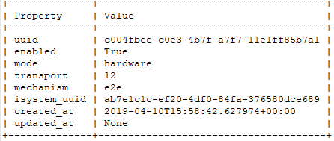
PTP Configuration in StarlingX CLI
system ptp-modify --enabled=<true/false> --mode=<hardware/software> --transport=<l2/udp> --mechanism=<e2e/p2p>
Enables/disables PTP on StarlingX and configure all its parameters.
system ptp-show
Displays the current status of PTP and all the configuration details.
System Inventory CLI provides a simple way to configure PTP in an entire StarlingX cluster.
Notes:
One simple command to configure PTP.
Settings are propagated to all StarlingX nodes.
NTP must be disabled before setting up PTP.

Slide 17
PTP Configuration in StarlingX GUI
Horizon web-interface is available for better user experience with PTP configuration in StarlingX.
Notes:
User-friendly way to configure PTP.
Couple clicks and you are done.

Slide 18
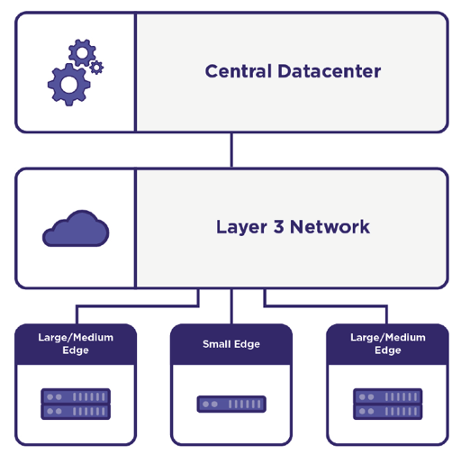
PTP Configuration in Distributed Cloud
StarlingX acts as a Centralized Datacenter and provides a system-wide Infrastructure Orchestration functions
Deployment and management of Edge Sites
Portal for shared configuration across all Edge Sites
Fault aggregation
Pathing Orchestration
PTP configuration is automatically applied to all Edge Sites from StarlingX Central Datacenter.
Notes:
DC manages geo distributed clusters from central location.
Shared configuration is propagated from DC to Edge Sites automatically.
Setting PTP at DC means that all Edge sites are configured for PTP as well.

Slide 19
PTP for Containers and Virtual Machines
Accurate time synchronization is free for any containers running on StarlingX compute hosts
KVM virtual PTP driver allows guests to sync their clocks to the host clock with high precision
Update reference clock in a time synchronization software to use the PTP device
Enjoy high-precision time synchronization across all the Containers and VMs on every compute node
Compute Host
VM-1
VM-2
VM-3
chrony
chrony
chrony
User Space
User Space
User Space
Kernel
Kernel
Kernel
/dev/ptp0
/dev/ptp0
/dev/ptp0
User Space
Hypercall
Sync Clock
Kernel
KVM
PHC
System Clock
NIC
PTP
Notes:
Goal is to synchronize user workloads, not StarlingX nodes.
Containerized apps are getting accurate timestamps from Linux clock.
VM are easy to sync thanks to virtual PTP driver, that exposes PHC to a guest OS.
Use this virtual PHC device to take compute host’s time in your virtualized app.

Slide 20
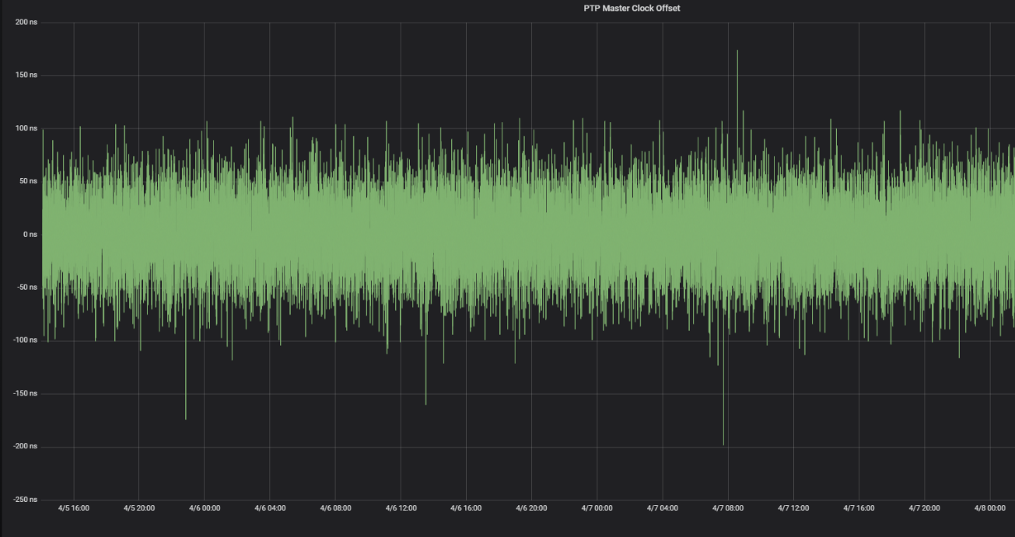
PTP Monitoring and Alarming
PTP Accuracy Monitoring
StarlingX continuously monitors the time offset between Master and Slave clocks and stores this information for monitoring and troubleshooting activities
PTP Status Alarming
StarlingX raises an alarm in case of unacceptable skew between Master and Slave clocks in a cluster is detected (more than 1ms skew)
NICs that do not support hardware PTP mode are reported as well.
Notes:
Monitoring is essential part of PTP – need to make sure that it does the job.
Time offset between controller and compute nodes is monitored all the time.
Unacceptable offset is alarmed right away to notify about network issues.

Slide 21
StarlingX PTP Latency measurements
Standard StarlingX configuration
 | Average | Median | Maximum
Controller Host – Compute Host | 19ns | 19ns | 656ns
Hardware Clock – System Clock | 18ns | 18ns | 256ns
Compute Host – Virtual Machine | 95ns | 68ns | 525ns
Total | 132ns | 105ns | 1164ns
Network switches configured as a Transparent Clock
 | Average | Median | Maximum
Controller Host – Compute Host | 10ns | 10ns | 44ns
Hardware Clock – System Clock | 45ns | 29ns | 215ns
Compute Host – Virtual Machine | 28ns | 23ns | 91ns
Total | 83ns | 62ns | 350ns
Low-Latency profile Compute Nodes
 | Average | Median | Maximum
Controller Host – Compute Host | 11ns | 10ns | 70ns
Hardware Clock – System Clock | 16ns | 14ns | 79ns
Compute Host – Virtual Machine | 27ns | 27ns | 34ns
Total | 54ns | 51ns | 183ns
Notes:
No GM was present, hardware timestamping and E2E mechanism.
3 values are summed up: controller PHC – compute PHC, PHC – Linux clock and host – VM.
Simple PTP enabling shows decent result, but occasional spikes are presents.
Configuring network switch as TC helps to reduce and guarantee Master-Slave offset.
Low-latency profile optimizes Linux OS scheduling and host-VM interactions.

Slide 22
StarlingX PTP Demo
04
IEEE 1588 Precision Time Protocol (PTP) on StarlingX

Slide 23
StarlingX PTP Demo
Showcasing StarlingX PTP functionality:
Seamless StarlingX cluster orchestration
Easy PTP deployment across the cluster
LinuxPTP operations on StarlingX platform
Guest VM synchronization with PTP Hardware Clock
Monitoring of PTP latency measurements

Slide 24
Notes:
- Seamless StarlingX cluster orchestration
- Easy PTP deployment across the cluster
- LinuxPTP operations on StarlingX platform
- Guest VM synchronization with PTP Hardware Clock
- Monitoring of PTP latency measurements

Slide 25
Q&A
05
IEEE 1588 Precision Time Protocol (PTP) on StarlingX

Slide 26
t
A Fully Featured Cloud
For The Distributed Edge
Join the Community
Mailing Lists: lists.starlingx.io Freenode IRC: #starlingx
Website: www.starlingx.io
Join the Foundation mailing list to stay up to date on all new projects!
http://lists.openstack.org/cgi-bin/mailman/listinfo/foundation

