Slide 1
Akraino, EdgeX, CORD, OpenEdge, ioFog… What’s the best solution for your edge?
Ruoyu Ying, ruoyu.ying@intel.com
Kailun Qin, kailun.qin@intel.com

Slide 2
Agenda
Edge computing definition
Typical edge computing implementations, use cases and their features
Available edge computing projects in the market
Summary

Slide 3
Definition of Edge Computing
EDGE COMPUTING IS THE PLACEMENT OF
ENDPOINT DEVICES
Closer to
DATA CENTER-GRADE
NETWORK, COMPUTE & STORAGE
TO IMPROVE SERVICE CAPABILITIES
Optimize TCO
Comply with Data Locality
And reduce application Latency
Outmost layers of
BEFORE TRANSITION TO THE ENDPOINT
OR
Another Network
The Edge Is the
Processing or Network

Slide 4
Edge Characteristics
Low Latency, Real Time, Optimized Infrastructure and Rapid Response
Massive Various Data Storage and Movement, Data Sovereignty
Enhanced Security and Data Privacy
Context or Location Awareness, Localization
Multi-Access Networking across Large-Scale and Small-Size Sites: Unreliable, Limited, High-Bandwidth
Intelligence, Smartness, Autonomy, Zero-Touch, Self-X
Notes:
So according to its definition, we could summarize that it may have these characteristics, like A, B, C, D

Slide 5
Typical implementations of edge computing
Notes:
Now we have a brief understanding on what is edge computing and also its characteristics. However, there are actually many ways to implement it. So let’s take a look at some typical implementations.

Slide 6
Definition of the implementation
Fog computing(FC): “A decentralized Computing infrastructure based on Fog Computing nodes (FCNs) placed at any point of the architecture between the end devices and the cloud. The FCNs are heterogeneous in nature and thus can be based on different kinds of elements including but not limited to routers, switches, access points, IoT gateways as well as set-top boxes.”
Mobile/Multi-access Edge Computing(MEC): “To bring computational and storage capacities to the edge of the network within the Radio Access Network to reduce latency and improve context awareness. The MEC nodes or servers are usually co-located with the Radio Network Controller or a macro base-station. The servers run multiple instances of MEC host which has the capabilities to perform computation and storage on a virtualized interface.”

Slide 7
Definition of the implementations – Cont’d
Cloudlet(CC): “Treated as ”data center in a box” running a virtual machine capable of provisioning resources to end devices and users in real time over a WLAN network. The services are Cloudlets are provided over a one-hop access with high bandwidth, thus offering low latency for applications.”
Reference: [1] Koustabh Dolui and Soumya Kanti Datta, “Comparison of Edge Computing Implementations:
Fog Computing, Cloudlet and Mobile Edge Computing”. 1-6. 10.1109/GIOTS.2017.8016213.

Slide 8
Characteristics of the implementations
Type of Implementation | FC | MEC | CC
Location | Near end device, dense and distributed | Radio Access Network Controller/Base station | Local/Outdoor Installation in one place
Device | Routers, Switches, Access points, gateways… | Servers running in base station or CO | Compact-size data centers
Access Mediums(mostly) | WiFi, LTE, ZigBee, MQTT, Bluetooth… | WiFi, LTE… | WiFi…
Logical Proximity | One/multiple hops | One hop | One hop
Ability for near-real-time Interaction | High | Medium | Medium
Multi-tenancy | Supported | Supported | Supported
Computation power | Medium | High | High

Slide 9
Characteristics of the implementations – Cont’d
Type of Implementation | FC | MEC | CC
Power Consumption | Low | High | Medium
Context Awareness | Medium | High | Low
Coverage | Low | High | Low
Server Density | Medium | Low | High
Cost/CAPEX | Low | High | Medium
Traffic Continuity | High | Medium | High
Active users | High | Medium | Medium
Reference: [1] Koustabh Dolui and Soumya Kanti Datta, “Comparison of Edge Computing Implementations:
Fog Computing, Cloudlet and Mobile Edge Computing”. 1-6. 10.1109/GIOTS.2017.8016213.
[2] Eugen Borcoci, “Fog Computing, Mobile Edge Computing,
Cloudlets - which one?”, 2016
[3] Baktir, Ahmet Cihat & Ozgovde, Atay & Ersoy, Cem. (2017). How Can Edge Computing Benefit from Software-Defined Networking: A Survey, Use Cases & Future Directions. IEEE Communications Surveys & Tutorials. PP. 1-1. 10.1109/COMST.2017.2717482.

Slide 10
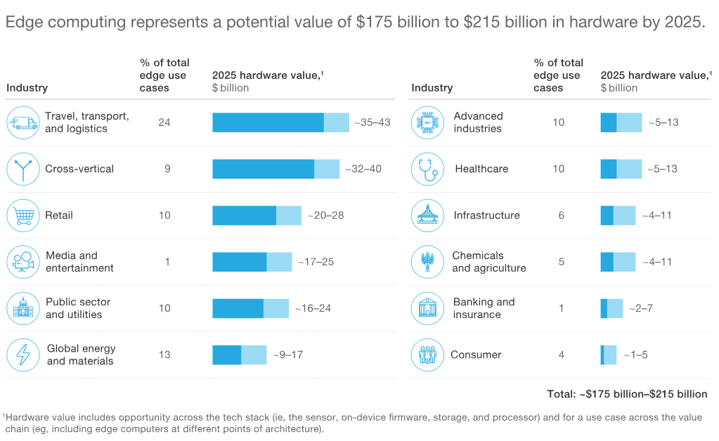
Edge use case overview
Reference: [1] https://www.mckinsey.com/industries/high-tech/our-insights/new-demand-new-markets-what-edge-computing-means-for-hardware-companies

Slide 11
Relationship between edge implementation and use case
 |  | Use case features
 |  | Band-width | Latency | Extensibility | Context Awareness | Power Consumption | Scalability | Privacy & Security
Implementation characteristics | Access Medium
 | Ability for near-real-time Interaction
 | Computation power
 | Context Awareness
 | Multi-tenancy
 | Logical proximity
 | Coverage
 | Power consumption
Highly related
Somehow related

Slide 12
Some typical use cases
Features | Use cases
 | Smart Cities | RAN-aware Context Optimization | Augmented Reality | E-Health | Autonomous Vehicles | Smart Grid | Video Caching & Analysis
Bandwidth
Latency
Extensibility
Context Awareness
Power Consumption
Scalability
Privacy & Security
Critical
Depends

Slide 13
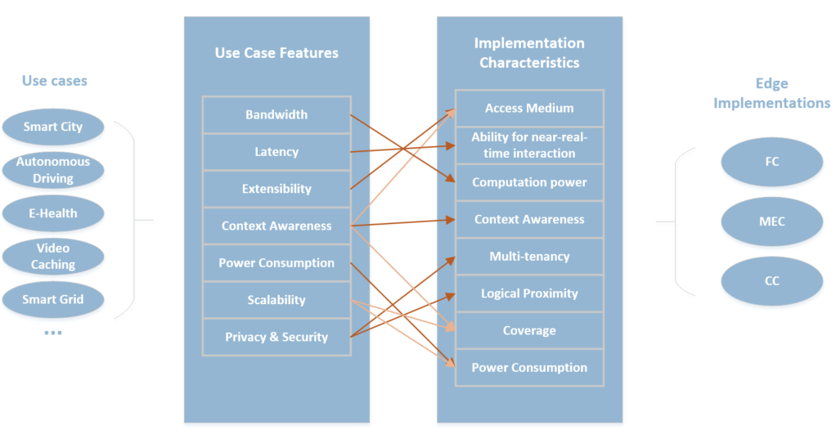
Work Flow

Slide 14
Recommendation for the use cases
Use Cases | Recommendation
Smart Cities | FC + MEC
RAN-aware Context Optimization | MEC
Augmented Reality | MEC/CC + FC
E-Health | FC
Autonomous Vehicles | FC + MEC
Smart Grid | FC
Video Caching & Analysis | MEC/CC

Slide 15
Open source projects available in the market

Slide 16
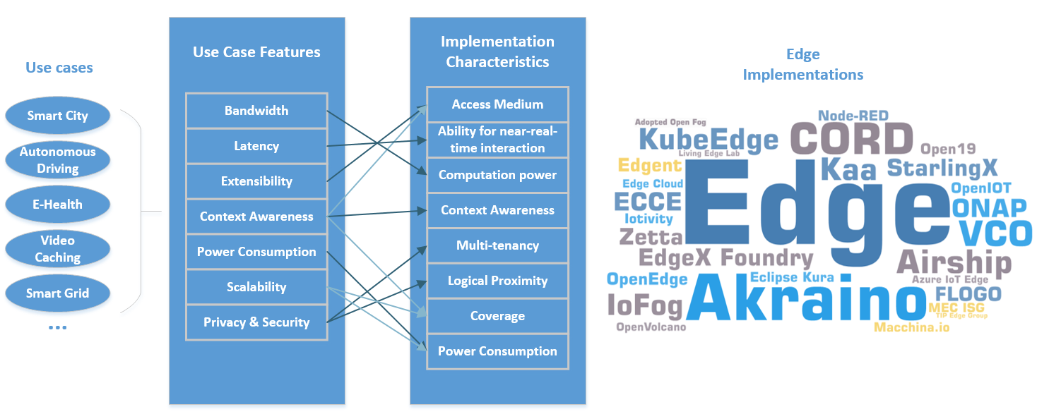
Regarding the projects…

Slide 17
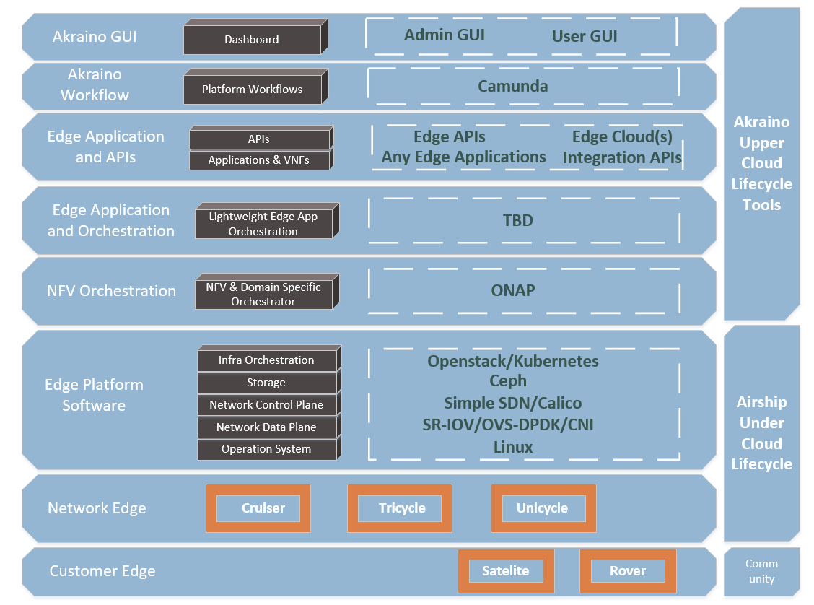
Akraino Edge Stack
“ Fully integrated edge infrastructure ”
“ Intend to develop solutions and support of carrier, provider and the IoT networks ”

Slide 18
BPs within the project
Connected Vehicle Blueprint
Edge Video Processing
Edge Lightweight and IoT Blueprint
Integrated Edge Cloud Blueprint
Kubernetes-Native Infrastructure for Edge
Micro-MEC
Radio Edge Cloud
StarlingX Far Edge Distributed Cloud
Time-Critical Edge Compute

Slide 19
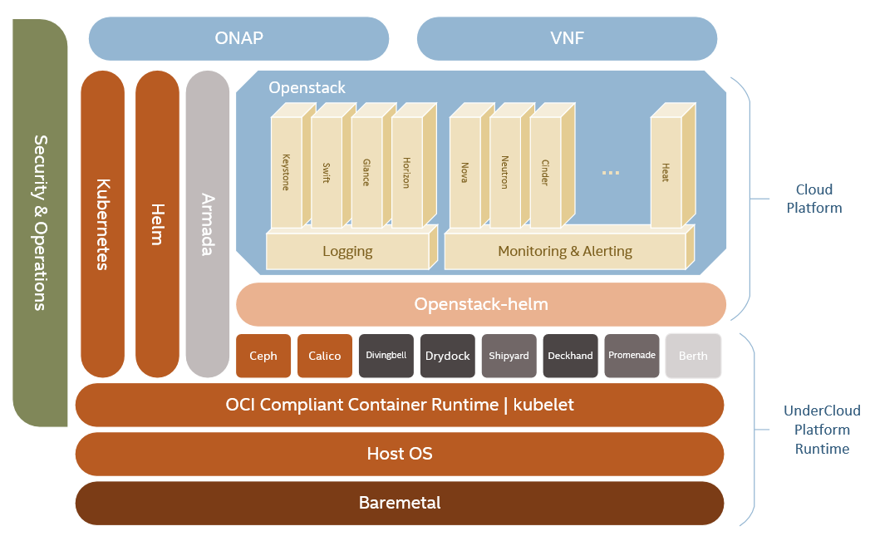
Airship
“Declarative, YAML-driven deployment”
“The implementation of Openstack on Kubernetes (OOK)”

Slide 20
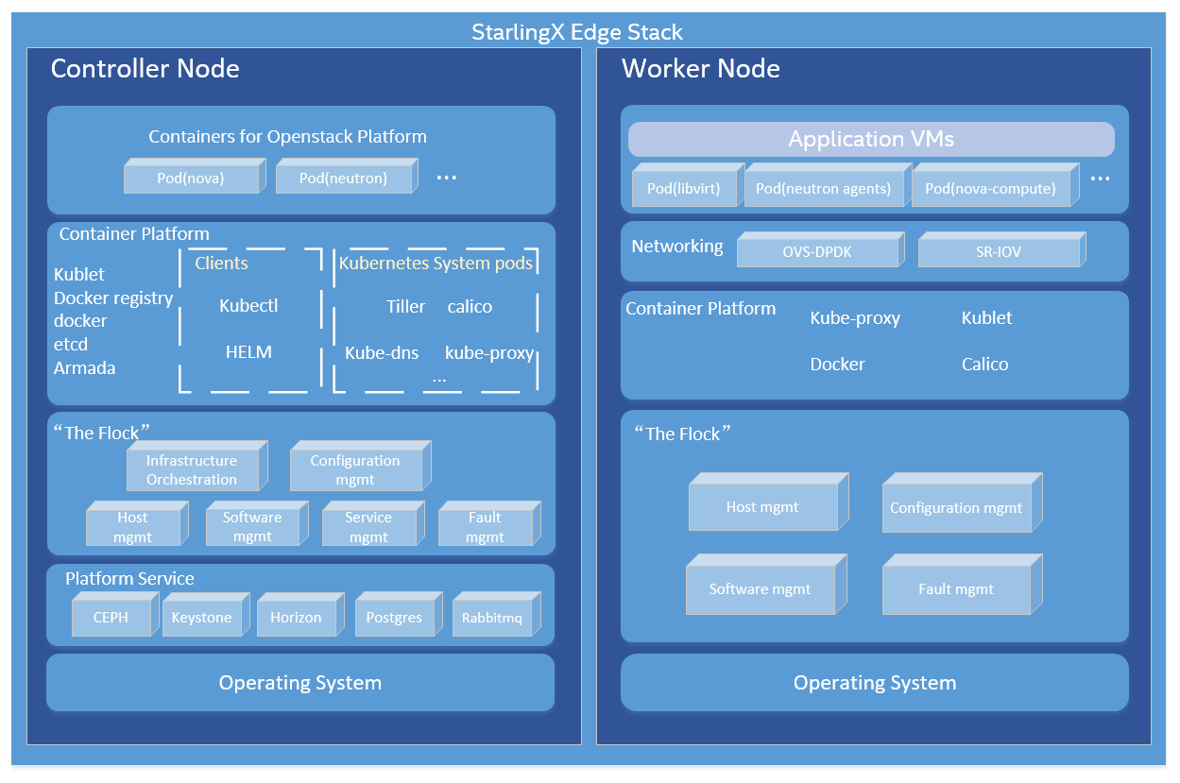
StarlingX
“A deployment-ready, scalable and highly reliable edge infrastructure software platform”

Slide 21
Evaluation of StarlingX
China Unicom, together with Intel, 99Cloud build a new ME-IaaS (Mobile Edge-Infrastructure as a Service) based on the StarlingX.^{[1]}
The approved Akraino blueprint that submitted by Tencent on connected vehicle has StarlingX proposed with TARS.^{[2]} StarlingX is also proposed to be used in another blueprint submitted by WR on Far Edge Distributed Cloud.^{[3]}
China Mobile Suzhou Software has evaluated StarlingX for its edge and cloud plan, and China Mobile Research Institute and Intel experimented vCPE onboarding on top of ONAP with StarlingX.
China Telecom Research Institute Guangzhou has evaluated StarlingX as a candidate for its edge solution
[1] Chinese ver: https://mp.weixin.qq.com/s/dlOpeo1Le5HEYCiSt3yUxg
[2] https://wiki.akraino.org/display/AK/StarlingX+Far+Edge+Distributed+Cloud
[3] https://wiki.akraino.org/display/AK/Connected+Vehicle+Blueprint

Slide 22
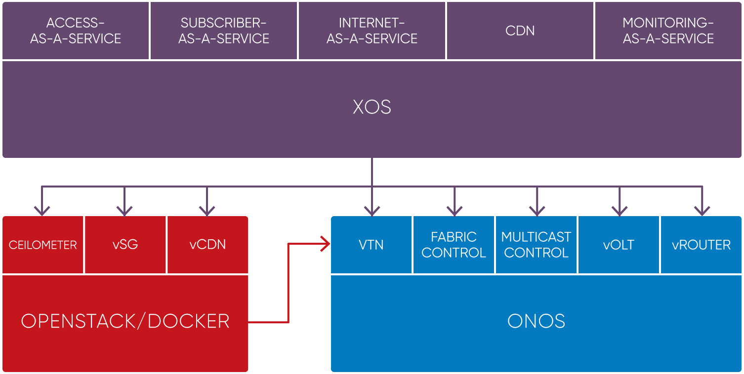
CORD
“Manage their Central Offices using declarative modeling languages for agile, real-time configuration of new customer services”
Notes:
Open virtualized service delivery platform that provides cloud economics and agility. Have three different sub-projects, residential, mobile and enterprise. It’s hoping that using this platform, it could fulfill needs of different subscribers no matter it is residential/enterprise or mobile. And for the inner software architecture, everything-as-a-service, user could apply different policies according to their need and extensible by design, like a framework for assembling and composing services. It is now using ONOS as the SDN which is implemented by services and also used by services such as openstack, and using XOS as the controller of the whole CORD platform.

Slide 23
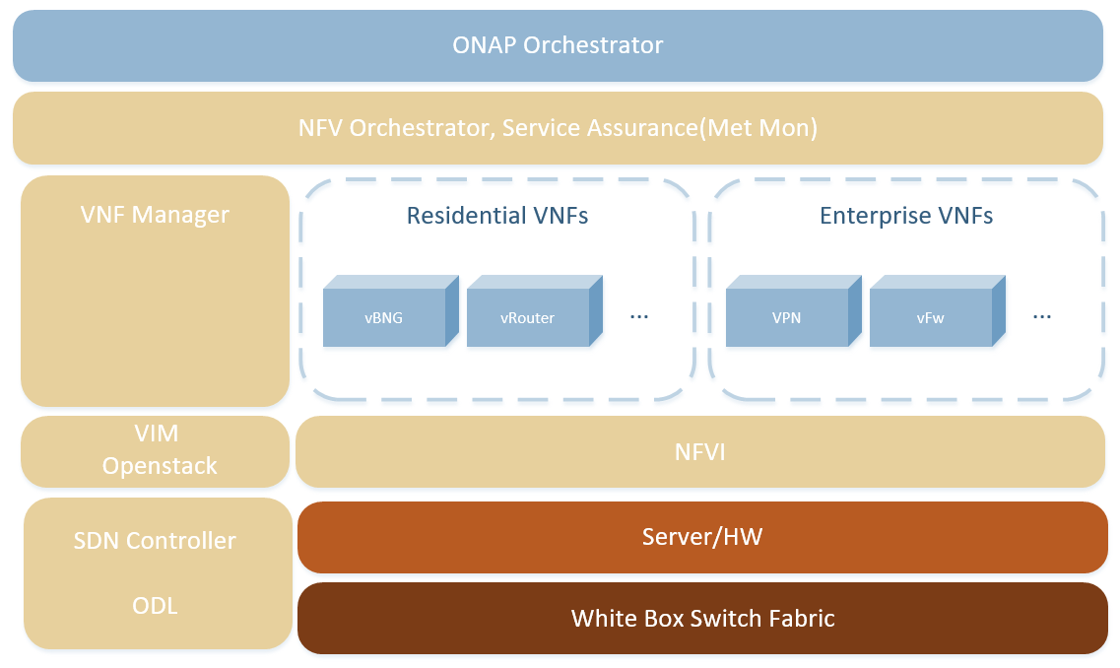
VCO
“Successfully completed two demos on residential, enterprise and mobile services ”

Slide 24
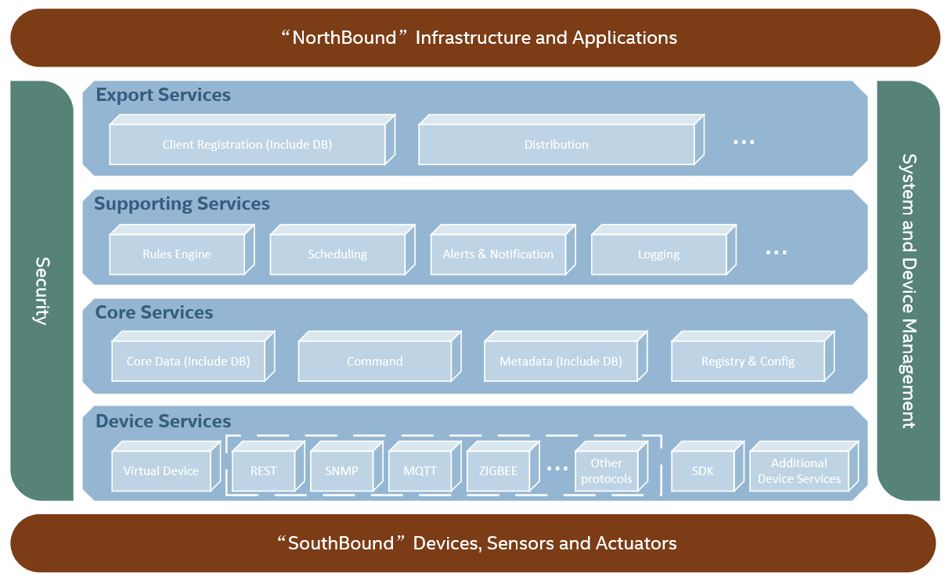
EdgeX Foundry
“Loosely coupled microservice framework with device management and various protocols supported”

Slide 25
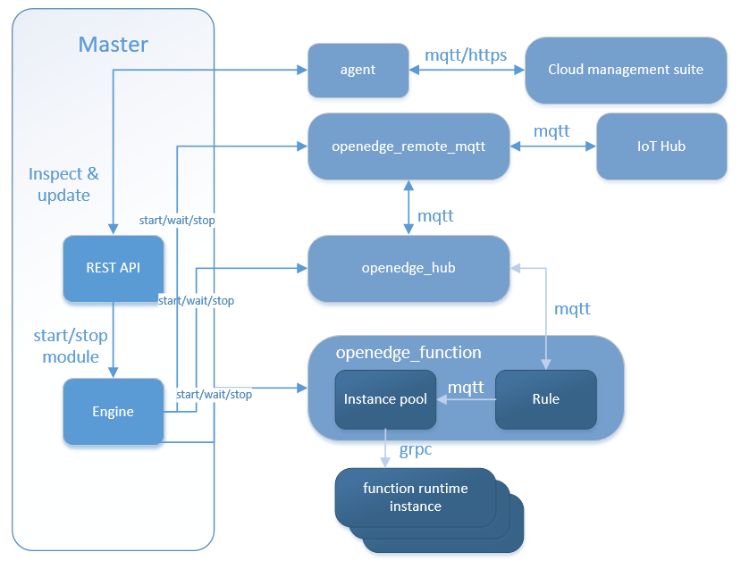
Open Edge
“Open edge computing framework that provide temporary offline, low-latency services, and include remote synchronization, function computing, video access pre-processing, AI inference, etc.”
Already support functions such as python 27, and compatible with Baidu CFC
Support both containerized mode and normal process mode

Slide 26
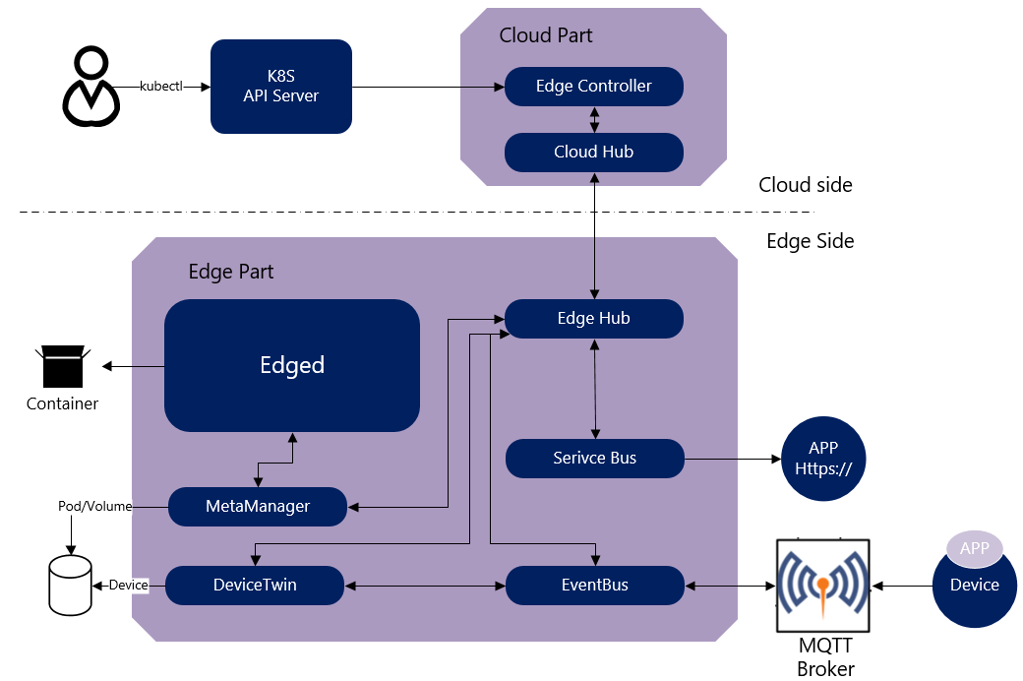
KubeEdge
“First Kubernetes Native Edge Computing Platform”
“Small footprint(66M and ~30MB needed for memory).”
“Easy to enable a mini-cloud at the edge”
Notes:
an open source system extending native containerized application orchestration and device management to hosts at the Edge. It is built upon Kubernetes and provides core infrastructure support for networking, application deployment and metadata synchronization between cloud and edge. It also supports MQTT and allows developers to author custom logic and enable resource constrained device communication at the Edge. KubeEdge consists of a cloud part and an edge part.

Slide 27
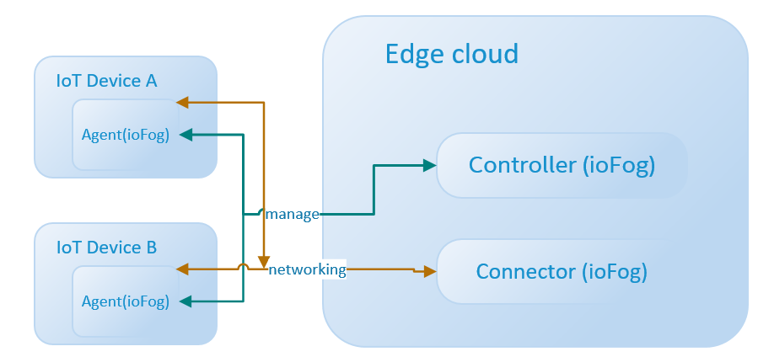
IoFog
“Deploying, running, and networking distributed microservices at the edge”
“Construct an Edge Compute Network (ECN) with Agent, Controller and Connector”
“Need to write microservices for one’s own purpose”

Slide 28
Glimpse of Edge Projects
Project | Foundation | Key Participators | Layer | Segment/Focus | MANO | SDN | Latest version | Infra | Code Repo
Akraino | Linux Foundation | AT&T, Intel, ARM, Nokia, Ericsson, Dell, Red Hat, Juniper, WRS, etc. | Umbrella, Full Stack | All-in-one edge stack | N/A | N/A | N/A | Openstack, K8S | http://gerrit.akraino.org
StarlingX | OpenStack Foundation | Wind River, Intel, Huawei, Ericsson, China Unicom, etc. | IaaS | Industrial IoT and MEC | ONAP | ODL | 1.0 | OpenStack | https://git.starlingx.io/cgit
Airship | OpenStack Foundation | AT&T, SKT, Intel, Mirantis, etc. | Deployment | Openstack on Kubernetes | ONAP/Tacker | Calico | 0.1 | OpenStack/K8S | https://git.airshipit.org/cgit
CORD | Linux Foundation | AT&T, SK Telecom, Verizon, China Unicom and NTT, etc. | IaaS | MEC for residential, enterprise & mobile | XOS | ONOS | 6.0 | OpenStack/K8S | https://github.com/opencord
vCO | Linux Foundation | Red Hat, China Mobile, etc. | IaaS | MEC for residential, enterprise & mobile | ONAP/Tacker | ODL | 2.0/3.0 | OpenStack | No code repo yet. Just POC

Slide 29
Glimpse of Edge Projects
Project | Foundation | Key Participators | Scope | Layer | Segment/Focus | Latest version | Code Repo
EdgeX Foundry | Linux Foundation | Dell, Vmware, etc. | Common framework for Edge solutions (SDK). | PaaS | Industrial IoT | 3.0 (4.0 expected in April 2019) | Go: https://github.com/edgexfoundry/edgex-go Java: https://github.com/edgexfoundry
OpenEdge | N/A | Baidu, etc. | Open edge computing framework | PaaS |  | 0.1.2 | https://github.com/baidu/openedge
KubeEdge | CNCF, Linux Foundation | Huawei, etc | Extend native containerized application orchestration capabilities at Edge | PaaS |  | 0.2 | https://github.com/kubeedge/kubeedge
Azure IoT Edge | N/A | Microsoft | Internet of Things (IoT) service that offload task to edge | PaaS | IoT | 1.0.8-dev | https://github.com/Azure/iotedge
ioFog | Eclipse Foundation | Edgeworx, etc. | Edge computing platform through microservice at edge | PaaS | IoT | 2.0/3.0 | https://github.com/ioFog/iofog.org
Eclipse Kura | Eclipse Foundation | Eurotech, Rad Hat, Comtrade, etc. | Platform for building IoT gateways, enabling remote management & app deployment | PaaS | IoT | 4.0 | https://github.com/eclipse/kura/

Slide 30
Summary

Slide 31
What’s the best for your edge?
EC implementations have difference on characteristics
Use case have their unique features and suitable implementation
Projects could be categorized into different implementations
Find the features of your USE CASE and choose the most appropriate implementation for that!

Slide 32
Thank You
Q&A

