Slide 1
Best Practice to Run Zuul on Kubernetes
NeilSun & XiaoZhou
EasyStack RD

Slide 2
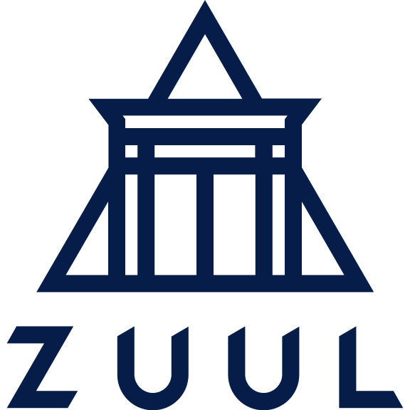
01
Before We Talking About Zuul...
02
Why Zuul?
03
Make Zuul More Flexible
04
Let's show it!

Slide 3
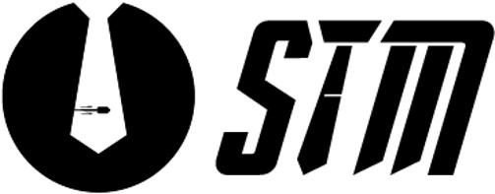
Before We Talking About Zuul...
CICD
=
No Fight Between Dev. Team& QA Team& Ops. Team
We Call it Suit-Mob

Slide 4
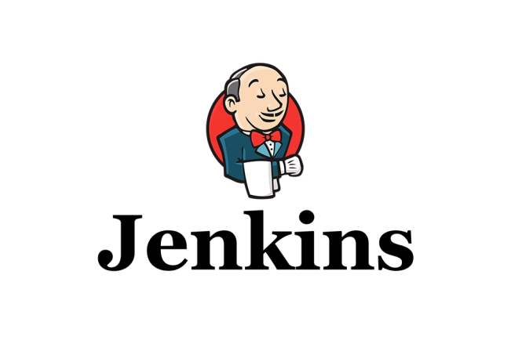
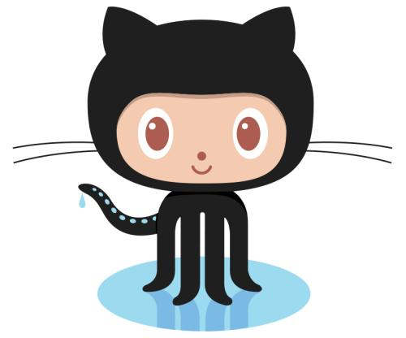
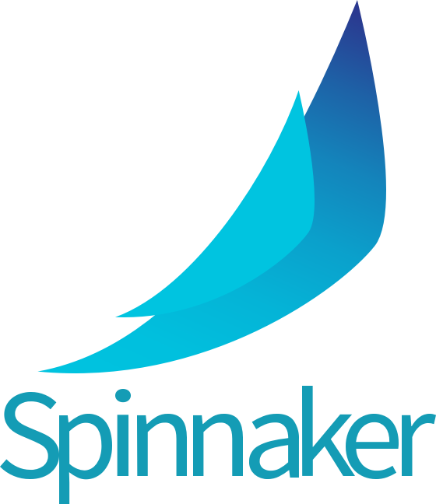
Before We Talking About Zuul...
How To Make It?
Notes:
And how can we make it happend? there are a serval of tools to achive that goal.
Jenkins is a old brand tools writed by Java, and it provide pipelines to plan users' jobs.
Spinnaker is a cloud native CICD platform, it can connect to kubernets and multicloud easily.

Slide 5
01
Before We Talking About Zuul...
02
Why Zuul?
03
Make Zuul More Flexible
04
Let's Demo!

Slide 6
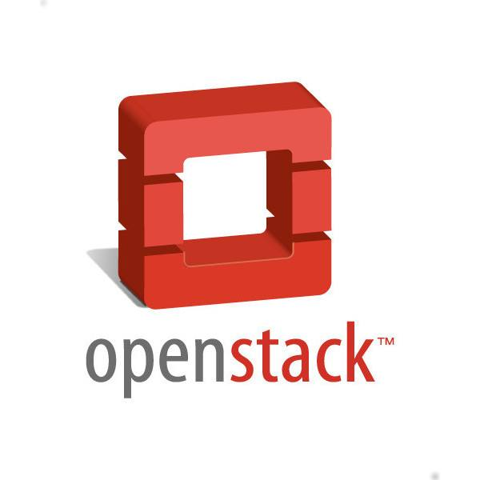
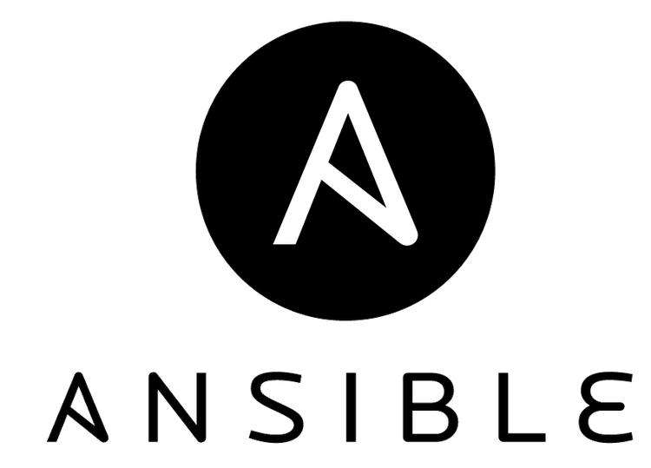
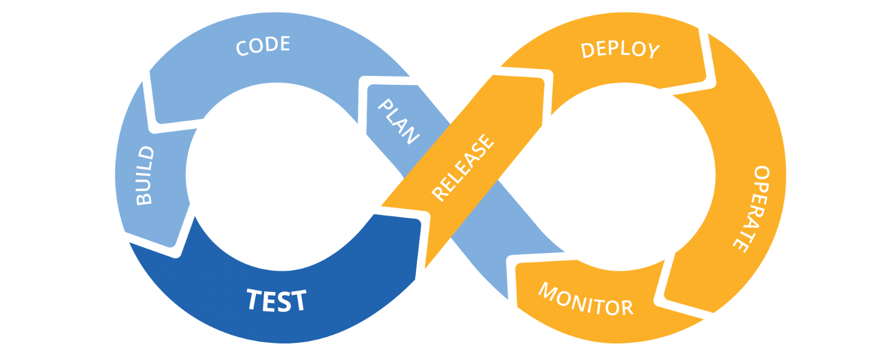
Why Zuul?
Why Zuul ?
Based on Ansible, High Scalability
Tested By OpenStack,
Powered by OpenStack VM Cluster by default
Multi-tenant, and Multi-Cloud Support
Not Only For Cloud Native, But Also For Everyone

Slide 7
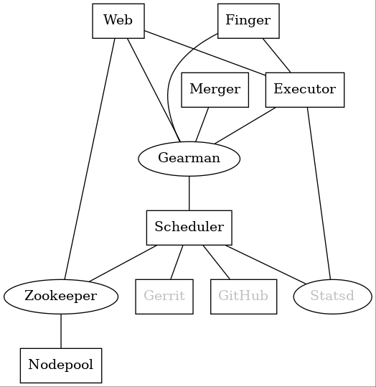
Why Zuul?
Architecturer Overview
Notes:
There are 4 main services in zuul,zuul-scheudler\merger\executor and web. and another is nodepool, it helps to lanch VM.
Onces a patch pushd, zuul-scheduler will be triggered, and chose a suitable nodes from nodepool, and send a message to executor via gearman, zuul executor will do jobs on nodes. Finally result will collect by finger services.

Slide 8
01
Before We Talking About Zuul...
02
Why Zuul?
03
Make Zuul More Flexible
04
Let's show it!
Notes:
福莱斯特宝
As we known, defualt zuul is running on openstack

Slide 9
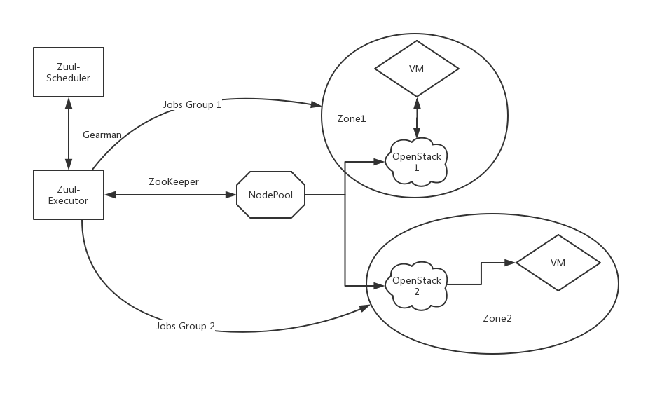
Make Zuul More Flexible
Zuul Run Jobs On OpenStack VM
Executor can access VM via FIP or Internal IP.
Notes:
Generally speaking, We run Zuul Jobs on OpenStack Virtual Machine, And besides, we can use more than one openstack cluster, one called zone1 and another will be zone2, and schedule will choose a suitable nods from nodepool server by zookeeper, and then, executor wiil play ansible jobs on openstack Virtual machine via floating IP or Internal IP if they are in the same subnet......
.....
You can define what zone to run jobs in your project-config, and jobs will run on your
Nodepool wiil lanch vm up to limit, and the ready vm will prepare for running jobs.
The problm is that if we run so mamy jobs at the same time, it wiil be queued ,and the result may be too slow

Slide 10
Make Zuul More Flexible
Thinking About K8S
1. More and more Microservices run on Kubernetes, Include OpenStack, Zuul jobs should support running on K8S to ensure the same environment between product and devlopment.
2.Starting a pod cost less than starting a VM.
3.Kubernetes has it's own slef recovery mechanism, that will help Zuul to achieve HA \ LB and upgrade.
Notes:
麦克雷僧

Slide 11
Make Zuul More Flexible
What's the gap
1. How Nodepool connect to Kubernetes, and control job pod lifecycle.
2.How Zuul executor connect to Kubernetes and run jobs on pods.
3.How to deploy Zuul on Kubernetes.

Slide 12
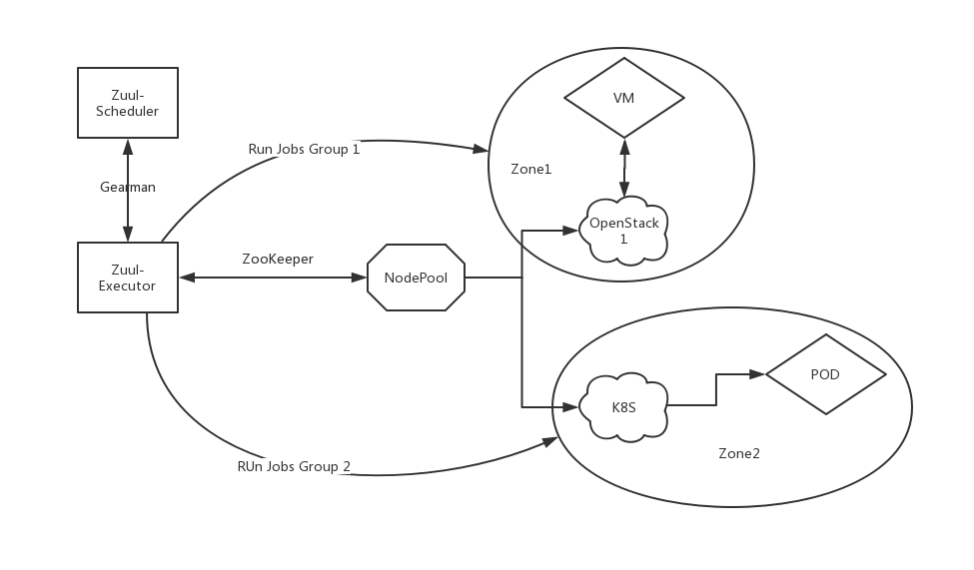
Make Zuul More Flexible
Zuul Run Jobs On Kubernetes
1.Ansible provides kubectl connection,
Zuul executor can access K8S pod by kubectl.
2.handle a pod as a virtual machine.*
Notes:
This picture explains how to zuul run jobs on k8s,
when a patch in review, it will trigger CICD workflow, and zuul-scheduler will chose a VM or a pod to run jobs.
you can config which cluster to run jobs in your project-config yaml.
and then executor will use ansible to connect to pod,
ansible and 2 ways to connect to pod:
use kubeclt or handler a pod as virtual machine, and use ssh to connect to,
we'd better to choose kubectl rather than ssh, it wiil be easily ,and users needn't to care about their network env.

Slide 13
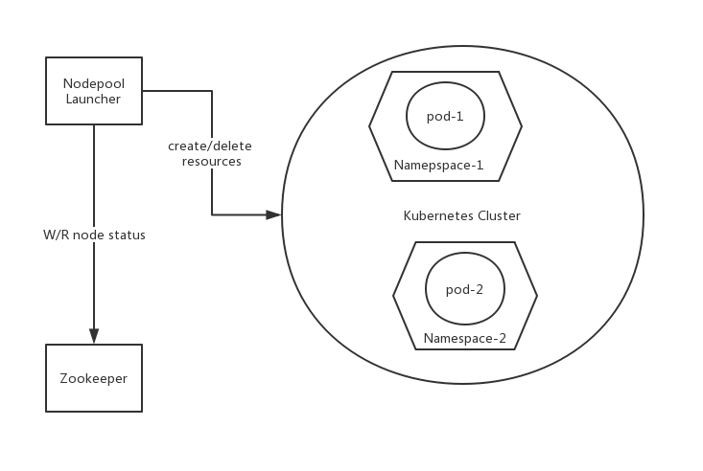
Make Zuul More Flexible
How NodePool controls pod lifecycle
Notes:
1. Nodepool Kubernetes driver use Python Kubernetes SDK to interact with Kubernetes.
2. Nodepool will launch pods, namespaces, and each pod monopolizes one namespace.
3. Nodepool creates a serval of Kubernetes resources, like Serviceaccount, Role and Rolebinding for each namespace.
4.Zuul will get certification information and user token that created by Nodepool, and create {JOB_DIR}/work/.kube/config for Ansible kubectl connector.
5.Finally, Nodepool will delete all resources in appoint namespace and namespace itself, when job finished.

Slide 14
Make Zuul More Flexible
How NodePool controls pod lifecycle
1. Nodepool Kubernetes driver use Python Kubernetes SDK to interact with Kubernetes.
2. Nodepool will launch pods, namespaces, and each pod monopolizes one namespace.
3. Nodepool creates a serval of Kubernetes resources, like Serviceaccount, Role and Rolebinding for each namespace.
4.Zuul will get certification information and user token that created by Nodepool, and create {JOB_DIR}/work/.kube/config for Ansible kubectl connector.
5.Finally, Nodepool will delete all resources in appoint namespace and namespace itself, when job finished.
Notes:
木闹普耐c斯

Slide 15
Make Zuul More Flexible
Some details you should care
1. We are using Zuul v3.7.0, early version may not support.
2. Make sure your ansible version is v2.5 or later(Upstram Zuul will automatic install ansible latest version )
3.Some playbook options may not support by ansible kubectl connection, like synchronize or remote unarchive, etc... You may need to change them to cp or kubectl shell option.
Notes:
木闹普耐c斯

Slide 16
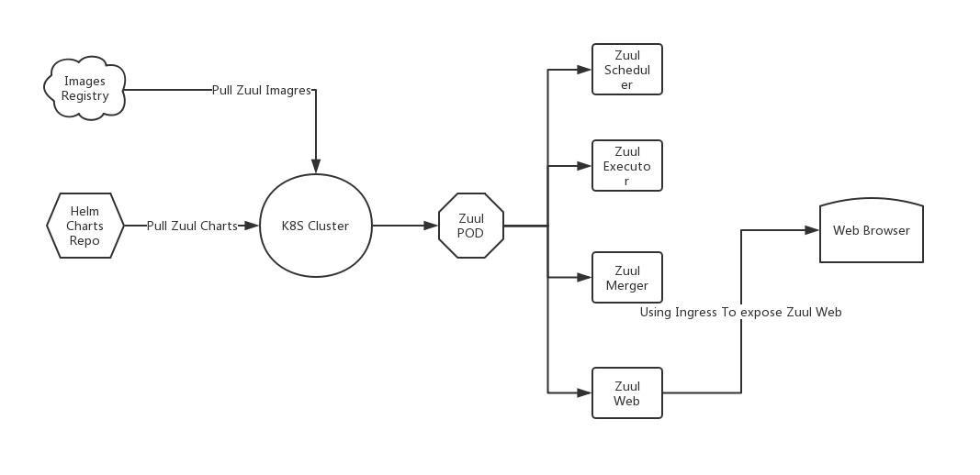
Make Zuul More Flexible
What's Next?
Notes:
Finally, we hope to make zuul run on k8s itself, we choose to use helm charts to deploy zuul and nodepool services ,and pull zuul-images from docker registry, Onces helm upgrade command triggered, zuul wiil pull the latest image and latest charts from repos.
We choose to use four containers in one pod to deploy our zuul service, the benfit is that the projects will be storage in the disk, and needn't cloning again, and since zuul service are all stateless, we can aslo split them.
And K8S ingress service will expose zuul web port, so that users can access zuul web from web browser.

Slide 17
Make Zuul More Flexible
Let's Demo !

Slide 18
EasyStack Team

Slide 19
Make Zuul More Flexible

