Slide 1
Vitrage
November 2018
Project Update, OpenStack Summit Berlin
Muhamad Najjar, muhamad.najjar@nokia.com

Slide 2
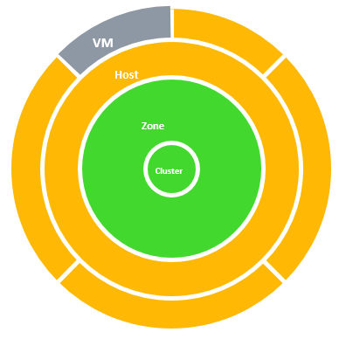
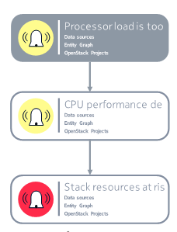
What is Vitrage?
The OpenStack Root Cause Analysis service
Vitrage is used for organizing, analyzing and expanding OpenStack alarms & events.
Root Cause Analysis
Deduced alarms and states – alarms based on system insights
Holistic and complete view of the system

Slide 3

Project Background
        Founded three years ago
        An official OpenStack project within six months
        First official release – Newton
        Today – stable, mature, running in production
        ~10 active contributors in Rocky

Slide 4

Rocky Features

Slide 5
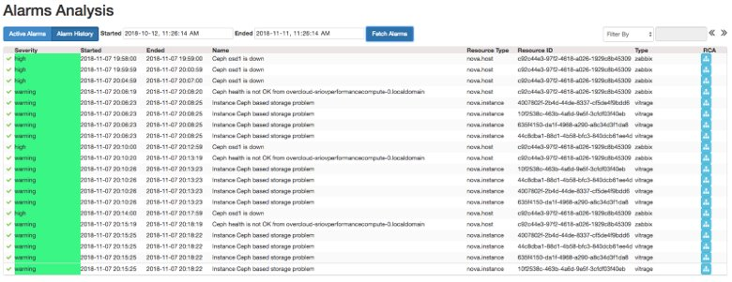
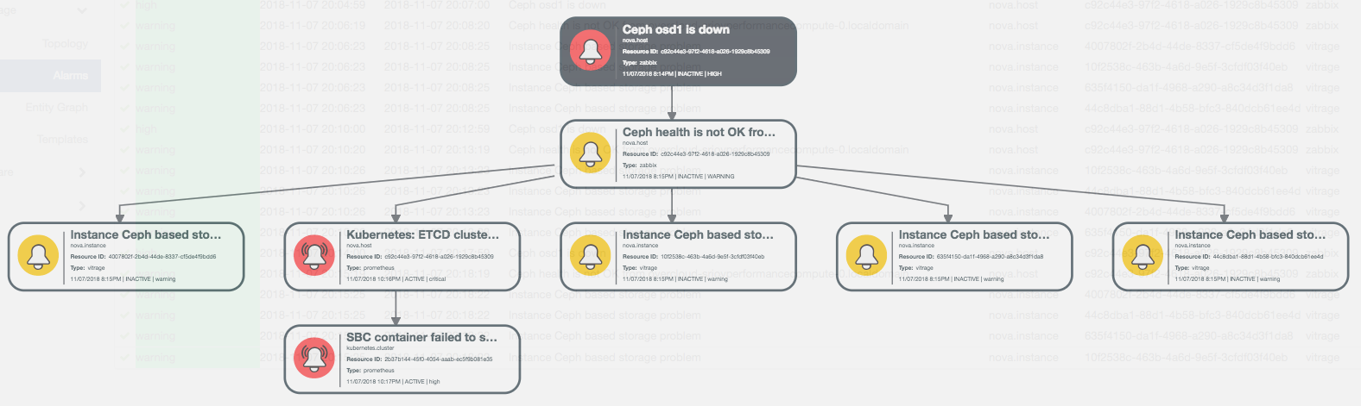
Alarm History
        Motivation
        Root Cause Analysis of yesterday’s alarms
        Alarm statistics
        Future - machine learning

Slide 6
Alarm History
        Implementation
        History in Relational database (MariaDB)
        Store only basic information (alarm + resource id)
        Query time slices

Slide 7
Fast Failover for Enhanced High Availability
  Past releases:
    After restart, graph was rebuilt from scratch
    Inefficient datasources + large graph => long startup
  In Rocky:
    Graph state is stored in relational database
      Snapshot after each get_all
      Events after the snapshot
    Upon restart, reload graph from database
MariaDB

Slide 8
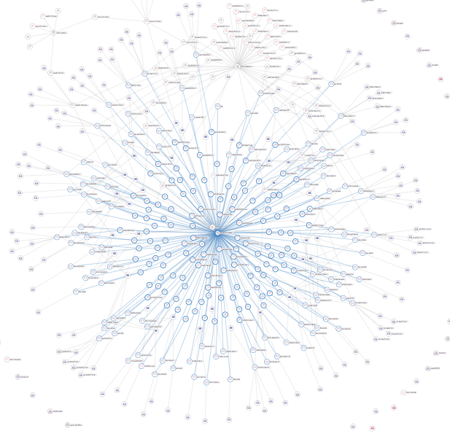

High-Scale & Performance
  Significant performance improvements
  Graph was tested to work with over 100,000 entities
  To be continued

Slide 9
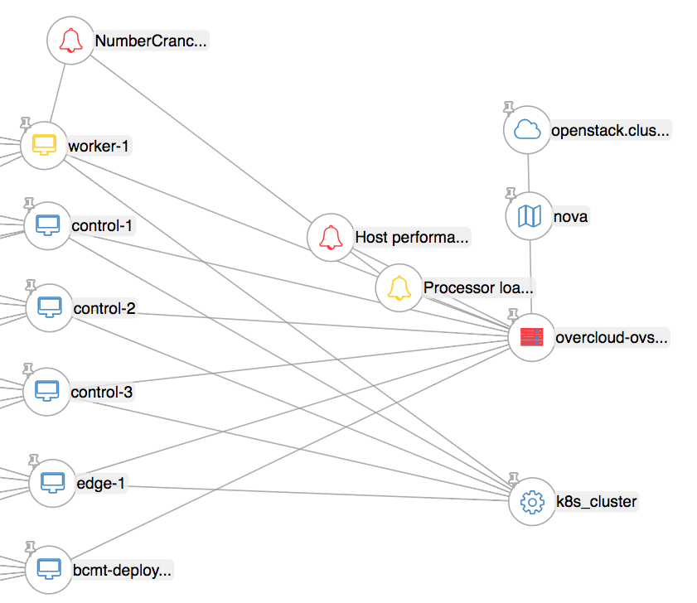
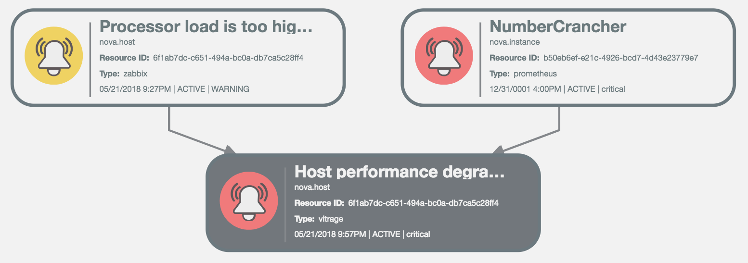
Kubernetes and Prometheus Datasources
  Kubernetes – topology datasource
  Prometheus – Kubernetes related alarms

Slide 10
Stein Features

Slide 11
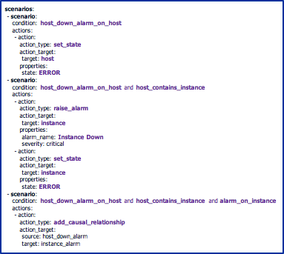

Easier Template Generation
        Goals
        Easy to write typical templates
        Complex syntax for complex templates
        Typical template: Host affects instance

Slide 12

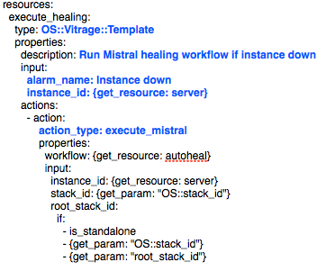
Configure Vitrage from Heat Templates
        Motivation
        Support self-healing scenarios
        Goals
        Easy configuration of Vitrage from Heat
        Reuse common topology patterns
        Minimal input required from the user

Slide 13
Improve Vitrage Topology API
        Primary goal: reduce API memory consumption
        Support detailed queries that return less information
        Support paging (how?)
        Future: query language for complex queries
        all hosts that have a vm in error state

Slide 14
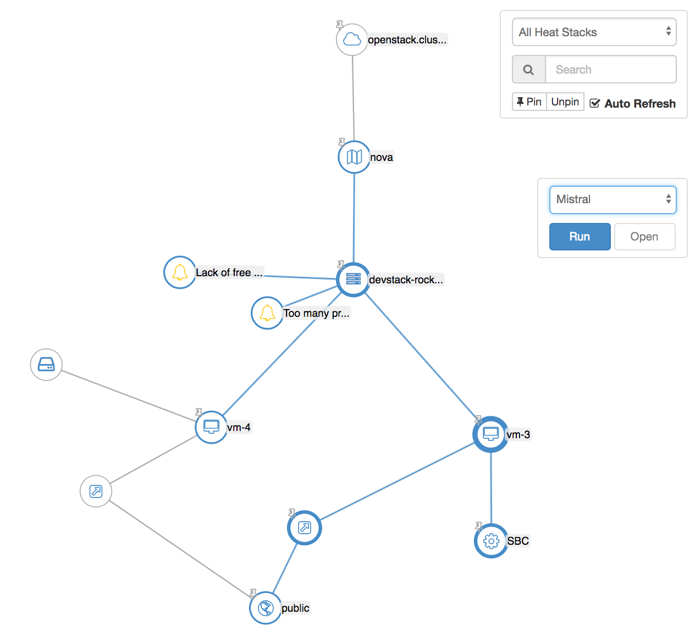
Entity Graph Action Panel
  Run an action from a list
  Action type depends on the selection

Slide 15
Other Stein Features
        Refactor vitrage-tempest-plugin
        Support upgrade
        Trove datasource
        Additional integrations – if time permits
          Monasca
          Zaqar

Slide 16

Cross-Project Work
  Self-healing SIG (Special Interest Group)
  “coordinate several OpenStack projects … reacting to failures and other events by automatically healing services”
  Vitrage & Congress – done (Rocky)
  Vitrage as part of Heat templates – in progress
  Vitrage & Monasca – future

Slide 17


Vitrage in NGPaaS
  The NGPaaS project is an innovation project in Phase 2 of the 5G Public Private Partnership (5GPPP), and funded under the Horizon 2020 Framework Programe of the European Commission
  Vitrage development for NGPaaS
      In Rocky: Kubernetes and Prometheus datasources
      In Stein: support PODs topology?

Slide 18
Contact Us
Vitrage wiki page: https://wiki.openstack.org/wiki/Vitrage
Official documentation: https://docs.openstack.org/vitrage/latest/
Vitrage IRC channel: #openstack-vitrage
OpenStack mailing list – use [vitrage] tag

Slide 19
Q&A
Thank you!
openstack
openstack
OpenStackFoundation

