Slide 1
Vitrage hands-on lab
Muhamad Najjar, Marina Koushnir
CloudBand, Nokia
14-November-2018

Slide 2
Lab Flow
Introduction to Vitrage
Getting started – Vitrage CLI and UI
Vitrage Integration with Prometheus and Kubernetes
Vitrage templates
Summary
Q&A
Link for instructions – https://pastebin.com/TxkxP4qw

Slide 3
Lab Flow
Introduction to Vitrage
Getting started – Vitrage CLI and UI
Vitrage Integration with Prometheus and Kubernetes
Vitrage templates
Summary
Q&A
Link for instructions – https://pastebin.com/TxkxP4qw

Slide 4
Introduction to Vitrage – Root Cause Analysis Service
Project background
Started 3 years ago, during the Mitaka cycle
Became an official project 6 months later
First official version – Newton
~10 active contributors in the Rocky release

Slide 5
Vitrage Functionality
Vitrage is the OpenStack RCA (Root Cause Analysis) service for:
Organizing OpenStack alarms & events
Analyzing them
Expanding the knowledge based on alarms & events
Vitrage's ultimate goals are:
To give users a complete view of the structure and state of their cloud
Allow them to address issues in a timely and effective fashion

Slide 6
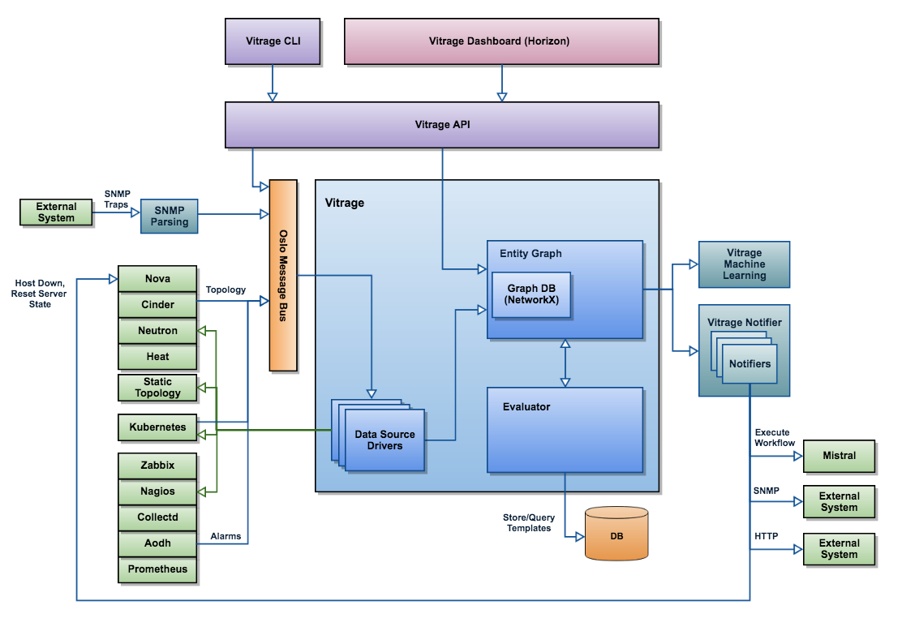
Vitrage High Level Architecture
API, CLI, UI
Graph
Datasources
Evaluator
Notifiers
Templates

Slide 7
Lab Flow
Introduction to Vitrage
Getting started – Vitrage CLI and UI
Vitrage Integration with Prometheus and Kubernetes
Vitrage templates
Summary and Q&A
Link for instructions – https://pastebin.com/TxkxP4qw

Slide 8
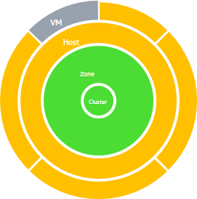
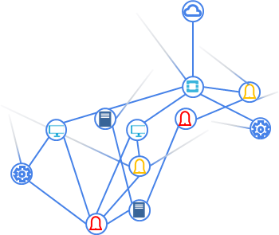
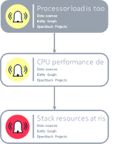
What does Vitrage UI Include?
Entity Graph
Represents the relationships between the different entities
Topology Graph
Represents system health, allowing to focus on failing resources
Visualized RCA
Root cause analysis between alarms in the graph

Slide 9
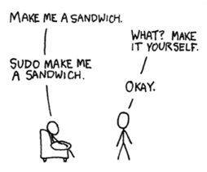
Vitrage CLI
Vitrage topology show
vitrage alarm list/show/count
vitrage template list/show/add/delete
vitrage rca show
vitrage resource list/show
vitrage webhook add/delete/list/
show

Slide 10
Vitrage CLI
vitrage topology show
vitrage alarm list/show/count
vitrage rca show
vitrage template list/show/add/delete
vitrage resource list/show
vitrage webhook add/delete/list/show

Slide 11
LAB
Get available IP
https://etherpad.openstack.org/p/osa-ny1.b
Instructions
https://pastebin.com/TxkxP4qw

Slide 12
Lab Flow
Introduction to Vitrage
Getting started – Vitrage CLI and UI
Vitrage Integration with Prometheus and Kubernetes
Vitrage templates
Summary n’ Q&A
Link for instructions – https://pastebin.com/TxkxP4qw

Slide 13
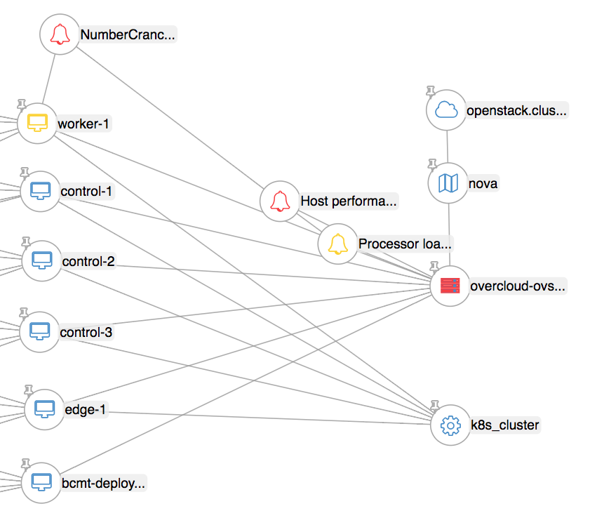
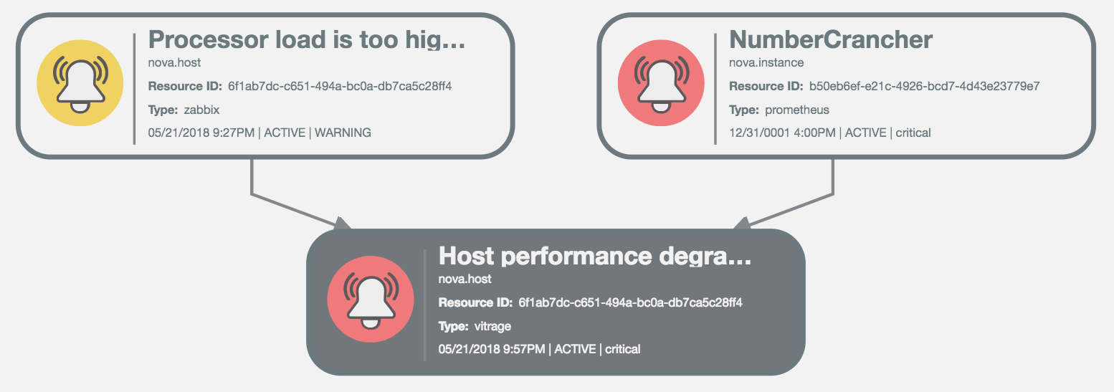
Vitrage Integration with Prometheus and Kubernetes
Kubernetes – topology datasource
Prometheus – Kubernetes related alarms

Slide 14
LAB

Slide 15
Lab Flow
Introduction to Vitrage
Getting started – Vitrage CLI and UI
Vitrage Integration with Prometheus and Kubernetes
Vitrage templates
Summary n’ Q&A
Link for instructions – https://pastebin.com/TxkxP4qw

Slide 16
Vitrage Templates
YAML file
Defines actions to be taken based on system topology & alarms
Added/modified by user
Each template can contain one or more scenarios
Supports the following operations (“scenarios”)
if <condition> then raise deduced alarm
if <condition> then set deduced state
if <condition> then add causal relationship (used for RCA capability)
if <condition> then execute Mistral workflow

Slide 17
Vitrage Templates
The template is written in YAML language, with the following structure:
metadata: ...
definitions:
entities:
- entity: ...
- entity: ...
relationships:
- relationship: ...
- relationship: ...
scenarios:
scenario:
condition: <if statement true do the action>
actions:
- action: ...
Condition building-blocks
Actions defined based on the building blocks

Slide 18
Vitrage Templates – Deduced Alarm Example
If a host is in state ERROR, raise an alarm of type host_in_error
metadata:
version: 2
type: standard
name: raise_alarm_for_host_errors
description: host in error raises alarm
definitions:
entities:
- entity:
category: RESOURCE
type: nova.host
state: ERROR
template_id: host_in_error
scenarios:
scenario:
condition: host_in_error # uses template_id
actions:
- action:
type: raise_alarm
target:
target: host_in_error # uses template_ids
properties:
alarm_type: host_malfunctioning # any string
severity: critical

Slide 19
Evaluator
Scenarios are evaluated upon system events
Scenario conditions are represented as small graphs
Upon event, the evaluator:
Retrieves scenarios relevant to event
Evaluates condition using sub-graph matching algorithm
Executes actions for each matched condition

Slide 20
LAB

Slide 21
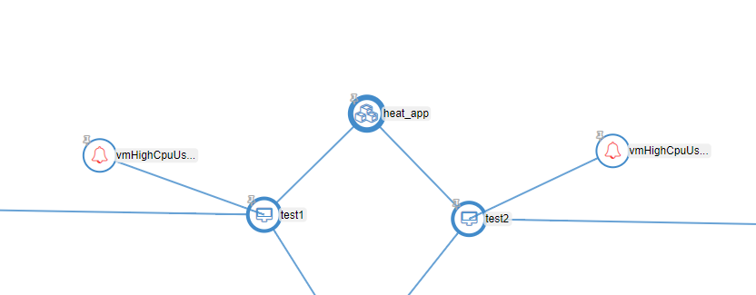

Slide 22
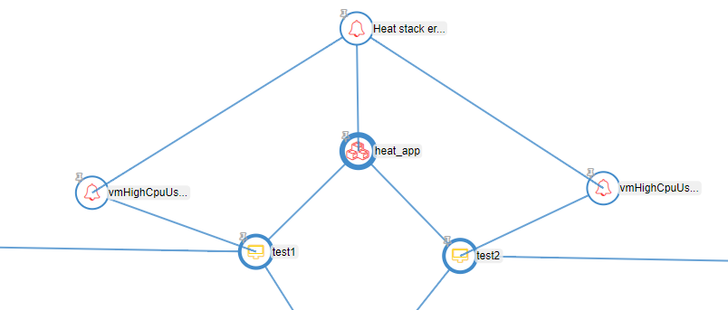

Slide 23
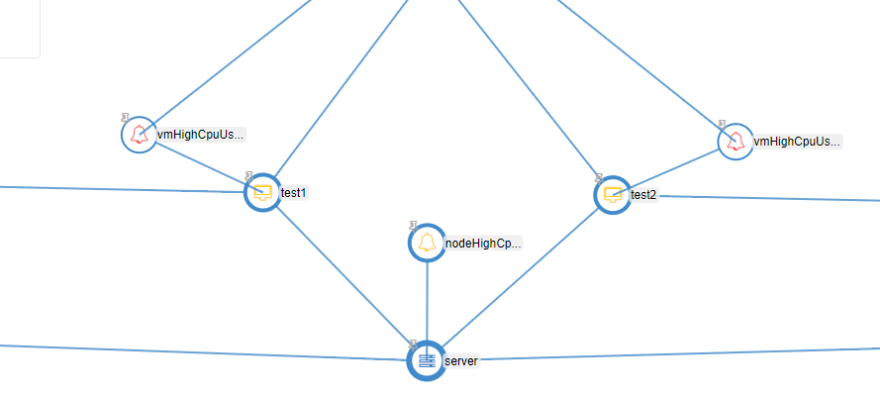

Slide 24
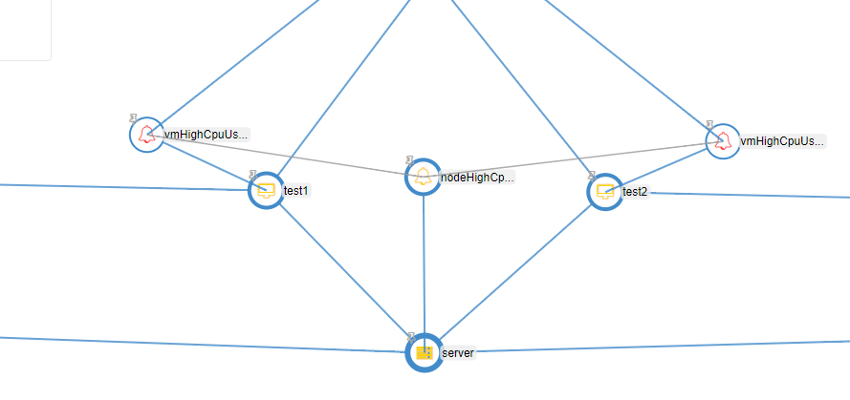

Slide 25
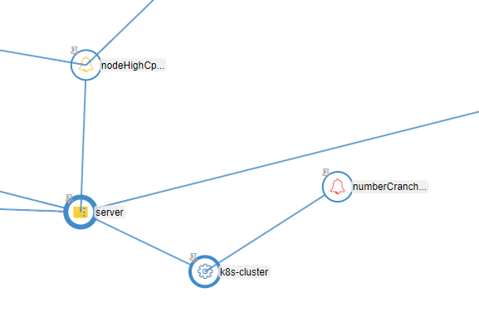

Slide 26
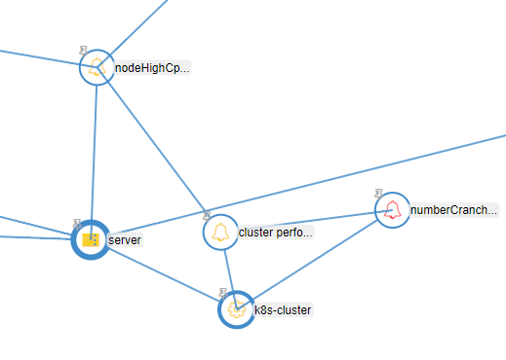

Slide 27
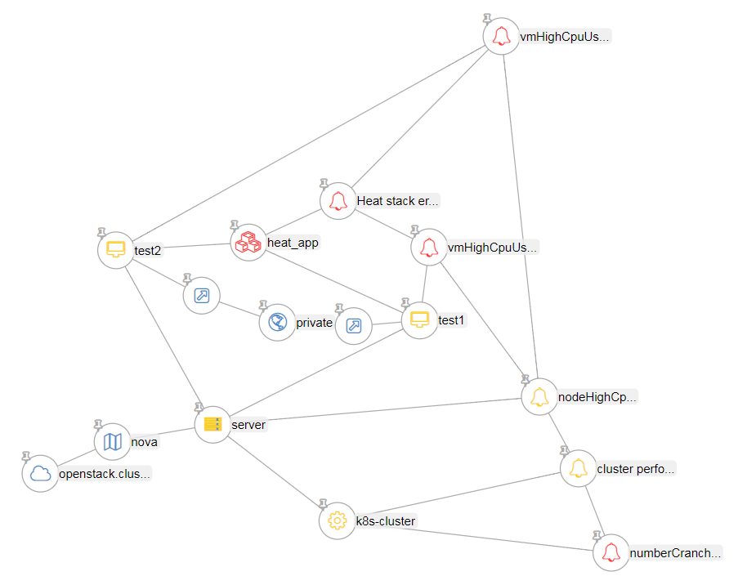

Slide 28
Summary – Things We Learned Today
How to effectively use Vitrage for fault management scenarios
Vitrage functionality
Vitrage architecture
Vitrage configuration - how to adjust it to your needs
Vitrage integration – Prometheus and Kubernetes

Slide 29
Questions

Slide 30
Come Join Us!
More Vitrage sessions in the coming days...
Vitrage wiki page: https://wiki.openstack.org/wiki/Vitrage
Official documentation: https://docs.openstack.org/vitrage/latest/
Contact info:
Email openstack-dev@lists.openstack.org with [vitrage] tag
IRC channel: #openstack-vitrage
Weekly IRC meeting: Wednesday at 8:00 UTC on #openstack-meeting-4

