Slide 1
Cinder and NVMe-over-Fabrics
Network-Connected SSDs with Local Performance
Tushar Gohad, Intel
Moshe Levi, Mellanox
Ivan Kolodyazhny, Mirantis

Slide 2
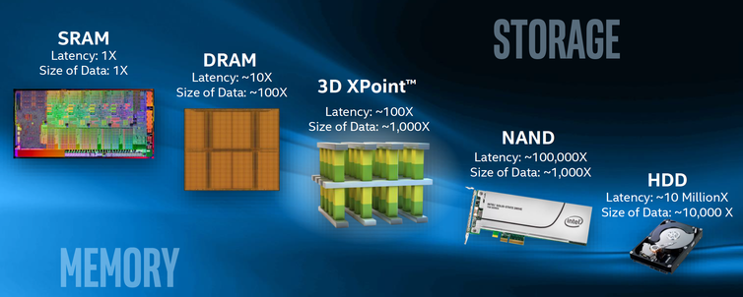
Storage Evolution
Technology claims are based on comparisons of latency, density and write cycling metrics amongst memory technologies recorded on published specifications of in-market memory products against internal Intel specifications.

Slide 3
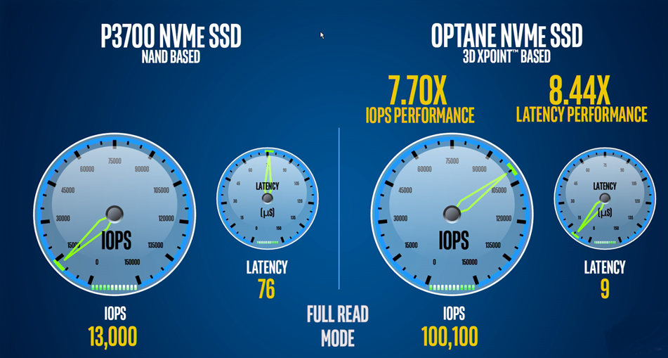
Intel 3D XPoint* Performance at QD=1

Slide 4
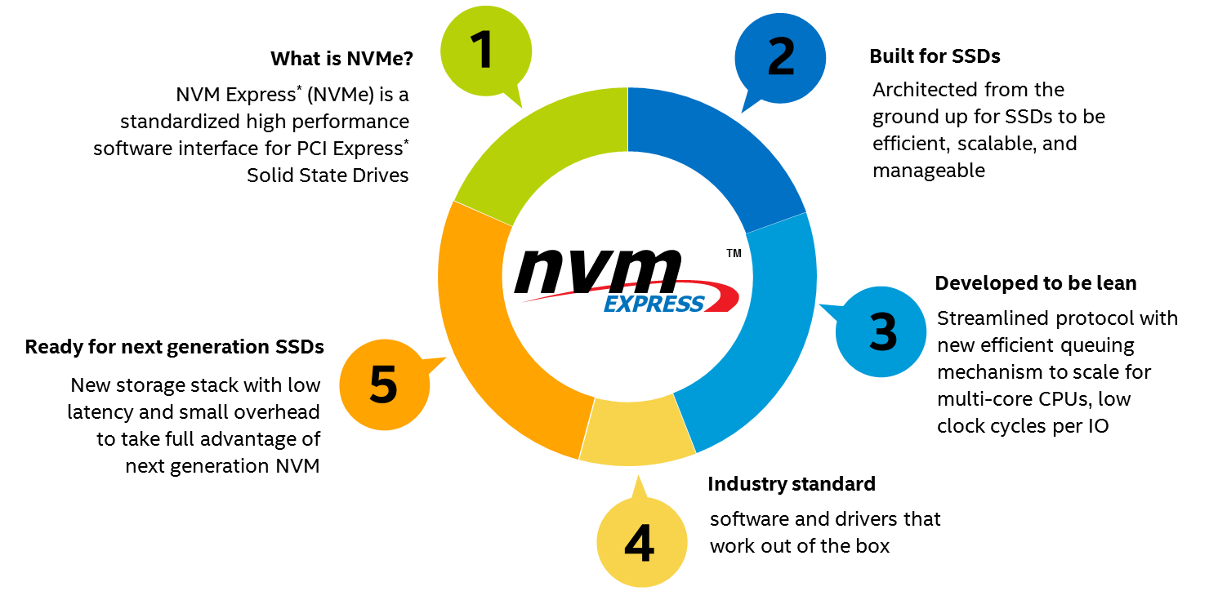
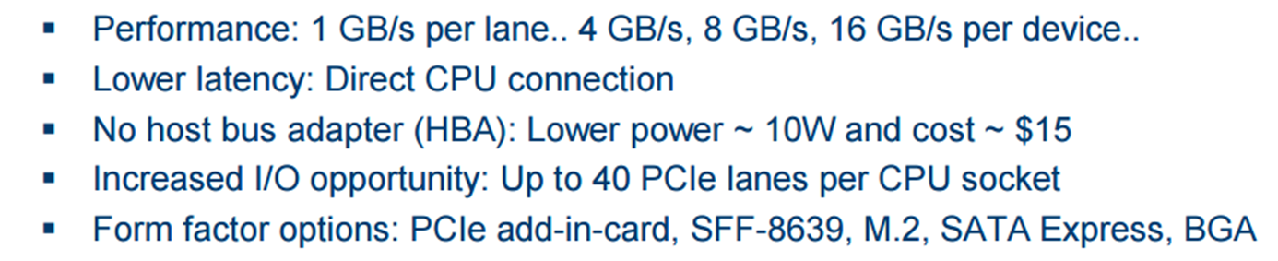
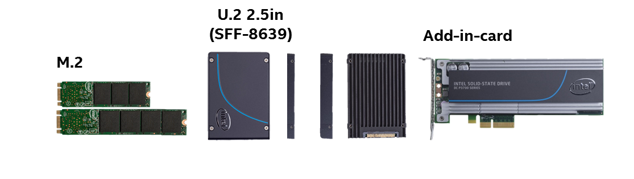
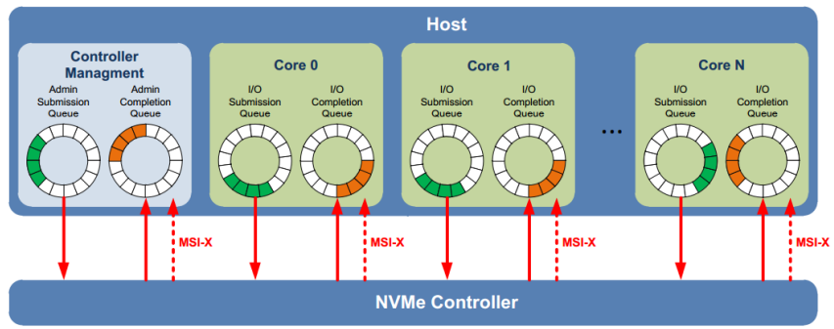
NVM Express (NVMe)
Standardized interface for non-volatile memory, http://nvmexpress.org
Source: Intel. Other names and brands are property of their respective owners. Technology claims are based on comparisons of latency, density and write cycling metrics amongst memory technologies recorded on published specifications of in-market memory products against internal Intel specifications.
Notes:
NVM Express is an interface specification optimized for PCI Express® based storage solutions, such as solid-state drives. The NVMe 1.0 specification defines a scalable architecture that unlocks the potential of PCIe-based SSDs. With a throughput improvement of 6x and reduced storage latency over 6 Gbps SATA SSD, the Intel SSD PCIe Family increases processor utilization while scaling to meet demand.
NVM Express revolutionizes storage by delivering faster access to data and lowering latency and power consumption. NVM Express reduces latency, is achieved by eliminating the delay associated with memory adapters and optimizing the storage protocol that has limited SSD performance until now. NVMe reduces the number of layers in the storage protocol stack. Storage commands are processed with 60% fewer processor cycles and 60% less latency. These freed up processing cycle can now be used for real application workload, improving the efficiency of the processor.
NVMe delivers higher input/output operations per second (IOPS) and reduces power consumption for a lower total cost of ownership.
Segway: Intel sets itself apart from others by delivering the PCIe Family optimized for today’s mixed workload applications

Slide 5
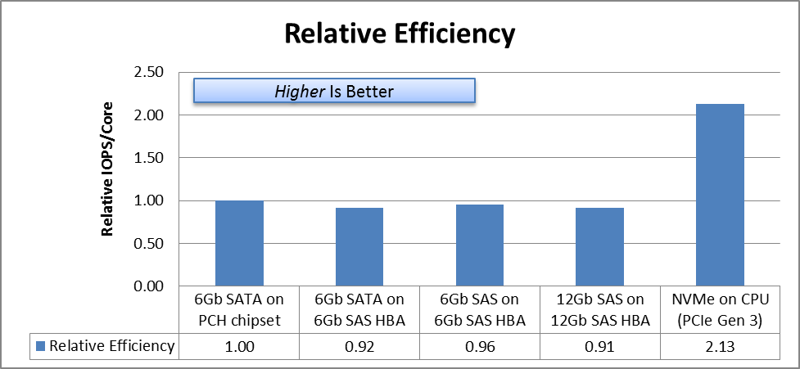
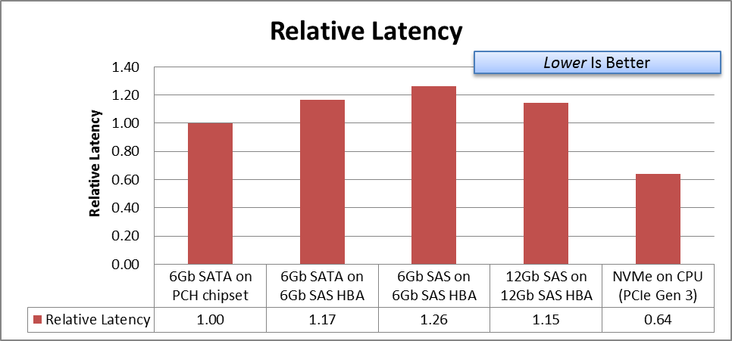
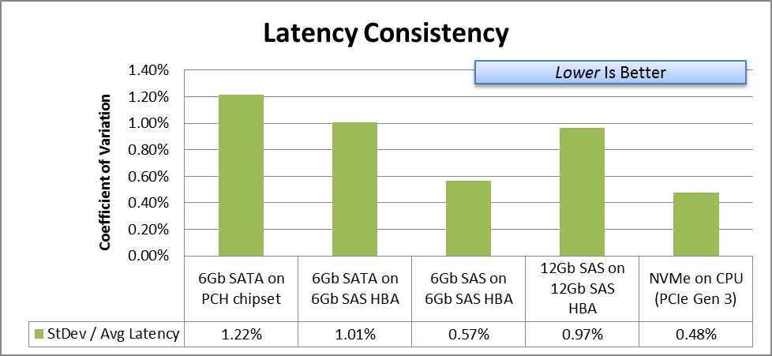
NVMe: Best-in-Class IOPS, Lower/Consistent Latency
3x better IOPS vs SAS 12Gbps
For the same #CPU cycles, NVMe delivers over 2X the IOPs of SAS!
Lowest Latency of Standard Storage Interfaces
Gen1 NVMe has 2 to 3x better Latency Consistency vs SAS
Test and System Configurations: PCI Express* (PCIe*)/NVM Express* (NVMe) Measurements made on Intel® Core™ i7-3770S system @ 3.1GHz and 4GB Mem running Windows* Server 2012 Standard O/S, Intel PCIe/NVMe SSDs, data collected by IOmeter* tool. SAS Measurements from HGST Ultrastar* SSD800M/1000M (SAS), SATA S3700 Series. For more complete information about performance and benchmark results, visit http://www.intel.com/performance. Source: Intel Internal Testing.

Slide 6
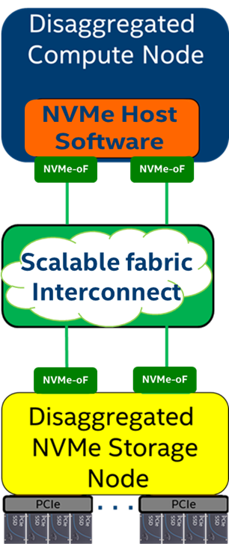
Remote Access to Storage – iSCSI and NVMe-oF
Network
Disaggregated
Cloud Deployment Model
NVMe-over-Fabrics
  NVMe commands over storage networking fabric
NVMe-oF supports various fabric transports
  RDMA (RoCE, iWARP)
  InfiniBand™
  Fibre Channel
  Intel® Omni-Path Architecture
  Future Fabrics
iSCSI
Target
NVMe-oF*
Target
SCSI
NVMe
Block Device Abstraction (BDEV)
Block Device Abstraction (BDEV)
SCSI
Devices
NVMe
Devices

Slide 7
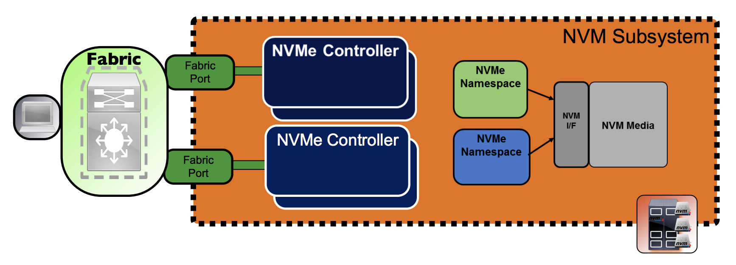
NVMe and NVMe-oF Basics
Notes:
Namespaces - mapping of NVM Media to a formatted LBA range
Subsystem Ports are associated with Physical Fabric Ports
Multiple NVMe Controllers may be accessed through a single port
NVMe Controllers are associated with one port
Fabric Types; PCIe, RDMA (Ethernet RoCE/iWARP, InfiniBand™), Fibre Channel/FCoE

Slide 8
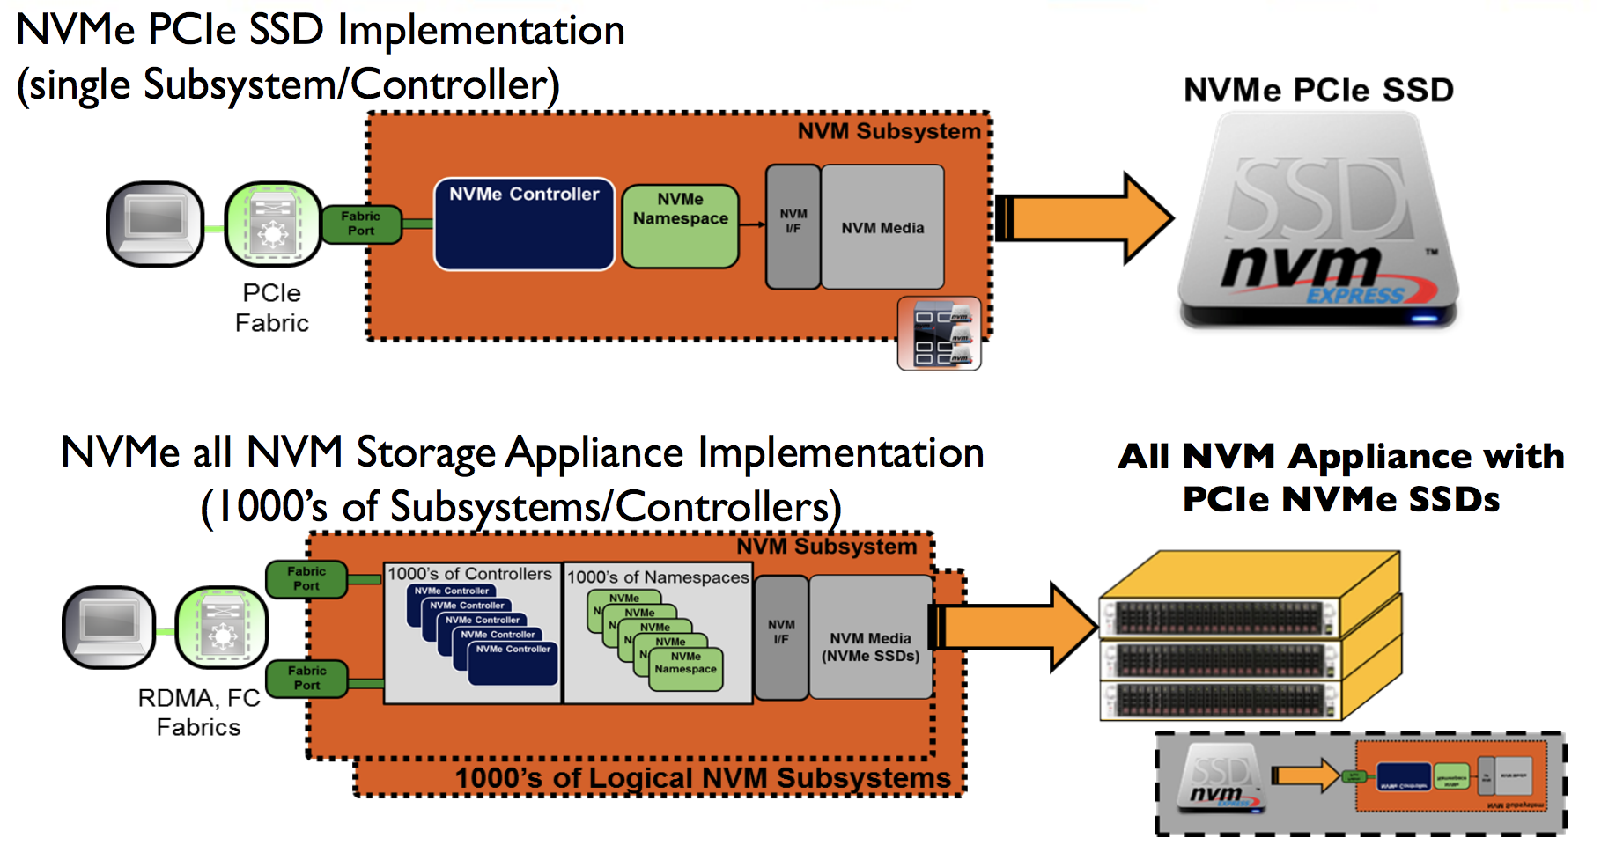
NVMe Subsystem Implementations including NVMe-oF

Slide 9
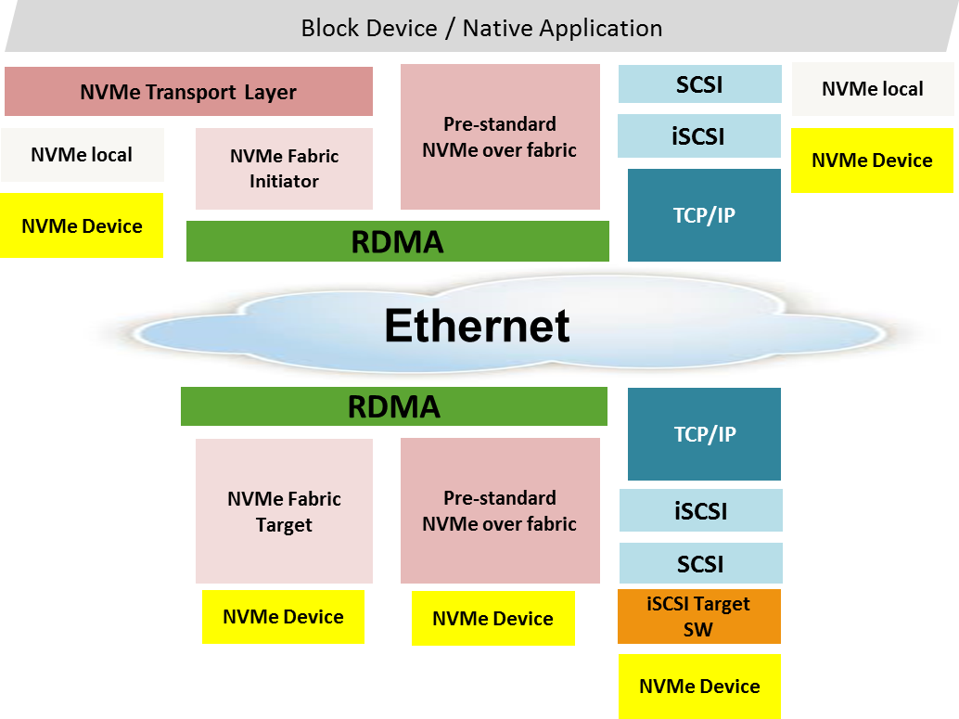

NVMe-oF: Local NVMe Performance
The idea is to extend the efficiency of the local NVMe interface over a network fabric
  Ethernet or IB
  NVMe commands and data structures are transferred end to end
Relies on RDMA for performance
  Bypassing TCP/IP
For more Information on NVMe over Fabrics (NVMe-oF)
  http://www.nvmexpress.org/wp-content/uploads/NVMe_Over_Fabrics.pdf
Notes:
How NVMeOF Maintain the NVME Performance.
So the NVME interface is very efficient and lightweight that moves the bottle neck form the disk to the network.
To keep the same performance as local NMVE interface we need a fast with low latency protocols.
And that is were RDMA comes to the rescue.
We have RDAM over Converged Ethernet (RoCE) and RDAM over InfiniBand.

Slide 10
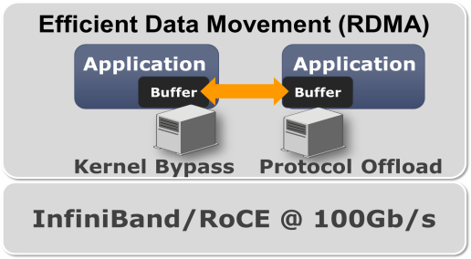
What Is RDMA?
Remote Direct Memory Access (RDMA)
Advance transport protocol (same layer as TCP and UDP)
Main features
  Remote memory read/write semantics in addition to send/receive
  Kernel bypass / direct user space access
  Full hardware offload
  Secure, channel based IO
Application advantage
  Low latency
  High bandwidth
  Low CPU consumption
RoCE, iWARP
Verbs: RDMA SW interface (equivalent to sockets)
Notes:
RDAM Remote version for DMA. DMA (Direct memory Access)
DMA - allow you to read/write from Memory without utilize the CPU.
RDAM is the same only with remote Server. So you can access Memory from server A to server B without utilizing the CPU. (need lossless fabric)
The RDAM bypass all the kernel (TCP/IP) stack and transport layer is done in the RDAM NIC it self.

Slide 11
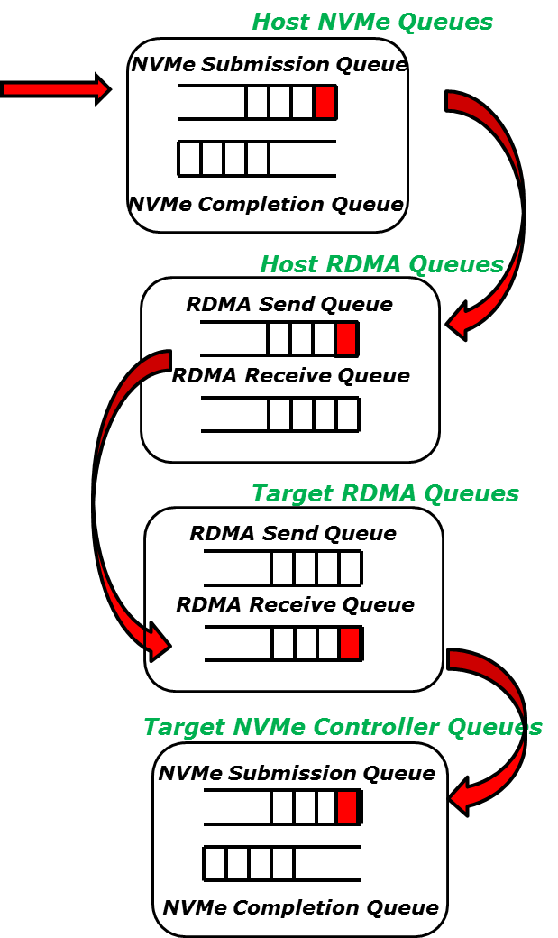
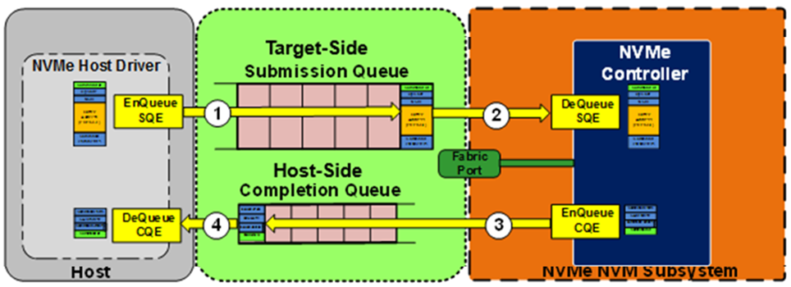
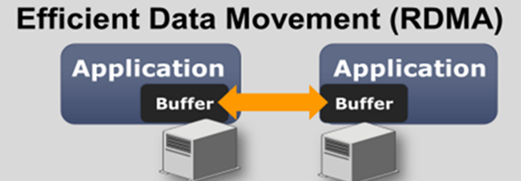
RDMA and NVMe: A Perfect Match
Network
Network
Notes:
NVMe and RDAM are both asynchronous protocals
Queue base protocols.
AS you can see in the diagram RDAM has Send Queues, Receive Queues and Completion Queues.
NVME has ADMIN Submission Queues and Completion Queues for Controller Management and IO Submission and Completion for IO operation

Slide 12
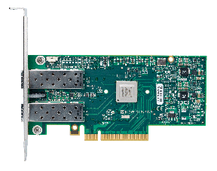
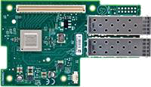

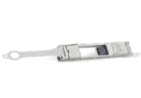
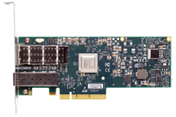
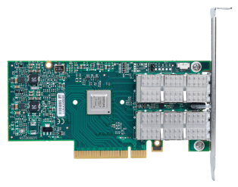
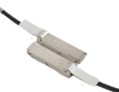

Mellanox Product Portfolio
NICs
Switches
NICs
Cables
Cables
Ethernet & InfiniBand RDMA
End-to-End 25, 40, 50, 56, 100Gb
Notes:
How NVMeOF Maintain the NVME Performance.
So the NVME interface is very efficient and lightweight that moves the bottle neck form the disk to the network.
To keep the same performance as local NMVE interface we need a fast with low latency protocols.
And that is were RDMA comes to the rescue.
We have RDAM over Converged Ethernet (RoCE) and RDAM over InfiniBand.

Slide 13
NVMe-oF – Kernel Initiator
Uses nvme-cli package implement the kernel initiator side
Connect to remote target
nvme connect –t rdma –n <conn_nqn> –a <target_ip> –s <target_port>
nvme list - to get all the nvme devices

Slide 14
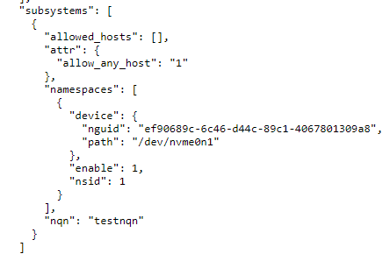
NVMe-oF – Kernel Target
Uses nvmetcli package implement the kernel target side
nvme save <file_name>– to create new subsystem
nvme restore – to load existing subsystems

Slide 15

NVMe-oF in
Available from Rocky release (we hope ☺)
Available with TripleO deployment
Requires RDMA NICs
Supports Kernel target
Supports Kernel Initiator
SPDK target is work in progress
Work Credit:
  Ivan Kolodyazhny (Mirantis) – First POC with SPDK
  Maciej Szwed (Intel) - SPDK Target
  Hamdy Khadr, Moshe Levi (Mellanox) – Kernel Initiator and Target

Slide 16
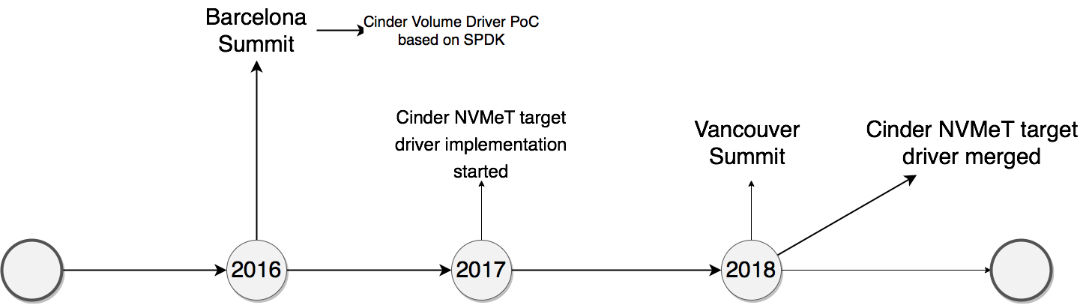
NVMe-oF in

Slide 17
NVMe-oF in
Cinder
First implementation of NVMe-over-Fabrics in OpenStack
Target OpenStack Release: Rocky
Nova
New
NVMe-oF
Target Drv
Kernel LVM
Volume Drv
Horizon Client
Tenant VM
New
/dev/vda
LVM
(Logical Volume Manager)
KVM
nvmet
NVMe-oF
Target
NVMe-oF Initiator
NVMe-oF Data Path
RDMA Capable Network
Nova/Cinder Control Path

Slide 18

NVMeOF – Backend
[nvme-backend]
lvm_type = default
volume_group = vg_nvme
volume_driver = cinder.volume.drivers.lvm.LVMVolumeDriver
volume_backend_name = nvme-backend
target_helper = nvmet
target_protocol = nvmet_rdma
target_ip_address = 1.1.1.1
target_port = 4420
nvmet_port_id = 2
nvmet_ns_is = 10
target_prefix = nvme-subsystem-1

Slide 19

NVMeOF with
# cat /home/stack/tripleo-heat-templates/environments/cinder-nvmeof-config.yaml
parameter_defaults:
CinderNVMeOFBackendName: 'tripleo_nvmeof'
CinderNVMeOFTargetPort: 4420
CinderNVMeOFTargetHelper: 'nvmet'
CinderNVMeOFTargetProtocol: 'nvmet_rdma'
CinderNVMeOFTargetPrefix: 'nvme-subsystem'
CinderNVMeOFTargetPortId: 1
CinderNVMeOFTargetNameSpaceId: 10
ControllerParameters:
ExtraKernelModules:
nvmet: {}
nvmet-rdma: {}
ComputeParameters:
ExtraKernelModules:
nvme: {}
nvme-rdma: {}

Slide 20
NVMe-oF and SPDK
Storage Performance Development Kit

Slide 22


Scalable and Efficient Software Ingredients
  User space, lockless, polled-mode components
  Up to millions of IOPS per core
  Designed to extract maximum performance from non-volatile media
Storage Performance
Development Kit
Storage Reference Architecture
  Optimized for latest generation CPUs and SSDs
  Open source composable building blocks (BSD licensed)
  Available via spdk.io

Slide 23
Benefits of using SPDK

Slide 24
SPDK Architecture
Storage
Protocols
Integration
NVMe-oF*
Target
iSCSI Target
vhost-scsi Target
vhost-blk
Target
Linux nbd
RDMA
Cinder
NVMe
SCSI
VPP TCP/IP
Storage
Services
Block Device Abstraction (bdev)
QoS
RocksDB
3rd Party
Logical Volumes
GPT
DPDK
Encryption
BlobFS
Ceph
Blobstore
QEMU
NVMe
Linux AIO
Ceph RBD
PMDK
blk
virtio
scsi
virtio
blk
Core
Drivers
NVMe Devices
Intel® QuickData Technology Driver
Application
Framework
NVMe-oF*
Initiator
NVMe* PCIe Driver

Slide 25
NVMe-oF Performance with SPDK
NVMe* over Fabrics Target Features | Realized Benefit
Utilizes NVM Express* (NVMe) Polled Mode Driver | Reduced overhead per NVMe I/O
RDMA Queue Pair Polling | No interrupt overhead
Connections pinned to CPU cores | No synchronization overhead
SPDK reduces NVMe over Fabrics software overhead up to 10x!
System Configuration: Target system: Supermicro SYS-2028U-TN24R4T+, 2x Intel® Xeon® E5-2699v4 (HT off), Intel® Speed Step enabled, Intel® Turbo Boost Technology enabled, 8x 8GB DDR4 2133 MT/s, 1 DIMM per channel, 12x Intel® P3700 NVMe SSD (800GB) per socket, -1H0 FW; Network: Mellanox* ConnectX-4 LX 2x25Gb RDMA, direct connection between initiators and target; Initiator OS: CentOS* Linux* 7.2, Linux kernel 4.10.0, Target OS (SPDK): Fedora 25, Linux kernel 4.9.11, Target OS (Linux kernel): Fedora 25, Linux kernel 4.9.11 Performance as measured by: fio, 4KB Random Read I/O, 2 RDMA QP per remote SSD, Numjobs=4 per SSD, Queue Depth: 32/job. SPDK commit ID: 4163626c5c
Notes:
Callouts
How to read the chart: the bars are the IOPS, same for both SPDK and kernel. The markers and line are the # of CPU cores required – 30 for kernel vs. 3 for SPDK.
Demonstrates scalability of SPDK NVMe-oF Target: 50Gbps per core, up to the limit of the network or disk
Built on top of SPDK NVMe driver, which has software overhead of about 277ns per I/O
RDMA Queue Polling eliminates interrupt software latency and improves consistency
Pinning I/O workload to cores eliminates synchronization, “core granularity” of resource allocation.

Slide 26
SPDK LVOL Backend for Openstack Cinder
First implementation of NVMe-over-Fabrics in Openstack
  NVMe-oF Target Driver
  SPDK LVOL based SDS Storage Backend (Volume Driver)
Provides High-performance Alternative to Kernel LVM and Kernel NVMe-oF Target
Upstream Cinder PR# 564229
Target Openstack Release: Rocky
Joint work by Intel, Mirantis, Mellanox

Slide 27
Demonstration
Upcoming Rocky NVMe-oF Feature

