Slide 1
Fault Management with OpenStack Congress and Vitrage, Based on OPNFV Doctor Framework
Barcelona 2016
Ryota Mibu NEC
Ohad Shamir Nokia
Masahito Muroi NTT

Slide 2
Contents
Failure Inspection in OPNFV Doctor - Ryota
OpenStack Vitrage - Ohad
OpenStack Congress - Masa

Slide 3
Failure Inspection in OPNFV Doctor

Slide 4
Virtualized Platform
VM
VM
VM
Volume
Port
Port
Port
Volume
Net
Net
PM
PM
H/W Switch
H/W Switch

Slide 5
Virtualized Platform
VM
VM
VM
X
Volume
X
Port
Port
Port
Volume
Net
Net
PM
PM
H/W Switch
H/W Switch

Slide 6
What is “failure”?
Depends on
Applications (VNFs)
Back-end technologies used in the deployment
Redundancy of the equipment/components
Operator Policy
Regulation
Topologies of Network / Power-supply
So, “failure” has to be configurable

Slide 7
Fault Management Architecture
Designed by Doctor Project
Applications
Manager
0. Set Alarm
6-. Action
5. Notify Error
Virtualized Infrastructure
4. Notify all
Controller
Controller
Notifier
Nova
Controller
Resource Map
Alarm
Conf.
Neutron
Ceilometer+Aodh
Cinder
3. Update State
2. Find Affected
4. (alt) Notify
Monitor
Monitor
Inspector
Monitor
Failure Policy
Congress
1. Raw Fault
Vitrage

Slide 8
State Correction APIs
Nova
Reset Server State
POST /servers/{server_id}/action
{ "os-resetState": { "state": “error" } }
Update Forced Down
PUT /os-services/force-down
{ "host": "host1", "binary": "nova-compute", "forced_down": true }
Neutron
Update port data plane status WIP https://review.openstack.org/351675/
PUT /v2.0/ports/<port-uuid>
{ "port": { "dp_down": true } }
Cinder
Reset a volume's statuses
POST /volumes/{volume_id}/action
{ "os-reset_status": { "status": "available", "attach_status": "detached", "migration_status": "migrating" } }

Slide 9
Inspector Module Options
OpenStack Vitrage
Various data source (OpenStack, Nagios, etc.)
Ability to store and refer physical topologies for correlation
Holistic & complete view of the system
OpenStack Congress
Dynamic data collection from OpenStack services
Flexible policy definition for correlation (Datalog)
Well integrated with other OpenStack projects

Slide 10
Stained glass art produced through the combination of brilliantly colored glass in varying degrees of transparency, creating a dynamic art form which is transformed with every variation in light
Notes:
Stained glass window
Taken alone they don’t make sense
Together they create a pattern

Slide 11
Vitrage in a nutshell
Official OpenStack project for Root Cause Analysis
Vitrage Functions
Root Cause Analysis – understand why faults occurred
Deduced alarms and states – raising alarms and modifying states based on system insights
Holistic & complete view of the system

Slide 12
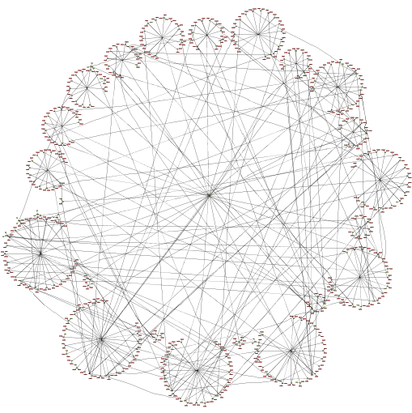
Vitrage – Architecture Highlights
Multiple
Data sources
Reflects how entities relate to one another
Configurable business logic
Template-based behavior
Easily extendible to add new data sources
Entity Topology Graph

Slide 13
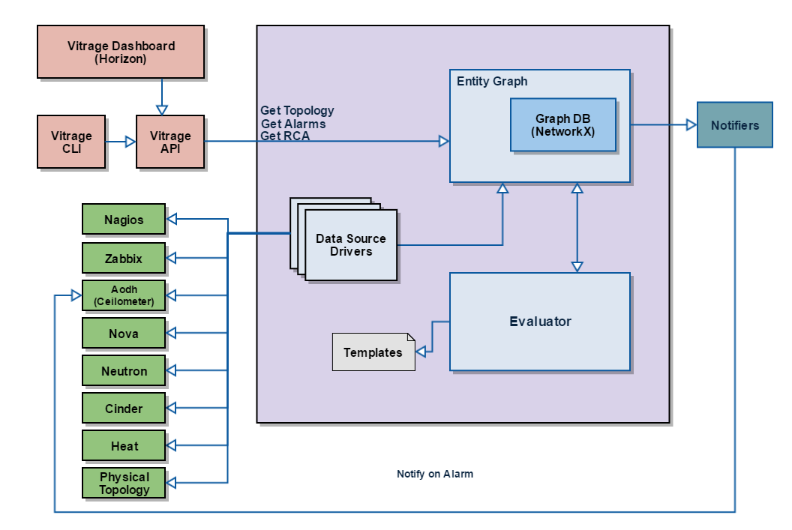
Vitrage High Level Architecture
Horizon Plug-in:
Hierarchical view
Vitrage alarm list
RCA diagram per alarm
Entity graph view
Templates list
Expose Vitrage alarms and state changes to other projects or external systems
Multiple Data Sources (extendible):
External monitoring tools: Nagios, Zabbix
OpenStack projects
Physical topology
Templates for deduced alarms and RCA:
Each template can contain one or more scenarios (scenario = condition + action)
Human readable
Configurable

Slide 14
Vitrage Template
Template contains three sections:
Metadata – name, description of template
Definitions – entities & relationships
Scenarios – conditions & actions
Each template can contain one or more scenarios (condition + action/s)
YAML format, human readable
Configurable

Slide 15
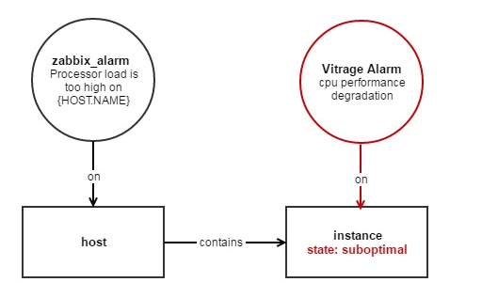
Template Example – Host high CPU load
Scenario 1 – Raise Alarm
When high CPU load on host and host contains instance:
Raise deduced alarm on instance named cpu performance degradation
Set state to suboptimal on instance
Scenario 2 – RCA
When high CPU load on host and host contains instance and cpu performance degradation alarm on instance, add causal relationship
Scenario 3 – Set host state
When high CPU load on host, set host state to suboptimal

Slide 16
Template Example – Host high CPU load
Raise alarm on VM (deduced alarm and state)
1
2
Add causal relationship
3
Set host state

Slide 17
How does it work? Entity Graph + Evaluator
Vitrage Evaluator listens to change events in the entity graph and upon event:
Retrieve templates (scenarios) relevant to event
Evaluate condition against the state of the Entity Graph
Execute actions for each matched condition
E
C
A
A
A
B
B
B
C
B
Sub-graph
Matching
F
C
A
C
F
C
G
G
G

Slide 18
Let’s see
Vitrage
Notes:
Stained glass window
Taken alone they don’t make sense
Together they create a pattern

Slide 19
Vitrage as Doctor Inspector
Push and pull interfaces to various monitoring tools (e.g. Nagios, Zabbix) and to OpenStack projects -> fast failure notification
Mapping between physical and logical failures
Expose more faults and changes to resources (deduced alarms and states)
Provide Root Cause Analysis indicators to the application manager
Can be configured differently for different systems

Slide 20
OpenStack Congress

Slide 21
What is Congress?
Governance as a Service
Define and enforce policy for Cloud Services
Policy
No single definition
Law/Regulations
Business Rules
Security Requirements
Application Requirements
Datalog style policy
Goal of Congress
Any Service, any Policy

Slide 22
Congress Architecture
Policy
Data
Policy
Monitor in Doctor
Policy Enforcement
Congress
API
Policy Engine
Nova DataSourceDriver
Neutron DataSourceDriver
Doctor
DataSourceDriver
Nova
Neutron

Slide 23
Congress Doctor Driver
Policy
Data
Policy
1.
Monitor
Policy Enforcement
Doctor data flow
Congress
API
2.
Doctor DataSourceDriver
4.
Policy Engine
3.
Monitor notifies hardware failure event to Congress
Doctor Driver receives failure event, insert it to event list of Doctor Data
Policy Engine receives the failure event, then evaluate registered policy and enforce state correction
Policy Engine instruct Nova Driver to perform host service force down and reset state of VM(s)
Nova DataSourceDriver
Neutron DataSourceDriver
Keystone DataSourceDriver
Security System DataSourceDriver
Nova
Neutron
Keystone
Security System

Slide 24
Congress Doctor Driver (Detail)
Driver Schema（HW failure example） +--------+-----------------------------------------------------+ | table | columns | +--------+-----------------------------------------------------+ | events | {'name': 'id', 'description': 'None'}, | | | {'name': 'time', 'description': 'None'}, | | | {'name': 'type', 'description': 'None'}, | | | {'name': 'hostname', 'description': 'None'}, | | | {'name': 'status', 'description': 'None'}, | | | {'name': 'monitor', 'description': 'None'}, | | | {'name': 'monitor_event_id', 'description': 'None'} | +--------+-----------------------------------------------------+
Event List of Doctor Data +----------------+-------------------------------+----------------+---------------+--------+--------------+------------------+ | id | time | type | hostname | status | monitor | monitor_event_id | +----------------+-------------------------------+----------------+---------------+--------+--------------+------------------+ | 0123-4567-89ab | 2016-03-09T07:39:27.230277464 | host.nic1.down | demo-compute0 | down | demo_monitor | 111 | +----------------+-------------------------------+----------------+---------------+--------+--------------+------------------+

Slide 25
Policy for Inspector
A hypervisor and instances on the hypervisor must be down state/error status if some errors are reported by Monitor.

Slide 26
Policy of Congress
List hypervisors that violate the policy
Still in “up” state even though it’s reported error happens
List instances that violate the policy
Still in “Active” status even though it’ reported error happens
binary_list("nova-compute")
active_hypervisor(hypervisor, binary):-
nova:services(host=hypervisor, binary=binary, status="up"),
binary_list(binary),
error_reported_hosts(hypervisor)
active_instance_in_host(vmid, hypervisor):-
nova:servers(id=vmid, host_name=hypervisor, status="ACTIVE"),
error_reported_hosts(hypervisor)

Slide 27
Policy of Congress
How to fix the violation
mark host down the hypervisor
Set the vm status to “error”
execute[nova:services.force_down(host, binary, "True")] :-
active_compute_hypervisor(host, binary)
execute[nova:servers.reset_state(vmid, "error")] :-
active_instance_in_host(vmid, host)

Slide 28
Scenario 1: sensitive app/operator
Defines both non-broken events and broken events as a failure
mark_down_events(’host.nic1.down')
mark_down_events(’host.nic2.down')
mark_down_events(‘host.cpu.high-load’)
error_reported_hosts(hosts):-
doctor:events(hostname=hosts, type=event_t, status=“down”),
mark_down_events(event_t)

Slide 29
Scenario 2: insensitive app/operator
Defines only broken events as a failure
mark_down_events(’host.nic1.down')
mark_down_events(’host.nic2.down’)
mark_down_events(‘host.cpu.high-load’)
error_reported_hosts(hosts):-
doctor:events(hostname=hosts, type=event_t, status=“down”),
mark_down_events(event_t)

Slide 30
Thank You!

