Slide 1
Lessons Learnt from Telco NFV deployments with SR-IOV
OpenStack Summit - Vancouver, May 23rd 2018
SOUVIK DEY
sodey@rbbn.com
SUYASH KARMARKAR
skarmarkar@rbbn.com

Slide 2
Survey
Are you aware of different Networking choices in Openstack ?
Have you deployed SR-IOV on Openstack ?
Are you aware of DPDK ?
Are you using SR-IOV+DPDK in Real-Time Telco workloads ?
Are you aware of issues with SR-IOV?

Slide 3
Agenda
SR-IOV - What, Why and How
Configuration for SR-IOV
Drawbacks
How to overcome them
Monitoring Demo
Deployment Scenario
Choices of SR-IOV NICs
Availability of SRIOV in Public Clouds
SR-IOV in Containers
Future Improvements Proposed

Slide 4
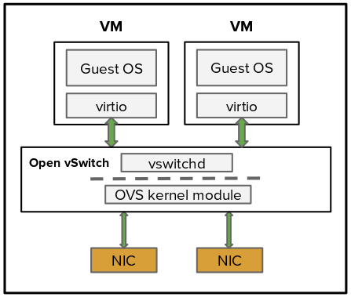
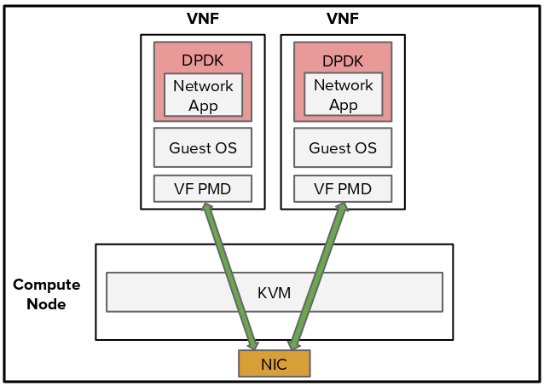
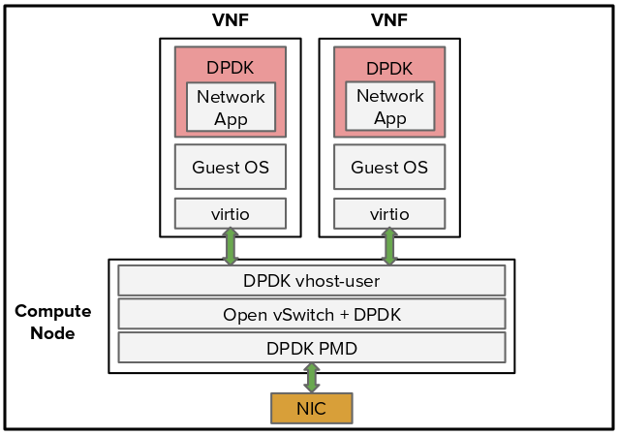
Openstack Networking
VNF with Open vswitch (kernel datapath)
VNF with SR-IOV
Single-Root IO Virtualization
VNF with OVS-DPDK
(DPDK datapath)
User space
Kernel space
PF1
PF2

Slide 5
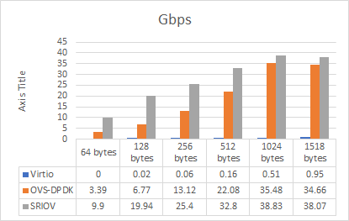
Performance comparison between different networking options
* Courtesy Intel

Slide 6
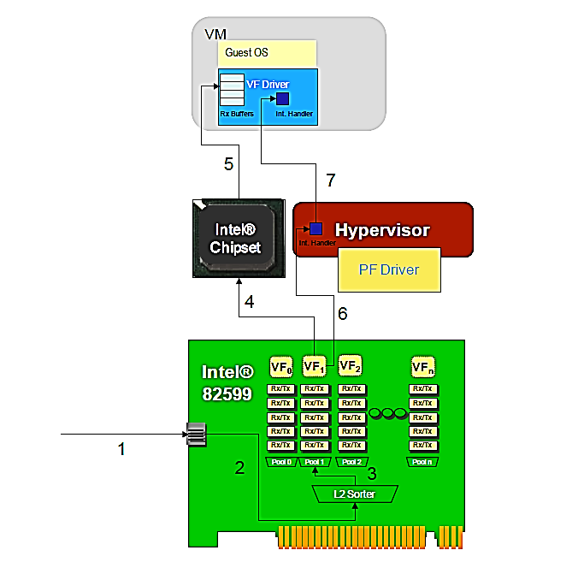
What is SR-IOV
Step 1 & 2: Packet Arrives, sent to the L2 Sorter/Switch.
Step 3: Packet is sorted based upon destination MAC address; or Mac+VLAN; in this case, it matches Pool/VF 1.
Step 4: NIC initiates DMA action to move packet to VM
Step 5: DMA’d into the VM’s VF Driver buffers.
Step 6: NIC posts MSI-X interrupt indicating a Rx transaction has been completed. This interrupt is received by the Hypervisor.
Step 7: The Hypervisor injects a virtual interrupt to the VM indicating a Rx transaction has been completed, the VM’s VF Driver then processes the packet.
* Courtesy Intel

Slide 7
Why SR-IOV is chosen for Telco NFV
Need High Packet Throughput/PPS
Small size Packets (64 bytes)
Low Latency & Jitter
Close to Zero Packet loss
Performance : Gives comparable to Bare-Metal performance.
SR-IOV allows a PCIe device to appear as multiple separate physical PCIe devices.
Low CPU load on the Host.
Pool to Pool (VF to VF) Bridging.
Security Features : Anti-spoofing
    MAC Address
    VLAN Tag
Cost Reduction – Capital and operational expenditure savings include
      Power savings
      Reduced adapter count
      Less cabling
      Fewer switch ports
When NFV work started due to Lack of Maturity and adoption/evolution of other Networking options ( OVS-DPDK / SmartNIC’s)

Slide 8
Agenda
SR-IOV - What, Why and How
Configuration for SR-IOV
Drawbacks
How to overcome them
Monitoring Demo
Deployment Scenario
Choices of SR-IOV NICs
Availability of SRIOV in Public Clouds
SR-IOV in Containers
Future Improvements Proposed

Slide 9
How to Configure SR-IOV
Host Level Changes
Enable VT-d/VT-x/SR-IOV in the BIOS
Add intel_iommu=on iommu=pt in the kernel boot param
Create VFs on the compute host
                echo <x> > /sys/bus/pci/devices/0000\:0x\:00.x/sriov_numvfs

Slide 10
How to Configure SR-IOV
Neutron-Server on Controller Changes
Modify the ML2 Neutron plug-in by editing the /etc/neutron/plugins/ml2/ml2_conf.ini
                [ml2]
                tenant_network_types = flat,vlan
                type_drivers = vlan
                mechanism_drivers = openvswitch,sriovnicswitch
                [ml2_type_vlan]
                network_vlan_ranges = physnet2:1000:2000,physnet3:2001:2100
                [securitygroup]
                firewall_driver = neutron.agent.firewall.NoopFirewallDriver
Add the supported PCI vendor VF devices defined by vendor_id:product_id in /etc/neutron/plugins/ml2/ml2_conf_sriov.ini
[ml2_sriov]
supported_pci_vendor_devs = 8086:10ed ( Intel 82599 NIC)
Modify the ml2_conf_sriov.ini
[ml2_sriov]
Agent_required=True
Add PciPassthroughFilter to the scheduler_default_filters parameter in /etc/nova/nova.conf

Slide 11
How to Configure SR-IOV
Compute Node Changes
Add pci_passthrough_whitelist to the /etc/nova/nova.conf
[default]
pci_passthrough_whitelist={"devname": "p5p2", "physical_network":"physnet3"}
Update the device_mapping in /etc/neutron/plugins/ml2/ml2_conf_sriov.ini
[sriov_nic]
physical_device_mapping = physnet3:p5p2
[securitygroup]
firewall_driver = neutron.agent.firewall.NoopFirewallDriver

Slide 12
Two more configurations...
With SRIOV and High Performance Network throughput requirement of Telco NFVs
Enable NumaTopologyFilter -- Required to select VFs and cpu cores from a single numa, so that the QPI/UPI bus is not used.
vcpu_pin_set should be enabled in the computes with SRIOV in nova.conf.
For other Performance Tuning references https://www.openstack.org/videos/sydney-2017/secrets-for-approaching-bare-metal-performance-with-real-time-virtual-network-functions-in-openstack-2

Slide 13
Agenda
Configuration for SR-IOV
Drawbacks
How to overcome them
Monitoring Demo
Deployment Scenario
Choices of SR-IOV NICs
Availability of SRIOV in Public Clouds
SR-IOV in Containers
Future Improvements Proposed

Slide 14
Drawbacks
SR-IOV requires support in the BIOS/OS/Hardware.
Security groups are not supported when using SR-IOV, thus, the firewall driver must be disabled using firewall_driver = neutron.agent.firewall.NoopFirewallDriver.
Only VLAN and Flat network is supported. So Flexibility is reduced.
No OpenStack Dashboard integration. Users need to use CLI or API to create neutron SR-IOV ports.
Live migration is not supported for instances with SR-IOV ports.
When using Quality of Service (QoS), max_burst_kbps (burst over max_kbps) is not supported. In addition, max_kbps is rounded to Mbps.
Link Redundancy
VLAN Support
Link Monitoring
Packet Monitoring

Slide 15
Agenda
Drawbacks
How to overcome them
Monitoring Demo
Deployment Scenario
Choices of SR-IOV NICs
Availability of SRIOV in Public Clouds
SR-IOV in Containers
Future Improvements Proposed

Slide 16
No OpenStack Dashboard Integration
Creating an instance in Openstack with SR-IOV networking is only supported through CLI or Heat Templates.
In Queens Release this limitation is corrected as per the below blueprint https://blueprints.launchpad.net/horizon/+spec/new-port-type-in-horizon
Now we can create SRIOV based instances through Horizon Dashboard.

Slide 17
VM Live Migration
VM Live Migration is not supported for SR-IOV enabled ports.
As with PCI passthrough, identical device configurations are required for live (and offline) migrations. Without identical device configurations, guest's cannot access the passed-through devices after migrating.
Auto Healing of SR-IOV instances is an issue. Only way is spawn and delete approach.

Slide 18
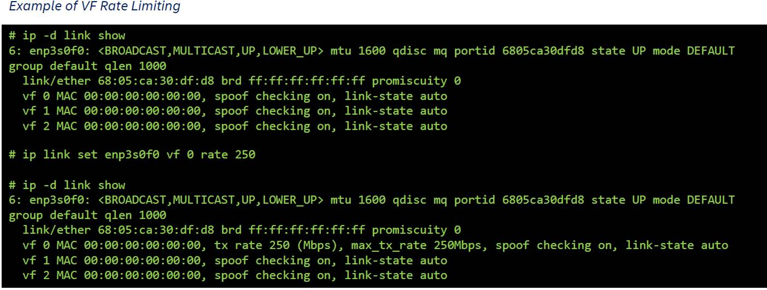
SR-IOV QoS
* Courtesy Intel

Slide 19
Link Redundancy
High Availability is an important attribute for both Application and Networking.
With SR-IOV, the infrastructure cannot provide link/path resiliency and the VNFs has to take care of that.
No VF bonding support on the NIC card.
Libvirt allocates MAC for the connected VF so that the MAC is retained on the VF.

Slide 20
Link Redundancy Cont…
Bond will use old active MAC
GUEST
libVirt allocated MAC for the SR-IOV
Interface and connects the pci using
<interface type = hostdev, managed=yes>
BOND0(MAC A)
MAC write fails as Guest is not allowed to change MAC.
MAC A
MAC B
HOST
MAC A
MAC B
Tx Packets will be dropped on the Host as spoofed packets as the source MAC will mismatch
SR-IOV Active Link
SR-IOV Backup Link

Slide 21
Link Redundancy Cont…
Use fail_over_mac=1
BOND0 mac will use the current interface mac
GUEST
BOND0(MAC A)
BOND0(MAC B)
MAC A
MAC B
HOST
MAC A
MAC B
Tx Packets will be sent out as the source MAC matches the interface MAC.
But in case of using DPDK bonding this will not work as fail_over_mac is not supported.
SR-IOV Active Link
SR-IOV Backup Link

Slide 22
Link Redundancy Cont…
The new Queens blueprint introducing the trust mode on the VF which allows the Guest to alter the MAC of the VF.
https://blueprints.launchpad.net/nova/+spec/sriov-trusted-vfs
vf 0 MAC <MAC A>, spoof checking on, link-state auto, trust on, query_rss off
GUEST
BOND0(MAC A)
MAC A
MAC A
HOST
MAC A
MAC A
Tx Packets will be sent out as the source MAC matches the interface MAC.
SR-IOV Active Link
SR-IOV Backup Link

Slide 23
VLAN Tagging
Network segregation is another important attribute of Telco NFVs.
Normally, to achieve this VLANs are used to do L2 segregation.
Let’s see how VLAN and VLAN + Link redundancy has an effect with SRIOV.

Slide 24
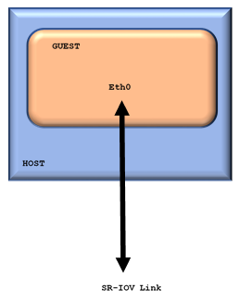
VLAN Tagging
NFV can support 4096 VLAN per VF
Which will be bypassed by the PF.
Only 1 VLAN can be assigned while creating Openstack Network at the PF. PF will insert and strip the VLAN

Slide 25
VLAN Tagging + Link Redundancy Issues…
Bond created with fail_over_mac=1
And VLAN on top of that.
GUEST
As VLAN and Bond doesnot interact VLAN
still uses the MAC A
VLAN(MAC A)
BOND0(MAC B)
BOND0(MAC A)
MAC A
MAC B
Bond Interface updates it’s MAC to B
HOST
MAC A
MAC B
Tx Packets dropped as spoofed packets
as source MAC varies
SR-IOV Active Link
SR-IOV Backup Link

Slide 26
VLAN Tagging + Link Redundancy Issues…
Create the Bond on the VLAN interfaces with fail_over_mac=1
GUEST
BOND0(MAC B)
BOND0(MAC A)
Create VLANs on both active and backup links
VLAN(MAC A)
VLAN(MAC B)
MAC A
MAC B
VLAN retains its original MAC and BOND0 starts using MAC B
HOST
MAC A
MAC B
Tx Packets will be sent out as the source MAC matches the interface MAC.
SR-IOV Active Link
SR-IOV Backup Link

Slide 27
VLAN Tagging + Link Redundancy Issues…
Enable trust mode on, so that the VM can alter the
libvirt allocated MAC
GUEST
VLAN(MAC A)
BOND0(MAC A)
MAC A
MAC A
HOST
MAC A
MAC A
Tx Packets will be sent out as the source MAC matches the interface MAC.
SR-IOV Active Link
SR-IOV Backup Link

Slide 28
Link Monitoring
With High Throughput requirement , the NFV guest uses DPDK to read the packets from the SR-IOV VFs.
DPDK app should take care of running a watchdog to monitor the link status.
On Link loss, the Tx queue should be disabled and no packets should be sent.
On Link Coming back, both Rx and Tx queues for the VF should be reset and re-initialized to make packet flow work properly.
Re-initialization will take care of reconfiguring the VLANs in shadow table if any.
If not using XCAST_MODE_ALLMULTI enable host driver then the IPv6 Multicast addresses needs to be reconfigured again after re-init.

Slide 29
Packet Monitoring
Debugging Networking issues with a SRIOV VNF is difficult.
All Telco Customers need real time centralized debugging capability which is challenging with SRIOV Networking.
All sniffer applications work at Linux pcap level so do not have capability to record media since networking is SRIOV and most Telco VNF’s dealing the fast path is DPDK based.
Choices:
              TOR Switch –Not Practical
          Host/PF level
          VNF supporting the Monitoring at performance hit.
          Smart NIC’s

Slide 30
Agenda
How to overcome them
Monitoring Demo
Deployment Scenario
Choices of SR-IOV NICs
Availability of SRIOV in Public Clouds
SR-IOV in Containers
Future Improvements Proposed

Slide 31



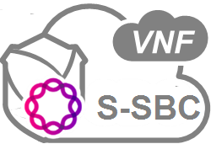
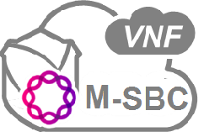

Live Demo: Packet Monitoring
VNF 1
MONITORING
COLLECT
COLLECT
VNF 1
VNF 2
NEW
Demonstration Shows:
Intel DPDK
Live Signaling/Media Monitoring
Call Quality Analysis
CALL LOAD

Slide 32
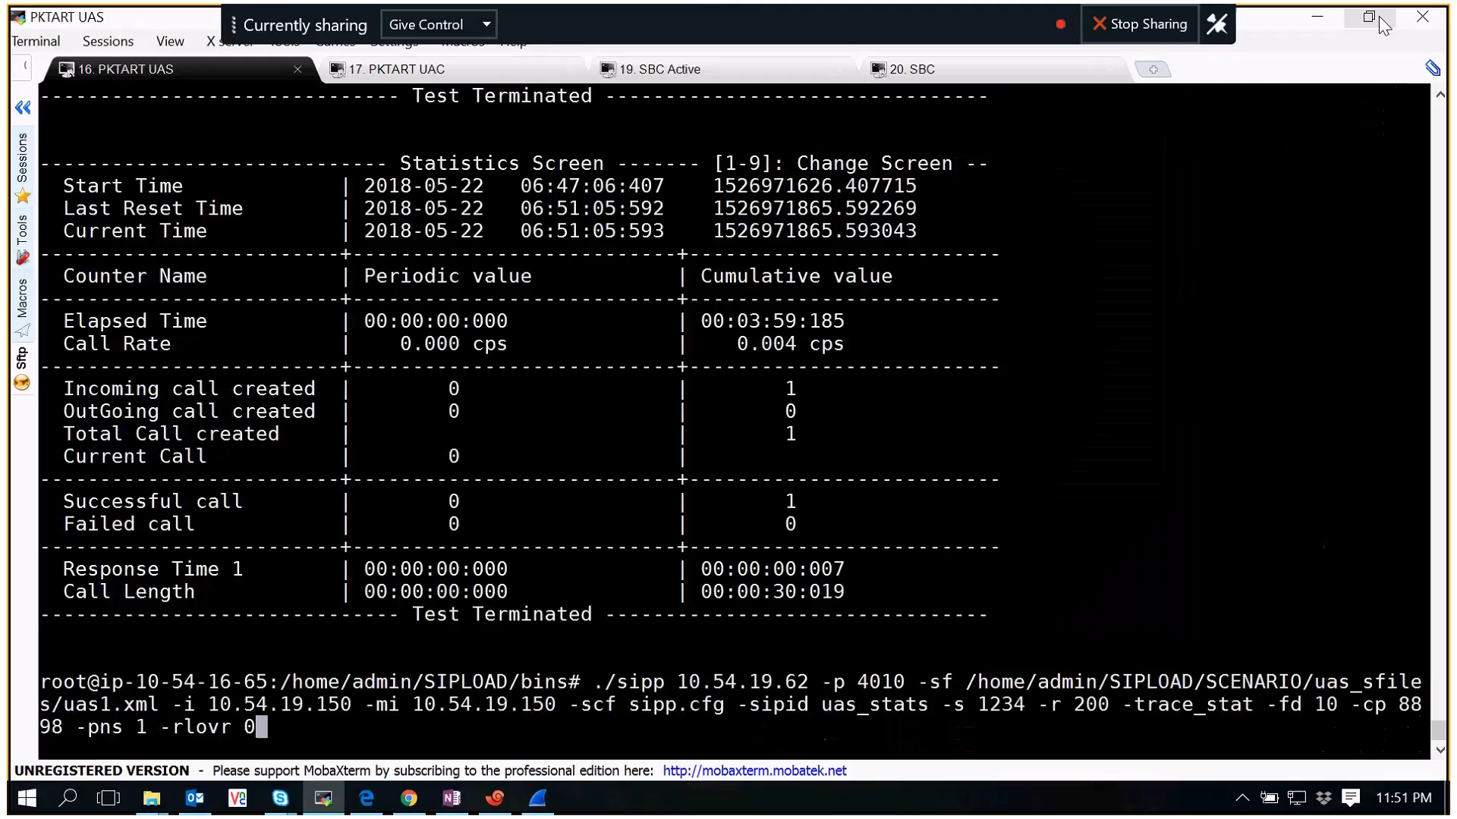
Monitoring Demo

Slide 33
Agenda
Monitoring Demo
Deployment Scenario
Choices of SR-IOV NICs
Availability of SRIOV in Public Clouds
SR-IOV in Containers
Future Improvements Proposed

Slide 34
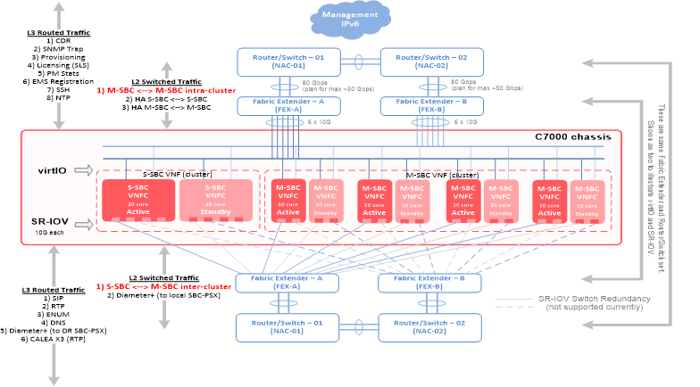
Lessons from Tier-1 Deployment of NFV with SRIOV

Slide 35
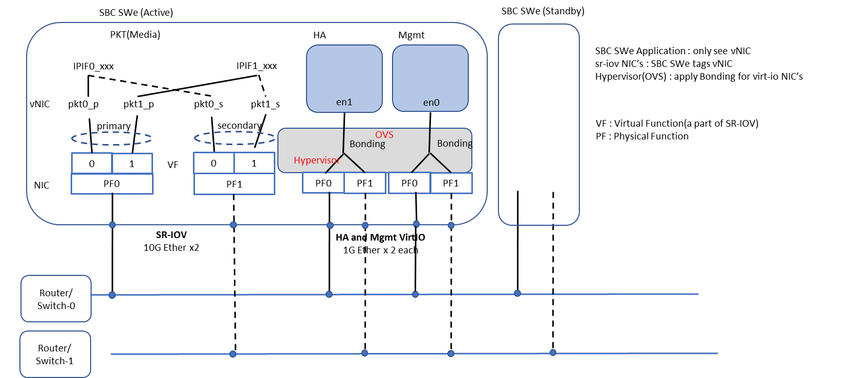
Lessons from Tier-1 Deployment of NFV with SRIOV

Slide 36
Agenda
Deployment Scenario
Choices of SR-IOV NICs
Availability of SRIOV in Public Clouds
SR-IOV in Containers
Future Improvements Proposed

Slide 37
Choices in SRIOV HW and their comparison
Types of NIC | MAX VFs/PF | MAX VLANs on PF | RSS Offload Support | IPv6 Multicast Addr | H/W Offload Support Special Features | comments
Intel Niantic NICs - 82599 | 64 | 64 | Yes | Older version supports only 30 MC Addresses. | CPU offloading of transport operations VLAN stripping/insertion | Only 10G bw supported
Intel Fortville NICS – x710/xl710 | 32/64 | 32/64 | Yes | Supports Promiscuous Multicast | CPU offloading of transport operations VLAN stripping/insertion | 10/25/40 G bw supported
Mellanox Connect X4/X5 | 256 | 256 | Yes | Supports Promiscuous Multicast | CPU offloading of transport operations VLAN stripping/insertion 1K ingress and egress QoS levels Guaranteed QoS for VM | 10/25/40 G bw supported
QLogic | 64 | 64 | Yes | Supports Promiscuous Multicast | CPU offloading of transport operations VLAN stripping/insertion
Broadcom | 64 – in steps of 8 | 64 | Yes | Supports Promiscuous Multicast | CPU offloading of transport operations VLAN stripping/insertion

Slide 38
Agenda
Choices of SR-IOV NICs
Availability of SRIOV in Public Clouds
SR-IOV in Containers
Future Improvements Proposed

Slide 39
Availability of SRIOV in Public Clouds
Cloud burst scenarios NFV’s may need to the use of Public Cloud for capacity Needs
Type of Clouds | SR-IOV Support | Comments
AWS | Yes | C3, C4, D2, I2, M4 (excluding m4.16xlarge), and R3 instances
Azure | Yes | D/DSv2 and F/Fs With Hyperthreading Support instances:D/DSv3, E/ESv3, Fsv2, and Ms/Mms
GCE | No
Oracle | Yes | Oracle Bare Metal Cloud Compute Service
IBM | Yes

Slide 40
Agenda
Availability of SRIOV in Public Clouds
SR-IOV in Containers
Future Improvements Proposed

Slide 41
SR-IOV in Containers
CNI SRIOV plugin helps to use SR-IOV in Containers.
Pros:
    Low latency using user-mode driver
H/W offloads
HW-based QoS
High-performance
Cons:
Limited bandwidth inside NIC
Limited # of VFs
NIC-vendor specific issues
No live migration
* Courtesy Intel

Slide 42
Agenda
SR-IOV in Containers
Future Improvements Proposed

Slide 43
Future Openstack blueprints for Telco NFV
              https://blueprints.launchpad.net/horizon/+spec/pci-stats-in-horizon
              https://blueprints.launchpad.net/nova/+spec/sriov-bond
              https://blueprints.launchpad.net/kuryr-kubernetes/+spec/kuryr-kubernetes-sriov-support
              https://blueprints.launchpad.net/nova/+spec/share-pci-device-between-numa-nodes

Slide 44
Agenda
Future Improvements Proposed

Slide 45
References
https://www.intel.com/content/dam/www/public/us/en/documents/technology-briefs/sr-iov-nfv-tech-brief.pdf
https://docs.microsoft.com/en-us/azure/virtual-network/create-vm-accelerated-networking-cli
https://docs.aws.amazon.com/AWSEC2/latest/UserGuide/sriov-networking.html#enable-enhanced-networking>
https://www.ibm.com/developerworks/community/wikis/home?lang=en#!/wiki/Power%20Systems/page/vNIC%20Frequently%20Asked%20Questions
https://blogs.oracle.com/cloud-infrastructure/oracle-bare-metal-cloud-compute-service-virtual-machines

Slide 46
Q & A

Slide 47
Thank You
OpenStack Summit - Vancouver, May 23th 2018
Suyash Karmarkar
Principal Software Engineer
Principal Software Engineer

