Slide 1
Vitrage
May 2018
Project Update, OpenStack Summit Vancouver
Ifat Afek, ifat.afek@nokia.com
Yuval Adar, yuval.adar@nokia.com

Slide 2
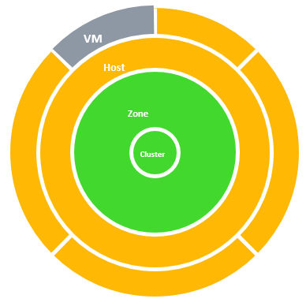
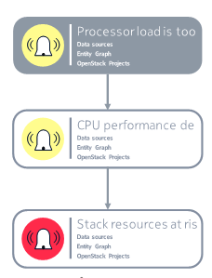
What is Vitrage?
The OpenStack RCA (Root Cause Analysis) service
Vitrage is used for organizing, analyzing and expanding OpenStack alarms & events.
Root Cause Analysis
Deduced alarms and states – alarms based on system insights
Holistic and complete view of the system
Notes:
Insert Mascot right

Slide 3

Project Background
        Founded during the Mitaka release of OpenStack
        Became an official OpenStack project on June 1st 2016
        First official release - Newton
        ~10 contributors in the last release

Slide 4

Queens Features

Slide 5
Webhook Notifications
  Existing: Dedicated notifiers (Nova, SNMP, Mistral)
  In Queens: API for registering on Vitrage alarms
  By resource id
  By alarm name
  By regular expression
  HTTP callback upon alarm

Slide 6
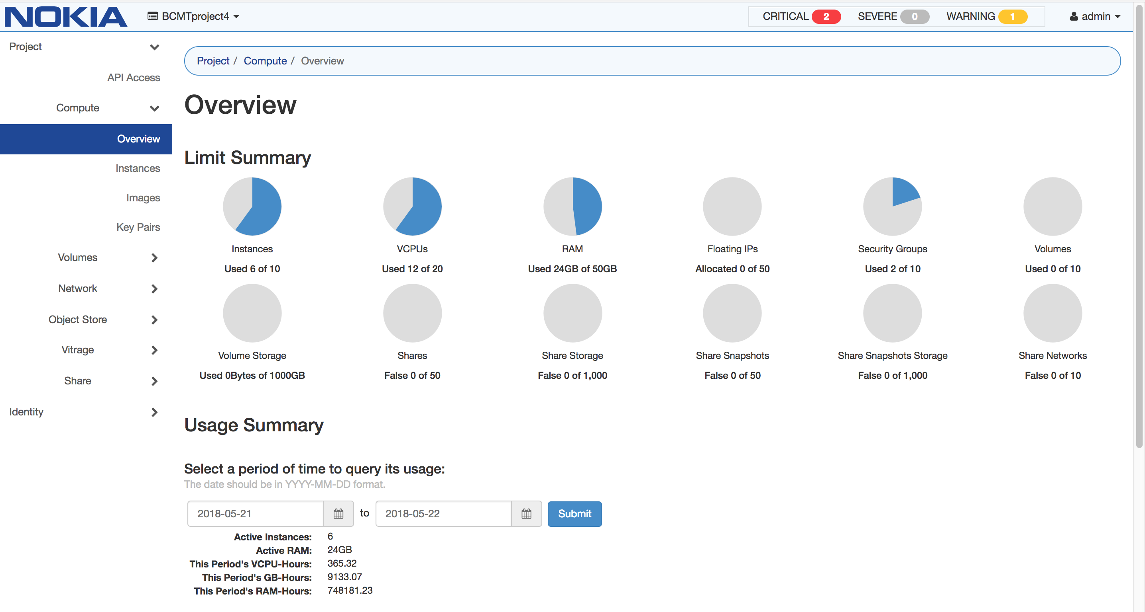
Alarm Banner
  Number of active alarms displayed in every Horizon menu
  Redirect to Vitrage alarms view

Slide 7
Other Queens Features
        Performance improvements
          Parallel evaluation of Vitrage templates
          Memory usage optimization
          Tested and verified for 60000 entities
        SNMP parsing service
        Templates enhancements
          API for template add/delete
          Regular expressions, functions, include

Slide 8
Rocky Features

Slide 9
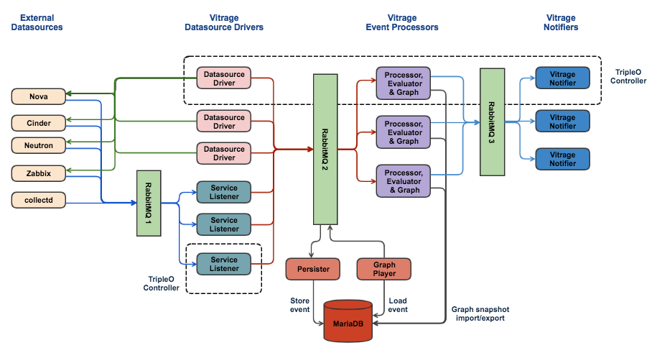
High Availability and Alarm History
  Improve Vitrage high availability support
  Store alarm history using snapshots and events
  Implementation stages
      Pike – collector
      Queens – persistor
      Rocky – load from history
      on process startup

Slide 10
Alarm History
        Motivation
        Root Cause Analysis of yesterday’s alarms
        Alarm statistics
        Future - machine learning
        Implementation
        History in Relational database (MariaDB)
        Store only basic information (alarm + resource id)

Slide 11
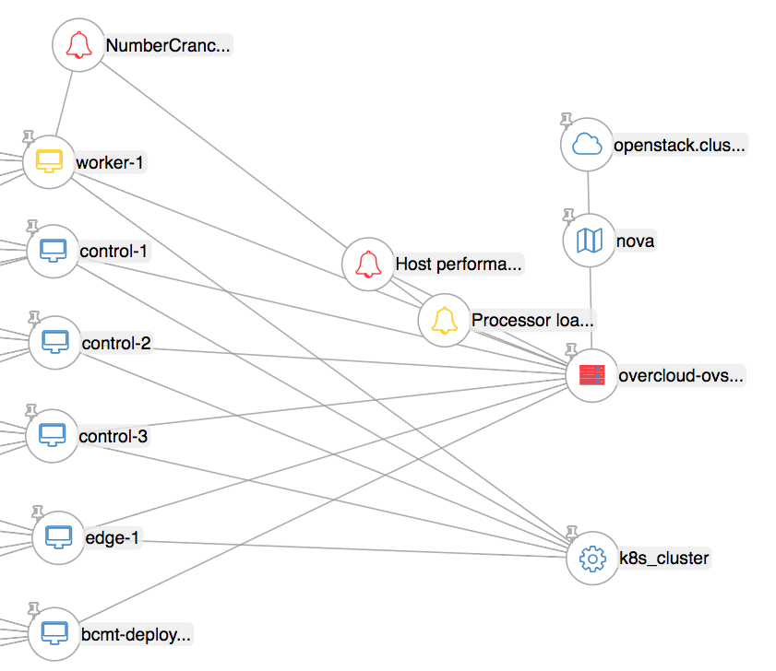
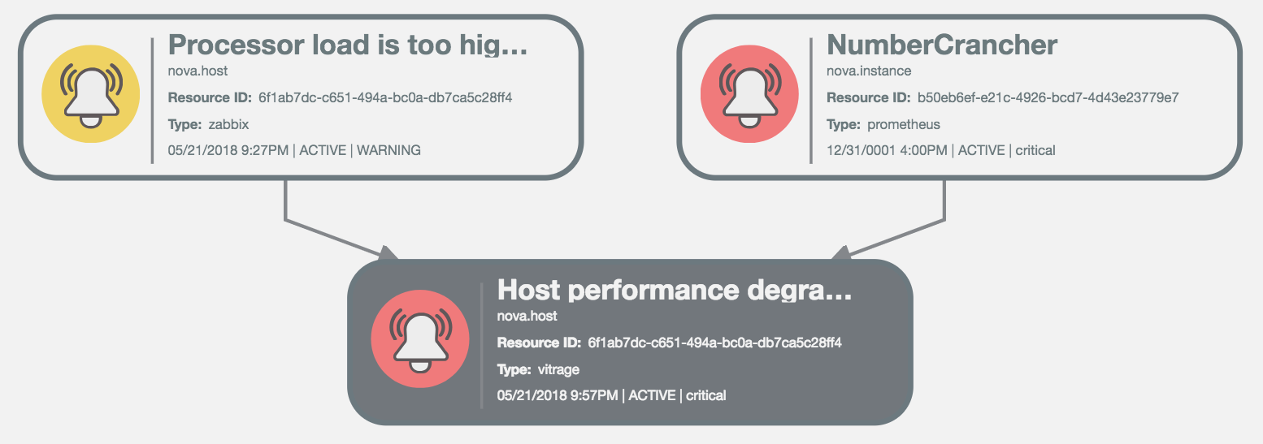
Kubernetes and Prometheus Datasources
  Kubernetes – topology datasource
  Prometheus – Kubernetes related alarms

Slide 12
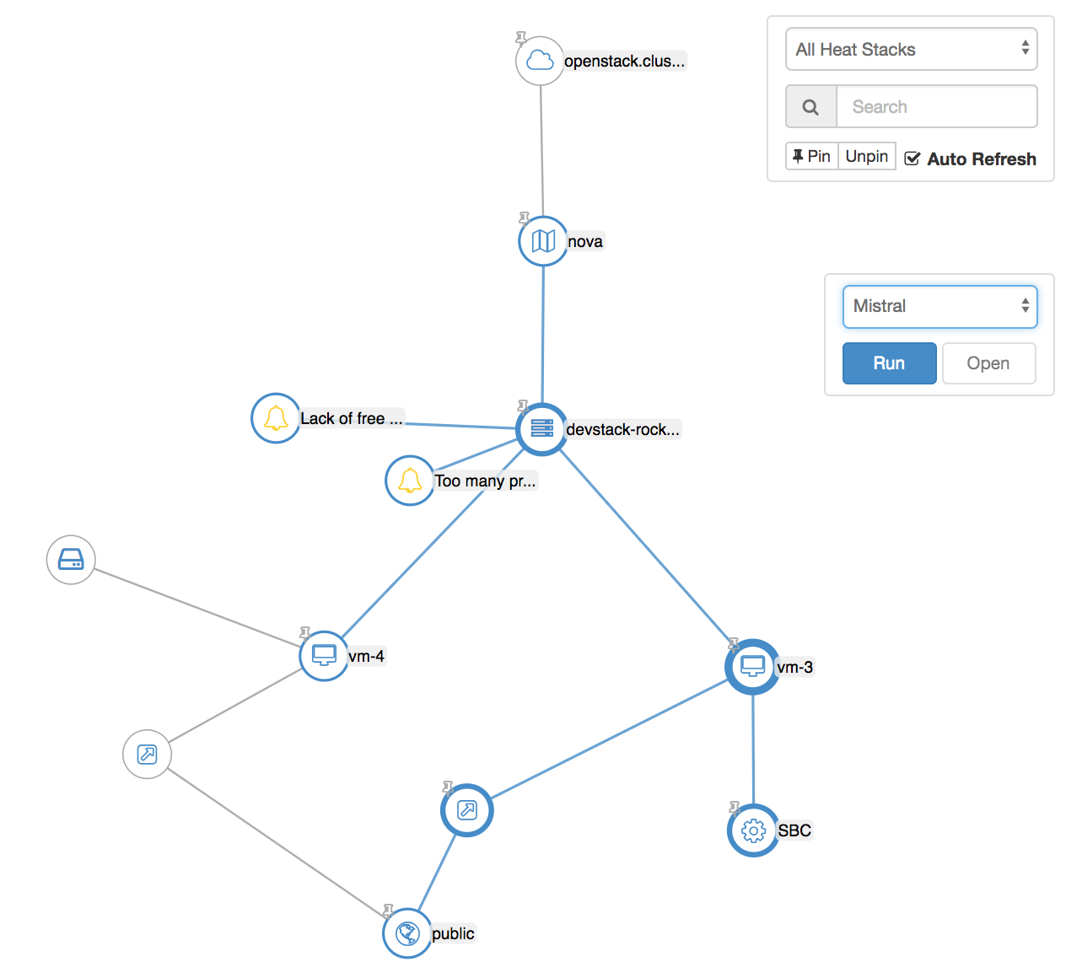
Entity Graph Action Panel
  Run an action from a list
  Action type depends on the selection

Slide 13
Cross-Project Work
  Self-healing SIG (Special Interest Group)
  “coordinate several OpenStack projects … reacting to failures and other events by automatically healing services”
  Vitrage & Congress – in progress
  Vitrage & Monasca – future?

Slide 14
Contact Us
Vitrage wiki page: https://wiki.openstack.org/wiki/Vitrage
Official documentation: https://docs.openstack.org/vitrage/latest/
Vitrage IRC channel: #openstack-vitrage
OpenStack mailing list – use [vitrage] tag
Visit our next sessions in the summit!

Slide 15
Q&A
Thank you!
openstack
openstack
OpenStackFoundation

Slide 16
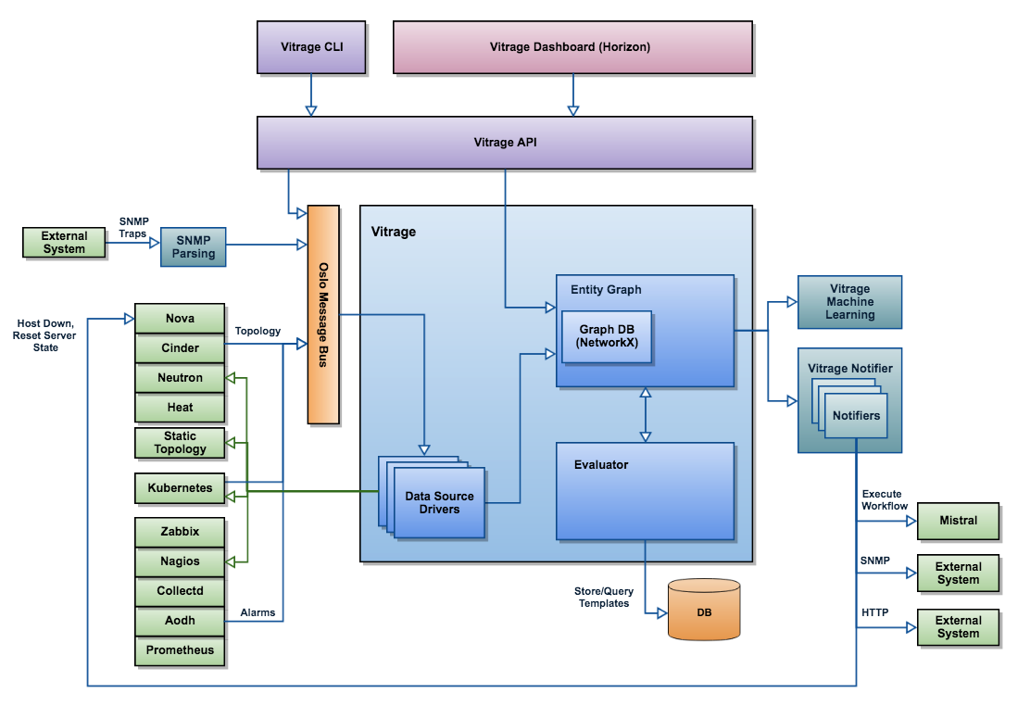
High Level Architecture

