Slide 1
VDI on OpenStack
Virtual Client Computing on a Private Cloud
Justin Rackliffe / Fidelity Investments
Alessandro Pilotti / Cloudbase Solutions

Slide 2
Market Opportunity
Primarily a Microsoft Windows ecosystem
Dominated by two mature Enterprise Software Service providers in VMware and Citrix
Commonly deployed on dedicated proprietary infrastructure stacks
Heavily used in verticals where regulations and security posture require content controls while supporting legacy application stacks
IDC is tracking an 8.9% growth from $3Bn to $4.6Bn to 2020
Notes:
Market Growth Sources
IDC thinking VCC will grow 8.9% CAGR till 2020 from 3b to 4.6 (2020)
http://searchvmware.techtarget.com/feature/VMware-gaining-ground-as-VDI-market-grows

Slide 3
What is VDI?
Mix of stateful and stateless instances
Complicated capacity management do to high variance in workload consumption
Service quality is directly correlated to the resources assigned to the instances
Customer experience depends on features outside of the core infrastructure offering
Notes:
Mixture of stateful long lived Instances with stateless ephemeral sessions
Limited elasticity commonly requiring increasing capacity dedicated to the Customer
Highly dependent on providing a quality user experience leveraging display remoting, other redirection features, and local execution techniques
Highly varied resource consumption patterns and general purpose nature commonly demands high-end capabilities (Flash, GPU) with lower utilization due to shift alignment
I can’t increase your productivity by giving you 3 laptops
Web Browsing spikes memory, CPU and GPU load dramatically

Slide 4
Why Cloud for VDI?
Increasing Utilization
Service Diversity
Elasticity
Prioritize delivering value and not capacity
Notes:
Increase utilization of expensive resources like GPU and Flash by emerging ML/AI workloads within an elastic framework
Shift some of all workloads from dedicated proprietary infrastructure to commodity software and hardware
Enable better tiering of services based on collection of features
Leverage private cloud for burst demand in the case of business continuity or business cycle growth
Refocus VDI service operators back on customer and experience and away from chasing infrastructure TCO and depreciation
Consumption to Creation reasons:
Security
Control
Scale
Joy’s Law
Examples…
Linux, Apache HTTPD/Tomcat, Hadoop
Supporting the consumption to creation pivot
http://www.wsj.com/articles/SB10001424053111903480904576512250915629460
https://github.com/capitalone
http://www.cio.com/article/2928658/open-source-development/why-enterprises-embrace-open-source.html
https://opensource.com/business/15/4/why-open-source-enterprise-natural-allies
Market Growth Sources
IDC thinking VCC will grow 8.9% CAGR till 2020 from 3b to 4.6 (2020)
http://searchvmware.techtarget.com/feature/VMware-gaining-ground-as-VDI-market-grows
Virtual private cloud at a 26.35% CAGR to 45.69b (2022)
http://www.cio.in/knowledge-vault/rise-virtual-private-cloud/article/virtual-private-cloud-market-grow-26-percent-cagr-during-2016-2022
https://globenewswire.com/news-release/2016/11/01/885249/0/en/Virtual-Private-Cloud-Market-is-Growing-at-26-35-CAGR-to-2022.html

Slide 5
Why OpenStack for VDI?
Most VDI solution lack a real IaaS framework
Standard REST API (works with all vendors)
Improved scalability on-prem or on public cloud
Wide hypervisor / storage / networking choices

Slide 6
Windows in OpenStack
Windows is a first class citizen in OpenStack
Provisioning is performed by Cloudbase-Init
  Windows 7, 8, 8.1, 10
  Windows Server 2012, 2012 R2, 2016
Heat templates or Userdata scripts can perform customizations
  Active Directory membership
  RDP Group Policies
  Per-user application configurations

Slide 7
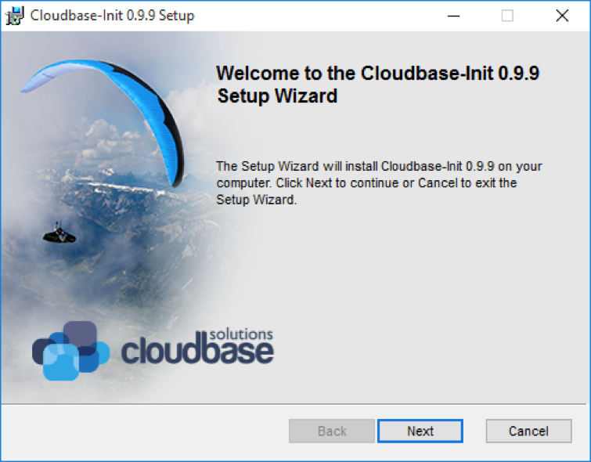
Cloudbase-Init
Available on any OpenStack hypervisor
  Hyper-V, ESXi, KVM
Cloudbase-Init
  Provisioning agent
  Userdata execution (PowerShell)
Hyper-V or any SVVP platform
More than 8 Million reported

Slide 8
VDI Options for OpenStack
Remote Desktop Connection Broker
Citrix XenDesktop
Guacamole + VDIBroker (Open Source)

Slide 9
Microsoft RDS + OpenStack
Microsoft’s VDI offer
Web portal and RDP over HTTP
Connection broker (CB) assigns a desktop to a user request
CB offers a plugin model for 3rd parties
Plugin uses Keystone, Nova, Neutron, Glance, Cinder API
Notes:
Not an all or nothing approach

Slide 10
Microsoft RDS + OpenStack
Pros:
  Familiar UX for Microsoft customers
  Supports traditional shared RDS as well
  AD SSO
Cons:
  Default portal UX is outdated and requires ActiveX
  PowerShell support for managing 3rd party plugins / pools is hacky

Slide 11
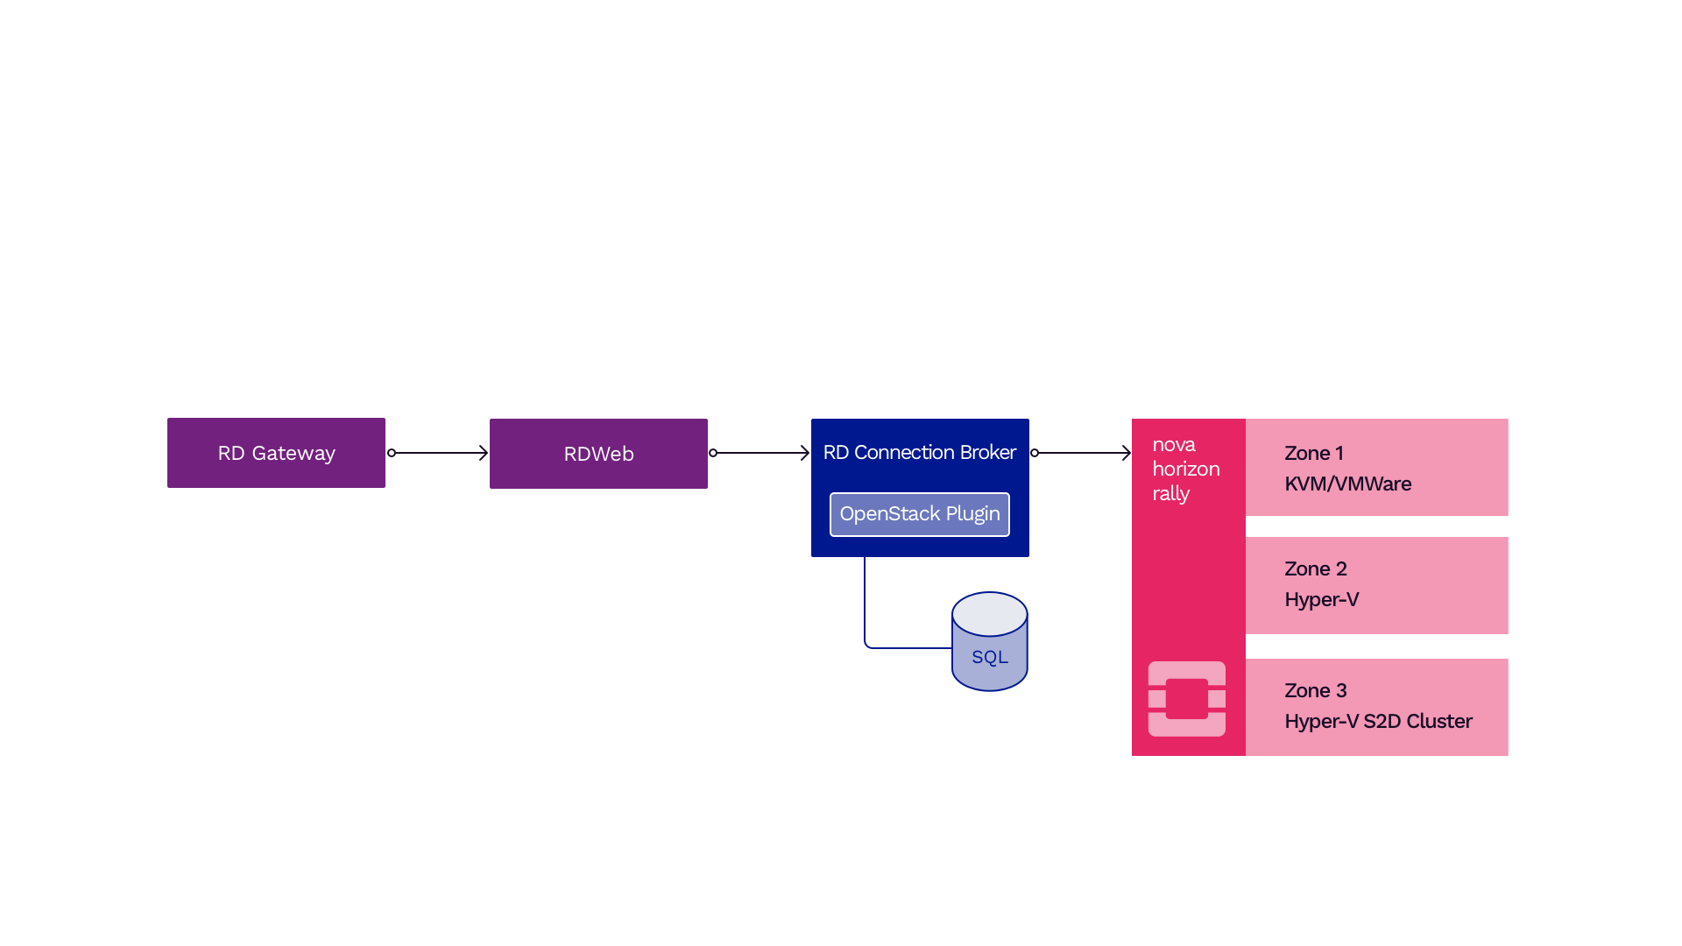
Microsoft RDS + OpenStack

Slide 12
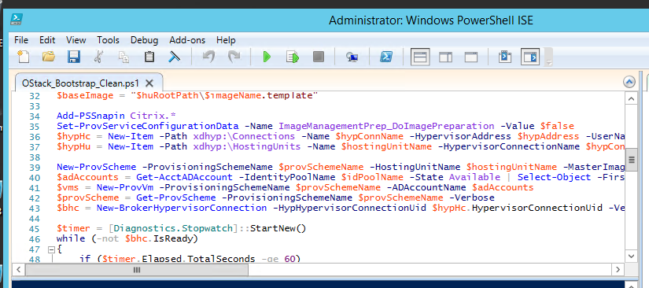

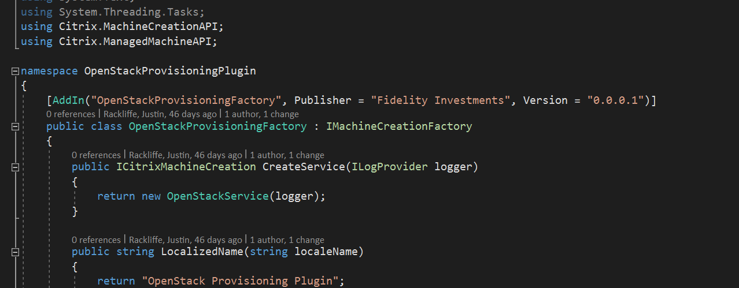
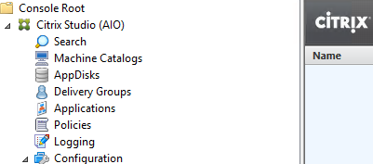
Citrix + OpenStack
Machine Creation Services Partner SDK and OpenStack.NET
Powershell and Event Tracing for Windows
Github repository (work in progress)
  https://github.com/fmr-llc/...
https://xkcd.com/1833/
Notes:
Bit of a black box when it comes to how the Citrix services and Studio interact
Debugging primarily via Event Tracing for Windows (CDF to Citrix)
Orchestration via PoSH as Studio is not dynamically extensible today

Slide 13
Citrix Machine Creation Services
Studio/PoSH
Create Hypervisor Connection
Create Hosting Unit
Gather Identities
New ProvVM (will loop based on request)
Create ProvisioningScheme
Power
On
Attach IdentityDisk
Create IdentityDisk
Create Instance
Prepare Master
Gather Inventory
Create Catalog
Add Machine to Catalog
Create Group
Add Machine from Group
Assign Machine
http://info.tintri.com/rs/tintri/images/tintri_xd71-deepdive-mcs.pdf
https://www.citrix.com/blogs/2016/04/04/machine-creation-service-image-preparation-overview-and-fault-finding/
Notes:
Image master prep includes tasks like Windows and Office rearm and DHCP tests. It will do PvD work as well if you were using that.
The IdentityDisk is a 16MB secondary volume that includes the machine account data used in registry injection prior to the Workstation service starts

Slide 14
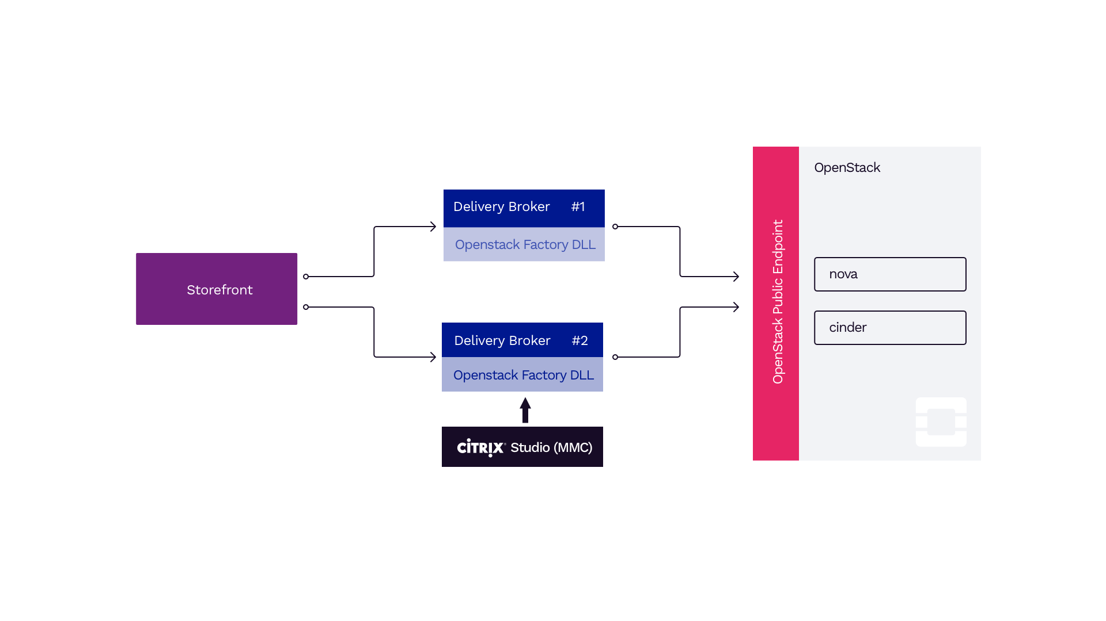

Slide 15
Open Source VDI
Provides a fully Open Source alternative
Web frontend (HTML5)
Guacamole + FreeRDP
  In-browser HTML5 desktop session
RDP over HTTP
  External native clients

Slide 16
OpenStack VDI Broker
Implements logic for managing pools of desktops / applications
Separate project: decoupled from frontend
Written in Python
Uses keystone, oslo.* components
REST API
https://github.com/cloudbase/vdi-broker

Slide 17
Open Source VDI
Pros:
  No vendor lock-in
  No licensing costs
  Can leverage RemoteFX (Hyper-V)
Cons:
  Lacks some advanced features that proprietary solutions offer

Slide 18
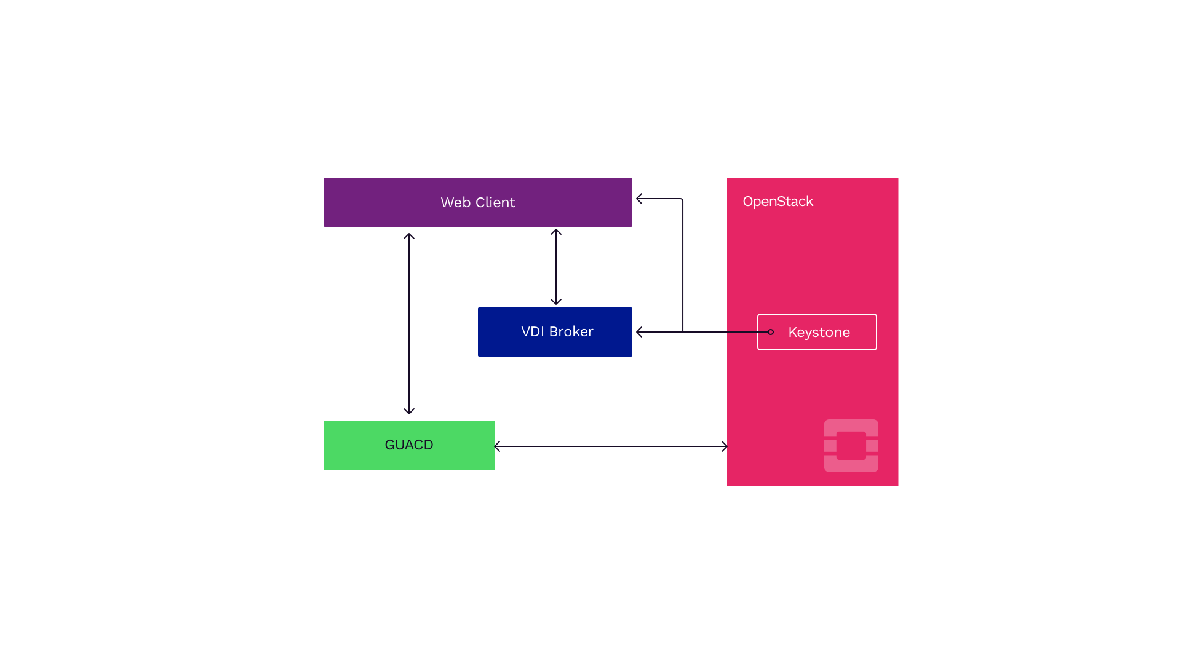
Guacamole / FreeRDP + OpenStack

Slide 19
Guacamole / VDIBroker
Demo

Slide 20
Resources
Cloudbase-init
RDCB plugin repo/pointer
Fidelity Investments Github
OpenStack.NET SDK
Citrix Ready Program
VDI-Broker GitHub
Thank You!
Notes:
Shout out to Carolyn Van Slyck at Rackspace for her work there

