Slide 1
Utilizing Standalone Cinder in Hybrid OpenStack/non-OpenStack Environments
Jay Bryant and Bin Zhou - Lenovo Cloud Technology Center
Rich Wellum - Nokia
May, 2018

Slide 2
Goals
To develop a POC at Lenovo to address a problem seen in the community and with our customers; disaggregated storage control that is overly complex, human-driven and fault intolerant.
Design a solution that provides a single-pane-of-glass solution that is both powerful and simple by using the power of the OpenSource technologies.
Leverage OpenStack storage (Cinder), and other widely available technologies (Kubernetes, Docker, Kafka etc), to enable a solution with Scale, Resilience, Data Analytics and AI.

Slide 3
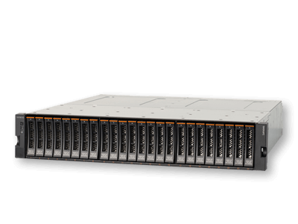
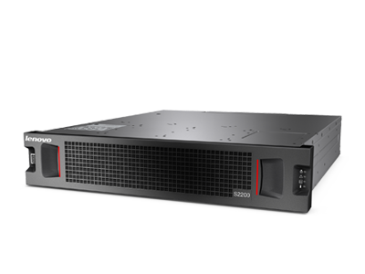
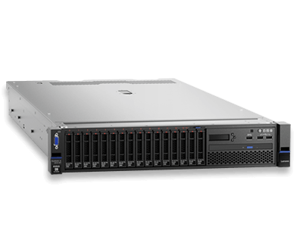
The Proof of Concept
Lenovo Unified Storage and Analytics Controller (LUSAC)

Slide 4
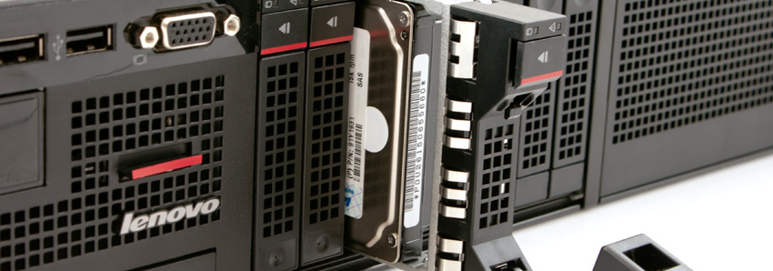
Storage

Slide 5
Objectives and Expectations
Cloud Customers expect simple user interaction from a ‘Single Pane of Glass’
Support for migration of existing, 3rd party storage volumes on to Lenovo storage
Support for integration of our storage solutions with pre-existing non-Lenovo storage
Provide customers with an option to integrate Software Defined Storage solutions

Slide 6
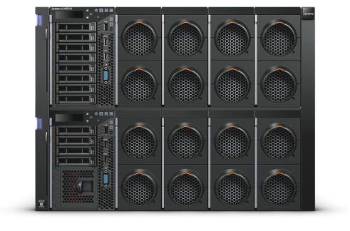
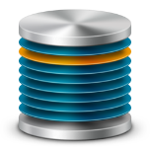
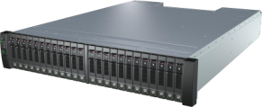
Current User Experience
Storage Administrator
Compute
Storage Request
S/DS-Series Storage
Storage Attachment
Communicate Details
User Finally has Access
Customers
V-Series Storage

Slide 7
Desired User Experience
Storage Administrator
LUSAC
Metrics
Compute
GUI
Request
S/DS-Series Storage
CLI
Info
Storage
Management
Export
API
Customers
V-Series Storage

Slide 8
Design
S/DS-Series Storage
LDAP
LUSAC
Compute
V-Series Storage
Keystone (Auth)
Cinder (Block)
Active Directory
Swordfish API
Manila (File)
Administrator
Lenovo UI or Direct API Access
LeoStor / 3rd Party
Datapath Access to Storage FC/iSCSI/RemoteFS
Swordfish
Swift (Object)
Ceph / eSAN
Self-service User
Monitoring/Logging/Analysis
Cloud Application – API Access
DX8200-N
DX8200-C
Data Analysis
Notes:
Remove Horizon
Add a Swordfish API box.

Slide 9
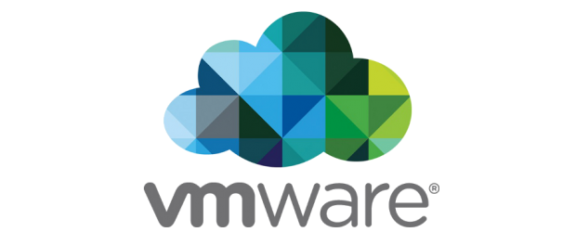
Administrative Interaction via Storage Controller
LUSAC
Compute
GUI
S/DS-Series Storage
Export
CLI
Storage Administrator
Export
Manage
API
V-Series Storage

Slide 10
Admin Demo

Slide 11
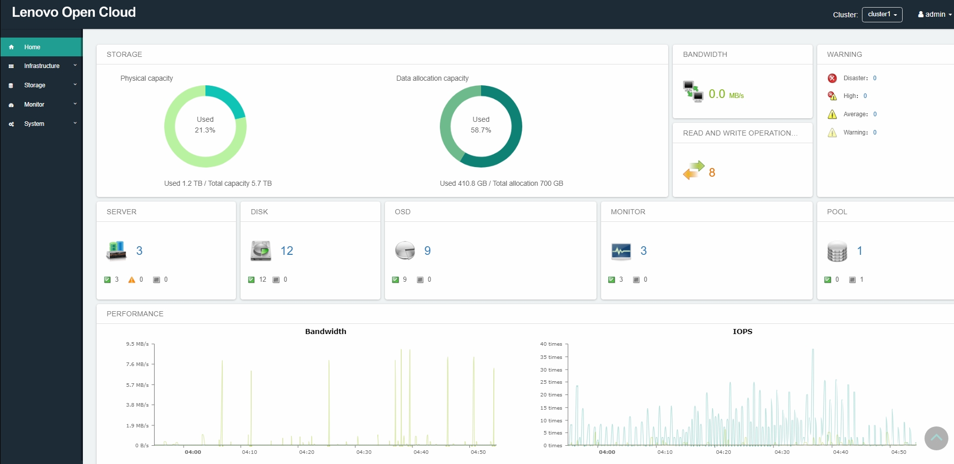
OpenSource User Interface (UI)

Slide 12
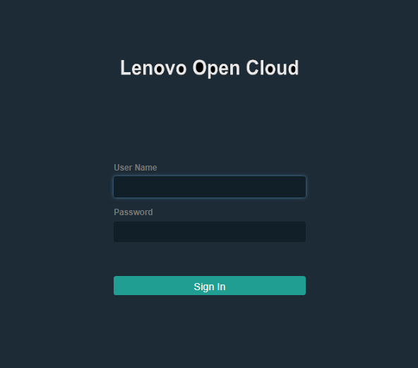
Leverages Open UI Technologies
A simple, unified interface for most administrative tasks
A unified user experience for all user tasks
Modular for easy addition of future functionality

Slide 13
User Interaction via Storage Controller
Storage Administrator
LUSAC
Compute
GUI
S/DS-Series Storage
New
Volume
Storage
Management
Export
CLI
Export
API
Customers
V-Series Storage

Slide 14
User Demo

Slide 15
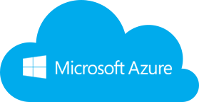
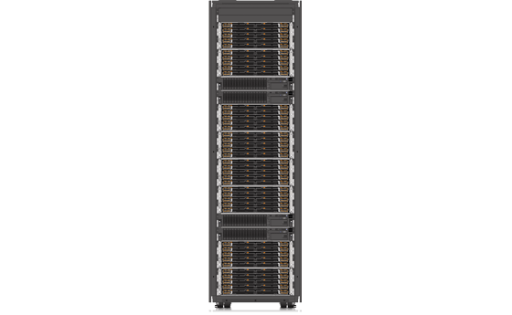
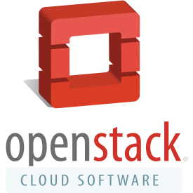
Integration with Other Environments
LDAP
LUSAC
Active Directory
Cinder
Keystone
Datapath Access to
Storage
Manila
Administrator
Lenovo UI
or API Direct
Swift
Self-service User
Monitoring/Logging/Analysis
Cloud Application – API Access
Legacy Private Cloud
Data Analysis
Notes:
Make note that there is no modification required to make these things work.
Can VMWare/Azure talk to LSC?
VASA/VAAPI? We could have a layer in LSC that translates Azure and VMWare API’s to OpenStack APIs.
We need to be able to talk about a VMWare integration point.
Vvol Integration … Need to add Vvol support for Cinder.
What is the current V/DS interface to VMWare?
Docker already has fuxi that provides a Cinder API interface for Docker.
We have value add from automating Line Of Business Access. That is going to be a Day 2 value from the beginning.
Day 0 value add, being able to allocate storage within VMWare is going to be a Phase 2 type of change.

Slide 16
Data Gathering and Data Analysis

Slide 17
Why and what data we gather from the storage system
Reduce application disruption and downtime for organizations with virtualized infrastructure;
Monitor run-time performance;
Diagnose performance issues between storage and infrastructure;
Predict and resolve issues proactively;
Correlate performance metrics across host, network, and storage layers;
Unify the user interfaces and hide the complexity of various hardware from users;
Logs
Performance metrics
Configuration
Alarms and Events

Slide 18
Monitoring Data Pipeline
Systems
Under
Observation
Data
Aggregator
Per Cloud
Data
Analytic
Cloud
Applications
VMs
Hypervisor
OS
Physical Device/
Hardware

Slide 19
More challenges in designing the data gathering solutions
Highly Scalable
Highly Available
Easily maintainable
Highly extendable to new Heterogeneous hardware or software

Slide 20
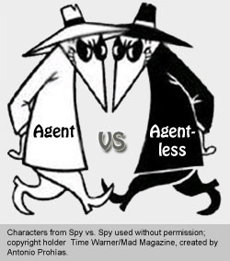
LUSAC Data Gathering Agent
Agent-based vs Agentless
Wide range of devices
Traffic throttle
Open source
Filebeat for logs
Telegraf for metrics
Systems
Under
Observation
Applications
VMs
Data
Aggregator
Hypervisor
TCP
OS
Physical Device/
Hardware
Filebeat
Telegraf

Slide 21
Storage Controller Data Aggregator
LUSAC Customer-Premises
Cinder
MySQL
KeyStone
Kafka
Data Analytic Cloud
RabbitMQ
Heapster
Log
Scraper
kafka
Metrics
Scraper
Fluentd
collector
Config
Scraper
Telegraf
collector
Notes:
Need to replace LUDP with a more general cloud based analytics or an explanation of what LUDP stands for.

Slide 22
Data Analytics Platform - LUDP

Slide 23
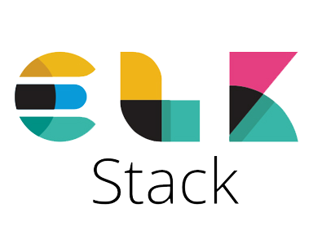
Storage Controller Data Store on LUDP
New software developed in house
Batch data processing and analysis
Implements data analytics models: trending, clustering, outlier detection
Support Big Data volume through Spark & HDFS
LUDP
RDD
telegraf
HDFS

Slide 24
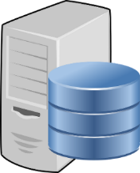
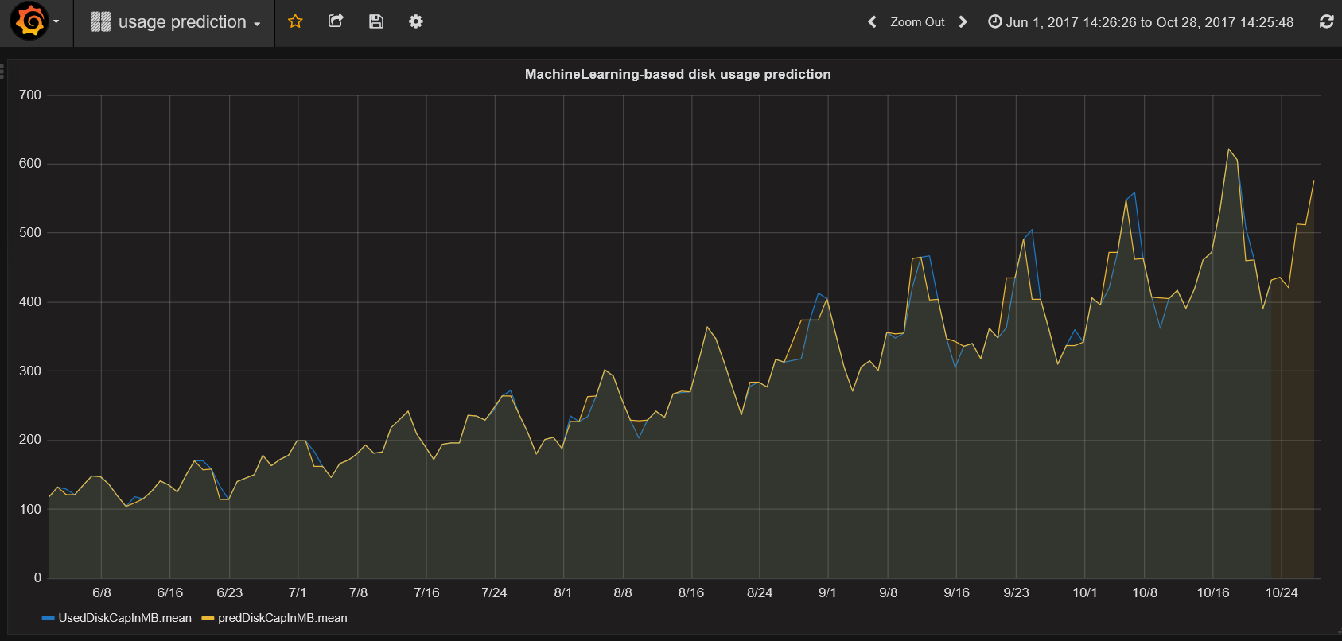
Storage Usage Trending
LUDP
HDFS

Slide 25
Summary
Three Geo-distributed locations
Five-layer of the full infrastructure
15+ Open Source components in pipeline
70+ different SW/HW components under monitoring
Scalable to millions of data samples per seconds
Resilient to software, hardware and network failures
Storage usage prediction based machine learning and big data analytics
Notes:
Need to replace LUDP with a more general cloud based analytics or an explanation of what LUDP stands for.

Slide 26
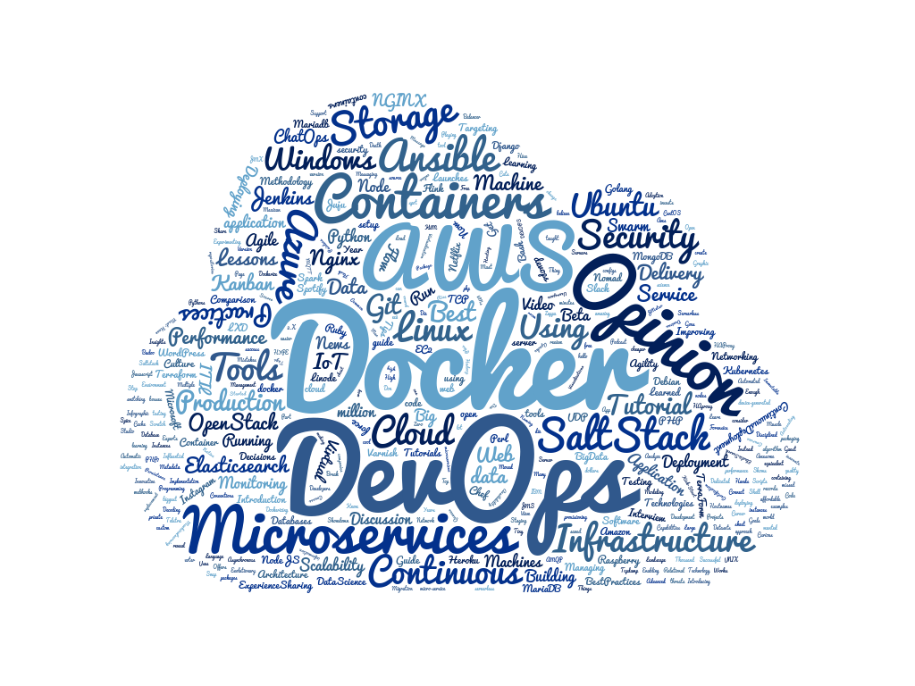
Infrastructure, Containers, Microservices

Slide 27
Objectives for the Infrastructure of a Storage Controller
Based on Stable Controlled source code
Quick and easy to deploy
Simple development environment
CI/CD safe-guards
Isolation of technologies
Future Proof
Cutting edge
Forward looking
Operational Ease
Resilient
Scalable
Scale Out (new Services)
Changes pushed upstream into community
The solution – A Containerized Infrastructure, Micro-Service adoption, running on a Kubernetes Cluster

Slide 28
Microservices are services that are generally containerized and are easily distributable through some form of a network to be easily replaceable parts.
These services are defined by a specification where they do a single task, expose some endpoint or API and are composable with other microservices.
There is a need for these services to talk to each other, and to external services and to do this they use some form of a meshing network.
These networks right now are done through container networks, such as the Docker Overlay Network, the Kubernetes "POD" system, linkerd, serf, and a multitude of other systems like istio.
Isolation of technologies
Quicker ramp-up time for developers
Quicker, simpler Upgrades
Roll-out acceleration
Enables Containerization

Slide 29
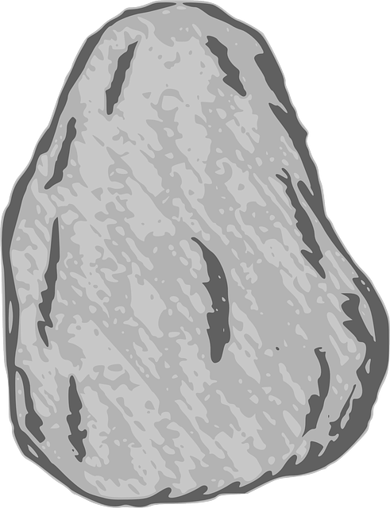
Containerization in Production
Security
Code
Quality
Container Hosting
Docker
Peer Discovery
Scale
Resilience
Development to Production
Rolling Deployment
Monitoring

Slide 30
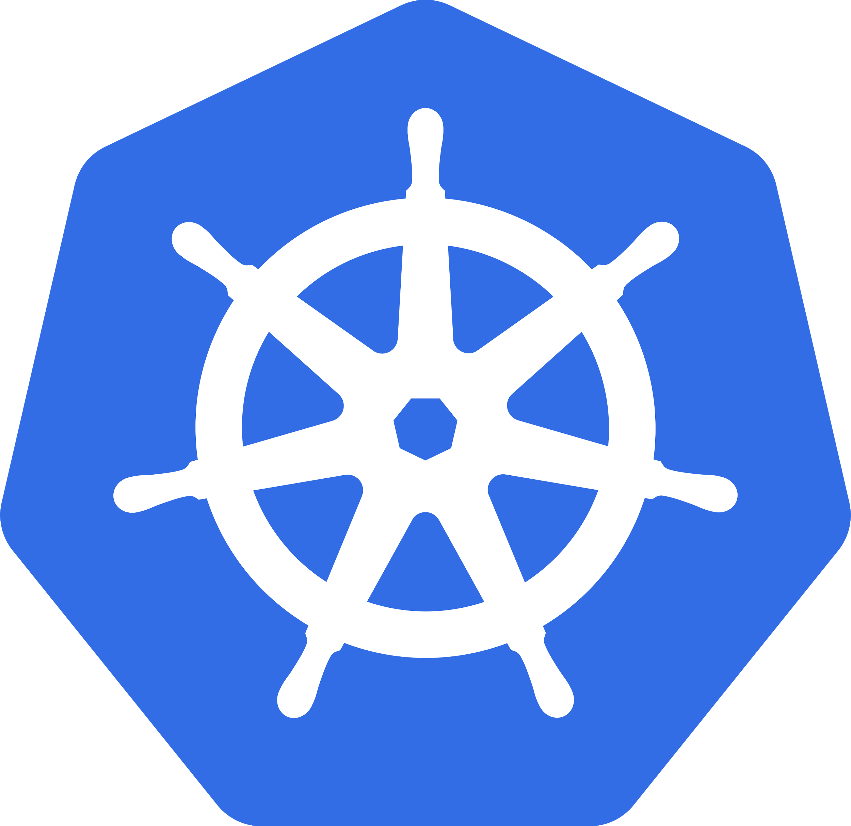
Enter Kubernetes...

Slide 31
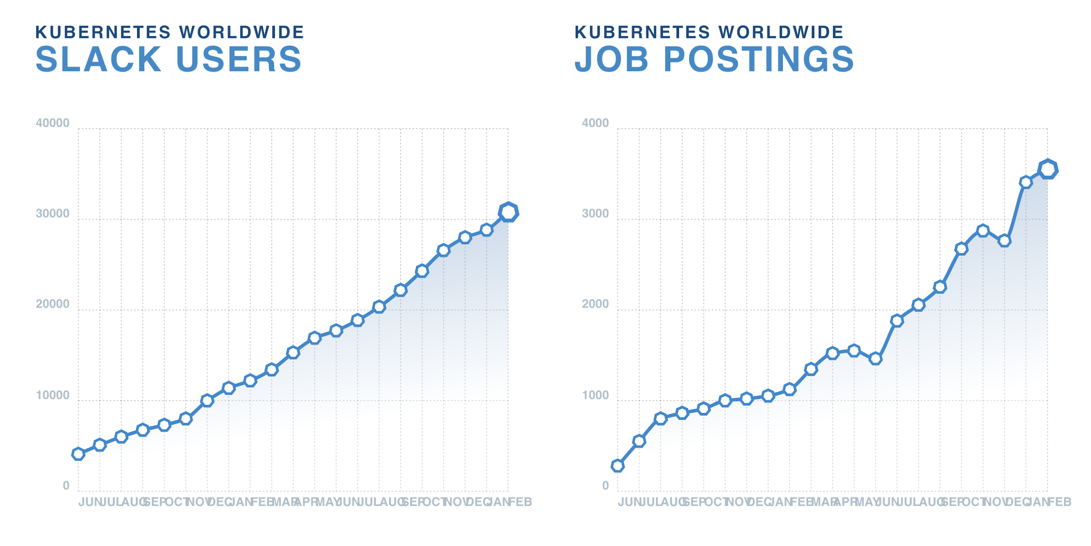
Kubernetes COE (Container Orchestration Engine)
Kubernetes is the open source standard for managing application containers from local to planetary scale.
Originally developed by Google using 15 years of R&D, Kubernetes now flourishes in the open source community and has become the foundation for production cloud native solutions.
Kubernetes is the largest and fastest growing open source software solution focused on democratizing distributed system patterns.
In its first two years of general availability, more production users have committed to Kubernetes than any other comparable solution

Slide 32
Building a containerized environment, development and productization
Develop
Generate Images
Deployment and Operation
Storage Controller Kubernetes Cluster
GUI using Openstack Horizon technology
Clone Kolla repo matching development
Horizon
Lenovo GUI, CLI and Direct API Access
Keystone (Auth)
Fluent-bit log aggregator
Cinder (block)
Storage using Openstack Cinder technology
Point to dev code and build Docker Images
Resilient, scalable, secure, modern.
Libraries / Clients / other services and apps
Push images to local registry or dockerhub
Deployment with openstack-helm
Data Analytics

Slide 33
Conclusion and Wrap-up

Slide 34
What did we learn?
Open Technologies Can be Leveraged to Solve Real Problems
Reduces Internal Development Burden
Provides Richer Solutions
Speeds Time to Market
Provide Industry Best-In-Class Solutions
We Can Improve Existing Storage and Virtualization Experience
Bring Data Analytics Value Add to Storage Market
Improve Administrative and User Experience Making Our Offerings More Attractive

Slide 35
Q&A

Slide 36
Backup Slides

Slide 37
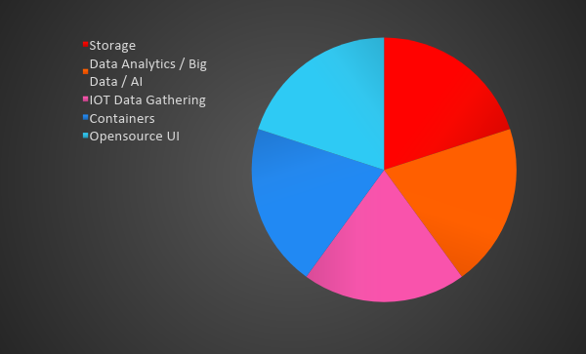
5 big technology buckets
Notes:
Talk about how we set out to create a PoC that pulled OpenSource tools from these different areas to create our solution.

Slide 38
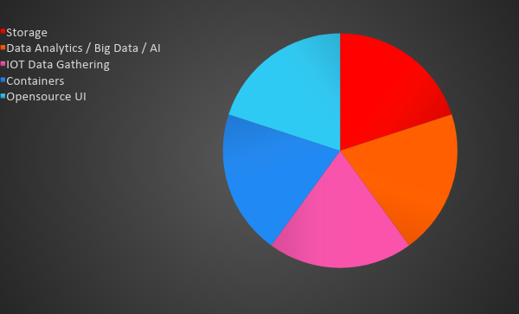
Storage

Slide 39
Challenges We Were Trying to Solve
Cloud Customers expect simple user interaction from a ‘Single Pane of Glass’
Support for migration of existing customers to Lenovo storage
Support for integration of our storage solutions with existing environments
Provide customers with an option to integrate Software Defined Storage solutions

Slide 40
Administrative Demo

Slide 41
Goal
Use Open Technologies to Create a Unified Storage Controller for many Storage Offerings

Slide 42
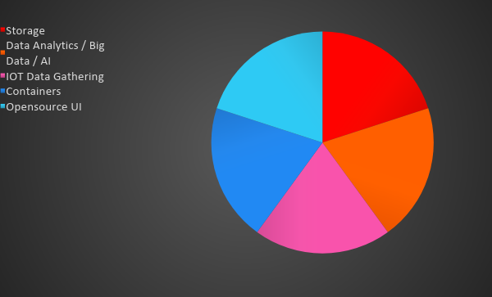
OpenSource UI

Slide 43
User Demo

Slide 44
IOT and Data Gathering

Slide 45
Containers

Slide 46
Data Analytics / Big Data / AI

