Slide 1



StarlingX CI, from zero to Zuul*
Elio Martinez
A fully featured Cloud for the Distributed Edge
*Other names and brands may be claimed as the property of others
Notes:
Hello friends, my name is Elio Martinez, I’m part of the StarlingX project. I will talk a little bit about myself, I have more than 10 years of experience in testing in different fields, starting from normal black box validation over Android, going through graphics, security and other interesting projects. In to this year I was assigned to StarlingX. I am really exited about it, it looks to be the more challenging and interesting project that I was part of. I want to thank you all for being here. During this presentation I will show you the way that we are planning to use and implement Zuul in to StarlingX. Will try to do it an interesting way to keep you awake. If I start talking too slow, please throw me something, beers and mescal is always welcome.

Slide 2

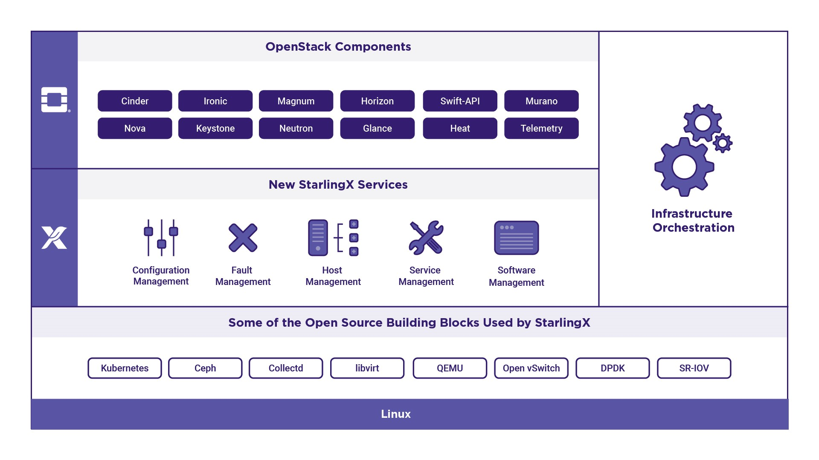
StarlingX
StarlingX is a deployment-ready, scalable, highly reliable Edge infrastructure software platform
Services from the StarlingX virtualization platform provide:
Easy deployment.
Low touch manageability.
Rapid response to events.
Fast recovery.
This software combines services of its own with leading open source projects such as OpenStack*, Ceph* and OVS*
*
*
*Other names and brands may be claimed as the property of others
Notes:
Lets start with some definitions just to clarify and go straight to the part that real matters
StarlingX is a complete Cloud infrastructure software stack for the Edge used by the most demanding applications in industrial IOT, telecom and other use cases. Jus to mention a few
It is based on mature production software deployed in mission critical applications. We have just newly open sourced StarlingX code for Edge implementations in scalable solutions that can be productized now. It uses both OpenStack components as well as a number of proven open source building blocks to create its complete offering.
Tested and released as a complete stack, StarlingX provides a deployment-ready, scalable and highly reliable software platform to build mission critical Edge clouds.
Its unique project services include configuration, fault, service, software and host management to ensure high availability of user applications.
The StarlingX virtualization platform is designed to build up your Edge cloud quickly, manage it easily, respond and recover extremely fast.

Slide 3
Continuous Integration Design
Have an automated test suite/ test driven development.
OpenStack Continuous Integration (CI) compatible.
Easy to maintain.
Check-in regularly to the mainline.
Regression testing capable.
Keep your testing fast.
Notes:
As we should know , all the CI design are based in order to reach certain goals, including compliance , scalability and others,
im mentioning some examples of this goals before we start talking about our future implementation. But we need to know , that , if the bases are solid, the structure can be handled easily.
I’m going to talk about the problem that we need to fix, how are going to solve it, and what are the best, or at least one way to do it.
For Intel we found that our project needs to reach compliance with the Open Stack Foundation and satisfy our internal processes as well. Following our 4 principles, Open Collaboration, Open Design, Open Development, Open Source.

Slide 4
What is Zuul
Definition: Zuul is a pipeline-oriented project gating system. It facilitates running tests and automated tasks in response to Gerrit events.
Zuul is a program that drives continuous integration, delivery, and deployment systems with a focus on project gating and interrelated projects.
Notes:
Official Definition: Zuul is a pipeline-oriented project gating system. It facilitates running tests and automated tasks in response to Gerrit events.
Drives continuous integration, delivery, and deployment system with a focus on project gating and interrelated projects.
Is that it? Of course not. We need to consider that there are others tools. But, please, let me explain why do we think that Zuul is the best option for us

Slide 5
Why Zuul?
We want to keep our main project principles, Open collaboration, Open design, Open Development, Open Source.
Continuous Integration (CI) tool from OpenStack Foundation (OSF)
StarlingX is aligned to OSF guidelines.
We can use as a gate keeper or job oriented, both options taking existing Jenkins jobs, create new jobs using Ansible and then merge everything in the same format.
A project gating system that drives continuous integration, delivery, and deployment systems
*Other names and brands may be claimed as the property of others
Notes:
Why Zuul? As far as we should know Zuul is the gate-job keeper for those automated routines in OpenStack , it is one the favorite tool for that purposes.
Since we want to be aligned with the Open Stack foundation , we are choosing this tool, first of all , because we want to keep everything open and being on compliance. We can use it as a gate keeper o job oriented, both options taking existing Jenkins jobs and then,
we can migrate them in to Ansible playbooks . We need to understand all the good stuff that Zuul can offer to our project.

Slide 6
Zuul Advantages
Can work as gatekeeper or job oriented (both in the same project).
Gerrit friendly.
Jenkins compatible.
Optimized for Ansible playbooks.
Easy to configure.
Notes:
With this slide, im just mentioning some of the advantages that Zuul can bring up to our project, one of them and something that comes up to my head at the beginning is that is easy to configure, second should be that we can use it in both ways, as gatekeeper or job oriented, it can make some code reviewing (before we merge broken code). It is compatible with Jenkins through Gaerman , and if we have existing Jenkins jobs, as we do right now with the sanity testing, we can migrate them to Ansible. Besides that, we can create new jobs according with our testing scope.

Slide 7
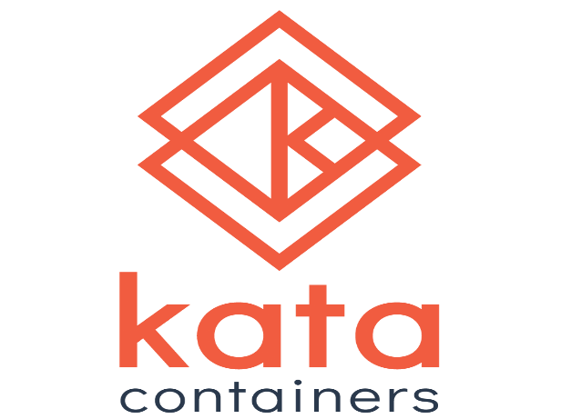
Who Is Using Zuul Today? At least inside Intel
Project with Kata Containers.
        Justification for using Zuul: avoid Jenkins maintenance on existing jobs, it is not fully implemented but it is on track.
        They like the way that Ansible playbooks works, configuration is friendly and they are saving time
*Other names and brands may be claimed as the property of others
Notes:
Who is using Zuul today at least insde Intel? Why I’m mentioning this? Because we need some Zuul implementations done and working as baseline. In theory all the advantages can sound good, but is better to see it working. Besides that, we can have some internal support and guidance as soon as we try to implement it .

Slide 8

Scope of Work
Where is StarlingX placed in relation to OpenStack?.
What can be tested in the infrastructure that already exists?.
What kind of infrastructure do we need for specific features?.
*Other names and brands may be claimed as the property of others
Notes:
What should be scope of work of this automation process?
Where is StarlingX placed from the OpenStack perspective?
What can be tested in the infra that already exist?
And besides that , what kind of infra do we need for those specific features that are included or planned to be included with the distro.
With these 3 questions, we are creating a plan in order to accomplish our goals.
Making emphasis in all the new starlingX services, just to mention some of them , configuration management, fault management host, management, service management and software management.
All of them working together with all the open stack components.

Slide 9

Challenges with StarlingX
New project based on OpenStack.
New services that provide additional functionality.
All configuration should be tested in an automated way.
There are about 3500 manual test cases that need to be automated ASAP.
*Other names and brands may be claimed as the property of others
Notes:
So, after checking all the good stuff that we can do with Zuul, What should be next?
What is our problems talking about CI?
What are the challenges that we are going to face during this implementation?
What should be the most important things that we need to consider to make it work?
As I mention before we want to follow all the rules in the Open Stack Community , that means , coding, developing, testing, documentation, reporting and go on.
Plus those special extended StarlingX capabilities that is making our distro optimized to a certain kind of hardware, such as OVS and DPDK. And added to the picture, the whole set of different configurations for the test execution in a full automated way.
Do we really need to test everything vs everything all the time?
Is there any way to corner case those test cases ?

Slide 10
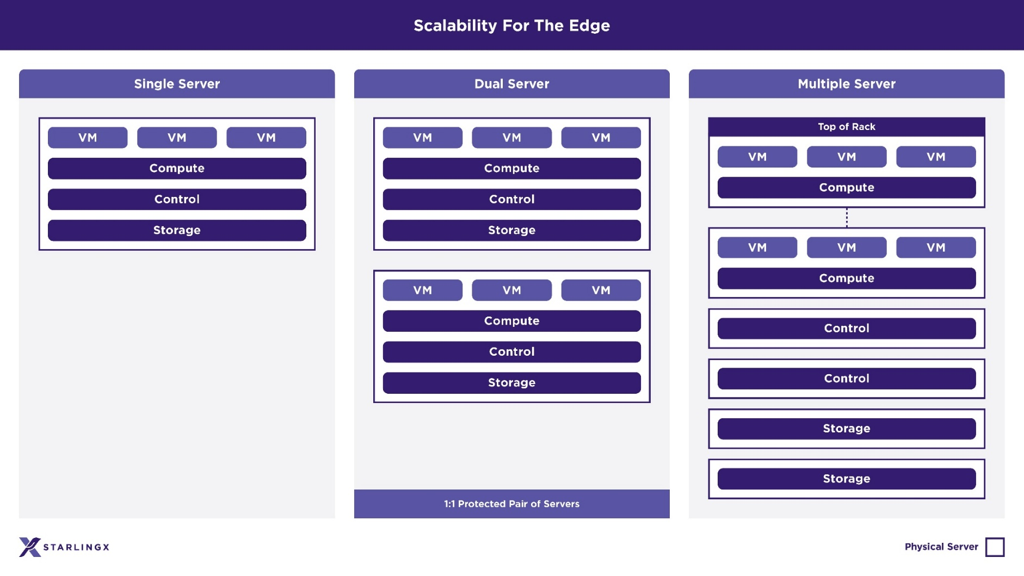
Configurations
*Other names and brands may be claimed as the property of others
Notes:
Our infra should contains testing phases according with our needs for all existing configurations, simplex, duplex, multimode with local storage, and multimode with dedicated storage.
We need to test all different configurations because we don’t want to generalize or assume that everything works, we need to determine what belongs to what, and do the proper assignation for each of them.
Besides that we want to isolate those specific tests for all.

Slide 11
Zuul Implementation
Test Development (gates)
Should be done quickly.
Needs to solve dependency issues.
Test Execution (orchestration)
Must be considered for all testing phases.
Must be adaptable for existing Jenkins jobs.
Needs to be designed for different suites.
Notes:
So, we know what our problem is,
we have a lot of test cases to automate and we need to execute them, and we want to use Zuul as gate keeper and job orchestrator.
That is why we should divide the implementation into 2 main stages.
First phase should be the test case development.
And the second phase should be the test execution.
Let’s start with the test case development , otherwise what are we going to test?

Slide 12
Test Code Development

Slide 13

Test case automation
Robot suite as automation framework
Python based.
CLI and GUI capable (bash and selenium libraries).
Tag inclusion in order to identify different StarlingX configurations.
Needs to be smart to accomplish test validation criteria and able to return expected value.
*Other names and brands may be claimed as the property of others
Notes:
The automation infra structure must contains the way to introduce automated test cases into it, identify those tests according with our hardware-software configuration, create different test cases scenarios, divide into different suites and even compare with existing baselines.
We are developing test cases using Robot, who choose robot because it is python based.
That help us in the case of having special features or special needs that can be accomplished creating some python files, robot can read them without issues.
Since we have to check our results into CLI and GUI , we can use selenium and bash type command lines.
That brings a lot of ways to test the same scenario. different forms to test something that exists already.
We should add those characteristics to our testing scope and if we play with all different configurations, we have a lot of test to develop or adjust.

Slide 14
How Is the Test Case Developed? The monolithic way
Developer’s Code
Code Merging
Github/Gerrit
Revision
+2
*Other names and brands may be claimed as the property of others
Notes:
What is the typical way to develop a test case?
If we look at the slide, I’m showing the monolithic way to develop a single test case,
The developer automates the test case, upload the code into gerrit or github, then, the code goes through revision until it has the previous stablish qualification , in some cases +3 and then, the code is merged, otherwise, if the code gets a -1 it goes back to the developer. Sounds familiar? I mean, this way is really straight forward, but is not practical.
Why not? Because we are not developing one test case at the time. We need to think big,
We need to visualize our problem. And one single test case developer can not do all this job by his/her self.

Slide 15
Scenario for Multiple Developers
Dev 1
Dev 2
From a Single Sprint, just one code made it into merged status, since the others are having merge conflicts.
Dev 3
Dev 4
Dev 5
Dev 6
Dev 7
Notes:
Let me explain this with a simple example, for those 3500 something test cases, we need at least a team of 7 engineers, just to mention a number, each engineer is working on one test case per day, what can be wrong?
As the slide shows, in a single day we can have different merge conflicts, that means that we need to solve those conflicts in order to have all the engineers test cases up and working, why is that?
Because two or more test can touch the same file, and just for luck or extremely out of this world planning , a single test case can go through without any kind of issues or merging conflicts.
Again this is going to cost a lot of extra hours.

Slide 16


What Problems Tend to Surface?
Slow development for test cases.
Merge conflicts.
Slow testing since we need to wait until someone fixes the merging conflicts.
Notes:
The problems that this way can cause are obvious, it is to “legacy”, I mean, it is ok, if there are only some needed tests, but with our project we are planning to automate, at the beginning , about 3500 test cases, plus special features , more security and don’t forget performance in order to verify that our hardware is faster as we said before.
The problems comes up as soon as the number start making noise in our head.
Can we accomplish our goals with that monolithic way to develop more than 3500 test cases?
How many centuries do we need?
What happen if my peer is working on the same configuration file or touching global variables?.
Besides that, as soon as we make some progress, how long should I wait until next test is done?.
Please consider that we should take care of those enthusiasts that wants to include their own test cases, they should go through the same model.

Slide 17
The Best Solution
Different Files
Patch 1
File A
File B
Zuul Gating
File C
File A
Zuul Gating
Merging
File B
File D
Different Files
Patch 2
File E
Notes:
At this point, this is the first problem that Zuul can solve as a gate keeper, creating different access routes for those files that can create merging conflicts.
One single patch, with different files going through Zuul every time that is needed in order to avoid those conflicts.
In that way, we are avoiding to waste time and have more test cases up and running.
Merging those test cases in to a previous branch befor master.
That is why we are creating different branches since we need to adapt all the mentioned configurations, all those test developed test cases need to be flexible for each of those test cases.

Slide 18
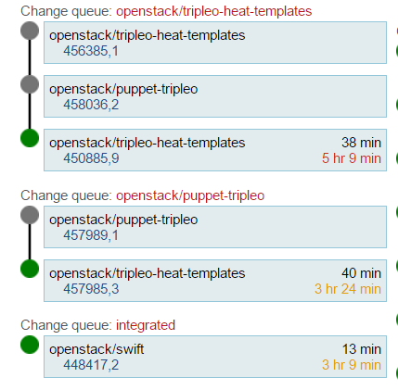
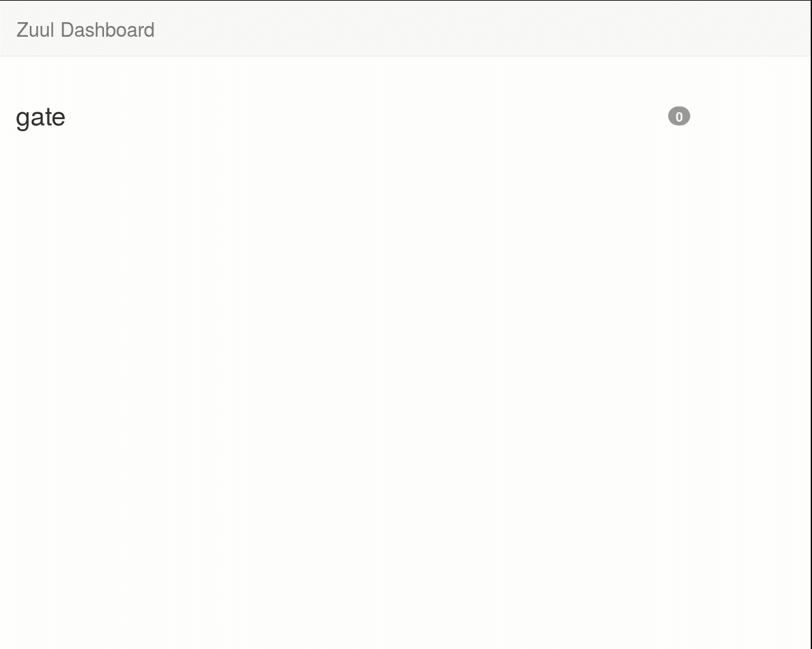
What Happens Next
Tests cases that modifies different files, should be able to go through Zuul testing avoiding dependencies problems.
* Video from https://zuul-ci.org/
Notes:
So far , our infrastructure should contain more gates that can identify and apply those test cases already merged and use them in the best way.
For that, we need to include into the test cases special tags that can handle the test cases in order to avoid duplication, or rework.

Slide 19
What does a Zuul Gate contain
Existing code for temporal repo with existing merged code.
Customized conditions that validates code health through pipelines (yaml).
Job scheduler.
Notes:
Ok, now we have zuul gates, but what does a zuul gate contain internally?
From the scratch, it has all the merged code in a temporal repo in order to compare and test the current file.
It has customize conditions that validates all this code, through pipelines wrote in a yaml format.
As a matter of fact all the Open Stack contributors are handled in this way.
All their patches are tested against each project conditions.
Returning the first +1 qualification in to their code.
In this way we are getting sure that all the developed code is sane and not breaking other stuff. But we need to modify that revision in order to make it more trustable since it needs more tuning. This depends directly on the project needs

Slide 20

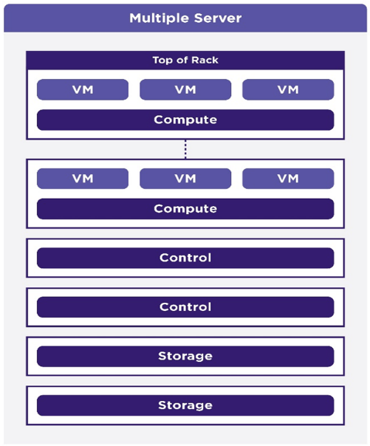
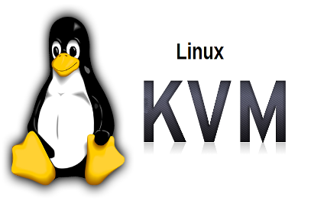
After Merging
X number of test cases that needs to be re-directed
Configuration
Component/Project
Virtualized or Bare Metal
Notes:
What happen with our project after all those automated test cases are merged?
We need to consider our testing scope right?
We need to re-direct those test cases into different ways in order to execute them.
What are those important kinds or test identifiers that we need ?
We are trying to make emphasis on obvious differences. Configurations, open stack components, if the tests if focused on Virtual Environment or can be tested on bare metal configuration.
Having those things on mind we can start thinking in the way or suites that we need to execute .

Slide 21
Job orchestration
Notes:
So, lets move on to the second Zuul use, job orchestration

Slide 22
Organize Test cases
TEST
COMPONENT
Suite 1
Suite 2
Suite 3
CONFIGURATION
SPECIAL FEATURE
Notes:
How are we going to achieve this?
Using tags, those tags, are going to be created in order to show what is the scope of each suite, starting with the configuration, specifying if is going to be executed on duplex, simplex, or multimode, bare metal, or virtualized.
Plus, one tag that contains the component, example, networking, and adding to that, another tag that contains some kind of sub domains for those who need it.
Beside that we are planning to include a special feature tag for those cases that need special attention since they the most characteristic features from the StarlingX Project.
We don’t’ want to over react with tags, and we need to be careful since we need to maintain them, and don’t turn this identifiers into future problem , trying to use a reduced number of them in a clean way.

Slide 23
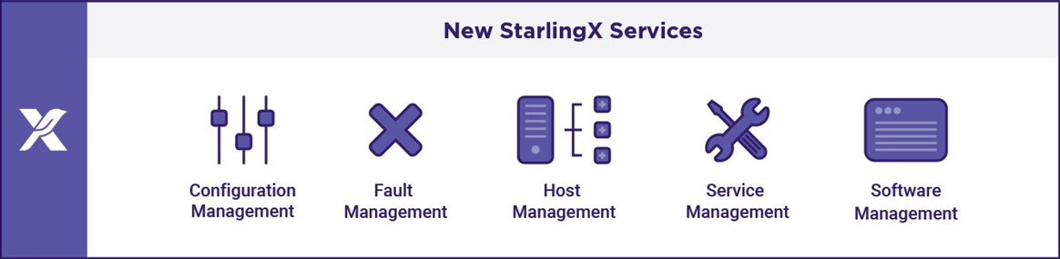
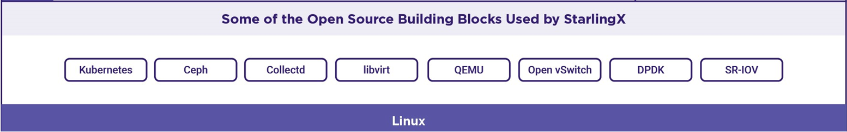
Special Features
*Other names and brands may be claimed as the property of others
Notes:
What kind of special features are we going include into the StarlingX project?
Just to mention a couple, OVS and DPDK, with those special features , we are optimizing our hardware, the idea is to reach network transfer speed ten times faster. Jus to mention an example, but as you can look in to the slide, we have a lot of them that will need special attention from us in order to validate the possibilities and showing the difference with the bases.
Those special features needs to be tested in the normal way, execute functional test cases, comparing performance behaviors , and execute them in different configurations.
Something that should be accomplished and developed in different releases. During the StarlingX growth.

Slide 24



Tests Execution
ISO (Daily)
Sanity
ISO (Feature introduction)
Special Features
Full Testing
Stable ISO
*Other names and brands may be claimed as the property of others
Notes:
This is going to be interesting, since we are thinking in 3 different main phases, first of all , we are getting one daily ISO to test.
For that daily ISO, we are executing our sanity suite.
.This suite contains about 22 basic test cases that determine if the latest ISO is healthy enough.
We are going to have special ISO’s that are going to include special feature development.
Those issues, are going to be executed with special test cases designed in order to exercise those part of the code that needs special attention, plus test cases that , like a domino effect, touches other open stack components.
The feature introduction iso , that contains all those specific feature changes that StarlingX needs,
and the latest, the official ISO that contains all the features and changes needed for an official Release. All those Different ISO in different times are going to trigger an specific Zuul job that will execute all the test suites according with our needs. For example, until today we have the Sanity Test suite up and running through a Jenkins Job, our plan, at the beginning is to keep that job and work with the gearmen plugin. In parallel we are going to evaluate the way to replace that Jenkins job with Ansible playbook in order to use Zuul , just to be compliance with the Open Stack foundation. Please take in consideration that , not all the configurations are going to be tested in a single run. Sanity is tested Daily, special features needs to be executed every time that are included, and evaluate, according with the results ,if they are going to be added to the Official Release. In that point we can say that we are going to execute in all the existing configurations.

Slide 25
What is Inside of an Ansible Playbook
Yaml Format.
Contains all the instructions that are going to be executed.
Similar but not equal to bash instructions.
$ ansible-playbook first.yaml
-hosts:
- all
-tasks:
-action: ping

Slide 26
Execution Time Line
PRE
RELEASE 1
PRE
RELEASE 2
PRE
RELEASE 3
PRE
RELEASE 4
PRE
RELEASE 5
Special Feature ISO
Special Feature ISO
Official Release
Day 1
Day n
Notes:
But, is that i? test everything vs everything all the time? Of course not, we need to check how often do we should execute this suites.
At the beginning, we need to verify all the upcoming changes that the devs are doing in a fast way. They have their own unity test phase, but we need to test it as a single environment in a fresh installation (daily ISO)This testing is some kind of smoke testing, containing just a basic test cases that executes normal flow execution, with normal flow i mean that it only check that the final product is not broken or working bad.
According with some special features that needs more work or time. We need to trigger a special execution that includes those changes that makes StarlingX unique. Since those special features needs special cares, we are executing test cases that are involved with the feature and touches open stack components.
And at third place we have the Official Release testing that tries to test every single test case that we have in all the possible configurations available. That means that we should have different suites , with different tests and different testing scope.

Slide 27
Testing Scope
Sanity
Special Features
Full Testing
Functional
Open Stack Components
Performance
Values Comparison
Special Features
StarlingX
Tempest
Compliance
Notes:
As I mention before, we are dividing our testing scope according with our special characteristics, but we should not ignore other aspects that need to be reviewed.
In this graphic I’m showing that our sanity is just a glimpse of the full testing, that contains just a small part of our scope, making emphasis on those tests that can verify that the entire ISO is able to boot and make the basic operations, such as live migration.
Those for the special features need more attention, since it should impact other Open Stack components and everything needs to work together without problems, so the scope should be different.
The full testing suite, contains per se, all the suite inside of it since is the full cycle. Just to mention some of them, beside the open stack components, we need to exercise and compare performance values in order to show tendencies and verify if the numbers are increasing or decreasing. Plus we are thinking to include tempest testing in this cycle.

Slide 28

Reporting!
Sanity
Every day
Special Features
Every time is needed
Every 3 months
Full Testing
Sanity executed on 1 configuration
Special Features and Full testing on 8
*Other names and brands may be claimed as the property of others
Notes:
In the same way that we are thinking In the execution for functional, performance, tempest.
We want to keep the report in the same way, having a master report, but with different time lines.
For this we want to use Zuul as well + the robot reporting. Thinking on something clean and easy to read .
Having the full picture on the screen.
Showing trustable and stable results. Of course, depending on the execution.
The reports must show all the information needed in an easy and understandable way, because we want to show all those result with a proper impact . Giving a strong way to demonstrate a healthy code.

Slide 29
The Full Picture
Gate Keeper
Test Code
SUITE | EXECUTION | REPORTED
SANITY | Every ISO | YES
FUNCTIONAL | Every Release | YES
TEMPEST | Every Release | YES
PERFORMANCE | Every Release | YES
STRESS | All time | YES
SPECIAL FEATURES | Every time that is needed | YES
ISOS for testing
Job Orchestrator
*Other names and brands may be claimed as the property of others
Notes:
On this slide im trying to include all the phases that we are going to implement using Zuul, as you can see we are taking advantage in two main phases, the first one as a gate keeper for code integration, and the second one as job orchestrator.
In this way we are trying to create a homogenous CI that will be taking care of all the stages mentioned before, from the test code generation until the reporting,
All of those phases fully automated using robot and executing the full test cycle.
considering that each test suite is being triggered by zuul using different Ansible playbooks, according with each test suite. And if its needed, compare historical values in order to find regressions on each test suite. Mostly focused on performance. Beside that special testing for those specific StarlingX features . And thinking in the future, we must add stress testing using the same model as another module in our testing infra structure.

Slide 30
Timeline
Starting point
A lot of manual test cases that needs to be automated.
No CI/CD.
Implementation
Zuul as a gate keeper for Test Code Deployment.
Zuul as orchestrator for different test suites.
Zuul as a main bridge for reporting.
Expectations
Zuul + Ansible, no Jenkins Jobs.
Notes:
As I showed to you during this short time, our starting point was some months ago with a lot of test cases to develop, trying to find the best way to automate them, execute and show the reports.
All these stages should be using open stack tools, such as Zuul . that give all the mentioned advantages mentioned on the firsts slides.
This process is not easy, and we need to align to existing rules. The main idea is to implement an Infrastructure handled by Zuul that can control everything from the test case development until the reporting. Easy to maintain and fully scalable if something else is needed. Ad for that we need to split it in different modules as we did before.

Slide 31
Conclusion
We plan to use Zuul as main CI tool in order to be OSF compliant because we don’t want to reinvent the wheel.
If something is working, don’t change it! Continue to use it as much as possible!.
We prefer something with which the Open Stack Community feels comfortable.
We want to maintain our “four opens”.
*Other names and brands may be claimed as the property of others
Notes:
Zuul is the best option as CI tool in order to be Open Sack compliance, that give us the opportunity to show our code in a trustable way.
We don’t want to reinvent the wheel, that can cost a lot for engineering hours, testing and deployment. Something that we don’t want to spent if the tool is in use and working good.
As I’m saying in one of the slides. If there is something out working … use it! There is no need to spend resources in the investigation and code deployment for tools.
Besides that, I know that the community can help and contribute if there is a special need talking about Zuul. And why not? Contribute for Zuul as well. And I think that one of the most important thing on this subject is that we need to keep our 4 mains principles, Open collaboration, Open design, Open Development, Open Source.

Slide 32
Communication
#starlingx@Freenode
Mailing Lists:
  lists.starlingx.io
Email:
  info@starlingx.io
  http://lists.starlingx.io/cgi-bin/mailman/listinfo/starlingx-discuss
Weekly meetings:
  Zoom calls
  https://wiki.openstack.org/wiki/Starlingx/Meetings
Notes:
Please check out starlingx in different channels, we have our freenode channel, we have our mailing list, please send any doubts, questions or suggestions to info@starlingx.io . We have weekly meetings and Zoom calls, please feel free to contact us in any way. We will be happy to hear from you. We want to make Starlingx stronger, so please let me know if you want to contribute with us.

Slide 33
Questions?

Slide 34

Contact
Elio Martinez – Sr. Quality Assurance Engineer
elio.martinez.monroy@intel.com
A Different Zuul
Zuul is a genus of herbivorous ankylosaurine dinosaur from the Campanian Judith River Formation of Montana. The type species is Zuul crurivastator.
Thank you!

Slide 35
Backup

Slide 36

An OpenStack* Pilot Project
Backup
StarlingX is a Pilot Project under the governance of the OpenStack Foundation with an Apache 2.0 license
The first community release of StarlingX is planned for October 24th, 2018
StarlingX provides high performance, low latency, and high availability for Edge Cloud applications
OpenStack invites new users, operators and contributors as we build a mission critical infrastructure stack for Edge computing
StarlingX Web Site: https://www.starlingx.io/
*Other names and brands may be claimed as the property of others
Notes:
We are excited to introduce a new open source project called StarlingX under the administration and governance of the OpenStack Foundation. The first community release is in October, 2018 and the code is being released under the permissive Apache 2 license. We are inviting everyone to try out the software, join the community, and contribute to the code base. Please check out the website.

Slide 37
StarlingX – Edge Virtualization Platform
Backup
StarlingX provides a deployment-ready, scalable, highly reliable Edge infrastructure software platform
Services from the StarlingX virtualization platform provide:
Easy deployment
Low touch manageability
Rapid response to events
Fast recovery
Think control at the Edge, control between IoT and Cloud, control over your virtual machines.
*
*
*Other names and brands may be claimed as the property of others
Notes:
StarlingX is a complete Cloud infrastructure software stack for the Edge used by the most demanding applications in industrial IOT, telecom and other use cases.
It is based on mature production software deployed in mission critical applications. We have just newly open sourced StarlingX code for Edge implementations in scalable solutions that can be productized now. It uses both OpenStack components as well as a number of proven open source building blocks to create its complete offering.
Tested and released as a complete stack, StarlingX provides a deployment-ready, scalable and highly reliable software platform to build mission critical Edge clouds.
Its unique project services include configuration, fault, service, software and host management to ensure high availability of user applications.
The StarlingX virtualization platform is designed to build up your Edge cloud quickly, manage it easily, respond and recover extremely fast.

Slide 38
StarlingX – Next-Gen Container Architecture
Backup
Pods
Pods
Pods
StarlingX is evolving to
  Running OpenStack containerized,
  On top of a Bare Metal Kubernetes Cluster,
  With OpenStack Helm managing the Lifecycle of the OpenStack Cluster.
With Kubernetes Cluster initially supporting
  Docker runtime
  Calico CNI plugin
  CEPH as persistent storage backend
  HELM as the package manager
  Local Docker Image Registry.
Along with Kubernetes cluster available for non-OpenStack end user applications.
infrastructure
openstack
infrastructure orchestration
Container Platform
HELM
kubectl
kube-dashboard
kube-dns
kube-proxy
calico
etcd
kube-apiserver
kube-controller-manager
kube-scheduler
docker registry
docker
kublet
StarlingX Services
fault management
configuration management
software management
host management
service management
Open Source Building Blocks
CEPH
OSD
CEPH
MON
Same as Controller previous Page
Linux OS
Full Support for VMs and Containers
Notes:
Ian to add speaker notes

