Slide 1

Automated NFV Deployment and Management with TripleO
Sumedh Sathaye
Jean-Pierre Roquesalane
Arkady Kanevsky
Service Provider Organization, Dell EMC
Chris Janiszewski
OpenStack Soultions Architect - Red Hat
Notes:
<number>

Slide 2

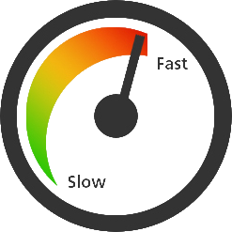


Network Function Virtualization Requirements
automation
cost
speed
open standards
Notes:
This is a high-level picture of an example NFV solution, built on Red Hat’s OSP platform.
This particular instance includes
H/W components from Dell EMC (servers, switches, and components)
S/W components from Red Hat (RHEL and OSP) and Dell EMC (scalable storage as an example)
Automated deployment capability called “JetPack”
This is Dell EMC’s join NFV solution with Red Hat.
But it can be any generic NFV stack.
The fundamental idea of NFV is to convert “network functions” in the Telco space into “virtualized network functions” (VNFs).
A few examples of the VNF stacks are:
vEPC = virtual Evolved Packet Core
vCPE = virtual Customer Premise Equipment
vIMS = virtual IP Multimedia Subsystem
VNFs is how Telco services are delivered to the market.
NFV produces cost and infra efficiencies, as well as opens the door for automated scaling, orchestration and monitoring. It also cuts time to market for the services offered, i.e. agility of service offerings is the primary business growth created by NFV. Cost savings are achieved via the use of COTS components (both h/w and s/w).
<number>

Slide 3
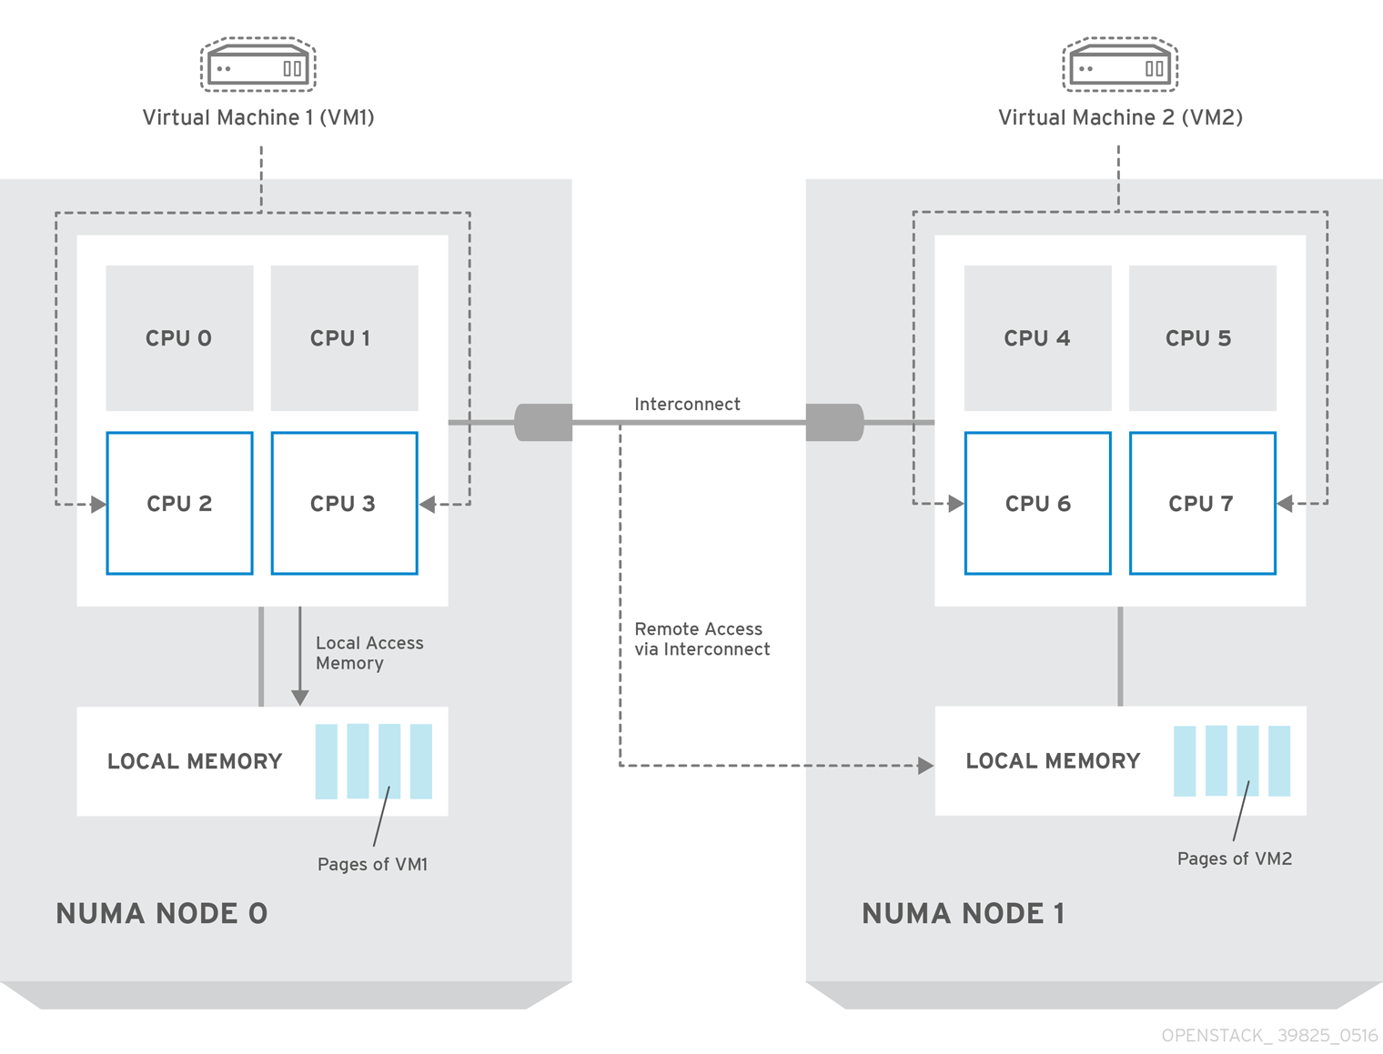
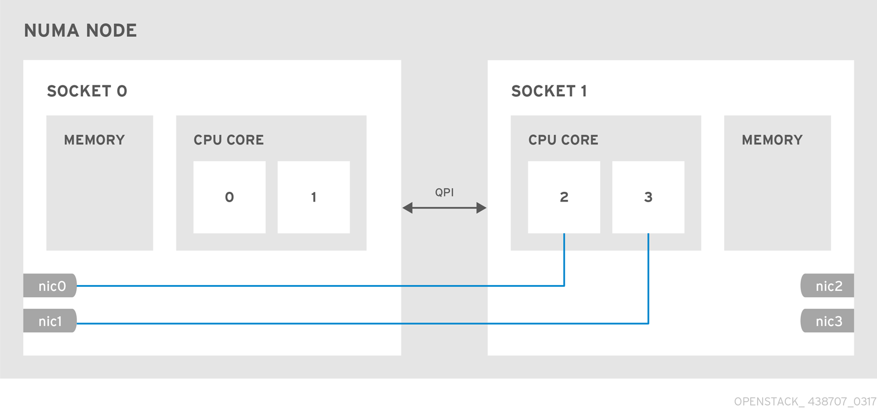
Virtualizing Network Functions – Challenges – NUMA and Memory Page to Frame translation
Notes:
This is a high-level picture of an example NFV solution, built on Red Hat’s OSP platform.
This particular instance includes
H/W components from Dell EMC (servers, switches, and components)
S/W components from Red Hat (RHEL and OSP) and Dell EMC (scalable storage as an example)
Automated deployment capability called “JetPack”
This is Dell EMC’s join NFV solution with Red Hat.
But it can be any generic NFV stack.
The fundamental idea of NFV is to convert “network functions” in the Telco space into “virtualized network functions” (VNFs).
A few examples of the VNF stacks are:
vEPC = virtual Evolved Packet Core
vCPE = virtual Customer Premise Equipment
vIMS = virtual IP Multimedia Subsystem
VNFs is how Telco services are delivered to the market.
NFV produces cost and infra efficiencies, as well as opens the door for automated scaling, orchestration and monitoring. It also cuts time to market for the services offered, i.e. agility of service offerings is the primary business growth created by NFV. Cost savings are achieved via the use of COTS components (both h/w and s/w).
<number>

Slide 4
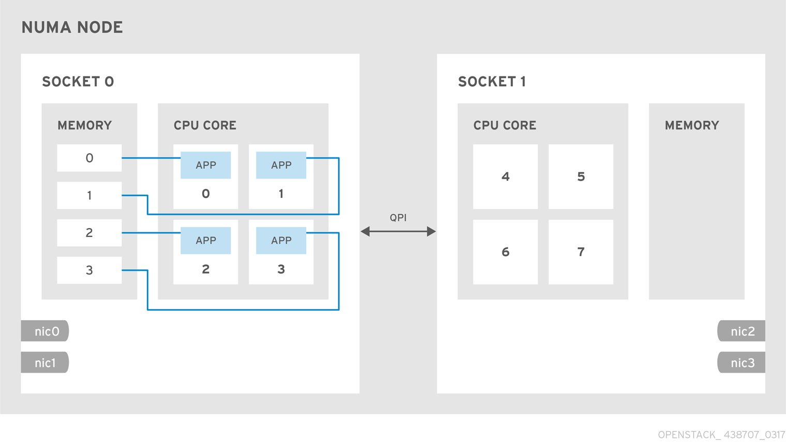
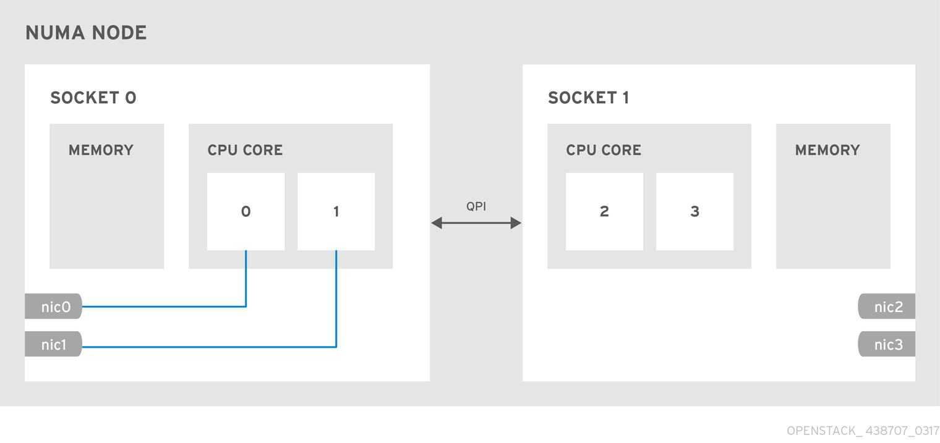
Virtualizing Network Functions – Solutions – CPU Pinning and Huge Pages
Notes:
This is a high-level picture of an example NFV solution, built on Red Hat’s OSP platform.
This particular instance includes
H/W components from Dell EMC (servers, switches, and components)
S/W components from Red Hat (RHEL and OSP) and Dell EMC (scalable storage as an example)
Automated deployment capability called “JetPack”
This is Dell EMC’s join NFV solution with Red Hat.
But it can be any generic NFV stack.
The fundamental idea of NFV is to convert “network functions” in the Telco space into “virtualized network functions” (VNFs).
A few examples of the VNF stacks are:
vEPC = virtual Evolved Packet Core
vCPE = virtual Customer Premise Equipment
vIMS = virtual IP Multimedia Subsystem
VNFs is how Telco services are delivered to the market.
NFV produces cost and infra efficiencies, as well as opens the door for automated scaling, orchestration and monitoring. It also cuts time to market for the services offered, i.e. agility of service offerings is the primary business growth created by NFV. Cost savings are achieved via the use of COTS components (both h/w and s/w).
<number>

Slide 5
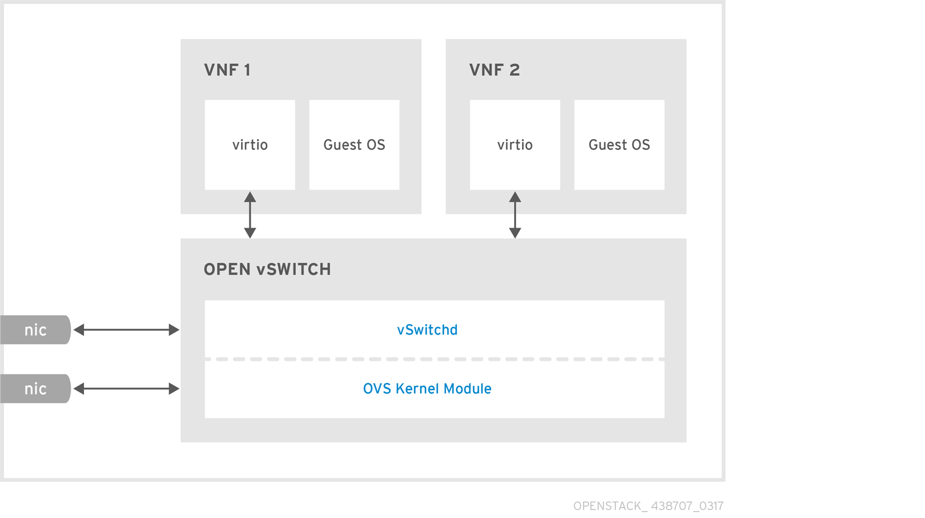
Virtualizing Network Functions – Challenges – network latency tolerance
Notes:
This is a high-level picture of an example NFV solution, built on Red Hat’s OSP platform.
This particular instance includes
H/W components from Dell EMC (servers, switches, and components)
S/W components from Red Hat (RHEL and OSP) and Dell EMC (scalable storage as an example)
Automated deployment capability called “JetPack”
This is Dell EMC’s join NFV solution with Red Hat.
But it can be any generic NFV stack.
The fundamental idea of NFV is to convert “network functions” in the Telco space into “virtualized network functions” (VNFs).
A few examples of the VNF stacks are:
vEPC = virtual Evolved Packet Core
vCPE = virtual Customer Premise Equipment
vIMS = virtual IP Multimedia Subsystem
VNFs is how Telco services are delivered to the market.
NFV produces cost and infra efficiencies, as well as opens the door for automated scaling, orchestration and monitoring. It also cuts time to market for the services offered, i.e. agility of service offerings is the primary business growth created by NFV. Cost savings are achieved via the use of COTS components (both h/w and s/w).
<number>

Slide 6
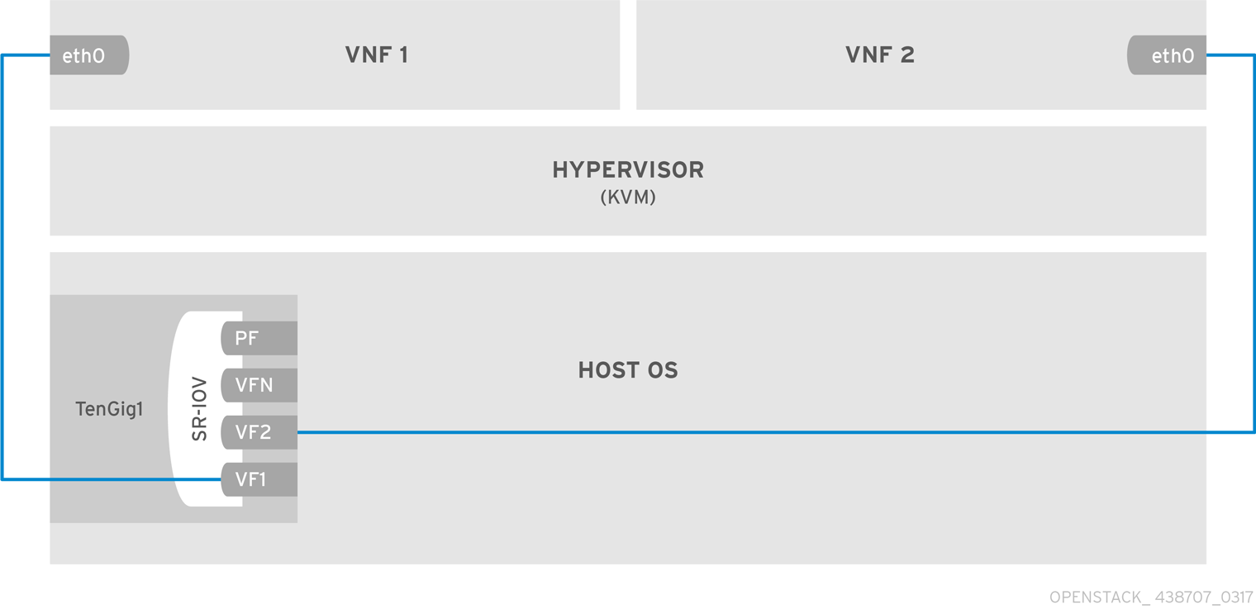
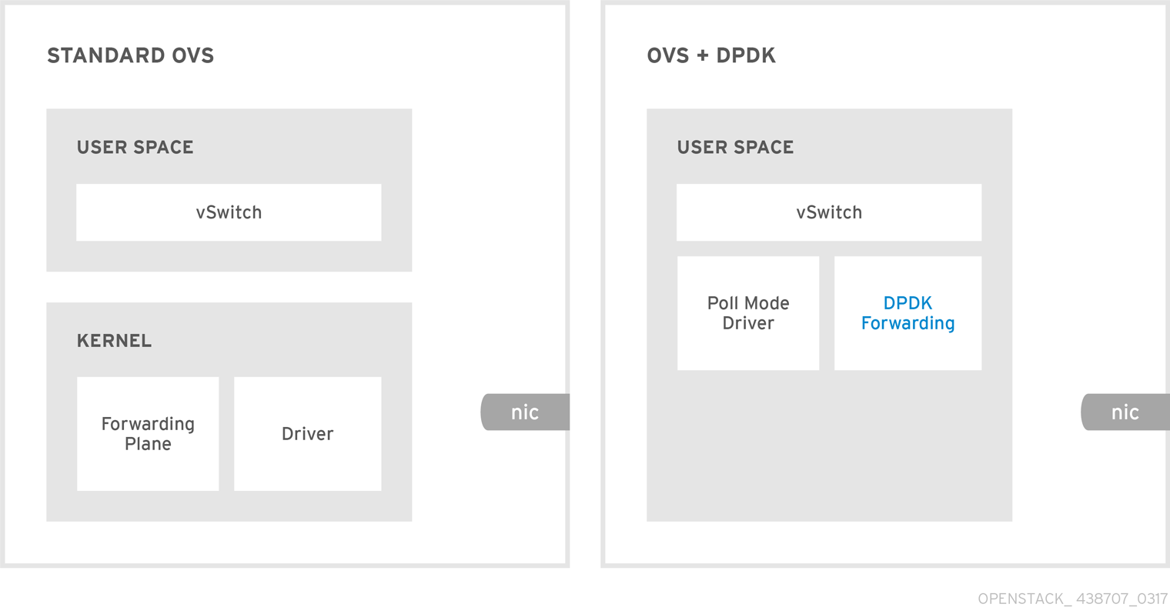
Virtualizing Network Functions – Solutions – SRIOV and DPDK
Notes:
This is a high-level picture of an example NFV solution, built on Red Hat’s OSP platform.
This particular instance includes
H/W components from Dell EMC (servers, switches, and components)
S/W components from Red Hat (RHEL and OSP) and Dell EMC (scalable storage as an example)
Automated deployment capability called “JetPack”
This is Dell EMC’s join NFV solution with Red Hat.
But it can be any generic NFV stack.
The fundamental idea of NFV is to convert “network functions” in the Telco space into “virtualized network functions” (VNFs).
A few examples of the VNF stacks are:
vEPC = virtual Evolved Packet Core
vCPE = virtual Customer Premise Equipment
vIMS = virtual IP Multimedia Subsystem
VNFs is how Telco services are delivered to the market.
NFV produces cost and infra efficiencies, as well as opens the door for automated scaling, orchestration and monitoring. It also cuts time to market for the services offered, i.e. agility of service offerings is the primary business growth created by NFV. Cost savings are achieved via the use of COTS components (both h/w and s/w).
<number>

Slide 7
Features of the Platform for NFV
HugePages – for virtual memory optimization
CPU Pinning – for NUMA optimization
SR-IOV – for guarantees of Bandwidth
OVS-DPDK – for high-performance N/W overlay
NIC Alignment – for bottleneck-free packet processing
Real-Time KVM – for bounded response times from VMs and Containers
SDN Controllers (e.g. ODL) – for optimized and flexible networking
Other fast-data path technologies (e.g. VPP, fd.io)….and so on
Notes:
To support the VNFs, a certain level of service-level guarantees are needed. Generally speaking, Telcos design the virtualized infrastructure for a known capacity (e.g. number of simultaneous calls, internet connections etc.)
To achieve the capacity numbers, as well as to determine service-level guarantees, many features are expected from the underlying virtualized infra.
This is a list of what are commonly considered as the “NFV features”
HugePages and CPU Pinning optimizations (1) improve performance, (2) and reduce impact of unknown events (e.g. page faults, remote cache accesses etc.) all of which can be adders to the total latency budget. The more you can reduce the latency impact of any of the platform events, the better.
SR-IOV (Single Root – I/O Virtualization) enables precise b/w allocation to VM Instances. It converts a single physical port into multiple virtual ports, each with a guarantee of bandwidth. VNFs depend on the unshared, guaranteed bandwidth to meet the SLA expectations e.g. no. of simultaneous voice connections etc. SR-IOV is a great enabler for that.
OVS-DPDK. OVS = OpenVSwitch. DPDK = Data-plane Development Kit, invented by Intel. DPDK turns the interrupt-based I/O model on its head, and handled ALL packet I/O via polling. Polling requires a dedicated core for continuous packet ingress/egress processing, however, it offers total predictability in packet processing latency.
OVS, of course, is the virtualized network overlay that is the backbone of OpenStack. When combined with DPDK, OVS is able to offer predictable packet processing latency. All VNFs crave predictability, which is why the OVS-DPDK combination is crucial to NFV.
So, now you have enabled HugePages, pinned down important VNF VM instances into CPUs, given them guaranteed b/w via SR-IOV, and are carrying packets via DPDK. What’s the next bottleneck? Frequently, the CPU sockets in which the VM instances are pinned down, are not physically aligned with the physical ports/networks on which the SR-IOV networks are carried.
NIC Alignment takes care of this. It’s the ability to choose (1) which socket CPUs to pin an instance in, and (2) which physical ports/wires over which the traffic bound for the instance is carried, and lastly (3) associating one with the other. When you are able to do this in a flexible manner, it eliminates the inter-socket communication overhead, over the QPI or the new UPI bus. This overhead can be significant – anywhere from 80 to 200 CPU cycles. When you are processing 12M+ packets per second (10GbE speeds), it becomes a huge latency adder!
The KVM is always there – silently providing services, partitioning, and protection to VM instances, as needed. However, its actions can have an impact on the latency of services offered by the VNFs running in VM instances. What’s worse, the impact can be intermittent, and thus unpredictable, even if bounded. This happens due to hypervisor context-switching activity at the KVM level. The RT-KVM (real-time KVM) of the Linux kernel placed bounds on the latencies of these unplanned and unpredictable events. With the bounds known, a service architect can now determine the worst-case service capacity and quality impact, which is a critical requirement for all NFV computation.
SDN, or software-defined networking enables the ability of carrying virtualized networks. This ability is critical to service providers because it is the bedrock on which multi-tenancy is built. Each customer of a service provider using NFV must feel as if theirs is the only network served by the provider. This illusion enabled the provider to (1) guarantee service capacity on a per-tenant basis, (2) provide isolation on a per-tenant basis, and (3) monitor & secure on a per-tenant basis.
Several technologies are taking root in the platform, which further aid the objectives of NFV. These are collectively being called fast-data path (FDP) technologies.
VPP = vector packet processing – enables the use of the SIMD (single-instruction, multiple-data) processing model in a general purpose CPU or GPU. I.e. 4 packet headers processed at a time, in s/w. How? Special, 256B wide registers hold the 4 headers and a single instruction operates on them.
We will only mention fd.io as an emerging NFV technology and not delve deeper.
<number>

Slide 8
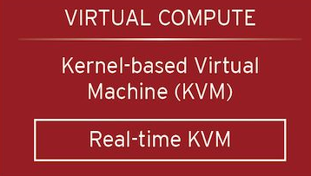
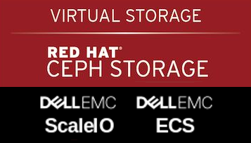
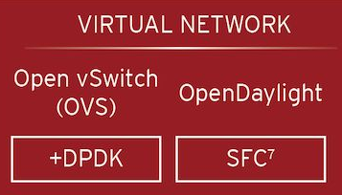


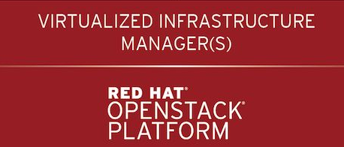

Network Function Virtualization on RH OpenStack
vEPC
vCPE
vIMS
SD-WAN
vCE
Other VNFs
NFV MANO
NFV Orchestrator
NFV Infrastructure
VNF Manager
Virtual Storage
OVS
ScaleIO
ECS
OVN
Virtual Compute
Ceph
Virtual Networking
Storage
Virtualized Infrastructure Manager
Compute
Storage
Networking
NFV FCAPS
PowerEdge
ESI/DSS
XtremIO
VNX
Isilon
S-Series
Z-Series
OS9 | OS10 | Open Networking
Hardware Resources
Operations
Management
Notes:
This is a high-level picture of an example NFV solution, built on Red Hat’s OSP platform.
This particular instance includes
H/W components from Dell EMC (servers, switches, and components)
S/W components from Red Hat (RHEL and OSP) and Dell EMC (scalable storage as an example)
Automated deployment capability called “JetPack”
This is Dell EMC’s join NFV solution with Red Hat.
But it can be any generic NFV stack.
The fundamental idea of NFV is to convert “network functions” in the Telco space into “virtualized network functions” (VNFs).
A few examples of the VNF stacks are:
vEPC = virtual Evolved Packet Core
vCPE = virtual Customer Premise Equipment
vIMS = virtual IP Multimedia Subsystem
VNFs is how Telco services are delivered to the market.
NFV produces cost and infra efficiencies, as well as opens the door for automated scaling, orchestration and monitoring. It also cuts time to market for the services offered, i.e. agility of service offerings is the primary business growth created by NFV. Cost savings are achieved via the use of COTS components (both h/w and s/w).
<number>

Slide 9

Why Red Hat OpenStack Platform - TripleO?
Technical:
Deployment and Lifecycle Flexibility
Feature set
In-place Upgrades
Part of OpenStack project / standards
Business:
Partner Ecosystem
Award winning, follow the sun support
Entire Stack ownership
Know-how
Notes:
Why TripleO? Why not a separate engine? Why not post-deployment <something>?
TripleO is good, and getting better. The project philosophy is one of minimalism (so it seems), which makes the processes just as complex as needed, but not overtly so.
It is a thriving project, led by the best of the industry. The well-defined, and general methodologies of TripleO deployments are quickly consumable and extensible for our purpose.
It also has the vehicle of the Node role that looked like the natural choice for us, to enable NFV features. We overload the default Compute role, and call it our own Custom Role, and that become the vehicle for us, as you will soon see.
TripleO also present several challenges:
It is rather new. The mitigating factor is that it’s moving with great velocity.
It lacks the maturity of other OpenStack projects because of its young age. We believe that over time, TripleO will mature nicely, and become robust.
[Need to very careful. Need to walk a tight line. Our participation on TripleO is rather cursory. We add config and extensions. Not to the core of TripleO. We need to position ourselves as outsiders, rather than active developers. It's a given that we will be submitting it to the community, eventually.]
<number>

Slide 10


Red Hat and DELL – The perfect partnership
Best in class hardware
Distributed Continued Integration Partner
OpenStack and Linux contributor
Enhancement for Lifecycle Management of NFV features with Dell JetPack
Turn-key solutions
Single Vendor support model
Notes:
If you take a look around the industry as to how these and similar NFV features are enabled in the context of OpenStack, you are left wanting than satisfied.
Service Providers who have the wherewithal are taking a DIY approach. Those who don’t, are depending on the VNF vendors to help them, or carry out the enablement on the layers below the VNFs.
Either way, this is leading to several shortcomings – which are going to become huge impediments in the future.
Here is a list of issues with a DIY approach:
Partial implementations: Often, the enablement is carried out absolutely to the extent necessary, and not with a holistic design approach.
Costly: the cost of the enablement is often a high adder to the base project, often the VNF enablement.
Flexibility: Consequently, little or no attention paid to the flexibility of the enablement.
Extensibility: what if the Linux kernel tomorrow starts supporting 16GB pages (the h/w already can). What if there are 4 or 8 or 12 CPU sockets – what will CPU pinning & NIC alignment have to look like, then? Most enablement does not pay attention to extensibility, rather they only focus on the means to 1 single end – get a VNF implemented.
Driven by high-level VNF requirements: what this generally means that a single VNF is what the enablement might be good for. Each new VNF will need changes/fine-tuning, which may be more expensive to carry out than taking a holistic approach from the beginning, as we have attempted to do here.
Complex: the complexity of the NFV feature enablement comes from their inter-dependencies. When you want both SR-IOV and DPDK (for example), how do you configure the compute nodes such that the balance of function (and utilization of resources) is achieved. Now, think about the 100s of combinations of the various features listed on before, and consider the complexity of this enablement. Unless you take a disciplined, deliberate approach to NFV feature enablement, you will find yourself dealing with unmanageable, complex, and frankly, buggy code that works for a very small subset of cases, and almost nothing else.
Huge skill-set requirement: the moving parts implies in the NFV feature set are complex, require knowledge of the underlying server, n/w, storage h/w and software, as well as the VIM platform (OpenStack) knowledge. Anybody who has tried to hire these skill-sets fast, knows what we are saying here!
Finally, A lot of different pieces need to be integrated.
H/W, S/W - including config settings on the switches, underlay/overlay networks, Linux & OSP components (eg Ceph), firmware and offload functionality. Having a single admin and mgmt point of view is crucial.
<number>

Slide 11
How to use TripleO for “Day-0” and “Day-N” Enablement and Lifecycle Management of NFV features?
Notes:
So, with this background, we set out by asking ourselves this question.
I am going to pause and let you stare at you for a while.
Notice that we want everything done via existing (and hopefully established) processes in TripleO.
Note that in this context, “Day-0” means at the initial deployment point in time. And Day-N means any time after the initial deployment has been completed and validated. Let that sink in. This requires the Day-0 processes to remember what was done Day-0. It means that the Day-N processes should be able to read and make sense of the earlier enablement(s). It also means that they should be able to deal with version changes in that information. It is a rather complex (and hence interesting!) problem to take on.
<number>

Slide 12
Our Solution: Overview
The Context
Red Hat OSP
Red Hat OSP Director
Dell EMC Jetstream JetPack automated life-cycle management software
  https://github.com/dsp-jetpack/JetPack
First Feature Set:
HugePages
CPU Pinning for NUMA optimization
Deployment only initially
The Approach
Custom Role “Dell NFV Compute”
Feature parameterization via JetPack settings files – OR – RHOSP Director UI
Database state to remember last-enablement
Puppet for customization of Heat Templates
Day-0 Enablement embedded within standard deployment
Day-N Enablement looks like a Compute node addition or update
Notes:
So let’s bring it all back together:
In the context of this talk, our project is based on RHOSP (10). It uses OSP Director (i.e. RH’s version of TripleO) for the deployment, and thus the enablement of the NFV features.
Layered on top of RHOSP (including OSP Director), is JetPack, Dell EMC’s deployment automation layer. JetPack was developed for the sole purpose of making the life our customers easier, when deploying RH OSP, and managing life-cycle of the solution.
In this first iteration of this project, we decided to enable a small subset of the NFV feature set: HugePages and CPU Pinning for NUMA Optimization.
So, bringing it ALL together, the overall solution approach is as shown on the right.
(at this point, simply walk them through each bullet – no big explanations needed, because the rest of the presentation will do exactly that.)
We are not claiming that there is no other work being carried out in TripleO upstream on this topic. Here is the link to Franck’s blueprint proposal.
Here, we are just:
Prototyping with JetPack
Using standard TripleO tooling and methodology
Will submit to upstream.
We do NOT plan to ignore the work being done upstream.
MariaDB used for the new DB, and new tables to hold the state of the NFV features, 1-row per node, as enabled.
With that, our solution will be able to take advantage of DB high-availability of RHOSPd, as it becomes available in the future.
<number>

Slide 13
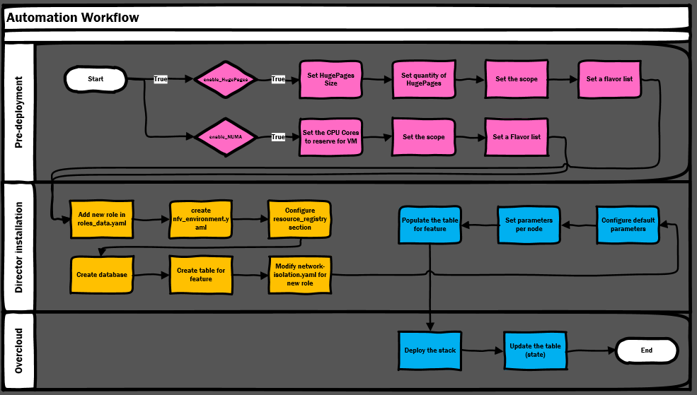
Solution: High-Level View
Managed by Heat/Puppet
Managed by JetPack
User actions
Notes:
The high-level flow of the solution is depicted here.
We notice that there are 3 main aspects to the solution:
Pre-deployment steps
RHOSP Director actions
Overcloud deployment actions
The rest of the talk will give more details of the process. At this point, it is good to note the many moving parts necessary to make this solution work. It also shows that parts that are managed by Heat/Puppet, and those that are managed by JetPack. We will revisit this picture again during this talk.
<number>

Slide 14
Our First steps.
A closer look into Day-0 initial deployment

Slide 15
Custom roles
Three key factors led us to use it as part of our design
Customizable: allow the user to set the features based on his/her needs
Flexible: allows modification during the lifecycle
Extendable Methodology: can accommodate other purposes such as data analytics, HPC, Hadoop, etc…
Notes:
The initial approach of our design was to consider three key factors.
The solution need to be customizable, and this is the most important part as the whole project depends on it. Nothing would be possible without the ability to set specific parameters on a per-role basis. That being said, we want to allow each and every user to customize the platform to accommodate his needs.
Flexibility is also something to consider. It is a good thing for being able to configure the deployment at the initial runtime, but what if the user wants to modify this configuration? Not to mention also that needs can change overtime during the lifecycle and disruption is not an option when that happens.
Additionally, this methodology can be extended to other role-specific purposes such as HPC or hadoop to name but a few.
<number>

Slide 16
NFV Compute custom role
A new Overcloud role defined e.g. « Dell-NFV-Compute »
A scheduler hint to help Nova pick a baremetal node
  based on overcloud node name
Network configuration and isolation is provided to the nodes using regular compute configuration
Parameters such as the flavor and the number of nodes to deploy is included into a new environment file
Notes:
The creation of a new custom role requires a set of modifications. First the definition of the roles need to be modified and a new role will be added.
JetPack doesn't assign roles to the baremetal nodes, but rather uses a scheduler hint based on the name of each node. This method is based on a definition of filters or scheduler hints described in a node placement file. As a result, a new scheduler hint is needed.
Network configuration and isolation specific to this new role need also to be created. These modifications will be done similarly to the way it's already executed with the basic compute node.
Static IP could also be provided but is not mandatory
An additional environment file will be created and parameters such as the flavor or the number of nodes based on the custom role to deploy will be set into this file.
<number>

Slide 17
Composable services
One service per NFV feature
Services will be « composed » into the custom role
Per new NFV services:
  Configuration will be achieved by leveraging Puppet manifests and Heat Templates meaning the creation of a new Heat Template
  Similarly, new Puppet manifest included into the Overcloud-full image
Configuration parameters are passed via Hiera and defined within the environment file. (Overcloud configuration files)
Notes:
There is one service per feature, meaning one service for hugepages and one for CPU Pinning. These two new services will be added within the role definition file.
(For features for which the services already exist, we will use those services (e.g. SR-IOV, OVS-DPDK etc.))
Creation of a service requires a heat template that will be called during the deployment. Similarly, one heat template per feature is needed. Theses files create an interface between Heat and the puppet manifest that actually configure the feature.
Heat will call these manifests right after the overcloud image is deployed on each node requiring us to modify the image.
An Overcloud config file including all of the configuration parameters will be created. All of these parameters and values will be stored within Hiera.
Environment files are the Overcloud config files. These are passed on the command line with the -e flag.
[Remember these phrases: "Composable services" and "Custom Roles“]
AI: JP - We should look at upstream - are there services for HugePages and NUMA?
Services are mostly used to install and configure openstack services like nova, neutron and so on. We are using this functionality a bit off its original usage, which is the configuration of the node itself by exposing the NFV features as services.
<number>

Slide 18
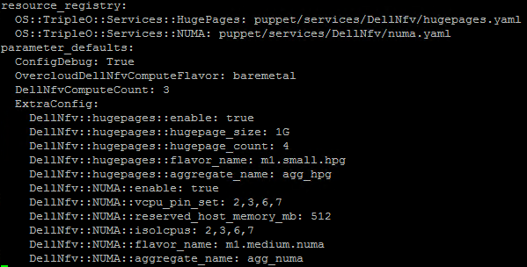
Required parameters
The environment file includes the following:
  OvercloudDellNfvComputeFlavor
  DellNfvComputeCount
  HugePage specific variables
  CPU Pinning specific variables
Notes:
This slide describes the parameters required within the environment file. This file is added when the deploy command is fired up.
OvercloudDellNfvComputeFlavor is the flavor used for deployment. In JetPack, the same flavor is used for all roles, which is the baremetal
DellNfvComputeCount specifies the number of node based on the new custom role that we want to deploy. This parameters can also be used to scale-up the platform.
Then we have specific parameters of the feature to configure.
<number>

Slide 19
Now, what’s next?
How can we deal with lifecycle management?

Slide 20
Configuration Hooks
We need an interface which can modify the configuration of a node during its lifetime
This interface will apply modification events on the NFV compute ready nodes (e.g. Dell-NFV-Compute nodes)
The whole thing will be managed by Puppet
Other Lifecycle Events managed likewise: add nodes, change node roles, etc.
Notes:
We are now looking into a method to inject our configuration into the overcloud deployment process.
First, this interface will be responsible for the configuration changes of the overcloud during its lifetime.
This situation occurs when the creation of the overcloud is complete and we want to inject additional configuration after the core Puppet Configuration.
Second, all of the NFV compute ready nodes will be targeted for modification event. All other nodes such as Controller, regular Compute and block storage nodes will remain unchanged.
Puppet, which is already used for configuring core services, will be responsible for all of that.
[Footnote:
Red Hat folks might have the following argument:
They have scripts to do the upgrade/update
This may seem like a repetition of that work.
We are saying: things are managed by Puppet. We will not use the RH mechanisms for changes in lifetime. We will use JetPack for now.
When we submit upstream, it may be make another script, or may run as a new RESTful service within Director.]
<number>

Slide 21
Configuration hooks
TripleO design does not have a mechanism to search for assigned node roles
We need to find all Dell-NFV-Compute role nodes. How?
  Requires testing statement based on the role (managed by Puppet)
  A single manifest does the trick for all features.
  Parameters are passed using Hiera
Then, the OS::TripleO::NodeExtraConfigPost hook used to perform lifecyle management modifications
Notes:
Post-deploy additional configuration is possible via the OS::TripleO::NodeExtraConfigPost interface, which is applied after any per-node configuration has completed.
The OS::TripleO::NodeExtraConfigPost applies configuration to all nodes, there is currently no per-role NodeExtraConfigPost interface. As a result, this use-case requires specific testing based on the name of the server.
Also, only one manifest can be executed using the configuration hook. This manifest needs then to include configurations for all the features. Additional test is implemented based on the parameters provided by the user
An additional line needs to be included into the environment file to map the template to the hook. Parameters values are also filled base on what the user will provide in the settings file
<number>

Slide 22
NFV Features Tracking Database
Tracking the state of all the features is important
All changes to parameters must be captured and stored at each change event during the lifetime of a deployment
Consistency of the data is a crucial factor when supporting lifecycle management of features
Notes:
Changes to the parameter values, or disablement (but NEVER removal) of an enabled feature must be captured.
Each time the state changes, it is logged in the DB. The last change is timestamped and the success/failure is captured.
It is extremely important to have consistent state data in a dependable manner. Otherwise, the deployment (the compute nodes, specifically), will enter an unknown state, recovery from which will be very difficult. We have strived to always be in a known-good state.
In TripleO, there is not natural place for the per-feature per-node state information to be held, nor is it available today.
We created a new set of tables
<number>

Slide 23
NFV Features Tracking Database
Database uses a new schema design featuring a whole set of new tables
Existing database management software in RHOSP Director is leveraged
New tables added – one per NFV feature
The tables are populated by Puppet at initial deployment and altered during lifecycle events
Notes:
At the initial deployment, JetPack deployer will create a new database as well as all of the tables needed including but not limited to versioning and features with an appropriate schema. This part can be easily managed by using SQLAlchemy within python scripts. The deployer will use the existing MariaDB layer to create the database specific to NFV features enablement and all of the tables. The schema is part of our design and is absolutely new.
MariaDB which is already installed on the Director as the main database management software for all openstack services will be used for storing all data when it comes to state tracking.
Each NFV Feature will have his own table, meaning that if a new feature is to be addedd going forward, an easy update process can add the table within the existing database.
There is no wait-and-retry method, therefore if the feature failed to be configured then the user will be warned by the script and he will be responsible to retry to enable the feature.
Some of the tables will be static, some others will be dynamic.
[JP?] AI: We should check when DBs exist in Upstream and in OSP 12? Pike? RH has 6 roles defined. Do they have separate DB per role? Is it a standard DB for all roles, with a per-role table?
As for Newton (RHOSP 10), there is no per-role DB. DB is broken down in a per-project database (ie Neutron, keystone, nova, ironic, etc…)
RH has 5 roles defines including controller, compute, blockstorage, objectstorage and cephstorage. Again no DB per role, all roles information are stored into ironic.
<number>

Slide 24
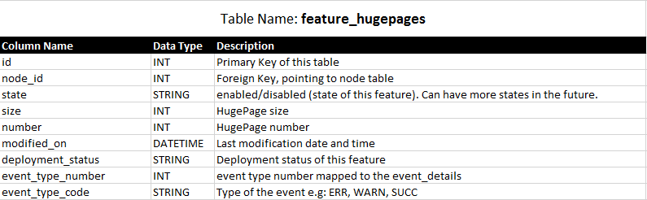
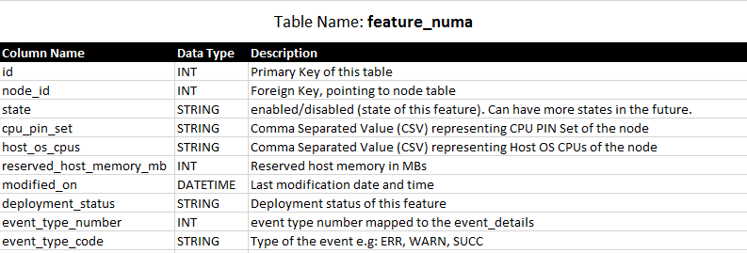
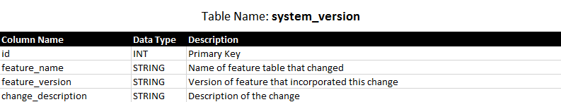
Database Schema
System_version table is used to guarantee upward and downward compatibility
of schema versions.
Notes:
This slide depicts the tables added for NFV enablement state-tracking purposes.
Three tables are shown:
The system_version table is used for database schema versioning. If the table does not exist, it is created and carried forward until the end of time, with no schema changes allowed in it.
It keeps the names and version numbers (monotonically increasing positive integers, held as a string) for EACH NFV feature enabled.
As an example, for the two features we are enabling this time, two tables are defined, one each for the HugePages (feature_hugepages) and NUMA (feature_numa) features.
Information related to the enabled state for each feature is held in these tables, along with a pointer back to the Ironic Node table.
As / when the schema of a feature table is changed, the version number for the table is increased.
A release of JetPack will know the highest feature schema version that it can support. If the version number is lower than it, JetPack can provide upward compatibility.
On the other hand, if the version number is higher than what JetPack knows about, it can exit gracefully by asking the user (1) that it has not ability to handle the higher version number, and (2) the user should upgrade JetPack so that a newer version will be able to handle and manage the feature for them.
[Footnote:
We are a bit leery of this proposal slide.
Machinary designed to support micro-versions, created upstream, may have some super-imposition with the DB schema approach that we are taking.
Our defense: Two fundamental aspects:
we need this now, for our customers.
The audience may hold us to the fact that we are part of the Open Source community (so why are we designing our own?)
We may have to take some brickbats.
]
<number>

Slide 25
Build, Automate!
How to give the user a seamless experience?

Slide 26
General workflow
Managed by Heat/Puppet
Managed by JetPack
User actions
Notes:
This is a high-level picture of the general worklow. It’s intended to describe how pieces are interconnected to each other.
Let’s take a closer look at it.
The workflow can be broken down into two parts.
The first will be managed by JetPack deployer and will do all tasks related to the customization including the modification of the roles mapping file and the network configuration with isolation for all the NFV compute ready nodes.
Besides, based on what has been defined into the settings file right before firing up the JetPack deployment process by the user, the deployer will fetch these parameters and populate the environment file that will be used during the creation of the stack.
It’s worth mentioning that the deployer will also create all database and tables needed by the features.
Second part will be managed as a team between heat templates and Puppet manifests.
It will ensure consistency of the configuration by checking if the feature is enable or not and will configure parameters accordingly. The NFV Features values will be injected into the appropriate tables and the stack will be deployed.
Depending of the completion status of the configuration, whether it is a success or a failure, the last known status will be set accordingly into the table.
<number>

Slide 27
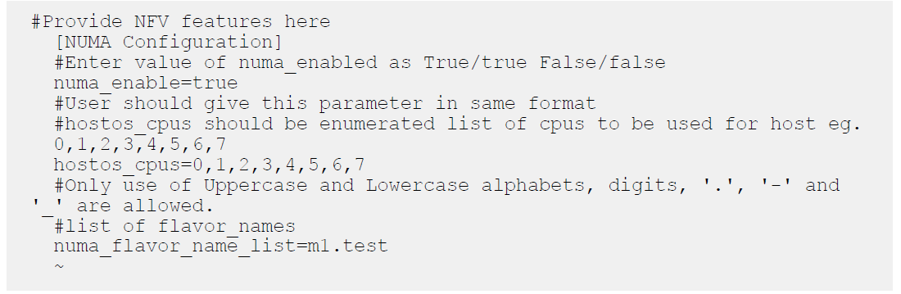
JetPack .ini file detail
Notes:
JetPack will have default values for these key=value pairs
(in the future), perhaps based on h/w introspection does by Ironic
defaults could be, as examples:
Enable_numa=False
Hostos_cpus=0,1,2,3
Numa_flavor_name_list=Null
<number>

Slide 28
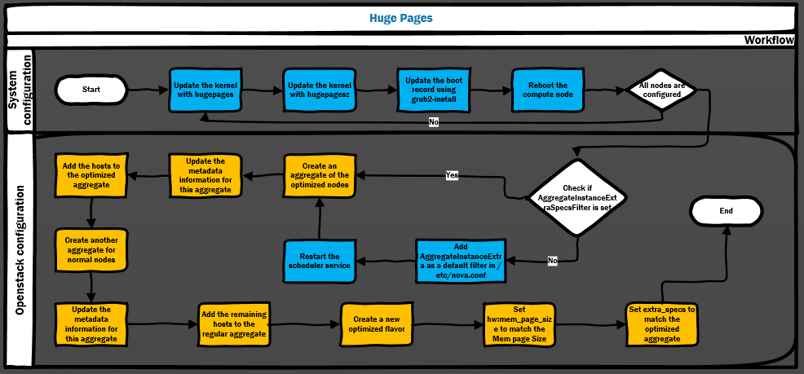
Huge Pages workflow
Managed by Heat/Puppet
Managed by JetPack
Notes:
This workflow describes the workflow that will take care of the Huge Pages Configuration.
Let’s take a look deeper in it.
When the heat template invokes the Puppet Manifest and depending on the parameters set which are fetched from Hiera, the process updates the kernel with the number of hugepages requested and the size chosen. Then the boot record is updated to reflect the kernel changes and finally reboot the host. This part is repeated for each NFV compute ready node to configure.
Once a node is configured correctly, a check is invoked and the appropriate table into NFV tracking Database is updated.
If all the nodes are configured according to the user request, then Puppet check if the default filter section of Nova includes the AggregateInstanceExtra filter. If that’s the case then Puppet configuration is complete, if not Puppet does a last step requiring nova to be modified and restarts the scheduler on eacht NFV compute ready node.
At this point, JetPack deployer creates a new aggregate for all NFV compute ready nodes that have been enabled for HugePages usage and put all of these hosts in there.
JetPack deployer also creates a regular aggregate for all basic compute nodes that don’t require NFV-specific configuration.
Finally, the JetPack deployer creates a flavor and tag it for appropriate use of the aggregate.
<number>

Slide 29
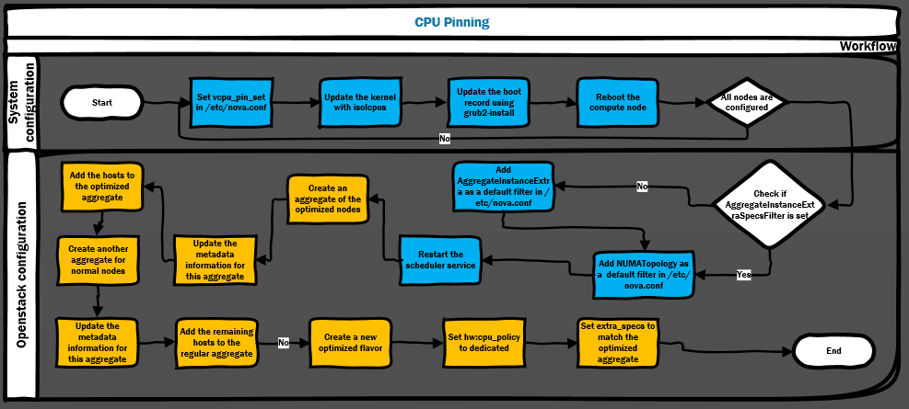
CPU Pinning workflow
Managed by Heat/Puppet
Managed by JetPack
Notes:
This workflow describes the workflow that will take care of the CPU Pinning Configuration.
Let’s take a look at it.
Similarly to what is achieved with the Huge Pages configuration, the first step handled by Puppet is to configure each NFV compute ready node depending on the parameters set for CPU Pinning configuration.
Then the boot record is updated to reflect the kernel changes and finally reboot the host. This part is repeated for each NFV compute ready node to configure.
Once a node is configured correctly, a check is invoked and the appropriate table into NFV tracking Database is updated.
If all the nodes are configured according to the user request, then Puppet check if the default filter section of Nova includes the AggregateInstanceExtra filter.
Note: In the case the NFV compute ready nodes are already configured for NFV specific features, this filter is already present as a default filter in Nova.
If that’s the case then Puppet adds a new filter specific for NUMA to Nova and restart the scheduler on each NFV compute ready node. , if not (meaning no other NFV specific is already enabled) Puppet adds both filters as default filter to Nova.
Remaining steps for JetPack deployer are the same as for Huge Pages, meaning aggregate and flavor creation including appropriate extra_specs for the flavor.
[NOTE that when multiple features are being enabled, and each enablment step requires a set of common actions (e.g. node reboot), we will combine such common actions as best and as appropriate as possible. It’s future work.]
<number>

Slide 30
The deployer.
What’s really under the hood?

Slide 31
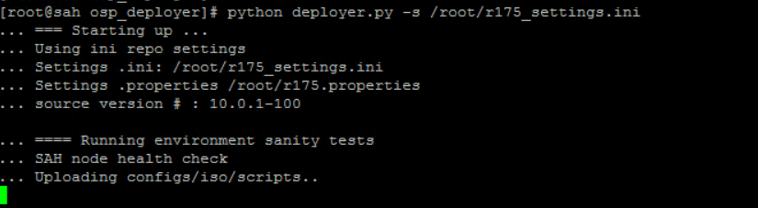
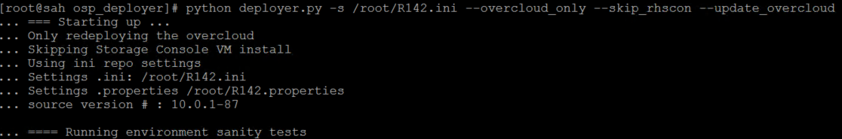
Day-0 and Day-N operations
At the initial deployment
During the lifecycle
Notes:
Day-0 and Day-N are different operations which means also different approaches for deploying an initial stack or update an existing one without any disruption.
On the left-hand side, we have a deployment command which creates a stack from the ground up, deploying also the undercloud and the storage console.
On the right-hand side, the situation is very different as we are assuming here that the overcloud has already been deployed and as a result we don’t want to destroy the stack.
The plan is then to skip the installation of the undercloud and the storage console and simply tell the deployer to roll an update of the stack. That update will only apply changes on the existing stack.
<number>

Slide 32
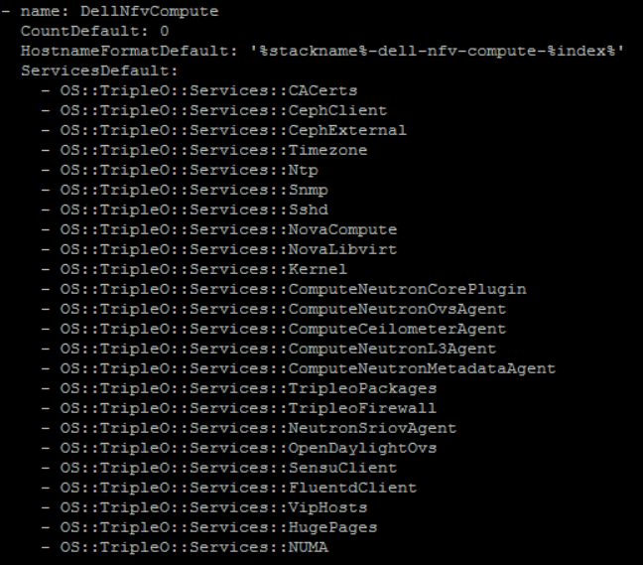
The role and the parameters
Notes:
On the left-hand side, the role definition file has been modified by adding a new custom role called DellNfvCompute. Default number of nodes for this role is intentionnaly left to 0 meaning that it’s not mandatory to have any of these nodes present.
Specific name will be assigned to provide better identification of these nodes.
Finally, two additional services are added for the first two NFV Features expected to be supported.
On the right-hand side, this is how the environment file looks like.
First two lines register the heat teamplate and map them to their corresponding services.
The ParameterDefault contains all parameters and values requested to set up the configuration.
This is also where the number of NFV compute ready nodes is set and all NFV specific values are defined.
<number>

Slide 33
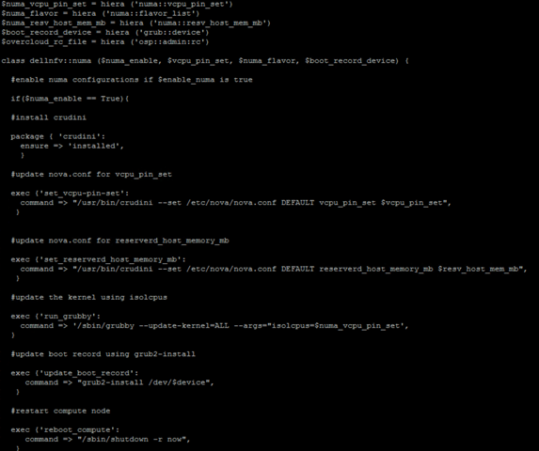
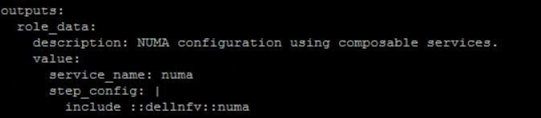
Heat and Puppet
This template snippet calls the Puppet manifest
This manifest configures the feature
Notes:
In the Heat template, a snippet is defined containing the puppet manifest to be invoked. This invokation is achieved using hiera as we can deduced from the syntax used.
The manifest fetches first the values for each variables and then passes their values to the main class that will execute all the configuration steps.
These puppet manifests need to be present as a basic puppet module in the overcloud image used for deploying the nodes.
<number>

Slide 34
The UI.
Because we all love graphic experience…

Slide 35
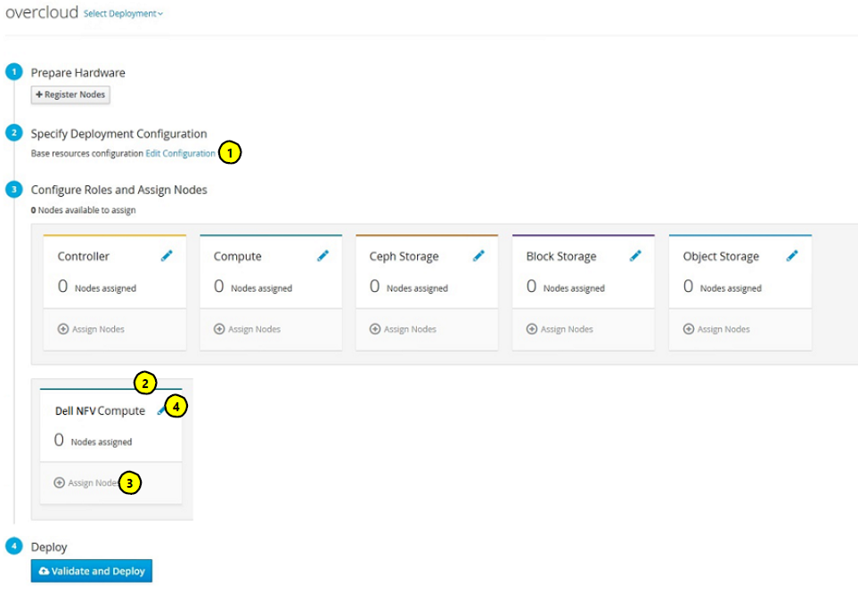
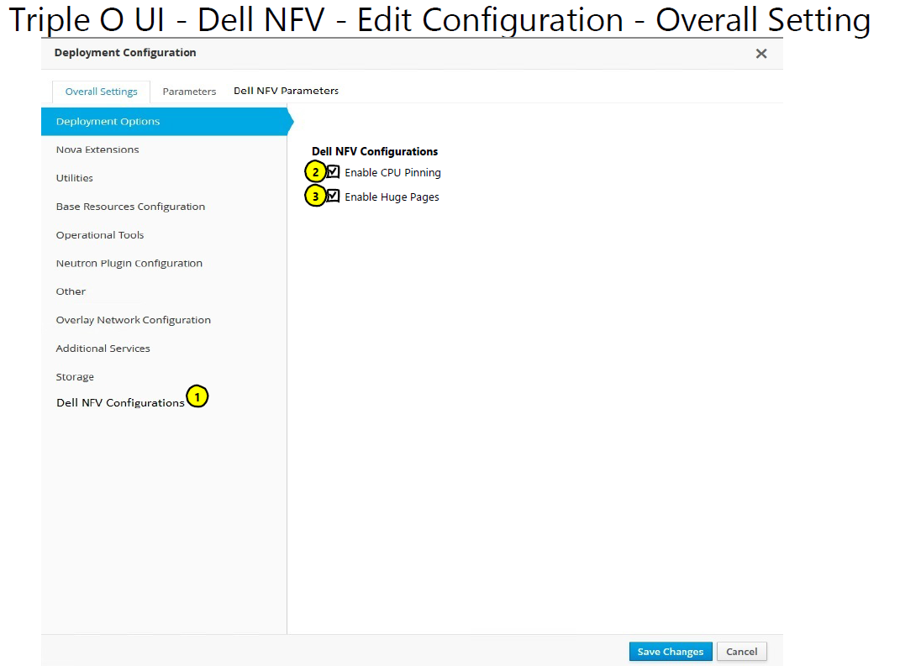
The wireframe…
Notes:
On the left-hand side, this is the landing page of the UI.
First step is to register the hardware and introspect the nodes. The process is very similar to what needs to be done using the CLI
Edit Configuration which is the second step of the overcloud deploy process, in which the user can edit the deployment and the resources configuration.
At third step, a separate NFV compute ready node is added to the existing roles
We can then assign registered nodes to the NFV compute ready node role.
Finally, we can configure the role in terms of parameters, services and network configuration including NFV specific configuration
On the right-hand side, we focus on the second step of the overcloud deploy process. Let’s take a look at it.
An option is provided to configure Dell NFV related settings
2 and 3. This includes the ability to enable/disable the feature by clicking on the check box. By default, it will be checked and if unchecked, the configuration of this feature will be disabled. One checkbox per NFV feature.
<number>

Slide 36
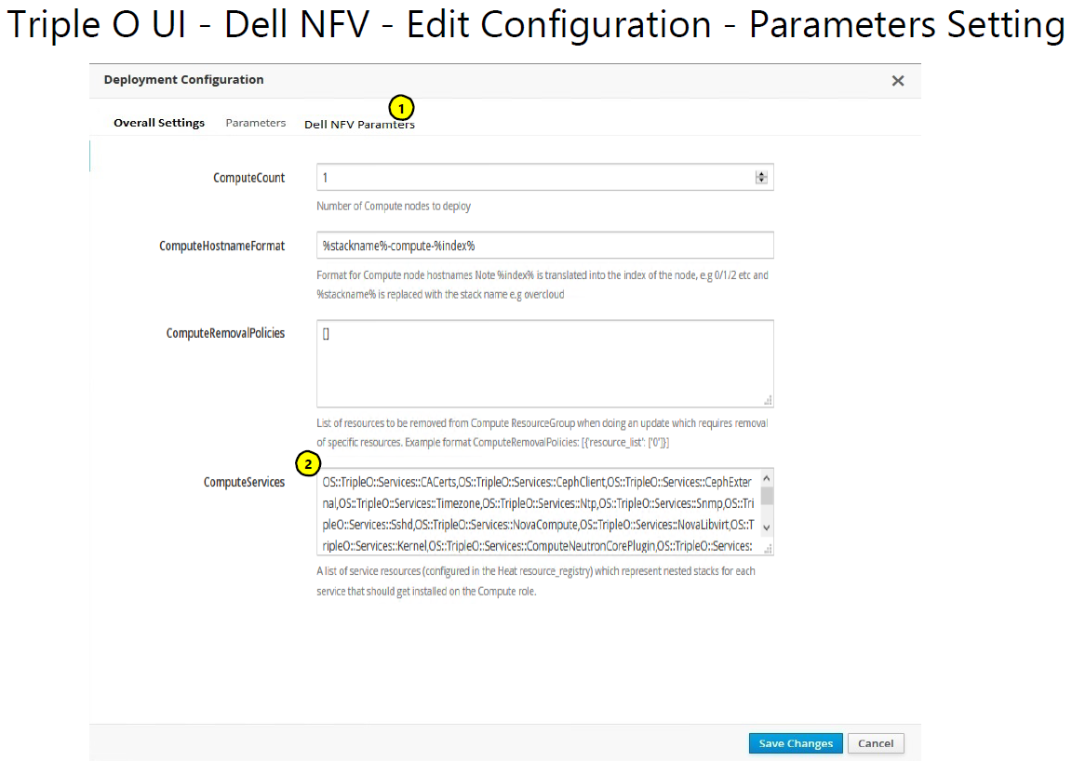
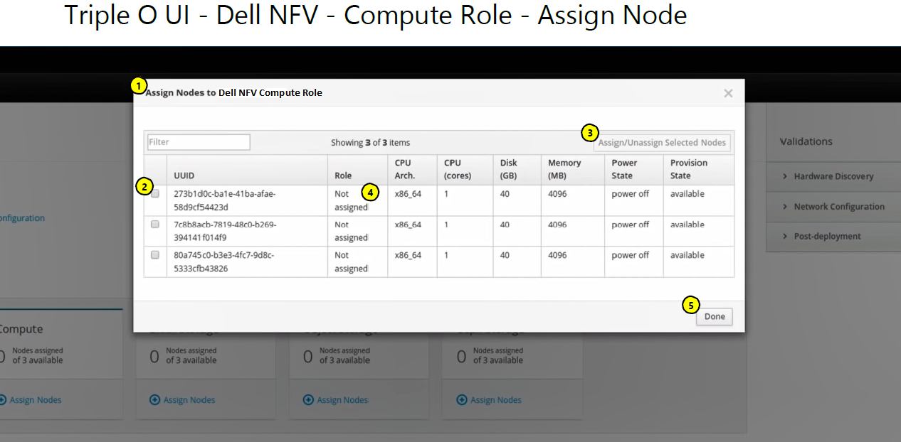
Settings and roles
Notes:
On the left-hand side, we are still on the edit configuration page, but a specific tab is added to the edit page.
In this tab, we can specify the number of node to deploy. 0 is the default.
As a reminder, every services configured are shown here including NUMA and Huge Pages
Next step is to assign node which is shown on the right-hand side.
A box pop up with the list of pre-registered node defined in the first step of the deployment.
A check box allows the node to be assigned as Dell NFV compute ready node role
This button assign all nodes previously selected to the Dell NFV compute ready node role
Once the node is assigned, the role tab will get updated with the Dell NFV compute ready node role
Done simply close the window ending up this part
<number>

Slide 37
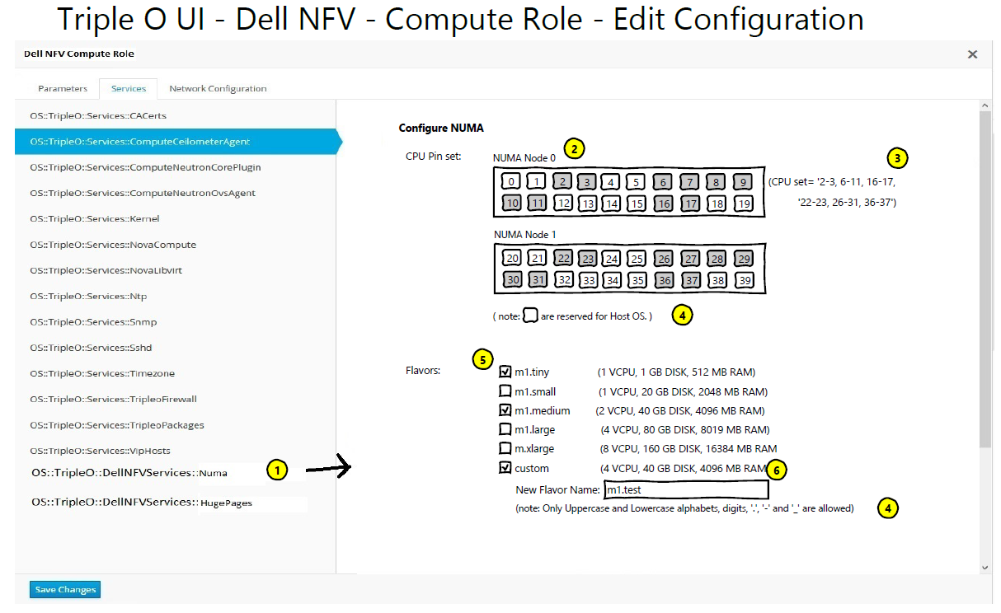
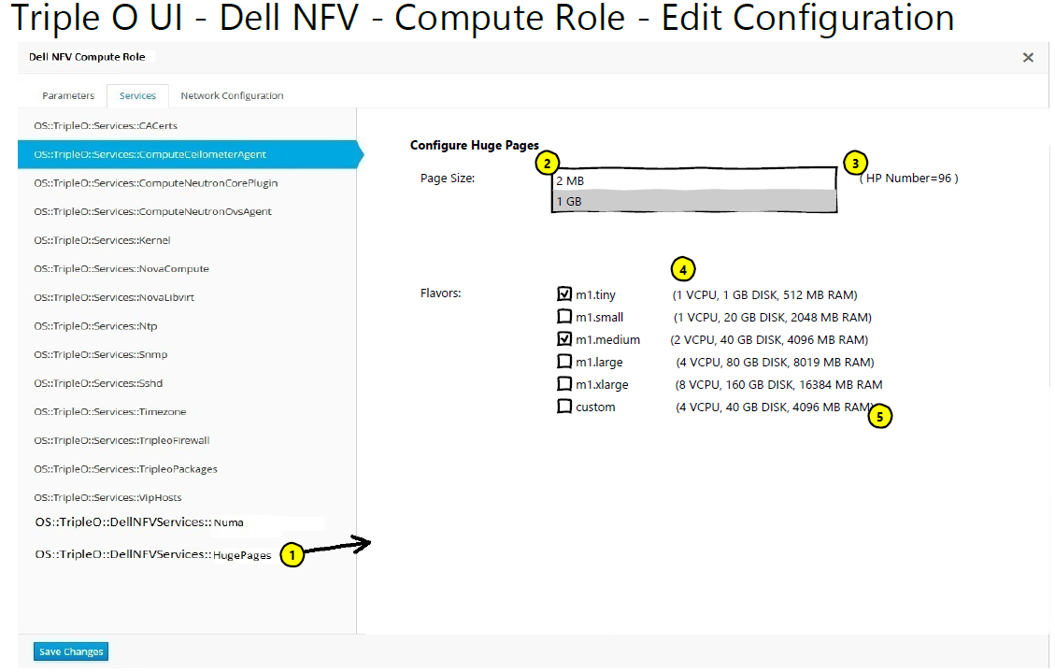
Features settings
Notes:
In the services tab, two new services corresponding to each feature are added.
On the left-hand side, we can see the NUMA service configuration section.
If this section is clicked, then options to configure NUMA are displayed. By default, configurations are already selected but can be changed as per requirement
CPU Palette according to the nodes, in which host OS CPUs are already selected and unchangeable. Remaining CPUs are free for selection for CPU Pinning
On the selection of CPUs, CPU set is displayed. Changes are done dynamically.
Notes to explain usage of the UI
Flavor list which check box to select the flavor. Details are shown in brackets.
A Custom flavor can be created. The option is visible onlys if checked, the new flavor is based on m1.small characteristics
On the righ-hand side, Huge Pages configuration is available
If this section is clicked, then options to configure HugePages are displayed. By default, configurations are already selected but can be changed as per requirement
List of default sizes available is displayed into a single selection list
On the selection of the Huge Pages size, the number of Pages available is populated. Changes are done dynamically
Flavor list which check box to select the flavor. Details are shown in brackets.
A Custom flavor can be created. The option is visible onlys if checked (unchecked in our example.)
[NOTE: elements of the UI will be greayed out e.g. the vCPU selection in this example, if it’s pre-selected for the user. Why pre-select? In a release, we may choose to restrict parms to pre-selected values, only to be removing the restriction in subsequent releases].
<number>

Slide 38
User Elements
Integrated with the RHOSP Director UI
Modifications are allowed on some of the parameters
Other parameters will be greyed out and filled with default values
Interaction with these parameters is considered for future releases
Notes:
Sometimes we want to make things more user-friendly and in that, the User Interface is a good fit to provide to the user a seamless sequence of steps turning it into an enjoyable and easy-to-manage experience
The initial approach for this design is to add to the existing RHOSP Director User Interface all the steps required for configuring the NFV Features in the overcloud. Besides, it will be fully integrated into the original dashboard coming with the director.
For the first release and similarly to what has been designed through the CLI, only some of the parameters will be allowed for modifications.
The remaining parameters will be greyed out and filled with default values. That way, the user will get the understanding of what is executed under the hood.
All of the parameters are intended to be customized in the next releases.
<number>

Slide 39
Conclusion.
What we’ve learned and how to succeed.

Slide 40
Take aways
In order to provide complete solution – hardware and software need to be developed and integrated together
Minimize deployment risk by selecting good partners with know-how
Look for value-add features that enhance OpenStack experience
Notes:
Sometimes we want to make things more user-friendly and in that, the User Interface is a good fit to provide to the user a seamless sequence of steps turning it into an enjoyable and easy-to-manage experience
The initial approach for this design is to add to the existing RHOSP Director User Interface all the steps required for configuring the NFV Features in the overcloud. Besides, it will be fully integrated into the original dashboard coming with the director.
For the first release and similarly to what has been designed through the CLI, only some of the parameters will be allowed for modifications.
The remaining parameters will be greyed out and filled with default values. That way, the user will get the understanding of what is executed under the hood.
All of the parameters are intended to be customized in the next releases.
<number>

