Slide 1
Running and maintaining Paddy Power Betfair’s OpenStack Cloud

Slide 2
Paddy Power Betfair - who we are.

Slide 3
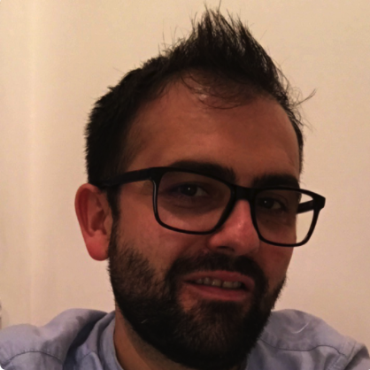
Adrian Miron - About me
Devops
Infrastructure Engineer
Senior Infrastructure Engineering Manager

Slide 4
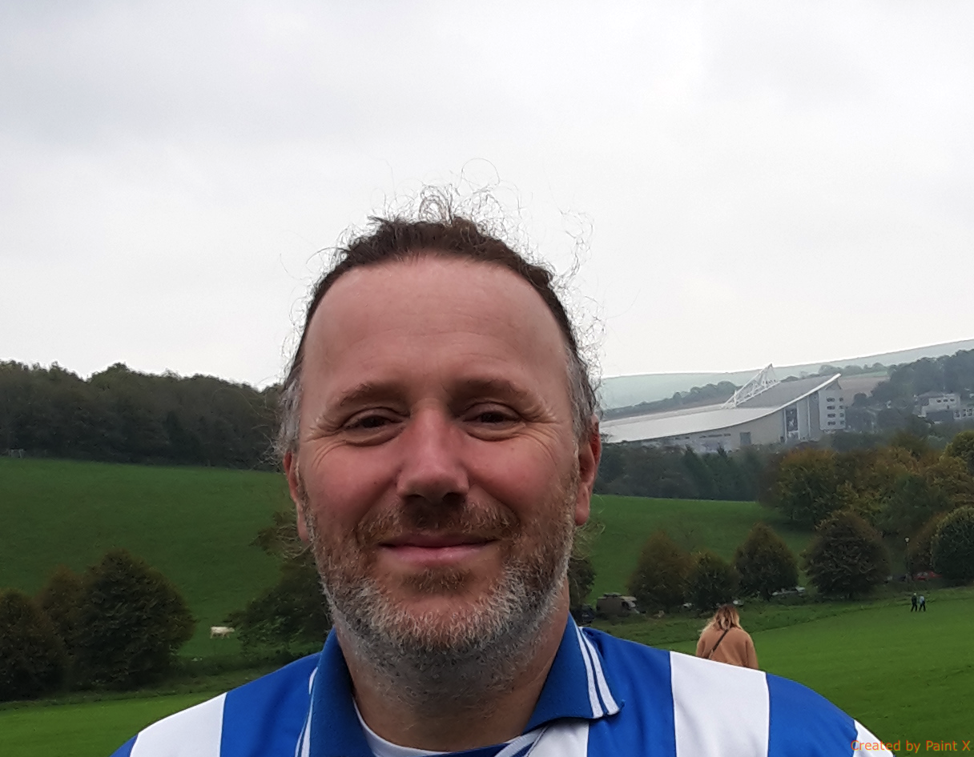
Thomas Andrew - About me
Developer
Software Development Manager
Cloud Populator
Head of Cloud Automation
Preferred pronouns: him / he / his
@GingerSeagull

Slide 5
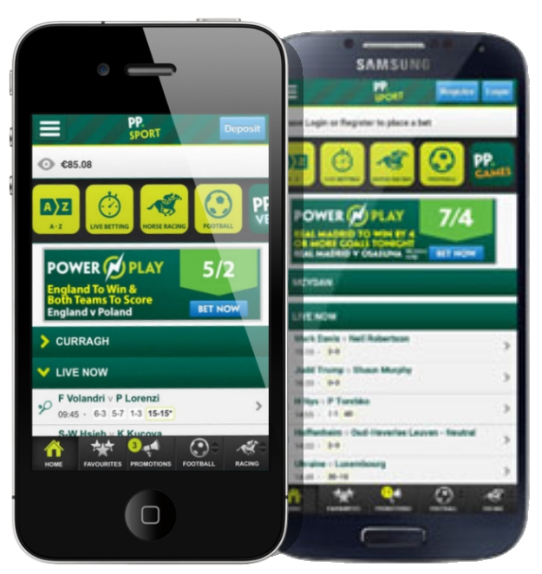
Everything on OpenStack (Almost)

Slide 6
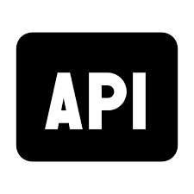
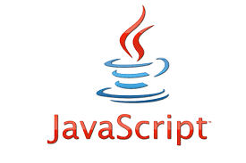
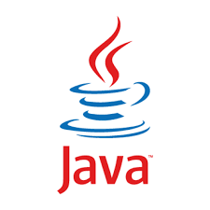
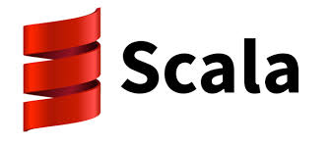
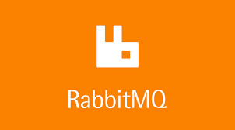
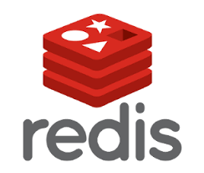
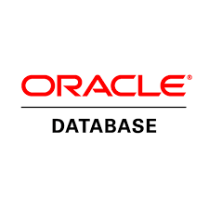
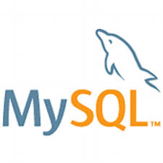
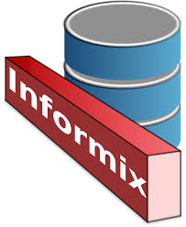
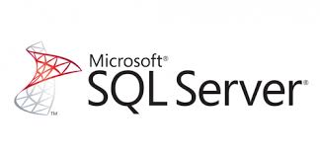
Technologies Used

Slide 7
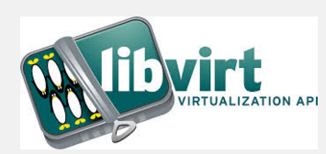
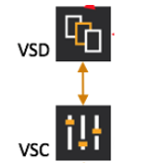
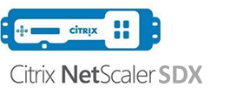
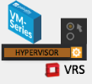
Our OpenStack Cloud - i2
GLOBAL LOAD BALANCER
IE1
IE2
External Load Balancer
Front End Load Balancer
Dark fibre
Infrastructure OSP
Infrastructure OSP

Slide 8
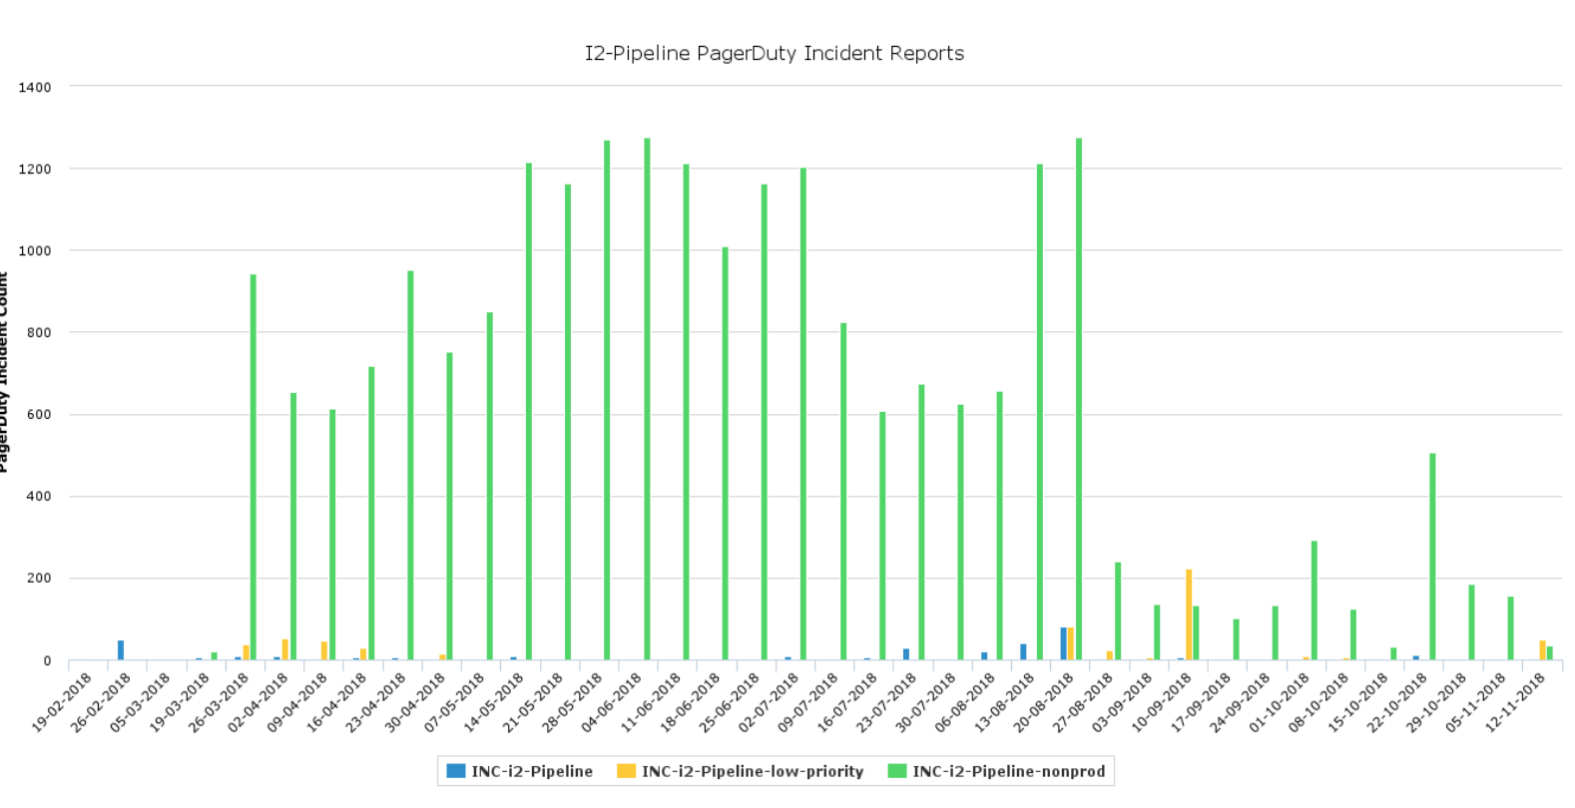
The stack that Jack built

Slide 9
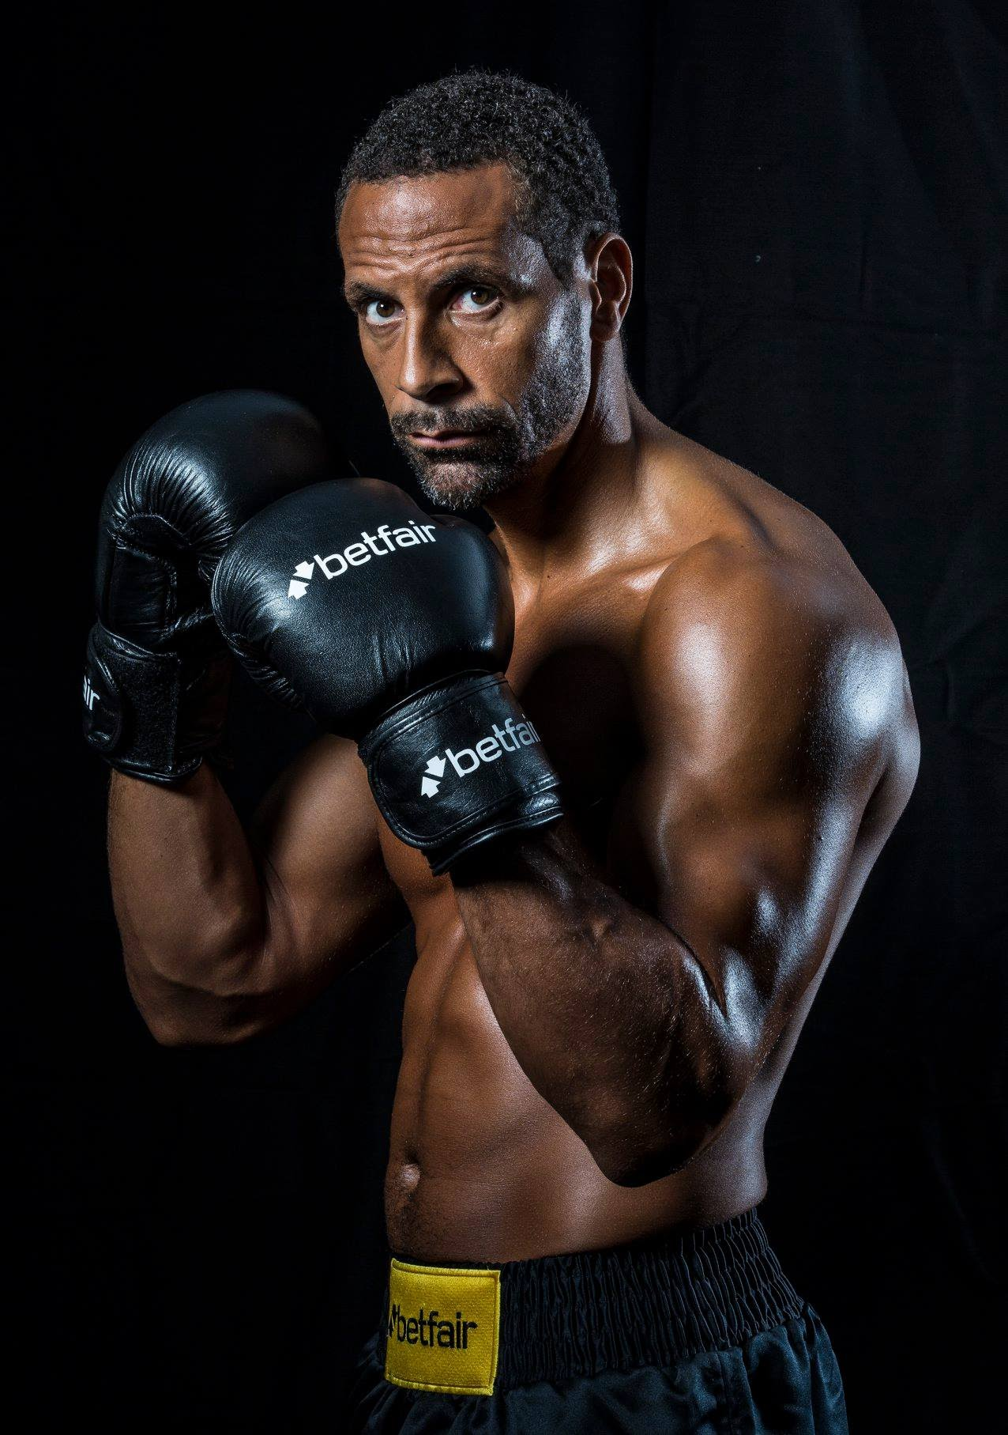
Our OpenStack Cloud - How we run it

Slide 10
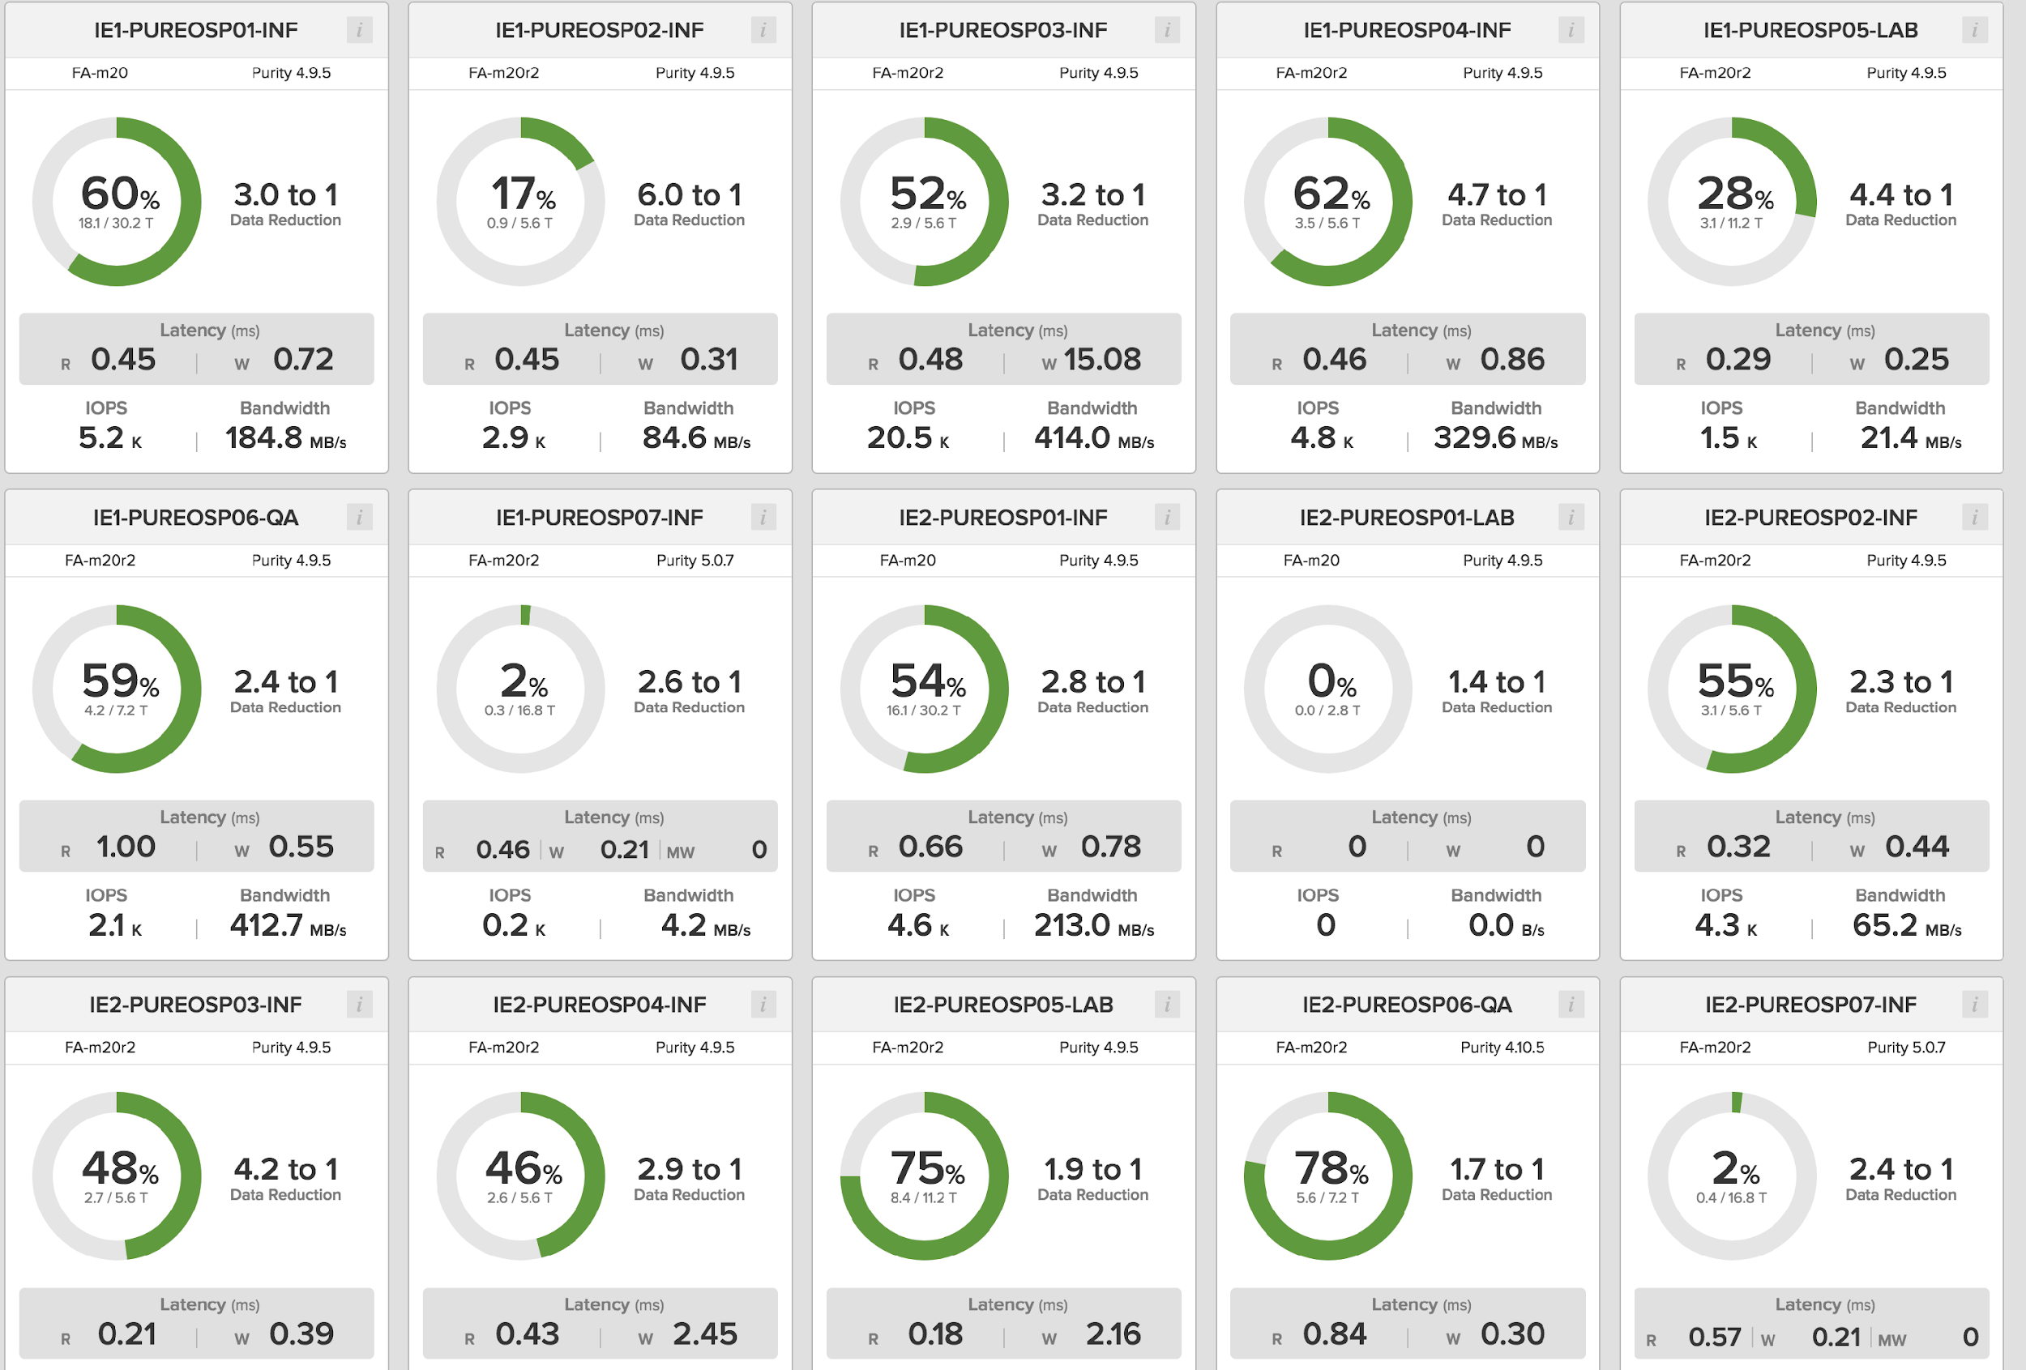
Our OpenStack Cloud - An example

Slide 11
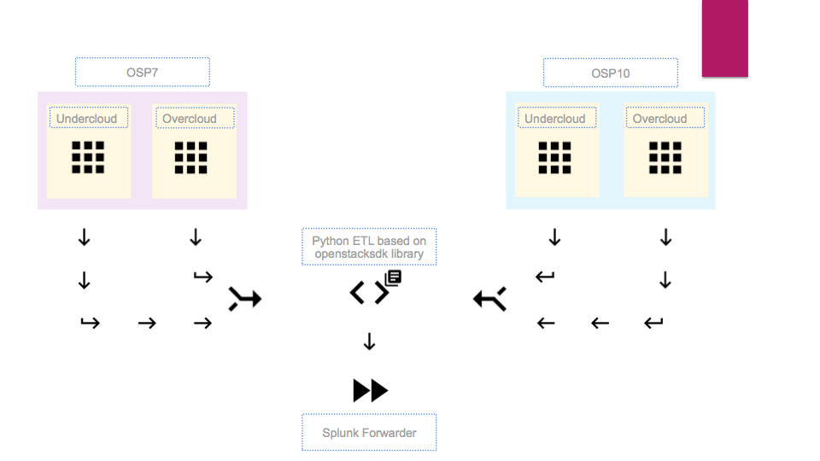
Our OpenStack Cloud - Reporting

Slide 12
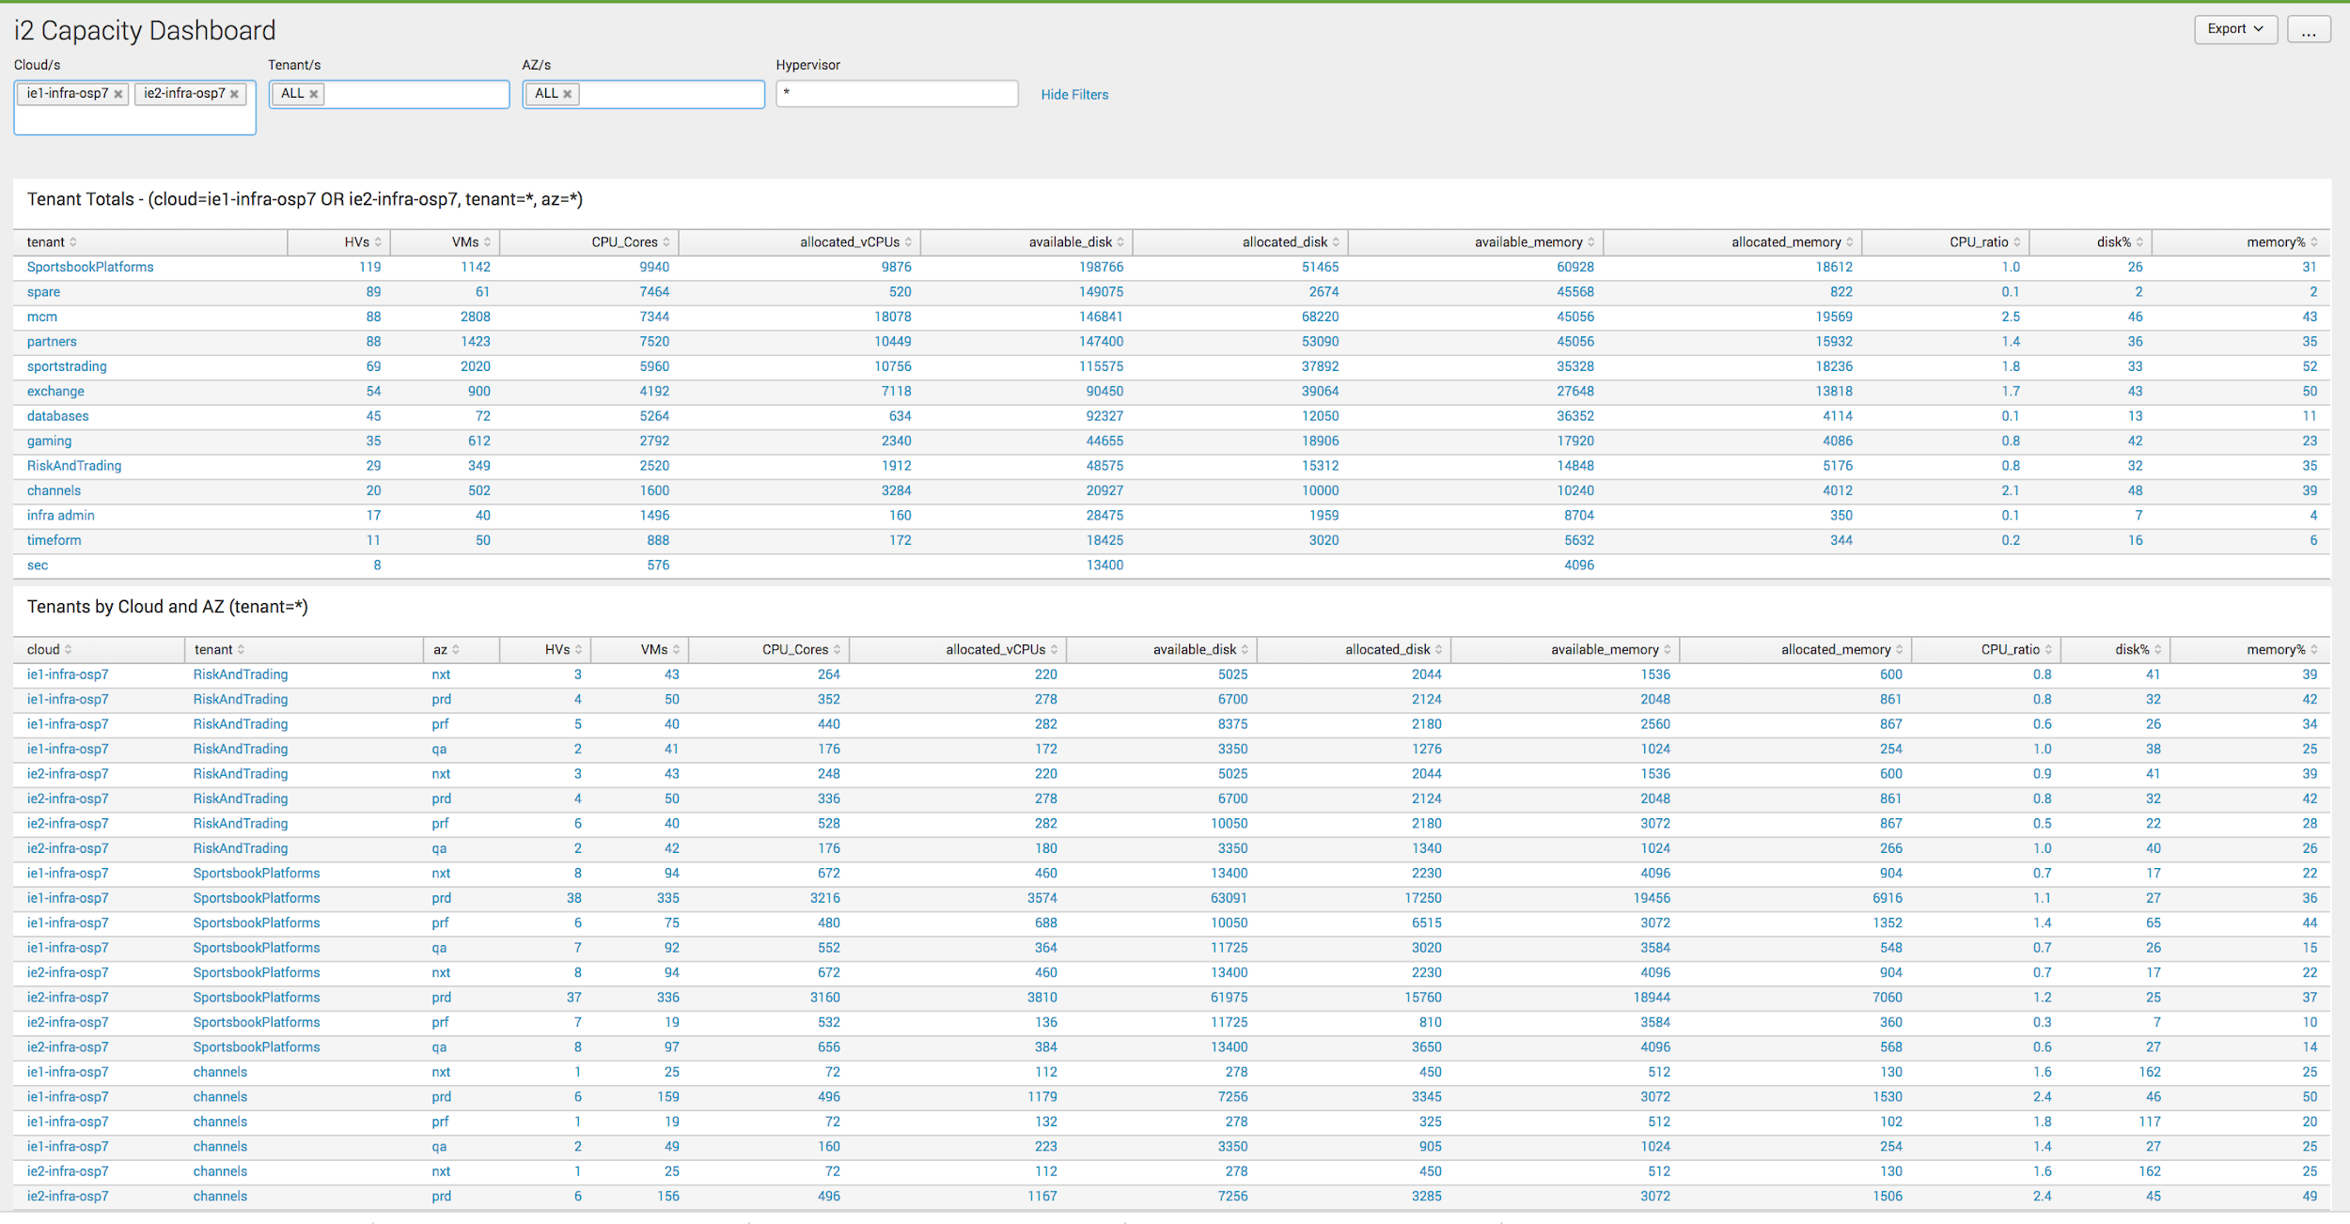
Our OpenStack Cloud - Reporting

Slide 13
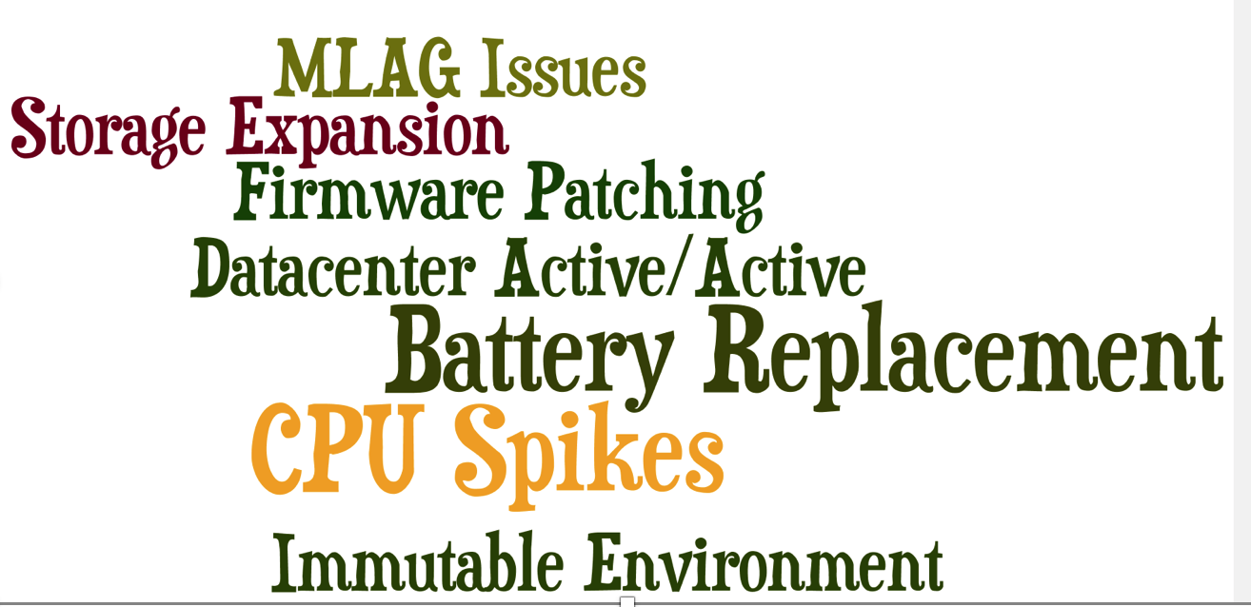
Our OpenStack Cloud - A Challenge

Slide 14
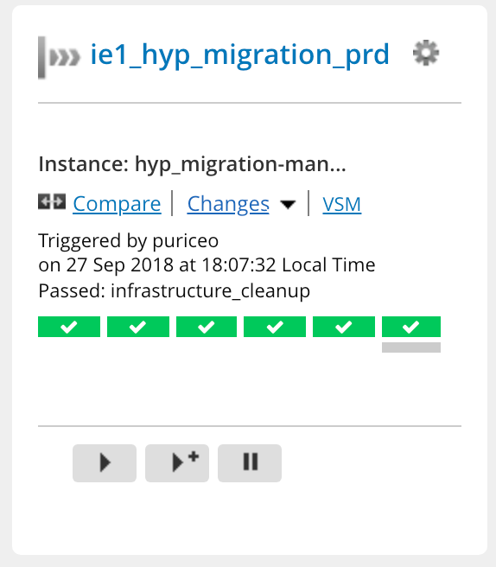
Our OpenStack Cloud - A Success
Migration from Kilo to Newton
Loading profile
Final Stage – Going Live
Create virtual environment
Cleanup stage
Create go structure
Tenant Preparation

Slide 15
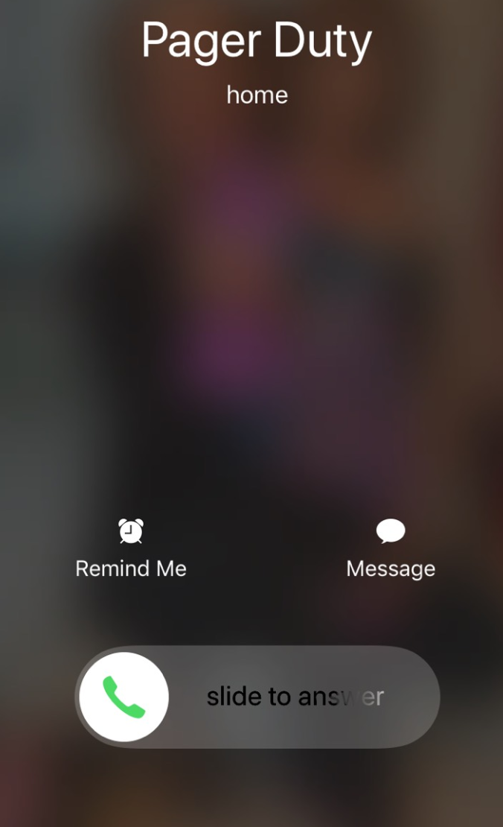
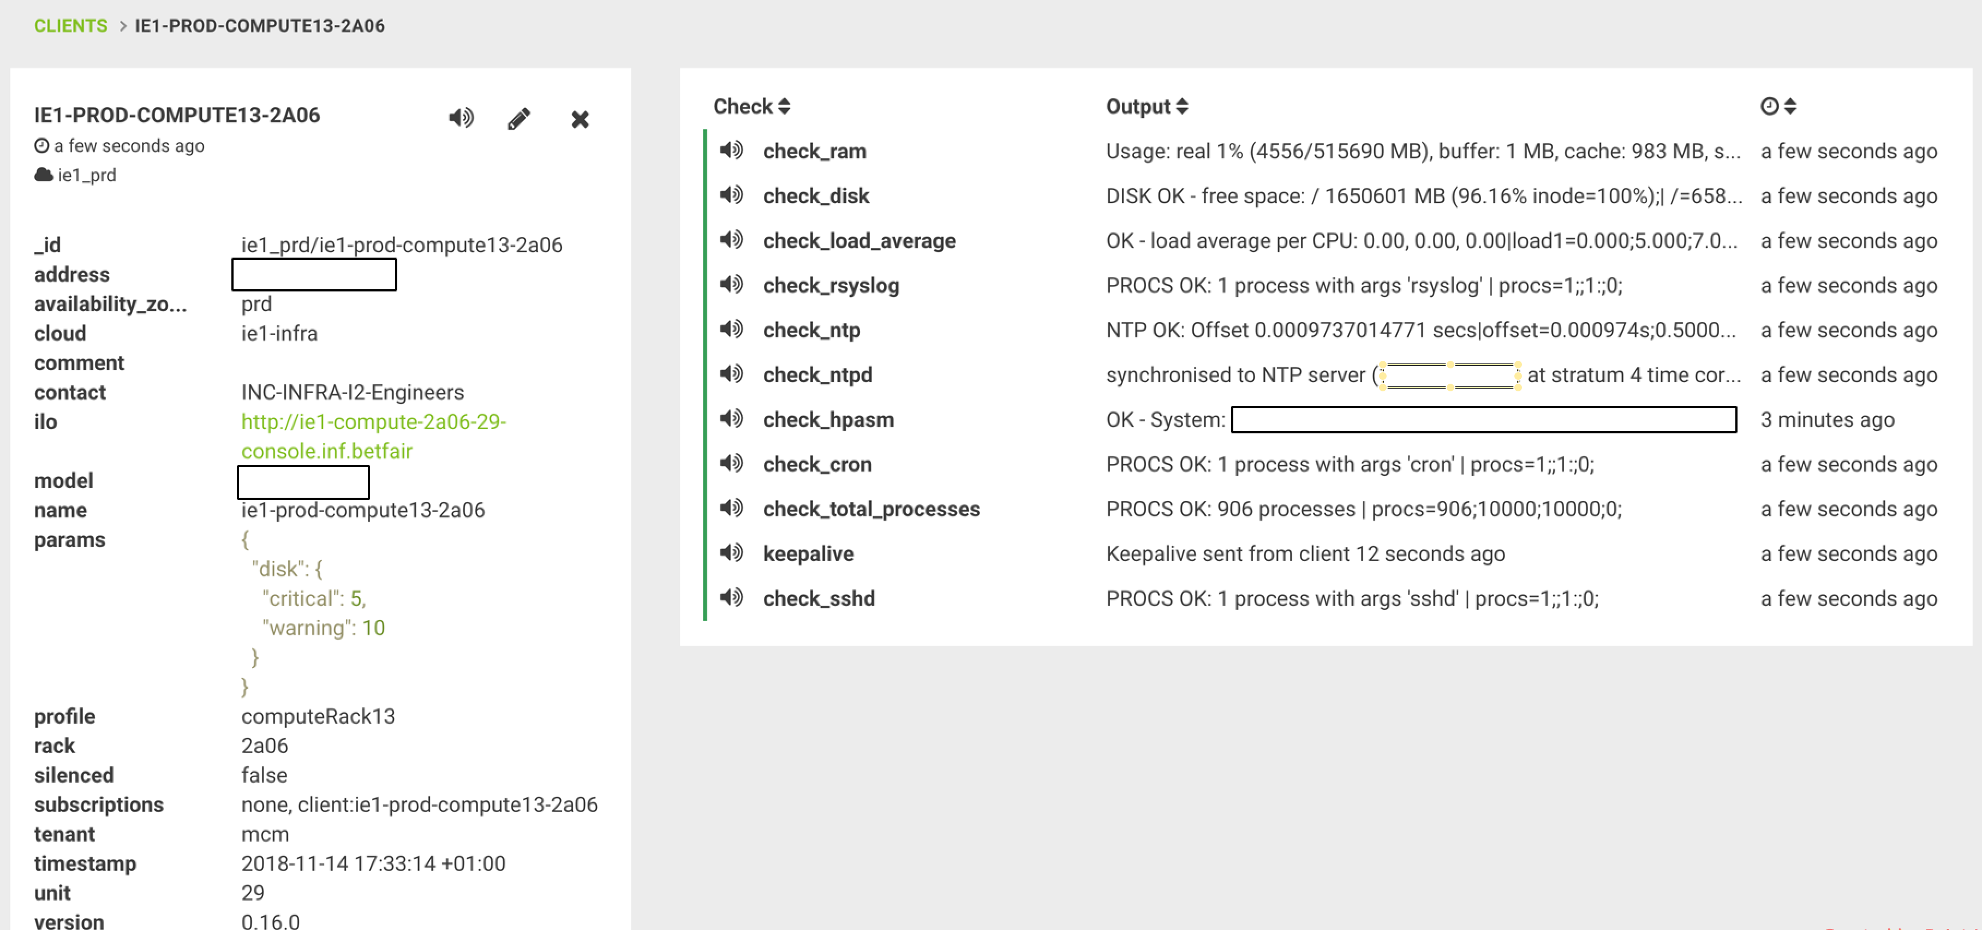
Operational Excellence – Hypervisor failure

Slide 16
Q&A

