Slide 1
OpenStack Octavia, Kubernetes, and Terraform
OpenStack Summit Vancouver 2018
German Eichberger
Software Engineer

Slide 2
German Eichberger
Senior Software Engineer with Rackspace
Core Reviewer OpenStack Octavia, OpenStack Ansible Octavia, Neutron Firewall-as-a-Service
Currently working on Rackspace’s Managed Kubernetes offering which leverages Tectonic, Terraform, OpenStack, etc.

Slide 3
Agenda
What is OpenStack Octavia?
Terraform Provider
Gophercloud
Kubernetes OpenStack Octavia
Future

Slide 4
OpenStack Octavia
Network Load Balancing as a Service for OpenStack.
Octavia provides scalable, on demand, and self-service access to network load balancer services, in a technology agnostic manner, for OpenStack.
The reference load balancing driver provides a highly available load balancer that scales with your compute environment.
Founded during the Juno release of OpenStack.
Moved from a Neutron sub-project to a top level OpenStack project during the Ocata series.
Octavia provides now it’s own API endpoint

Slide 5
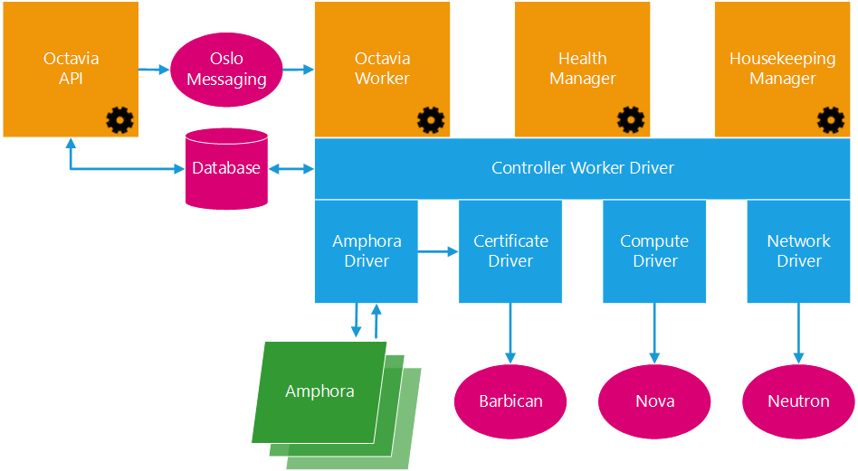
OpenStack Octavia Architecture

Slide 6
OpenStack Octavia and k8s
My amazing k8s app
API Server
API Server
API Server

Slide 7
OpenStack Octavia and k8s
My amazing k8s app
API Server
API Server
API Server
Terraform/Tectonic

Slide 8
Deploying Kubernetes
OpenStack
(Octavia)
Gophercloud
Terraform
with OpenStack plugin

Slide 9
What is terraform?
“HashiCorp Terraform enables you to safely and predictably create, change, and improve infrastructure. It is an open source tool that codifies APIs into declarative configuration files that can be shared amongst team members, treated as code, edited, reviewed, and versioned.”

Slide 10
OpenStack LBaaS in Terraform
Terraform has providers for most clouds and also OpenStack
Supports LBaaS V2 API with n-lbaas and Octavia
Uses OpenStack specific resources
openstack_lb_loadbalancer_v2
openstack_lb_pool_v2
openstack_lb_listener_v2
openstack_lb_monitor_v2
openstack_lb_member_v2
No single create nor cascade delete (doesn’t square with terraform)

Slide 11
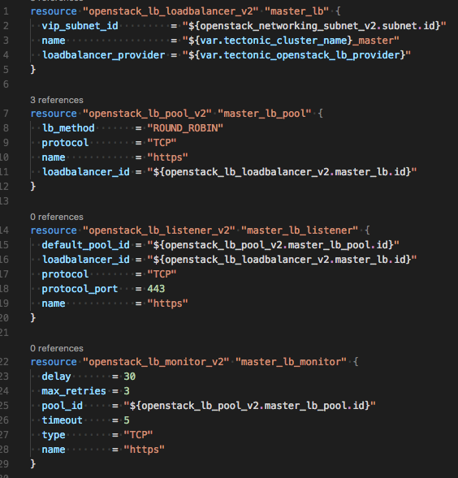
Excerpt from Tectonic for the k8s API LB
Footer

Slide 12
Activating the Octavia API
Specify `use_octavia` in addition to`provider = “octavia”` -- only use_octavia will leverage the Octavia API

Slide 13
Octavia in Gophercloud
Gophercloud is the client library to connect golang with OpenStack by allowing some more high level operation (other than straight API calls)
Gophercloud supports both n-lbaas and Octavia
OpenStack Load Balancing Service is now a top level service (before it was part of Neutron which caused problems)
We recently got cascading delete (Octavia API only)
And L7 rules/policies

Slide 14
OpenStack Octavia and k8s
My amazing k8s app
API Server
API Server
API Server

Slide 15
Deploying a LoadBalancer with Kubernetes
OpenStack
(Octavia)
Gophercloud
K8s with OpenStack plugin

Slide 16
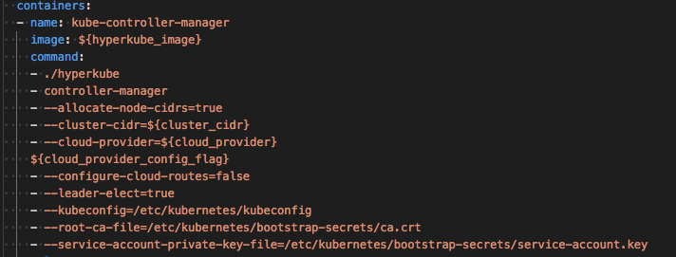
Cloud Provider

Slide 17
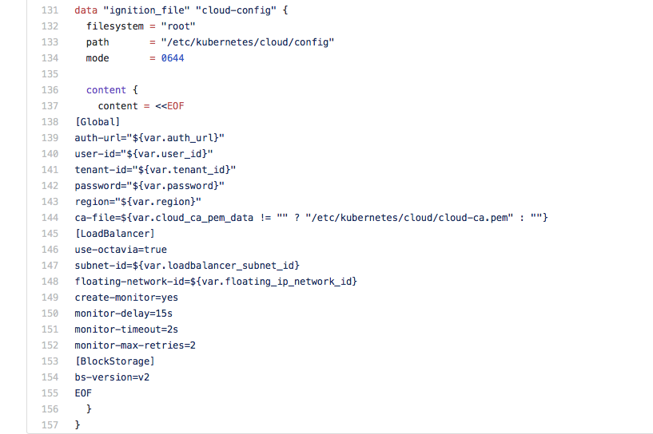
Cloud Provider
Footer

Slide 18
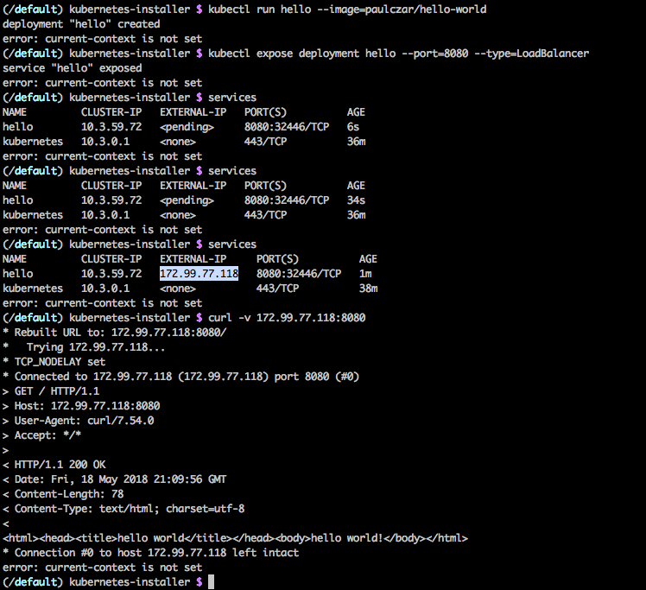
Type “loadbalancer”
https://medium.com/@pczarkowski/kubernetes-services-exposed-86d45c994521

Slide 19
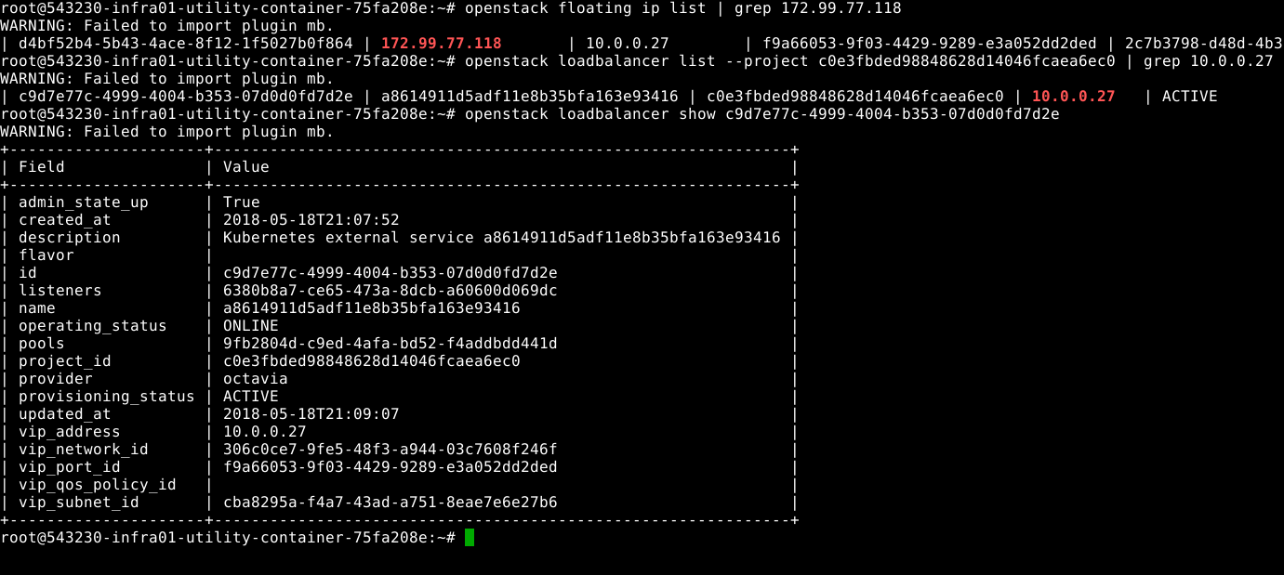
On the OpenStack side

Slide 20
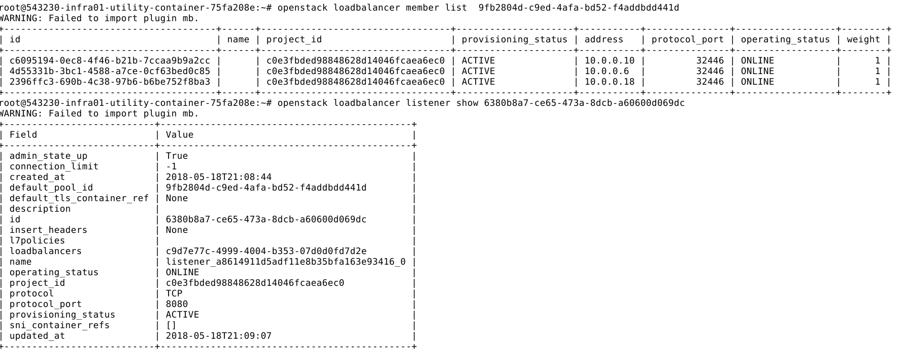
On the OpenStack side

Slide 21
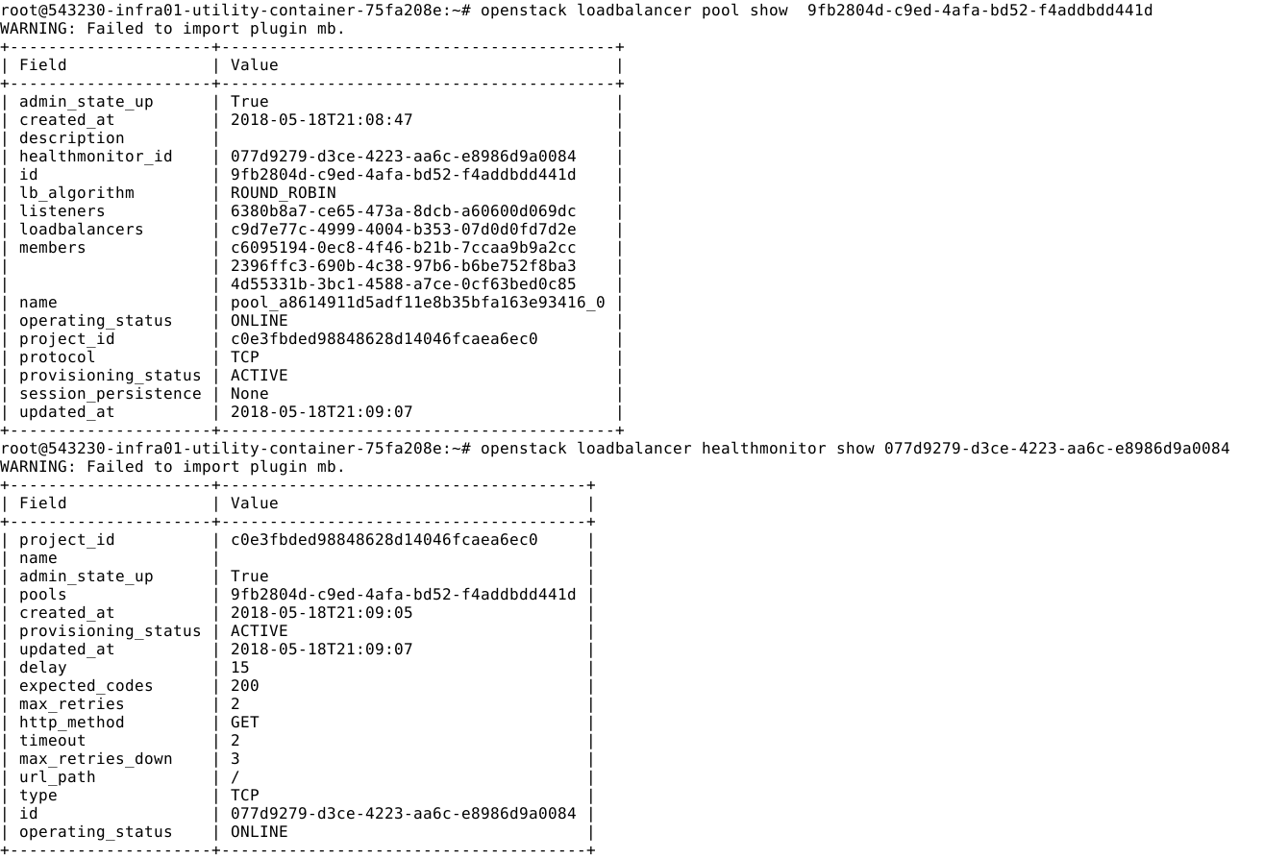
On the OpenStack side

Slide 22
OpenStack Octavia and k8s – a closer look
API Server
API Server
Nodes

Slide 23
OpenStack Octavia and k8s – a closer look
API Server
API Server
Nodes

Slide 24
OpenStack Octavia and k8s – a closer look
Nodes
Kube-proxy
Nodes
Kube-proxy
Pod

Slide 25
OpenStack Octavia and k8s – a closer look
Nodes
Kube-proxy
Nodes
Kube-proxy
Pod
Tenant network

Slide 26
OpenStack Octavia and k8s – ingress controller
Nodes
Kube-proxy
Nodes
Kube-proxy
app
Nodes
Kube-proxy
Ingress controller
Footer

Slide 27
Why use Octavia and (not) nginx, envoy, …
Octavia runs outside of k8s which allows:
Focus on k8s app and less on IaaS with Network design
High Availability with multi az, active-passive, etc
Reasonable error pages when the k8s cluster is down
No need to either assign Floating IPs to worker nodes or expose in a different way to the Internet – only expose the LB
Get an IP/port for each LB/service so can use common ports 80 or 443
Load balancing OpenStack, k8s, and other resources.
If Octavia is running as an ingress controller
TLS termination otherwise use an ingress controller
Save load balancing resources through L7 (e.g. /myapp1, /myapp2,…)

Slide 28
Future
Octavia as an ingress controller
http://superuser.openstack.org/articles/guide-octavia-ingress-controller-for-kubernetes/ - Lingxian Kong
Better integration between OpenStack Octavia and K8s
Custom tags?
Multicloud

Slide 29
Questions?

