Slide 1
USE KATA CONTAINERS TO DEPLOY AN NFV MPLS-EVPN
13 Nov 2018
OpenStack Summit - Berlin 2018

Slide 2
Marian Tudosoiu
Alexandru Bogdan Pica
System Architect
Software Developer
IRC: @mtudosoiu
IRC: @dtk
Notes:
1&1 IONOS is the largest hosting company in Europe with more than 90,000 servers in operation and around 12 million domains under management.
1&1 is a member of the United Internet group.
For more than 30 years we have been in this industry.
Last month 1&1 combined its web hosting, applications, and server product lines with ProfitBricks’ cloud infrastructure solutions, becoming 1&1 IONOS.

Slide 3
Agenda
Kata Containers
FRRouting
EVPN Use Case
Demo
Other Use Cases
Notes:
Personal Intro
Here are some topics which we will be covering today:
Kata Containers, specifically kata-runtime
We are going to show you how an FRR router can be ran inside of a container
We will use FRR as an VNF, in order to build an EVPN topology between two OpenStack Datacenters, and we will cover this scenario in our demo
We will also discuss about some other potential usecases

Slide 4
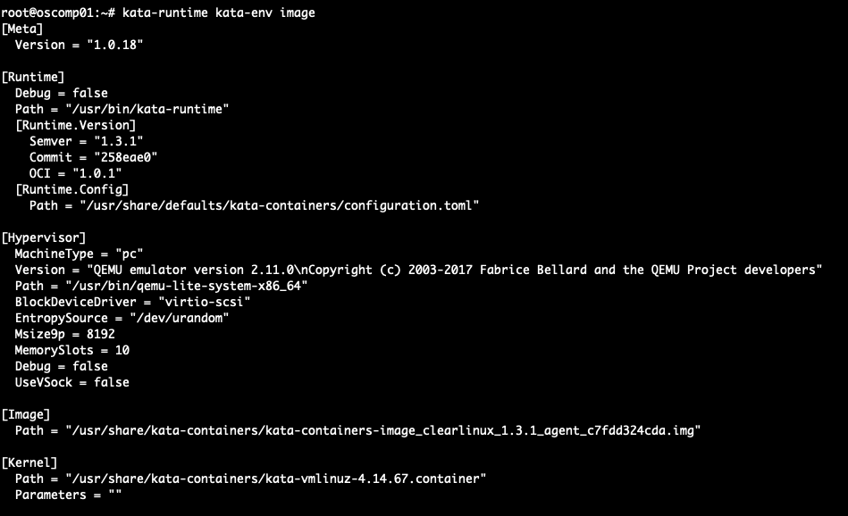
Kata Containers
Kernel – vmlinuz.container
Image – kata-containers.img
Notes:
As you may already know, kata containers offers the security of a vm, and the boot time of a container
That light VM is comprised of two main components: a Filesystem Image, and a Kernel
The kernel and the image to be used by the kata-runtime can be customized
You can specify which kernel / FS to use by changing a few lines of configuration

Slide 5
Kata Containers – custom kernel
Notes:
According to the katacontainers docs, this is what you have to do to compile a custom kernel
As you can see, the vanilla version of the linux kernel source is used, with just some patches applied on top of it

Slide 6
Kata Containers – custom kernel

Slide 7
Kata Containers – custom image
Notes:
- In order to be able to run the kernel compiled earlier, we also had to enable some sysctl flags needed for our usecase, within the FS Image.
- We had to make these changes before actually starting containers, so that is why we had to mount the image on our system by using guestfish, so that they are persistent.

Slide 8
FRRouting

Slide 9
FRRouting Features/Daemons
FRR Core | Linux | OpenBSD | FreeBSD | NetBSD | Solaris
zebra | Y | Y | Y | Y | Y
VRF | 4.8 | N | N | N | N
MPLS | 4.5 | Y | N | N | N
• Y - daemon/feature fully functional
• CP - control plane only • N - daemon/feature not supported
by operating system
WAN / Carrier protocols
bgpd (BGP) | Y | Y | Y | Y | Y
VRF / L3VPN | 4.8 | CP | CP | CP | CP
EVPN | 4.18 | CP | CP | CP | CP
VNC (Virtual Network Control) | CP | CP | CP | CP | CP
Flowspec | CP | CP | CP | CP | CP
ldpd (LDP) | 4.5 | Y | N | N | N
VPWS / PW | N | 5.8 | N | N | N
VPLS | N | 5.8 | N | N | N
nhrpd (NHRP) | Y | N | N | N | N
Link-State Routing
ospfd (OSPFv2) | Y | Y | Y | Y | Y
Segment Routing | 4.12 | N | N | N | N
ospf6d (OSPFv3) | Y | Y | Y | Y | Y
isisd (IS-IS) | Y | Y | Y | Y | Y
Notes:
BGP, Label Distribution Protocol, OSPF, EVPN, VRFs and so on

Slide 10
EVPN Use Case
Goal:
Using FRRouting & KataContainers on OpenStack BareMetal to deploy an EVPN network which can be used to interconnect two OpenStack Datacenters

Slide 11
EVPN Topology
MPLS over GRE
OpenStack DC01
OpenStack DC02
zun-compute01
zun-compute01
spine01
spine02
vxlan1001
leaf01
vxlan1002
leaf02
vxlan1003
ovs
ovs
VM
VM
VM
VM
VM
VM
VM
VM
VM
VM
VM
VM
VM
VM
VM
VM
VM
VM
VM
VM
VM
VM
VM
VM
VM
VM
VM
VM
compute01
compute02
compute03
compute01
compute02
compute03

Slide 12
Notes:
- we are using zun to deploy kata containers on bare metal
- because we need to add/remove interfaces to each kata containers all the containers are started with priviledged flag
- the FRR image is taken from glance repository
- we defined some specific availability zones inside OpenStack in order to segregate the compute nodes used for NFV from the other compute nodes
- we have a limitation at this moment kata containers are not able to hot plug/hot remove network interfaces. Each time a new interface needs to be added to a kata container in this setup the container must be restarted.

Slide 13
Notes:
- ssh enabled on all kata containers nodes
- vtysh is the cli of the FRR
- we are running OSPF in order to advertise the loopback ip addresses
- mpls was enabled
Label Distribution Protocol – used to exchanged label mapping information
BGP running between leaf nodes in order to advertise EVPN prefixes (MAC addresses)
L2VPN EVPN enabled
3 VXLANs (1001,1002 and 1003)
VXLAN Tunnel endpoints – local enpoint is manually configured, remote endpoint is dynamically discovered by BGP L2VPN protocol
The MPLS Label switching mechanism – Packets forwarded based on label

Slide 14
Notes:
Traffic capture between spine nodes using tcpdump
MPLS encapsulation
VXLAN encapsulated with VXLAN Tunnel endpoints and VXLAN Network ID
Source MAC address and dst MAC address for our packet
And ICMP traffic for our ping

Slide 15
Other Use Cases
VRFs
Routing Protocols
IDP/IPS
Firewalling

Slide 16
Q&A

Slide 17
Appendix
Useful links:
https://github.com/kata-containers/documentation/blob/master/Developer-Guide.md#install-guest-kernel-images
https://media.readthedocs.org/pdf/frrouting/latest/frrouting.pdf
https://docs.openstack.org/image-guide/modify-images.html
https://frrouting.org
https://github.com/FRRouting/frr

