Slide 1
Raise your voice!
How to connect Amazon Alexa to OpenStack

Slide 2
agenda
01 | Prerequisites
02 | Interaction with Alexa
03 | Application Architecture
04 | Amazon Alexa Skill Kit (ASK)
05 | Demo

Slide 3


Prerequisites
Alexa
AWS Developer Account
Coding
(Python)
Server
Cloud

Slide 4
01 | Prerequisites
02 | Interaction with Alexa
03 | Application Architecture
04 | Amazon Alexa Skill Kit (ASK)
05 | Demo

Slide 5
Interaction with Alexa
„Status Report“
„Status Report“
„Status Report“
Utterance
StatusIntentEN
„The total number…“
„The total number…“
StatusIntentEN
Intent
User
Echo Device
Alexa Skills Kit
„The total number…“
StatusIntentEN
OTC Control Center App
Total/Active/Stopped
report_status()
cloud.list_servers()
server_list = [ … ]
Backend Functions

Slide 6
01 | Prerequisites
02 | Interaction with Alexa
03 | Application Architecture
04 | Amazon Alexa Skill Kit (ASK)
05 | Demo

Slide 7
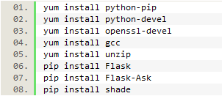
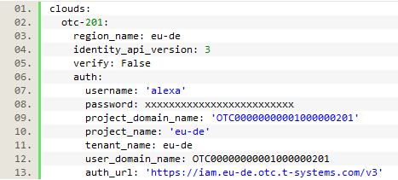
Application Architecture (Modules)
Needed software / python modules
Authentication with pyhton-shade

Slide 8
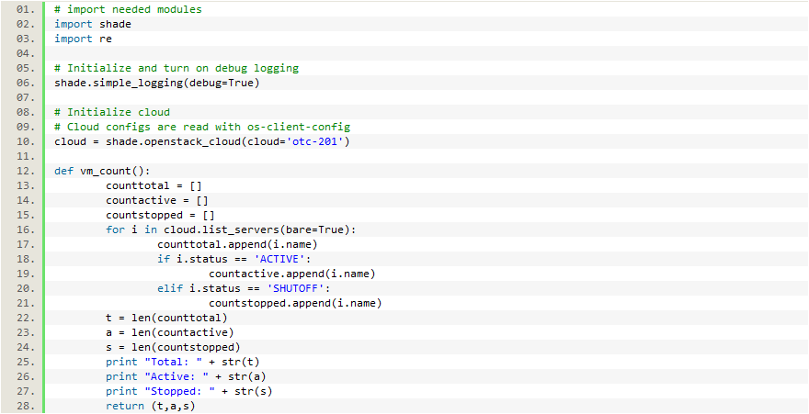
Application Architecture (Backend)

Slide 9
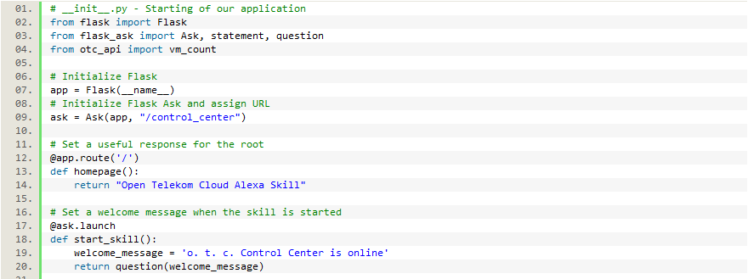
Application Architecture (Frontend 1/2)

Slide 10
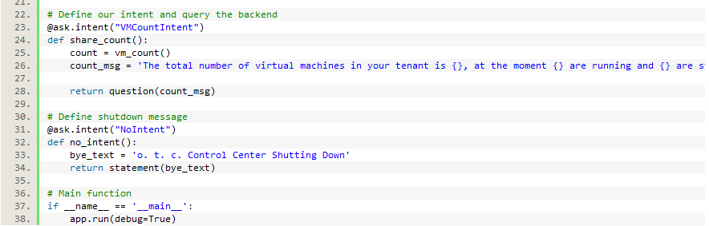
Application Architecture (Frontend 2/2)

Slide 11
01 | Prerequisites
02 | Interaction with Alexa
03 | Application Architecture
04 | Amazon Alexa Skill Kit (ASK)
05 | Demo

Slide 12
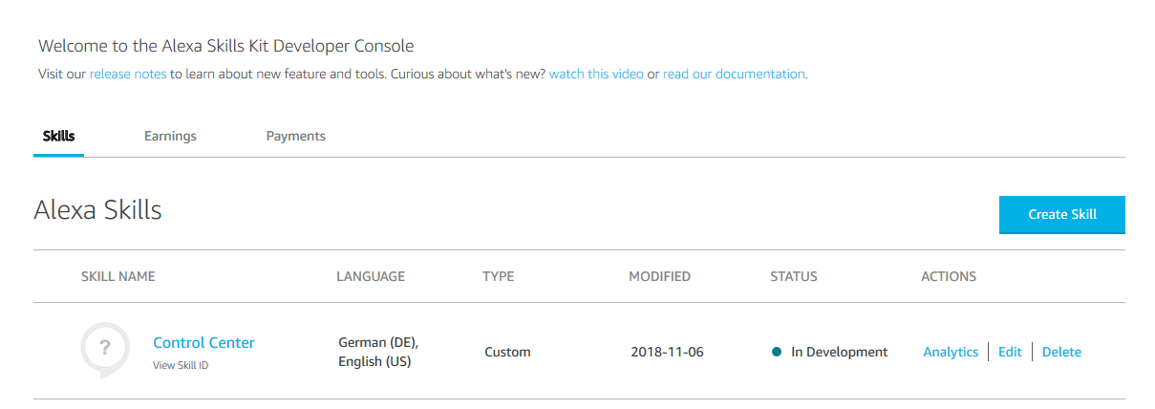
Amazon Alexa Skill Kit (ASK)

Slide 13
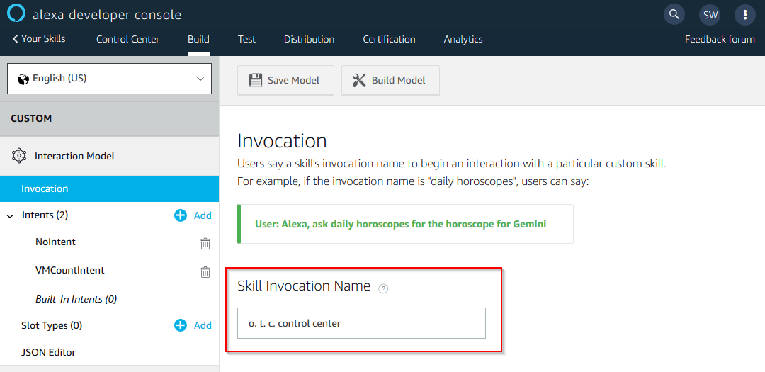
Amazon Alexa Skill Kit (Invocation)

Slide 14
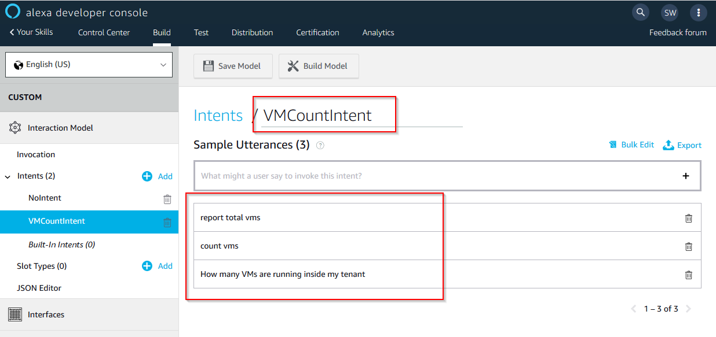
Amazon Alexa Skill Kit (Intent / Utterance)

Slide 15
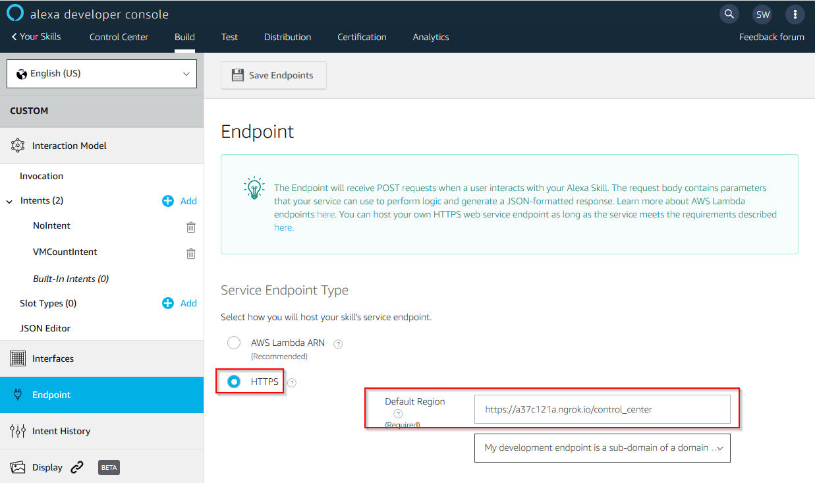
Amazon Alexa Skill Kit (ASK)

Slide 16
01 | Prerequisites
02 | Interaction with Alexa
03 | Application Architecture
04 | Amazon Alexa Skill Kit (ASK)
05 | Demo

Slide 17
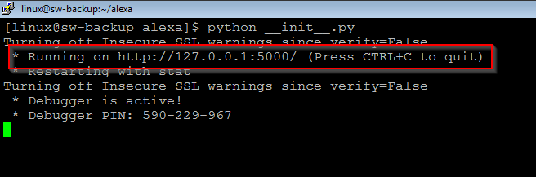
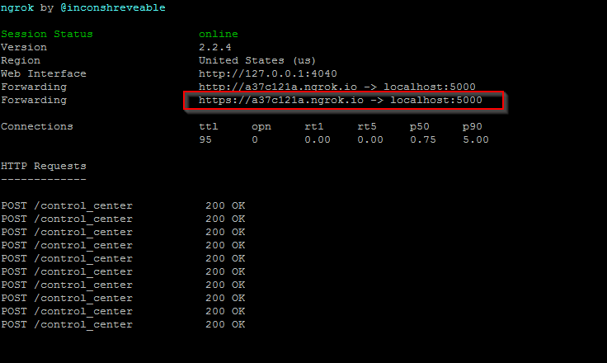
DEMO (Skill / NGROK)
Alexa Skill
ngrok

Slide 18
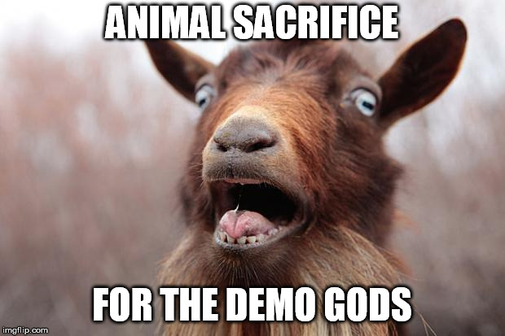
Demo

Slide 19

QUESTIONS?

Slide 20
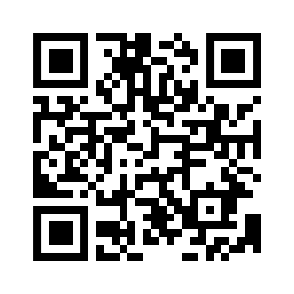
CONtact
Open Telekom Cloud:
https://open-telekom-cloud.com
Repository: https://github.com/OpenTelekomCloud/alexa-on-otc
Contact:
sebastian.wenner@t-systems.com

