Slide 1
On the Way to Cloud Native:
Working with Containers in a Hybrid Environment
Dr. Liat Pele, Reuven Milshtein, Timea Laszlo

Slide 2
Agenda
Introduction to hybrid environment
Network setup in hybrid environment
Monitoring and RCA in hybrid environment

Slide 3
Introduction to hybrid environment
Introduction

Slide 4

From monolithic VNFs to microservices & containers
Nokia Cloud-native VNF architecture
Splitting the functionalities into loosely coupled services
FUNCTIONAL SPLIT
API driven, well defined and open interfaces
Best of breed technology using Open interface
Monolithic VNF
Microservices
DISTRIBUTION
Deployment into containers
Host independent & flexible configuration and logging

Slide 5
From monolithic VNFs to microservices & containers
Cloud-native VNF architecture: Benefits
Simplified deployment
(VMs in cloud, blades in bare metal)
UPGRADEABILITY
Scale and upgrade services faster and independently
Whole VNF
Only affected service(s)
Sustainable SW architecture
using the right tool for the job
SCALABILITY
Speed and agility on the next level
as focus is on business capabilities
Efficiency in telco workload
by minimized virtualization overhead, faster processing, slower and predictable latency times
Whole VNF
Only affected service(s)

Slide 6
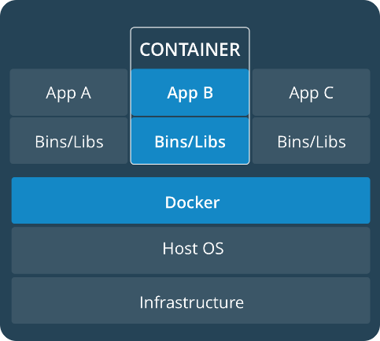
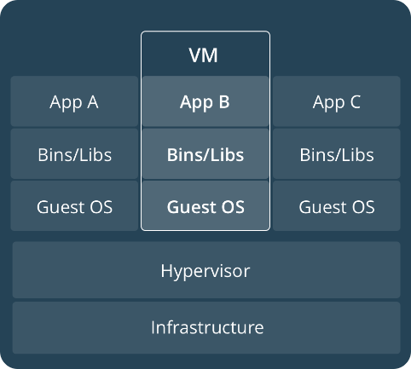
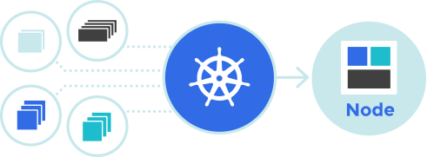
Tech stack of cloud-native VNFs
Docker and Kubernetes
"Docker packages applications and their dependencies together into an isolated container making them portable to any infrastructure. Eliminate the “works on my machine” problem once and for all."
source: docker.com
"Kubernetes is an open-source system for automating deployment, scaling, and management of containerized applications."
source: kubernetes.io

Slide 7
Deployment methods for container based VNFs
Hybrid environment
VNF
VNF
VNF
VM
VM
VM
C
C
C
C
C
Kubernetes
C
C
C
Docker
Kubernetes
Bare-metal
Docker
OpenStack
HW
HW
HW
HW
HW
HW
Notes:
Advantages of containers over VMs: Full isolation – better security
Advantages of containers over bare metal:
- Native performance
- Light weight
- Access to hardware functionality
- Full portability

Slide 8
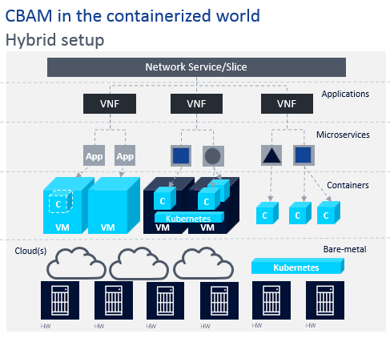
Container over VM vs Container over Bare-metal
Uniform
cluster management
Tenant separation
Foot print
GPU
Performance
VS

Slide 9
Container over VM vs Container over Bare-metal: Networking
Network time for running from a container
+
OVS
Network time for getting to the host
SR-IOV
DPDK
SR-IOV can be up to 2.5 times faster then OVS.*
And becoming closer to BM performance**
**https://www.intel.com/content/dam/www/public/us/en/documents/technology-briefs/sr-iov-nfv-tech-brief.pdf
*https://www.percona.com/blog/2016/08/03/testing-docker-multi-host-network-performance/
Notes:
* Equal in both cases.
* If using “host” network~ 0.99 % of the Throughput performance compering to No Docker containers And of ~ 0.87% employing Calico overlay (client/server) *

Slide 10
Networking in hybrid environment
Introduction

Slide 11

Hybrid system - VMs and bare-metal
Ironic - OpenStack program which aims to provision bare metal machines instead of virtual machines
Challenges
Networking - Provision network
Security – share control plane network
Long time until the bare metal is ready

Slide 12
Flow of bare-metal creation
Step 1:
Enrolls hardware
Ironic Conductor
Hosts
Bare metal
Ironic API
Nova Compute
(In the controller)
Nova Scheduler
Nova API
Step 2:
Create instance

Slide 13


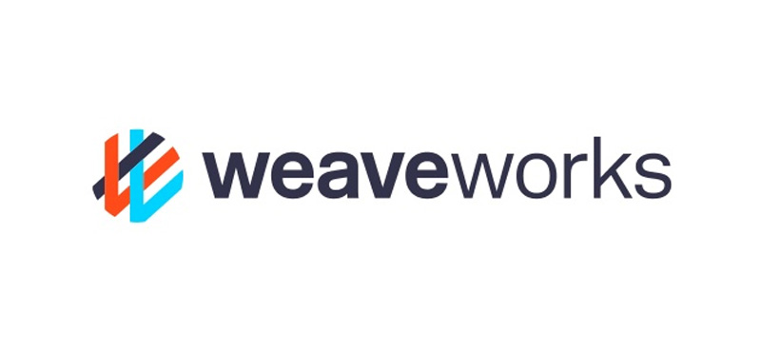
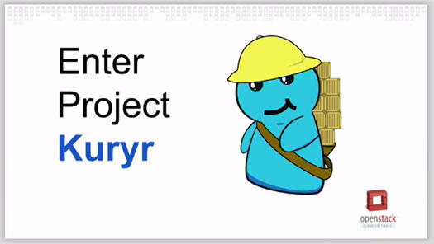
OpenStack - Container Networking

Slide 14
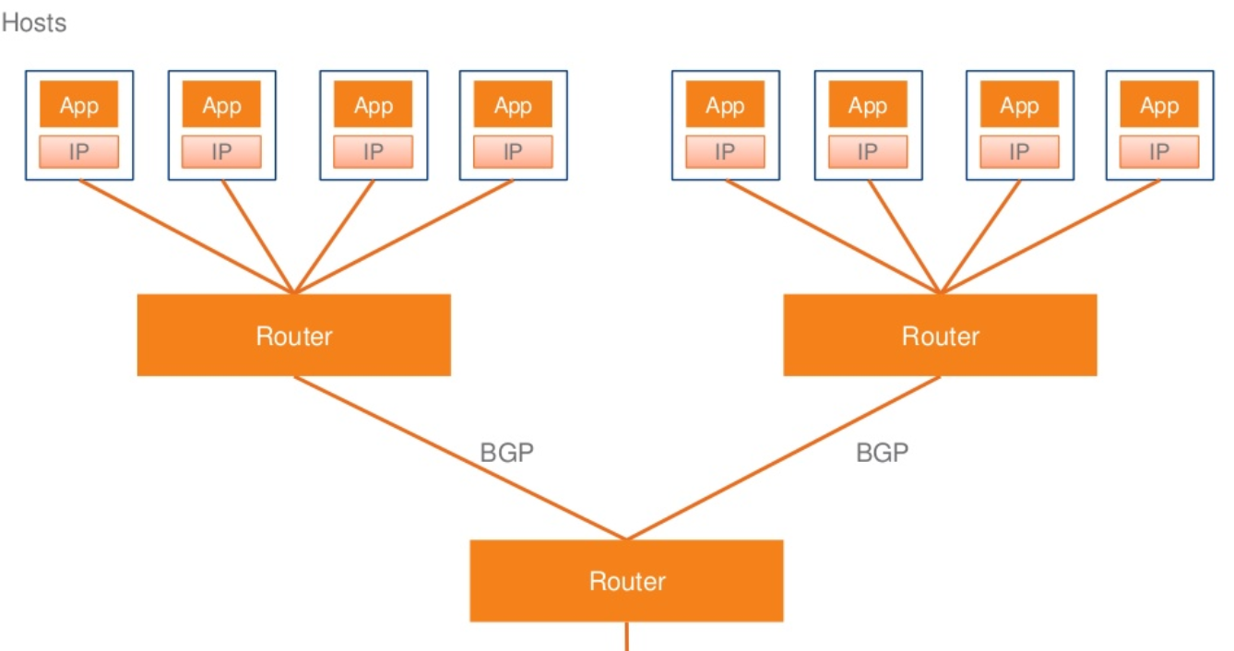
Container Networking: Calico
Notes:
Driver that provides IP- connectivity between VMs based on standard IP routing and iptables.
Calico provides simple, scalable and secure virtual networking
Calico uses BGP to distribute routes for every container
Each host preform like Router
Calico is able to offer better performance and network isolation than a flannel-based network system

Slide 15
Demo 1
Creating Containers over Bare-metal

Slide 16
Monitoring in hybrid environment
Introduction

Slide 17
Monitoring the hybrid environment
VNF
VNF
VNF
VM
VM
VM
C
C
C
C
C
Kubernetes
C
C
C
Docker
Kubernetes
Bare-metal
Docker
OpenStack
HW
HW
HW
HW
HW
HW
Leitner et al. (2012), Evans et al. (2015),
Emeakaroha et al. (2012), Farokhi et al. (2015)
Notes:
Objectives: State of VM in OpenStack,
%CPU, %Memory,%Disc useage
Network Traffic
Objectives: State of K8s and of OpenStack
Objectives: CPU, Memory, Network, Storage
+++++++++++++++++++++++++++++++++++++++++++++++++++++++++++++++
rx_bytes B/s Bytes received by the container
rx_packets Pckt/s Packets received by the container
tx_bytes B/s Bytes sent by the container
tx_packets Pckt/s Packets sent by the container
cpu_usage Float %CPU usage of the container
memory_usage KB %memory usage of the container
io_service_bytes_read B/s Bytes read from block device by the container
io_service_bytes_write B/s Bytes written to block device by the container
+++++++++++++++++++++++++++++++++++++++++++++++++++++
Objectives: Response time, application
throughput, dropped frames ,etc.
Academic works:
Leitner et al. (2012), Evans et al. (2015),
Emeakaroha et al. (2012), Farokhi et al. (2015)

Slide 18
Container Environment Monitoring Requirements
Reliable (no blind spots in case of outage)
Effective measurement
Support for data filtering
Scalable
Dynamical topology
Notes:
Monitoring tools need to be just as durable, if not more durable than, your application as a whole. Nothing is more frustrating than an outage that causes your monitoring tools to go dark, leaving you without insight at the time you need it most. While best practices for monitoring at this level tend to be very specific to the application, you should look at the failure points within your infrastructure and ensure that any outages that could happen would not cause monitoring blind spots.
Support scaling adaptation policies for large-scale dynamic environments
Include capability of storing of measured values
Able to filter measured values to diminish data exchanges
Resistance, no ‘blind spots’ due to outages
VM/container level Monitoring:
Quickly react to the dynamic resource management changes over time
Able to deal with the application topology and reconfiguration
Application level
Able to deal with the application topology and reconfiguration
Define effective measurement upon the application performance

Slide 19

Designed for server/agent architecture
Collects and aggregates monitoring data
Alerting system → predefined events and conditions
SQL databases
Tader, 2010

Slide 20

63% of
Kubernetes
clusters
Efficient time series DB
Flexible query language
Alerting
Many exports and integrations
Source: The New Stack 2017
Kubernetes User Experience Survey

Slide 21

What is Vitrage?
OpenStack Root Cause Analysis
Organizing, analyzing and expanding alarms & events
Root Cause Analysis
Deduced alarms and states
Holistic and complete view
Notes:
The OpenStack RCA (Root Cause Analysis) service
Vitrage is used for organizing, analyzing and expanding OpenStack alarms & events.
Root Cause Analysis – understand what causes faults to occur
Deduced alarms and states – raising alarms and modifying states based on system insights
Holistic and complete view of the system

Slide 22
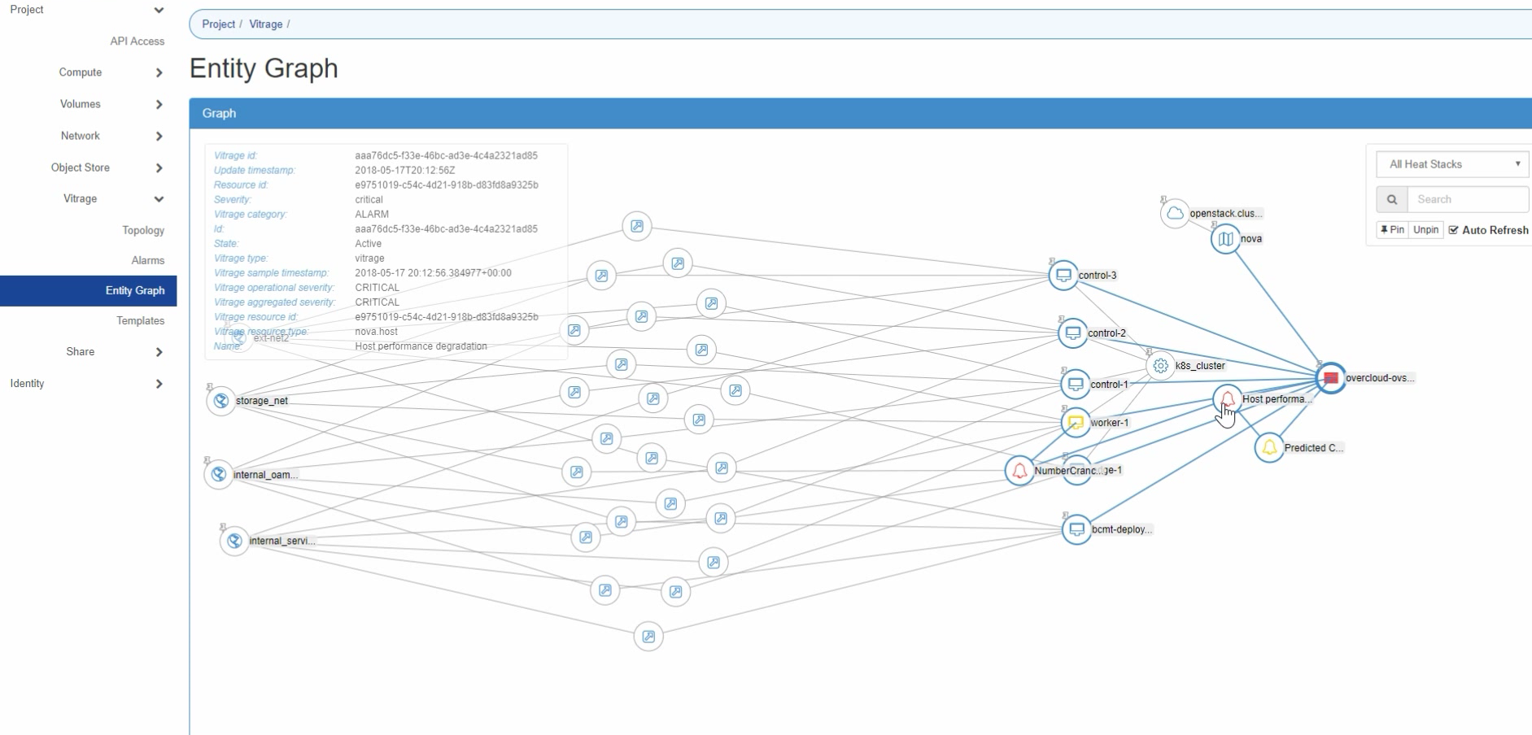
Vitrage - Entity visualization

Slide 23
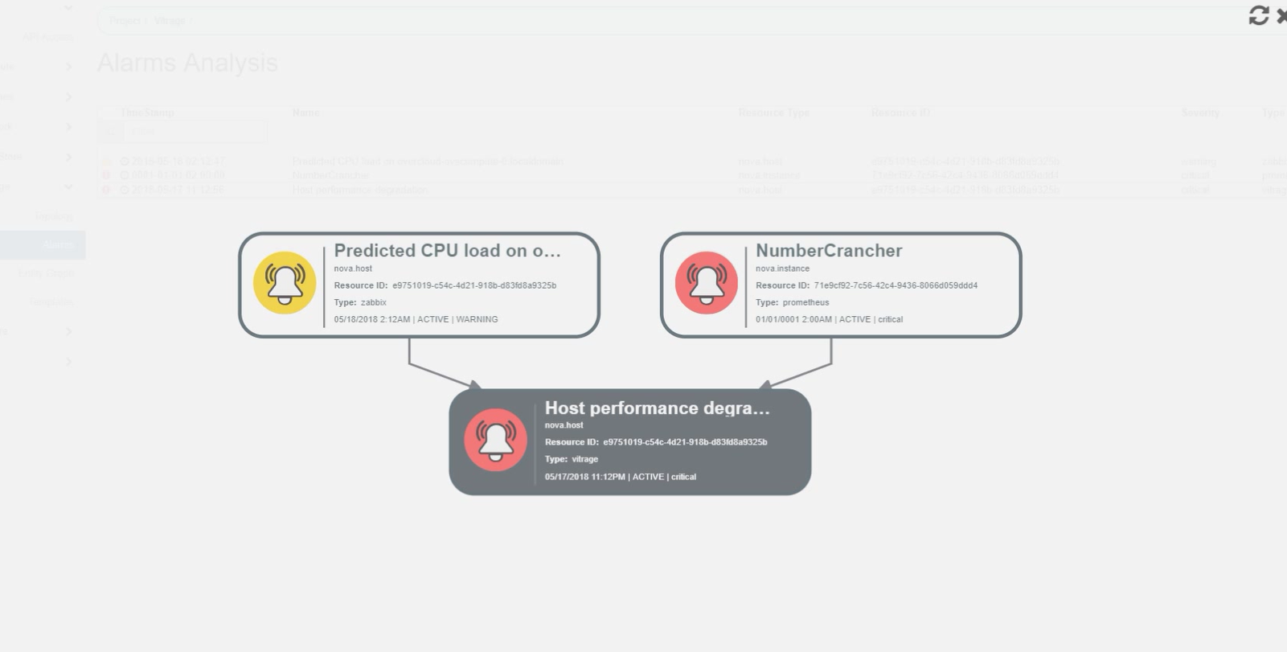
Vitrage - Root Cause Analysis

Slide 24
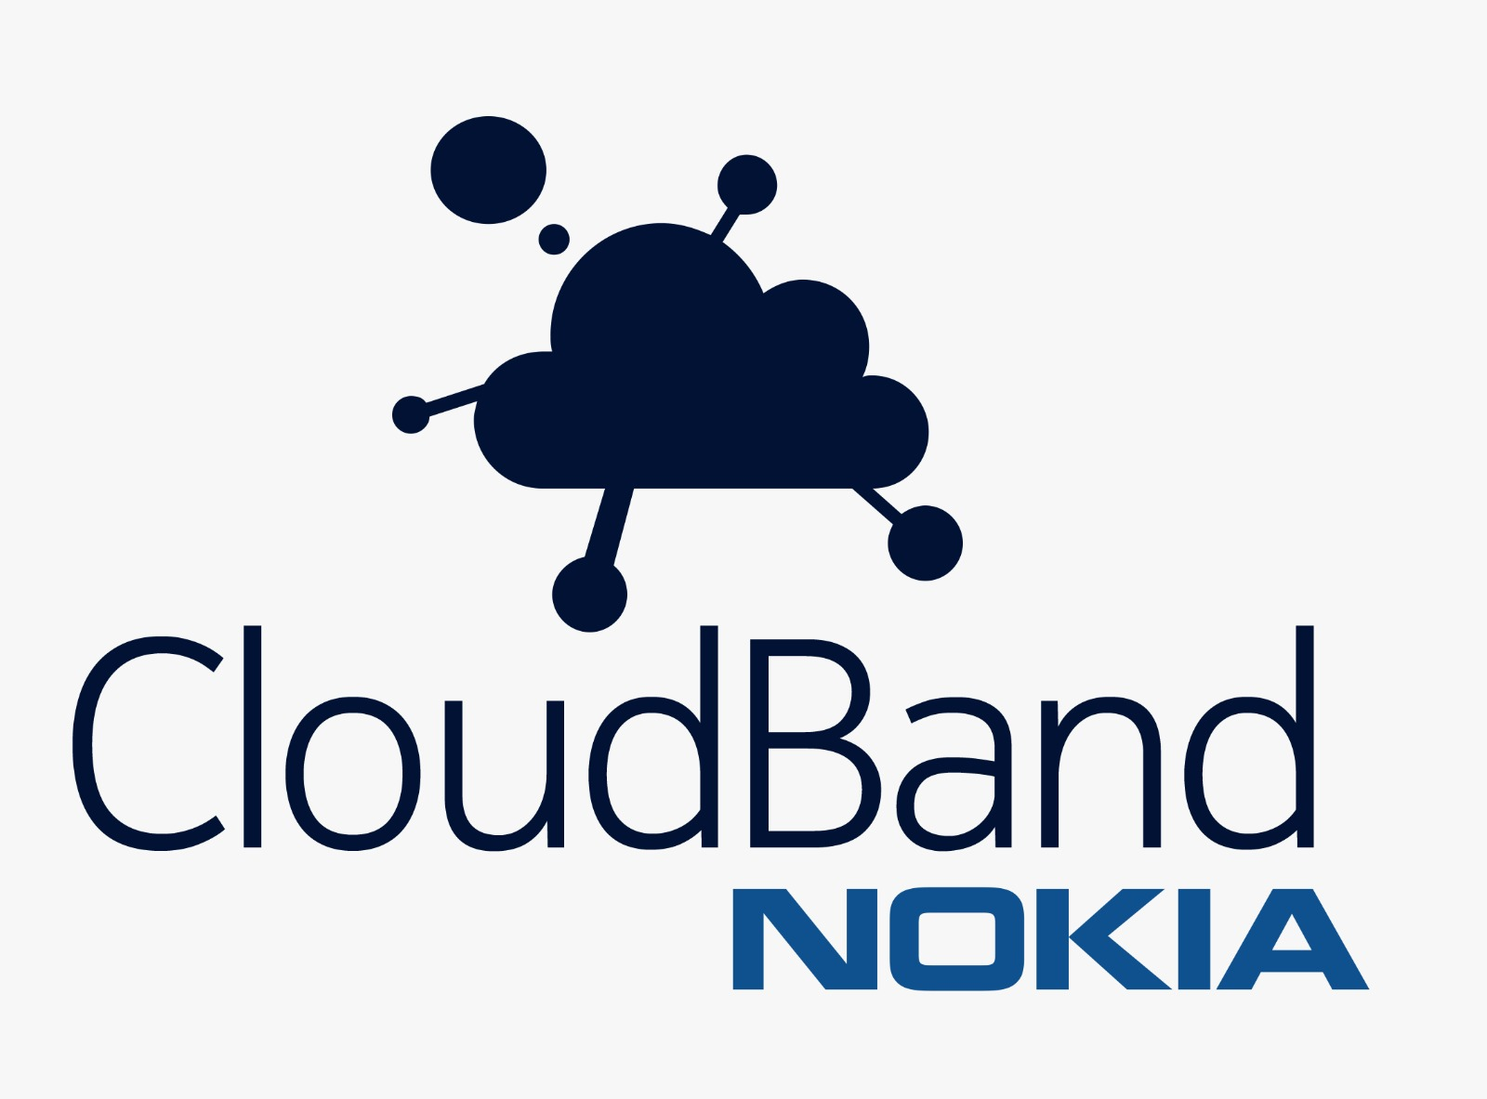
Q & A
Thank you!

