Slide 1
Bringing Istio to Openstack
Mesh expansion across Openstack instances
Tim Swanson/Arvind Somya
Technical Leader

Slide 2
Agenda
Introduction of Istio and Service Mesh
Istio+Kubernetes on OpenStack
Expanding the Istio Mesh across Openstack VMs
Istio Mesh Expansion Demo
Future Improvements
References
Q&A

Slide 3
Introduction

Slide 4
What is Istio *
A uniform way to connect, manage, and secure microservices.
Automatic load balancing for HTTP, gRPC, WebSocket, and TCP traffic.
Fine-grained control of traffic behavior with rich routing rules, retries, failovers, and fault injection.
A pluggable policy layer and configuration API supporting access controls, rate limits and quotas.
Automatic metrics, logs, and traces for all traffic within a cluster, including cluster ingress and egress.
Secure service-to-service authentication with strong identity assertions between services in a cluster.
* Directly from https://istio.io/about/intro.html
Notes:
Istio is a service mesh framework that provides a uniform way to connect, manage, and secure microservices.
Istio provides several features to microservices in the mesh:
Automatic multi-protocol load-balancing
Multi-protocol traffic controls like service endpoint aware traffic routing, circuit breaking, and fault-injection
Pluggable policy layer and configuration API
Automatic logging and metrics for microservice traffic
Security between all microservices in the mesh

Slide 5
What is a Service Mesh
Infrastructure layer for service-to-service communication
A mesh of proxies
Proxies injected as sidecars
Supports numerous protocols (HTTP 1/2, gRPC, TCP, UDP)
Can inspect API transactions at Layer 7 or layer 3/4.
Intelligent routing rules can be applied between endpoints
Web UI
Billing DB
API
API
Proxy
Gateway/ Ingress
Proxy
External
Requests
Proxy
Business Logic
Accounts
DB
API
API
Proxy
Proxy
Istio’s Multicluster enhancement allows cloud boundaries anywhere in above mesh
Notes:
Mesh of proxies
The APIs between the microservices are front ended by a proxy
Control plane for the Proxies
Envoy is the proxy
Sidecar injected
Secure and intelligent routing

Slide 6
Istio Architecture Source: https://istio.io/docs/concepts/what-is-istio/overview.html
Notes:
Figure borrowed from Istio.io – would encourage you to go
A bit dated
Pilot provide mesh topology and routing rules to the proxy
Mixer provides Telemetry collection
Mixer advanced policy and security checks, especially on server side of the API
Istio Auth -> Istio-citadel
Provides the Certs to Envoy for both Istio control plane communication & communication between the microservices

Slide 7
Istio Components:
Envoy – a proxy injected in every application Pod (as a sidecar)
Envoy is a separate open source project in the CNCF
Pilot – Serves as a control plane for the proxies to configure them and provide them their routing rules
Citadel (previously istio-auth) – Propagates certificates and keys to all the pods to secure both control plane and app exchanges
Mixer – Provides telemetry collection as well as sophisticated receive side policy checks.

Slide 8
API
Auth sends TLS
Certificates to all
Envoys.
Pilot transmits
Config data to
all Envoys
Control Plane
Pilot
Mixer
Auth
Mixer enforces policy
And gathers telemetry
from all envoys
Productpage
Reviews
Ratings
Productpage
Reviews
Ratings
Envoy
Productpage
Envoy
Reviews
Envoy
Ratings
Bookinfo Application

Slide 9
Bookinfo Application Microservice Architecture
V1 = No stars
V2 = Black stars V3 = Red stars
Notes:
Using bookinfo – Istio sample app
Blue on prem
Tan on GKE
Explain stars

Slide 10
Kubernetes on Openstack

Slide 11
Openstack
API
Create
K8s cluster
k8s Admin
Notes:
How do we use Kubernetes on OpenStack? The idea is similar to other public cloud kubernetes solutions. The kubernetes Admin creates a k8s cluster via openstack APIs (or an installer that uses openstack APIs, ie. kubeanywhere).

Slide 12
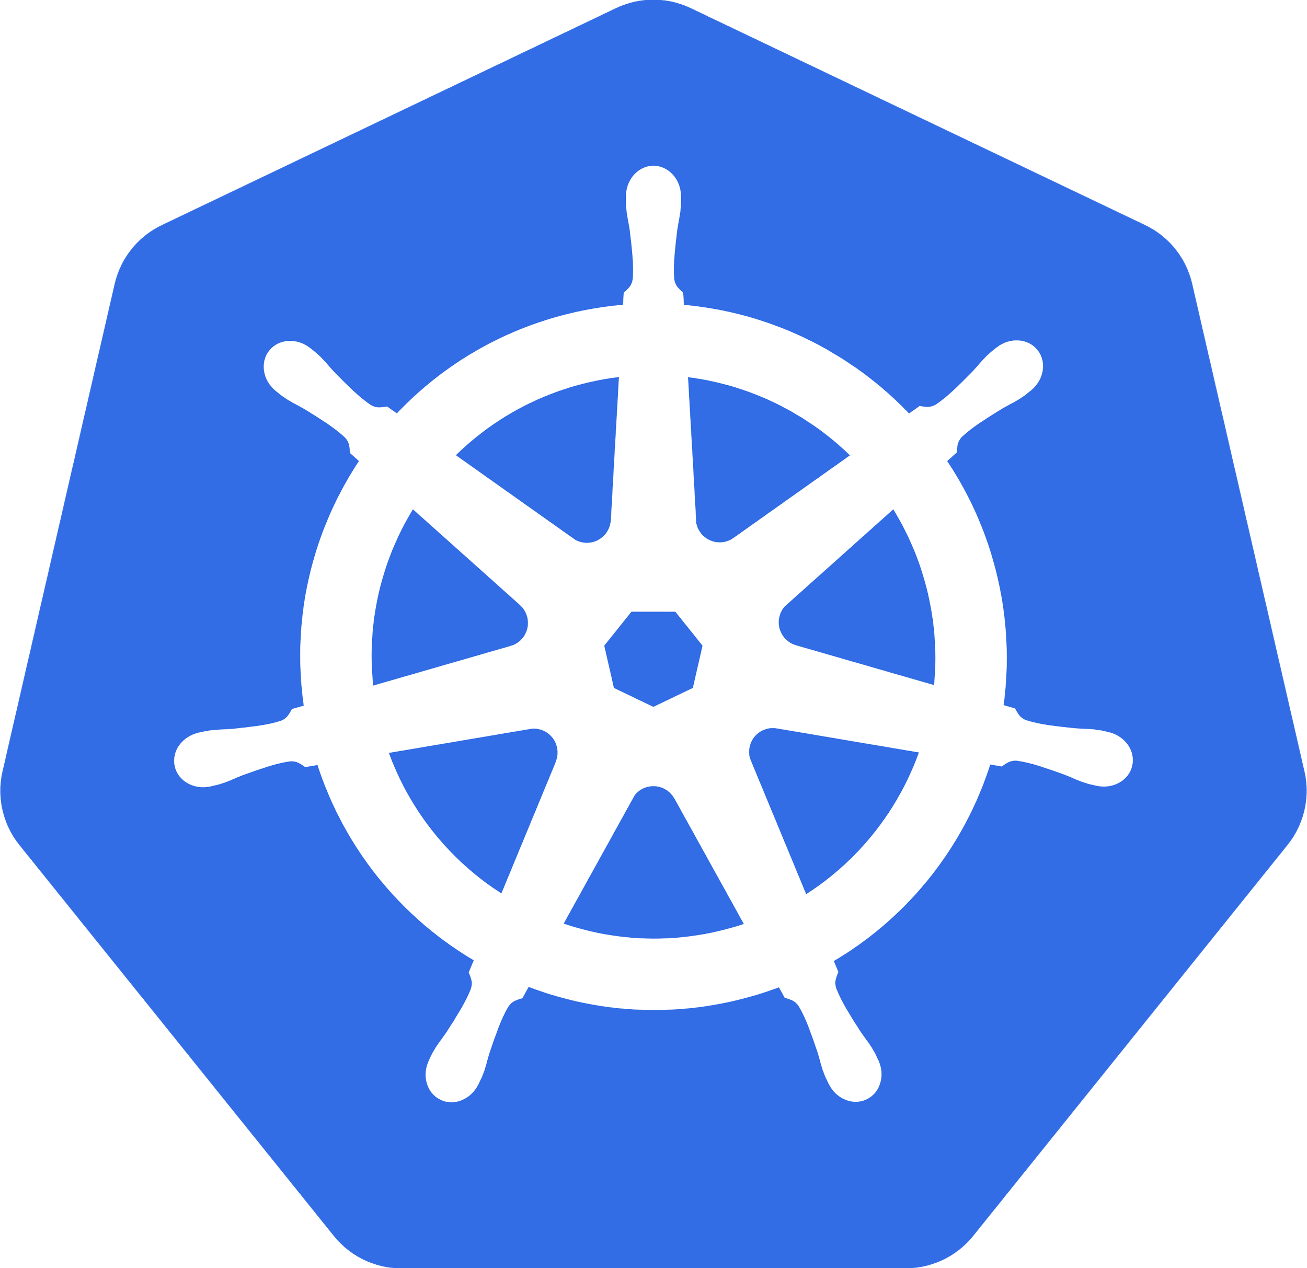
Openstack
API
Use K8s cluster
k8s User
Masters
Minions
K8s cluster
Notes:
The k8s cluster is created and then, ideally, the kubernetes user just interacts with the kubernetes cluster directly via k8s APIs.

Slide 13
Kubernetes Openstack Cloud Provider
Performs Openstack API operations based on kubernetes events
Main Scenario:
K8s loadbalancer service is created
Openstack LBaaS loadbalancer created and endpoints are setup
Istio Ingress Depends on Kubernetes LoadBalancer
Notes:
Certain kubernetes events may have corresponding actions at the cloud infrastructure level to support the desired functionality. Kubernetes defines an architectural component called “cloud-providers” which performs actions on the cloud infrastructure APIs during events in kubernetes. The Openstack cloud-provider is integrated in the kubernetes control-plane.
The main scenario pertaining to istio integration with openstack is the openstack cloud-provider’s support for implementing kubernetes loadbalancer objects. The openstack cloud-provider can use the openstack LBaaS API to create loadbalancers and add/remove VIP endpoints corresponding to kubernetes loadbalancer service types.
The canonical deployment of istio-ingress relies on a k8s loadbalancer type service.

Slide 14
apiVersion: v1
kind: Service
metadata:
name: istio-ingress
namespace: istio-system
labels:
istio: ingress
spec:
type: LoadBalancer
...
selector:
istio: ingress
Neutron
Router
Load
Balancer
K8s Service VIP
Create
Service VIP LB endpoints
Openstack
Cloud provider
Masters
Minions
K8s cluster
Notes:
The openstack cloud-provider is built into the kubernetes control plane and configured by the kubernetes installer. (e.g. Magnum)
The Openstack cloud-provider creates neutron loadbalancers on k8s service type = LoadBalancer setup.
Istio Ingress is implemented behind a k8s Loadbalancer type service

Slide 15
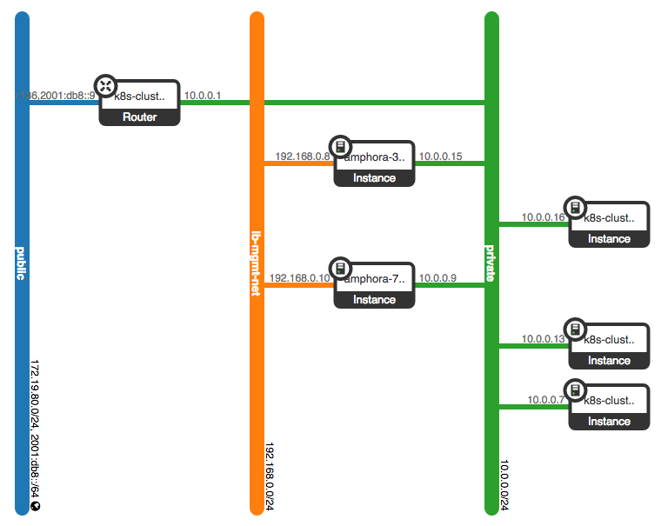
LoadBalancers Created for 2 k8s LB Services
Created by Kubernetes’ Openstack Cloud Provider
Hosting 2 k8s services of type “LoadBalancer”
LoadBalancer
VMs
K8s cluster
VMs
Notes:
This is the network topology view for a deployment of k8s with the openstack cloud provider setup to create openstack loadbalancers.
The images shows 2 Octavia loadbalancer VMs created by the k8s cloud provider when 2 k8s services of type loadbalancer.
Octavia implements loadbalancers created by neutron as haproxy VMs (amphora)

Slide 16
Neutron
Router
Each Nodes’ Pod CIDR Routes Needed
Openstack
Cloud provider
Masters
Minions
Node 1 router
Node 2 router
K8s cluster
Notes:
To enable Pod to Pod communication per node Pod CIDR routes are needed at the Minion Host level. This is taken care of by the CNI
For Pod to VM communication the Neutron router also needs a route to each Node’s Pod CIDR with next-hop as the Node address.

Slide 17
Neutron
Router
Pod CIDR Routes (extraroutes)
CNI plugin
Openstack
Cloud provider
Pod CIDR Routes
Masters
Minions
Node 1 router
Node 2 router
K8s cluster
Notes:
Kubernetes Node level routes are added by CNI plugin
Openstack Cloud Provider can add Pod CIDR routes to Neutron router

Slide 18
VM to Pods through Router
Neutron
Router
Openstack
Cloud provider
App
VM
Pod CIDR Routes
Masters
Minions
Node 1 router
Node 2 router
K8s cluster
Notes:
Kubernetes Node level routes are added by CNI plugin
Openstack Cloud Provider can add Pod CIDR routes to Neutron router

Slide 19
Installing Kubernetes and Istio on Openstack

Slide 20
apiVersion: v1
kind: Service
metadata:
name: istio-ingress
namespace: istio-system
labels:
istio: ingress
spec:
type: LoadBalancer
...
selector:
istio: ingress
Neutron
Router
Load
Balancer
K8s Service VIP
Create
Service VIP LB endpoints
Openstack
Cloud provider
Masters
Minions
K8s cluster
Notes:
The openstack cloud-provider is built into the kubernetes control plane and configured by the kubernetes installer. (e.g. Magnum)
The Openstack cloud-provider creates neutron loadbalancers on k8s service type = LoadBalancer setup.
Istio Ingress is implemented behind a k8s Loadbalancer type service

Slide 21
Expanding the Istio mesh across Openstack VMs

Slide 22
Why expand the mesh?
A lot of enterprise workloads still run in VMs
Containerization of apps might not be possible due to resource constraints
Enterprises are concerned about security in some cases
Vast infrastructure investments in virtualization already
Benefits of deploying apps on a mesh
Transition to a container only infrastructure

Slide 23
What this demo does
Spin up Bookinfo, Istio's sample application, on the Kubernetes cluster with all services in containers
Migrate the backend to a MySql container
Start an instance on Openstack
Provision the VM to join the Istio Mesh
Move the backend from a containerized MySql to a VM based MySql instance using Istio

Slide 24
Modify route rule to drain all traffic from Reviews and send 100% to Reviews v3
Create new route rule to send 80% of the traffic to Reviews v3
Create Reviews v3 pod
Create bookinfo basic pods
Default route rules split queries among all versions of a service
Deploy the Ratings v2 pod
Apply route rules to route all queries to Ratings v2
Productpage
Reviews
Ratings
Productpage
50%
Reviews
Ratings
Envoy
Productpage
Envoy
Reviews
Ratings
20%
Envoy
80%
50%
100%
Reviews
Ratings
Reviews
Ratings
Envoy
Reviews
v3
Ratings
v2
Envoy
Bookinfo Application

Slide 25
The MySql backend service will be replaced by an Openstack MySql VM
Apply route rules to route all traffic to the MySql backed Ratings pod
Deploy the Ratings v2 MySql Pod
Delete the MySql backend service
Productpage
Productpage
Productpage
Ratings
Productpage
Envoy
Ratings
MySql
Envoy
Productpage
Ratings
v2 MySql
Envoy
Reviews
Ratings
Reviews
Ratings
Envoy
Reviews
v3
Envoy
Ratings
v2
Bookinfo Application

Slide 26
Register the Openstack VM as the MySql backend in Istio
Spin up an Openstack VM with MySql configured for the Bookinfo backend
Productpage
Reviews
Ratings
Productpage
Reviews
Ratings
Envoy
Envoy
Productpage
Reviews
v3
Envoy
Ratings
v2 MySql
Envoy
MySql VM
Openstack
Bookinfo Application

Slide 27
Demo

Slide 28
What needs to be supplied to the VM
The VM needs to be able to talk to the Istio service and Pod endpoints. This can be achieved using a netplugin like Calico to redistribute routes.
The VM needs the Kubernetes secrets in order to communicate to the Kubernetes services and pods
The VM should be able to discover services on the Kubernetes cluster. We can do this via either a DNS relay, Dnsmasq or static entries in the host file. Using a DNS relay pointing to the Kubernetes DNS would be the ideal solution as this will protect the connections in cases of container restart and moves.

Slide 29
Future work
Better integration with major cloud providers AWS, GCE, Openstack etc. There isn’t an easy and native way to extend the Istio service mesh to conventional VM based clouds. So, we have to use hacky ways like bash scripts to extend the mesh. It would be ideal to have the ability to define service meshes per tenant/project and have VM’s electively join using a single toggle.
K8s/Istio should be able to treat the VM endpoint as another version of a service to help seamlessly transition service to and from a VM (currently we have to delete local services to replace). This might be fixed with 0.8 release of Istio.

Slide 30
References:
Istio Docs: https://istio.io/docs/
Istio Integrating VMs: https://istio.io/docs/guides/integrating-vms.html
Istio on OpenStack Magnum Example: https://tiswanso.github.io/istio/istio_on_magnum.html
Kubernetes OpenStack Cloud Provider: https://kubernetes.io/docs/concepts/cluster-administration/cloud-providers/

Slide 31
Questions/Comments?

