Slide 1
Intel and OpenStack: Contributions and Deployment
Das Kamhout, Principal Engineer, Intel IT
Dr. Malini Bhandaru, Open Source Technology Center, Intel SSG
OpenStack Summit, Hong Kong, Nov’13

Slide 2

Helping Fuel Innovation—and Opportunities
11.1%
X.org
GNU
Eclipse
9.3%
Webkit
JQuery
kernel.org
4.9%
4.2%
Yocto Project
OpenStack
01.org
Red Hat
Intel
SUSE
IBM
Hadoop
#2 Linux Contributor
improving performance, stability & efficiency
Across the Stack
contributions span every layer of the stack
Intel in Open Source
Project Contributor
Code Contributions to Open Source Projects
SPCEvirt_sc2010* Performance
3,000
2,500
2,000
1,500
1,000
500
0
Throughput
3x improvement over 3 years
Higher is Better
Intel is single largest contributor to these projects
MC-DP
WSM-EP
SNB-EP
WSM-EX
Proven Components
building blocks simplify development, reduce costs and speed time-to-market
KVM
Notes:
Intel actively contributes to a breadth of open-source projects across every layer of the solution stack.
Intel is proud to be a part of the open-source community. In fact, we’ve been there from the very beginning, long before it was a major force, and our high level of commitment has remained consistent from the start.
Intel employs thousands of software developers around the globe to ensure open-source software delivers top-notch performance, power-efficiency, scalability and security. We are second-leading contributor to the Linux kernel, behind only Red Hat, whose business model is based on open source. Among silicon vendors, we are the leading contributor. Moreover, we lead even software companies in our contributions.
Intel is committed to helping enable our hardware for open-source software, and our commitment goes way beyond that, spanning every layer of the solution stack, including middleware and applications.
Our work has resulted in phenomenal performance enhancements and product-quality software, delivering exceptional developer and end-user experiences.

Slide 3


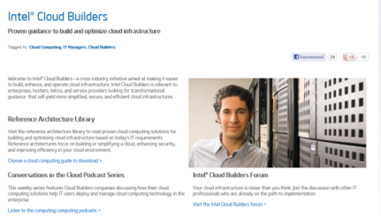
Intel Enables OpenStack Cloud Deployments
Across OpenStack projects
Open Source Tools
Top contributor to Grizzly and Havana releases¹
Optimizations, validation, and patches
Contributions
Intel® IT
Open Cloud
Intel IT Open Cloud with OpenStack
Delivering Consumable Services
Single Control Plane for all Infrastructure
Collection of best practices
Intel IT Open Cloud Reference Arch
Share best practices with IT and CSPs
http://www.intel.com/cloudbuilders
Intel® Cloud
Builders
¹Source: www.stackalytics.com
Notes:
Das leads off talking about

Slide 4



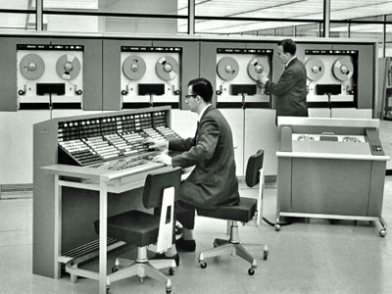
Stress on Datacenter Operations
Network
2-3 weeks to provision
new services¹
Storage
40% data growth CAGR,
90% unstructured³
Server
Average utilization <50%
despite virtualization⁴
New Challenges are coming….
1: Source: Intel IT internal estimate; 2: 3: IDC’s Digital Universe Study, sponsored by EMC, December 2012; 4: IDC Server Virtualization and The Cloud 2012
Notes:
we understand some of the constraints the datacenter is facing. You’re required to increase your storage capacity almost without limit, taking away budget from what could allow you to provide new services such as cloud-like capabilities or improving efficiencies to be parity with the best practices in the industry. Then let’s talk about the time – that storage capacity you purchased isn’t useful if it isn’t installed and provisioned. How do you connect it? Getting the network connections provisioned is not automated – you have to touch each vendor specific CLI. That’s not cheap either – how many of you have an entire team whose primary expertise is how to work the ins and outs of a vendor’s CLI? Intel IT has over a hundred in our shop ….so storage is taking space, budget & power. Networking is taking your time. How do you possibly get out of this spiral?

Slide 5
The Intel SDI Vision
  Self-provisioning, automated orchestration, composable resource pools
Datacenter Today
Software-defined Infrastructure
Private
Public
Idea for
service
IT scopes
needs
Balance
user demands
Idea for
service
Self service catalog & services orchestration
Automated
composition
of resources
Manually
configure
devices
Set up service
components,
assemble software
Service
running
Software
components assembled
Service
running
Time to Provision New Service: Months¹
Time to Provision New Service: Minutes¹
1: Source: Intel IT internal estimate
5
Notes:
Today, how do services get provisioned? Somebody has an idea for a service and then they have to call IT. A number of people in IT go ahead and scope their needs. IT sharpens their pencils, they look at what the requirements are for reliability, for capacity, how much web services access do they need? Then they balance that against the rest of the infrastructure and all of the user demands.
They're having to look at profitability, they're looking at cost, they're looking at the capacity that they know they have based on their archives and databases, to give them a paper estimate of the capacity they really have installed. Once they've got that in place, and procure the needed equipment, they have to manually configure it.
Manually configuring a device means you touch everyone. Whether it is having to actually physically plug in an Ethernet plug and make the connection between different boxes, or whether it's simply having to touch the command line interface of every single box to configure and provision it appropriately there is a human touch at every point along the way.
Once those are connected and configured, then they actually have to set up service. This pulls together the server and the storage and the data store so that the service is actually running and allows the original service requestor to develop the software and services they had in mind in the first place
Then and only then do you have the service running. The service is available & ready for customers to do business. The time to provision there is months, minimally speaking, about eight weeks according to the Intel IT internal estimates.
What should we be moving to? The end state of the future, the vision of re-architecting the data center and the result is something called software-defined infrastructure.
Once there's an idea for a service, the LOB customer can pull together very quickly from private or, public, cloud services, or from their own internal capabilities, using a self-service portal that orchestrates the services they need from an online catalog. Things like location, security, online payments can be pulled together automatically –then the customer can assemble the software components from a list that's available to them, whether from their internal IT department or a repository like GitHub. The service level agreement that the orchestrator creates tells the infrastructure orchestrator what resources do I need? What kind of availability do I need? How much storage do I need? How fast of a connection do I need between the compute and the storage? Then, how do I manage power and how do I manage temperature demands if I'm in a particularly intense workload?
All of this happens automatically. After the services are orchestrated, the infrastructure is orchestrated, the service is running. The time to provision a new service is minutes. Depending on how quickly somebody can put the software together, it should be push button - done

Slide 6
Open Data Center Alliance
Cloud Adoption Roadmap
Consumers
Start
Year 1
Year 2
Year 3
Year 4
Year 5
End
User
Legacy Applications on dedicated Infrastructure
Simple SaaS
Simple SaaS
Complex SaaS
Hybrid SaaS
Federated, Interoperable, and Open Cloud
Enterprise Legacy Apps
Cloud Aware Apps
Cloud Aware Apps
Cloud Aware Apps
App
Dev
Enterprise Legacy Apps
Legacy Apps
Legacy Apps
App
Owner
Complex Compute IaaS
Private PaaS
Hybrid PaaS
Simple
Compute IaaS
Simple Compute IaaS
IT Ops
Compute, Storage, and Network
Compute, Storage, and Network
Full Private IaaS
Hybrid IaaS

Slide 7
Intel IT Quick History
Design Grid since 1990’s
60k servers across 60+ datacenters
Cloud’s Uncle
Enterprise Private Cloud 2010
13k VMs across 10 datacenters
75% of Enterprise Server Requests
80% virtualized
Open Source Private Cloud 2012
1.5k VMs across 2 datacenters
Running cloud-aware and some traditional apps

Slide 8
OpenStack - Intel IT Convergence Platform
Silicon Design
Validation Labs
Enterprise Hosting
OpenStack
Existing Infrastructure
New Infrastructure

Slide 9

Top Challenges & Technical Responses
Trusted Compute Pools
Geo-tagging
Key Management
Enhanced Platform Awareness (crypto processing)
Security & Compliance
Intelligent storage allocation in Cinder
Multiple publisher support in ceilometer
Erasure code in Icehouse release
COSbench performance measurement tool
Erasure Code (storage cost)
Enhanced Platform Awareness (PCIe Accelerators etc.)
Intelligent workload & storage scheduling
Unit Cost Reduction
Business
Uptime
Live Migration, Rack-level redundancies
Intel® Virtualization Technology with FlexMigration
Notes:
Das leads off talking about

Slide 10
Intel Contributions* to OpenStack
Monitoring/Metering (Ceilometer)
User Interface (Horizon)
Expose Enhancements
Metrics
Compute (Nova)
Block Storage (Cinder)
Object Store (Swift)
Enhanced Platform Awareness
Filter Scheduler
Erasure Code
Object Storage Policy
Network Services (Neutron)
Trusted Compute Pools
(Extended with Geo Tagging)
Intel® DPDK vSwitch
Image Store (Glance)
Advanced Services in VMs
Intelligent Workload Scheduling
OVF Meta-Data Import
VPN-as-a-Service (with Intel® QuickAssist Technology)
Key Service (Barbican)
Key Encryption & Management
Compute |  | Networking | Storage
Enhanced Platform Awareness CPU Feature Detection PCIe SR-IOV Accelerators OVF Meta-Data Import | Trusted Compute Pools With Geo Tagging Key Management Intelligent Workload Scheduling (Metrics) | Intel® DPDK vSwitch VPN-as-a-Service with Intel® QuickAssist Acceleration Advanced Services in VMs | Filter Scheduler Erasure Code Object Storage Policies
*Note: A mixture of features that are completed, in development or in Planning
Notes:
Malini to present high level roadmap showing Intel contributions in most of the OpenStack projects.
Intention is not to dwell long on this slide, but to highlight our strategy on compute, networking and storage.
Suggested Time budget (1 minute)

Slide 11
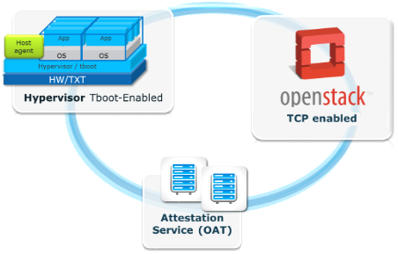
Trusted Compute Pools (TCP)
  Enhance visibility, control and compliance
  TCP Solution
    Platform Trust - new attribute for Management
    Intel® TXT initiates Measured Boot
      basis for Platform Trust
    Open Attestation (OAT) SDK – Remote Attestation
    Mechanism
      https://github.com/OpenAttestation/OpenAttestation
    TCP-aware scheduler controls placement & migration
    of workloads in trusted pools
TCP is enabled in OpenStack (Folsom release)
No computer system can provide absolute security under all conditions. Intel® Trusted Execution Technology (Intel® TXT) requires a computer system with Intel® Virtualization Technology, an Intel TXT-enabled processor, chipset, BIOS, Authenticated Code Modules and an Intel TXT-compatible measured launched environment (MLE). The MLE could consist of a virtual machine monitor, an OS or an application. In addition, Intel TXT requires the system to contain a TPM v1.2, as defined by the Trusted Computing Group and specific software for some uses. For more information, see here
¹source: McCann “what’s holding the cloud back?” cloud security global IT survey, sponsored by Intel, May 2012
11
Notes:
OpenStack Policy Engine / Console
Trust level of VM specified as Trusted
Compute (Nova) – Trust Filter
Dashboard (Horizon) – Trust Filter UI
Key Message: Intel TXT enables isolation and tamper detection in the boot process and provides verification that’s useful in compliance and by security and policy applications to control workloads.
Intel TXT is not new technology—it has been available on Intel vPro-branded clients for years. But it is now available for servers—and the use models there are quite compelling
Intel® TXT helps prevent software-based attacks on areas that are relatively unprotected today, such as
Attempts to insert non-trusted VMM (rootkit hypervisor)
Reset attacks designed to compromise platform secrets in memory
BIOS and firmware update attacks
Looking at it another way, Intel® TXT enforces control through measurement, memory locking and sealing secrets—essentially isolating the launch time environment. As such, it works cooperatively with Intel® Virtualization Technology (Intel® VT)
Intel® TXT is providing hardware-based protections in the processor, chipset and 3rd party Trusted Platform Modules (TPMs) that can better resist software attacks, making platforms more robust
This helps lower support costs, but also provides higher value capabilities such as enhanced control of workloads via security policy and reporting into security compliance dashboards—we’ll get into that in a moment.
Intel TXT provides high value by enabling trust in the platform—verifying launch time components and enforcing “known good” configurations of the critical software that will control the platform
The three key use models are:
Trusted launch – which is the basic verification of platform integrity, with lower risk from critical system malware and reducing support costs and data breach risks
Anecdote: we’ve heard from a number of EBOA customers that while they trust the hypervisor they use in their own datacenter, they trust that same hypervisor a lot less when it is run in another location—so verification of trust if a very useful assurance for them
Then we have 2 new use models that have even added benefits for virtual and cloud use models
2. Trusted pools – aggregation of multiple trusted systems and enabling platform trust status as a data point for security applications to enforce control of workload assignment – such as restricting sensitive VMs to only run on trusted systems
3. Compliance Support – using TXT hardware capabilities to establish and verify adherence to data protection and control standards—allowing hardware-based reporting of platform trust locally and remotely. This provides new visibility into their data protection capabilities
With these, we’ve really extended Intel’s leadership into server security and give customers more visibility and control they seek for their clouds
Built on Intel TXT:
Addresses concerns over limited visibility into capabilities of cloud infrastructure
Trust status usable by security and policy applications to control workloads to meet requirements
Hardware based trust and attestation provides verification useful in compliance
Visibility into security thanks to TXT
Control to decide how to act based on visibility
Connection to Compliance

Slide 12
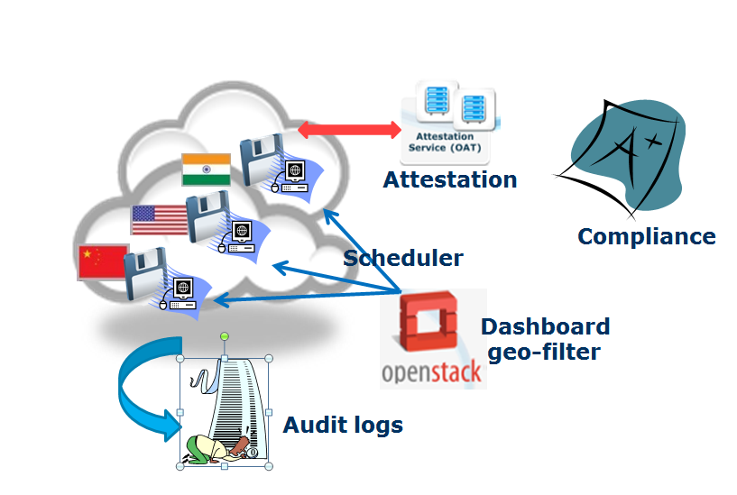
Trusted Compute Pools with Geo-Tagging
Use geo-location descriptor stored in TPM on Trusted Servers to control workload placement & migration
OpenStack* Enhancements
  Secure mechanism for Provisioning geo certificates
  Dashboard – display VM/storage geo
  Nova flavor extra spec – geo
  Enhanced TCP scheduler filter
  Geo Attestation Service (OAT +)
  Geo-tagged Storage
    Volumes
    Objects
Work in progress - Provide feedback, use cases
Notes:
Speaking points:
Geo controlled placement
VM placement, migration
Storage
objects and block/volume

Slide 13
Concept: Trusted Compute Pools (TCP) – VM Protection
Tenant-Controlled, Hardware-Assisted VM Protection in the Cloud
Customer
Data Center
Cloud Service Provider
Data Center
MH Client
MH Client
CSP-Image
Server
(Glance)
MH Client
2
Encrypted VM Image
Encrypted VM Image
5
DOM0
Encrypted VM SymKey
Launch command
MH: OVF
Plug-in
3
Cloud Service
Provider Portal
4
OAT
1
Launch request
(from anywhere)
Host + VMM
TXT + TPM
Key Mgt
Service
6
Request Encryption Key (AIK, KeyID)
Keys
Encryption Key (enveloped)
9
Policy
Request Host Trust Attestation
7
Trust Attestation
OAT/MTW
Response Trust Status, BindPubKey
8
Concept Demo in Citrix Booth

Slide 14
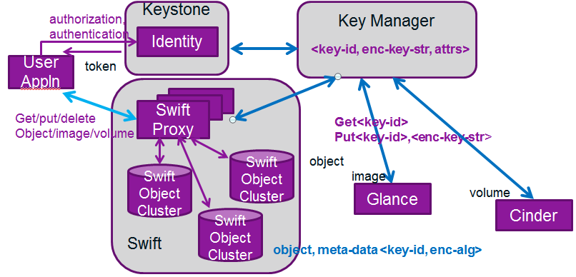
Key Management
Ease Security Adoption, new use cases, compliance
Server-side encryption
Data-at-rest security
Random high quality keys
Secure Key Storage
Controlled key access via Keystone
High availability
Pluggable backend – HSM, TPM
Barbican Key Manager:
  https://github.com/cloudkeep/barbican
Intel technologies: Intel® Secure Key, Intel® AES-NI
Prototype in Havana, incubate in Icehouse
14
Notes:
Understanding value of enabling the true random number generator (Secure Key), as true randomness of keys/seeds in the crypto algorithms is incredibly important in terms of setting up the security in the system.

Slide 15
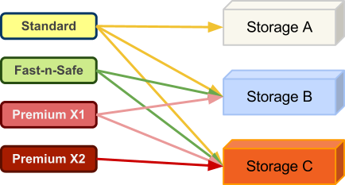
Filter Scheduler (Cinder)
Winner!
Volume Service 1
Volume Service 1
Volume Service 2
Volume Service 2
Weight = 25
Volume Service 5
Volume Service 3
Filters
Volume Service 3
Weighers
Weight = 20
Volume Service 2
Volume Service 4
  AvailabilityZone
  Filter
  Capabilities
  Filter
  JsonFilter
  CapacityFilter
  RetryFilter
Volume Service 4
Weight = 41
Volume Service 4
  CapacityWeigher
  AllocatedVolumesWeigher
  AllocatedSpaceWeigher
Volume Service 5
Volume Service 5
Example Use Case: Differentiated Service with Different Storage Back-ends
CSP: 3 different storage systems, offers 4 levels of volume services
Volume service criteria dictates which storage system can be used
Filter scheduler allows CSP to name storage services and allocate correct volume
15
15
Notes:
The Cinder Filter Scheduler, a new addition to the Grizzly release, intelligently allocates the storage volume based on the workload and the type of service required. This is achieved by applying a series of filters and weighers to each available volume service.
Filters:
AvailabilityZoneFilter
Filters volume services by availability zone. This filter must be enabled for the scheduler to respect availability zones in requests.
CapabilitiesFilter
Matches properties defined in a volume type's extra specs against volume services’ capabilities. Each storage back-end reports its capabilities to scheduler. Capabilities some common capabilities, such as
JsonFilter
The JsonFilter allows a user to construct a custom filter by passing a scheduler hint (the scheduler hint extension for cinder is not just merged ) in JSON format
CapacityFilter
Only schedule volumes on back-ends if there is sufficient space available. If this filter is not set, the scheduler may overprovision a back-end based on capacity (i.e., the space allocated for volumes may exceed the physical storage capacity). Note that some storage back-end supports more advanced feature such as thin-provisioning, de-duplication etc, therefore they may report ‘infinite’ (means unlimited) or ‘unknown’ free space instead of firm numbers. CapacityFilter handles these cases by simply let ‘infinite’ or ‘unknown’ pass.
RetryFilter
Filter out volume services that have already been attempted for scheduling purposes. If the scheduler selects a volume service to respond to a service request, and that volume services fails to complete the request (e.g. volume service report ‘unknown’ free space but unable to allocated enough space for requested volume when trying), this filter will prevent the scheduler from retrying that volume service for the service request.
This filter is only useful if the scheduler_max_attempts configuration option is set to a value greater than zero.
The Filter Scheduler takes the volume services that remain after the filters have been applied and applies one or more weighers to each of them to get numerical scores for each volume service. Each score is multiplied by a weighting multiplier specified in the cinder.conf config file. If there are multiple weighers, then the weighted scores are added together. The scheduler selects the host that has the maximum weights. Cinder comes with three weighers:
CapacityWeigher
This weigher calculates scores via multiplying volume back-end’s free_capacity_gb value by capacity_weight_multiplier. The default value for capacity_weight_multiplier is 1.0, thus the default behavior of this weigher is to select back-ends with most available space. If capacity_weight_multiplier is changed to negative value, say -1.0, the behavior will changed to picking back-end with least free capacity.
AllocatedVolumesWeigher
This weigher sorts back-ends by allocated volumes. The default value of ‘allocated_volume_weight_multiplier’ is -1.0, which is equivalent to choosing back-ends with fewest allocated volumes.
AllocatedSpaceWeigher
If the desired behavior is to consider allocated space of back-ends, this is the right weigher. The weight multiplier value for this weigher is by default -1.0, which is equivalent to picking back-ends that allocated least space.
Use Case A: Differentiated Service with Different Storage Back-ends
Cloud vendors usually provides different level of volume services to address all kinds of needs of end users. They may implement their Volume Service using more than one type of storage back-ends, each back-end has different capabilities.
To simplify the case, assuming our Cloud Vendor has 3 different storage systems:
low-cost storage system A, which has lowest performance but plenty of space;
middle range storage system B equipped with faster spindle thus better performance and is more reliable than A, and it supports fast snapshot but not fast cloning;
high-end storage system C provides best performance and reliability at highest cost per GB, and it has most advanced features support such as fast cloning, fast snapshot, de-duplication, and 3 level of QoS, etc.
Cloud Vendor would like to provide 4 different type of volumes for end users:
standard volume - cheap, no performance guarantee;
Fast-n-Safe volume - better performance (best effort, no guarantee) and more reliable than standard volume;
Premium volume X1 - better performance than standard volume, with best effort (no guarantee), supports fast snapshot;
Premium volume X2 - better performance than Fast-n-Safe with minimum performance guaranteed, supports fast cloning/snapshot;
As we can see here, the term Volume Type here is an abstraction of various properties of a volume. It is _NOT_ type of back-end storage. Remember this is true in the whole Cinder context.
So now we have (almost) everything in place, let’s see how to map those requirement (volume types) to storage systems: Standard volume can be created on all 3 storage back-ends, Fast-n-Safe & Premium X1 volume can only created on Storage B and C and Premium X2 volume requires capabilities on Storage C.
Figure Mapping between volume types and storage back-ends
One we figured out mapping between requirement and storage back-ends, we can now connect them via creating Cinder volume type. Other considerations such cost effectiveness shall be taken into account in real deployment. But again, to simplify this example, let’s limit Standard volume to be created only on Storage A; Fast-n-Safe & Premium X1 volume be created on Storage B; Premium X2 be created on Storage C.
To achieve that we need to created 4 Cinder volume types, here’s one possible combination:
type 1: name ‘standard’, with extra specs {‘volume_backend_name’: ‘Storage System A’}
type 2: name ‘fast-n-safe’, with extra specs {‘volume_backend_name’: ‘Storage System B’}
type 3: name ‘premium-x1’, with extra specs {‘QoS’: ‘false’, ‘fast snapshot’: ‘true’}
type 4: name ‘premium-x2’, with extra specs {‘fast clone’’: ‘true’, ‘fast snapshot’: ‘true’, ‘QoS:level’: ‘guarantee:200IOPS’}
Look into the details these 4 volume types: we can see first two types have extra specs explicitly specified the name of storage system. This is pretty straightward because we know which storage back-ends satisfy their need and we don’t want Storage C to serve request of these two types. The interesting part is in the definition of ‘premium-x1’ type, with that we added two capabilities in extra specs rather than explicitly specifying which storage back-end to use. The ‘QoS’:’false’ key value pair will rule of Storage C when processing with CapabilitiesFitler in filter scheduler, and ‘fast snapshot’:’true’ will reject Storage A. Actually this is more generic/portable definition we should use when creating volume types rather than putting non-portable limit (e.g. names of storage system) in. Notice there is a scoped key (‘QoS:level’) in ‘premium-x2’ type extra specs, this will be ignored by CapabilitiesFilter but can be utilized by back-end driver.

Slide 16
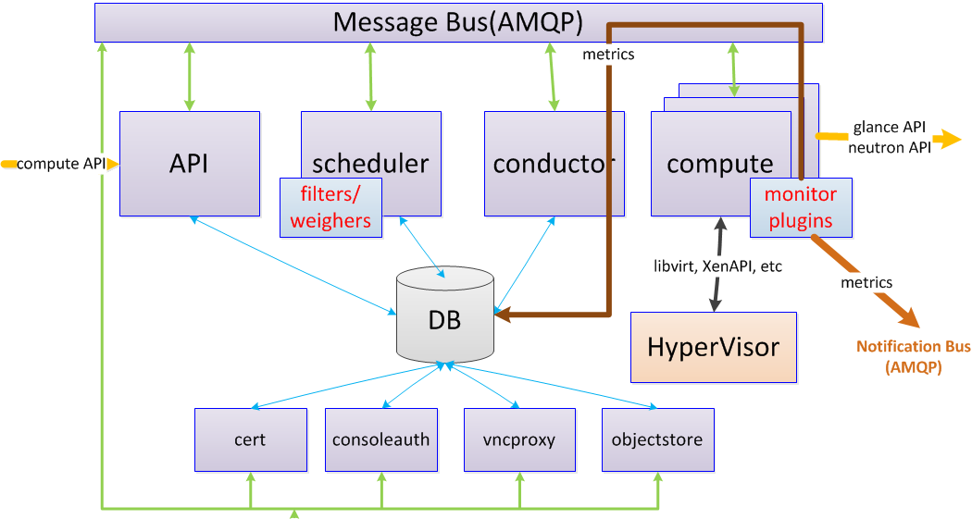
Data Collection for Efficiency:
Intelligent Workload Scheduling
Enhanced usage statistics allow advanced scheduling decisions
Pluggable metric data
collecting framework
Compute (Nova) - New filters
/ weighers for utilization-based
scheduling
Metering in Havana release, scheduling in future release
Notes:
Speaking points:
Collects data via plug-ins
Sends data to notification bus for use by other OpenStack* components
the bp is at https://blueprints.launchpad.net/nova/+spec/utilization-aware-scheduling.
Basically you can introduce the current arch and tell what we want to change.
Nova has API, scheduler, compute and conductor. When a scheduler gets a VM creation request from API, it will ask compute to spawn according to the filters and the weighers. The compute will call hypervisor to create the VM and ask the conductor to sync up the information with nova DB. However, the current mechanism is very simple. What we want to do is to reuse the resource tracker(s) in the compute(s) to retrieve the information of the host machine(s), e.s.p. utilization information (CPU utilization, network traffic, and so on), and then send the data into DB, later on the schedule could take advantage of the data for future scheduling with the new filter and the new weigher we defined.
What are we asking developers to do re. UBS?
the pluggable framework: the framework allows any user to create its plugin to retrieve the data about utilization. Note that actually the resource tracker above will call the plugins to get the data; and the framework allows to send the data into the message bus so other OpenStack components (not Nova only) can use the data, e.g. Ceilometer to monitor the hosts. 2) New filter and new weigher: that will be implemented for nova scheduler to do intelligent scheduling. With the pluggable framework, developers in other companies, e.g. Cisco, can add their own plugins to monitor network. Also, we can add node manager monitoring into a NM plugin in the future.

Slide 17

Enhanced Platform Awareness
Allows OpenStack* to have a greater awareness of the capabilities of the hardware platforms
Expose CPU & platform features to
OpenStack Nova scheduler
Use ComputeCapabilities filter to
select hosts with required features
  Intel® AES-NI or PCI Express accelerators
  for security and I/O workloads
  Upto 10x encryption & 8x decryption performance
  improvement observed ¹
Processor
Faster Encryptions
Data In Motion
Unencrypted
Data
ABCDEFGH
IJKLMNOP
QRSTUVW
Encrypted
Data
#@$%&%@#&%@#$@&%$@#$@%&&
Faster Decryptions
Some features in Havana, more in future releases
Intel® AES-NI = Intel® Advanced Encryption Standard New Instructions
See http://www.oracle.com/us/corporate/press/173758
Notes:
Enables premium flavors
Enhanced capabilities for cloud customers
Enhanced revenue for cloud providers

Slide 18
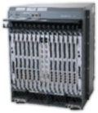

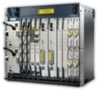







SDN & NFV: Driving Architectural Transformation
From This:
Traditional networking topology
Monolithic vertical integrated box
TEM proprietary solutions
To This:
Networking within VMs
Standard x86 COTS HW
Open SDN standard solutions
Firewall
VPN
IDS/IPS
VM: Firewall
VM:
VPN
VM: IDS/IPS
SDN/NFV
ASIC, DSP, FPGA, ASSP
NIC
Silicon
Chipset
Acceleration
Switch
Silicon
Wind River
Linux + Apps
TEM/OEM
Proprietary OS
IA CPU
Notes:
Adrian’s key points:
SDN/NFV driving a change in how appliances are developed, deployed and managed.
CapEX
Reduce dependency on proprietary hardware
Virtualize network functions on COTS HW
OpEX
Power
Ease of Maintenance via uniformity of the
physical network
Automation
Running production, test, service upgrades on same infrastructure
Service Revenue
New Services
Broader ecosystem for
faster innovation
Faster TTM to deploy
new services
Targeted services per Geo/Customer Type

Slide 19
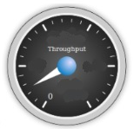
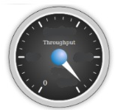
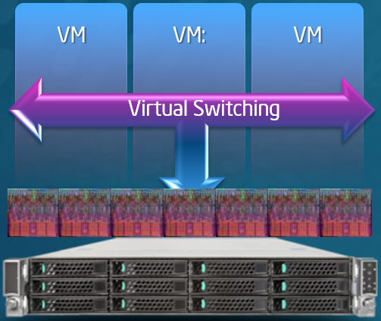
Intel® DPDK Accelerated Open vSwitch In Neutron
Open vSwitch
Intel DPDK vSwitch
ML2 Driver/Agent in Development
Neutron API
API
Extensions
10x
Neutron-ML2-Plugin
DB
DPDK vSwitch Mechanism Driver
External Controller
L2 Agent
DPDK vSwitch
L2 Agent
vSwitch
DPDK vSwitch
VM
VM
VM
VM
VM
VM
VM
VM
Unleashing Intel® DPDK vSwitch Performance in Neutron

Slide 20
OpenStack* Swift With Erasure Code
Upload
Download
Clients
RESTful API, Similar to S3
Obj A
Obj A
Access Tier (Concurrency)
Auth
Service
New Storage Policy capability
Applications control policy
EC can be inline or offline
Load Balancer
Lowers TCO with increased storage efficiency
Encoder
Decoder
Proxy
Proxy
Proxy
Capacity Tier (Storage)
Supports multiple policies at the same time via container tag
EC flexibility via plug-in
Storage
Frag 2
Storage
Storage
Storage
Storage
Storage
Storage
Storage
Frag 4
Storage
Storage
Frag 1
Storage
Storage
Storage
Storage
Storage
Frag N
Frag 3
Zone 1
Zone 2
Zone 3
Zone 4
Zone 5
Detailed Tutorial at: https://intel.activeevents.com/sf13/connect/sessionDetail.ww?SESSION_ID=1180&tclass=popup
Community Collaboration: https://intel.activeevents.com/sf13/connect/sessionDetail.ww?SESSION_ID=1180&tclass=popup

Slide 21
Intel actively contributing to OpenStack
Delivering interoperable, federated, efficient and secure Open Cloud solutions
Trusted Compute Pools
Geo-tagging
Key Management
Enhanced Platform Awareness (crypto processing)
Security & Compliance
Intelligent storage allocation in Cinder
Multiple publisher support in ceilometer
Erasure code in Icehouse release
COSbench performance measurement tool
Erasure Code (storage cost)
Enhanced Platform Awareness (PCIe Accelerators etc.)
Intelligent workload & storage scheduling
Unit Cost Reduction
Business
Uptime
Live Migration, Rack-level redundancies
Intel® Virtualization Technology with FlexMigration
Notes:
Das leads off talking about

Slide 22
Q&A

Slide 23
Legal Disclaimers:
INFORMATION IN THIS DOCUMENT IS PROVIDED IN CONNECTION WITH INTEL PRODUCTS. NO LICENSE, EXPRESS OR IMPLIED, BY ESTOPPEL OR OTHERWISE, TO ANY INTELLECTUAL PROPERTY RIGHTS IS GRANTED BY THIS DOCUMENT. EXCEPT AS PROVIDED IN INTEL'S TERMS AND CONDITIONS OF SALE FOR SUCH PRODUCTS, INTEL ASSUMES NO LIABILITY WHATSOEVER AND INTEL DISCLAIMS ANY EXPRESS OR IMPLIED WARRANTY, RELATING TO SALE AND/OR USE OF INTEL PRODUCTS INCLUDING LIABILITY OR WARRANTIES RELATING TO FITNESS FOR A PARTICULAR PURPOSE, MERCHANTABILITY, OR INFRINGEMENT OF ANY PATENT, COPYRIGHT OR OTHER INTELLECTUAL PROPERTY RIGHT.
A "Mission Critical Application" is any application in which failure of the Intel Product could result, directly or indirectly, in personal injury or death. SHOULD YOU PURCHASE OR USE INTEL'S PRODUCTS FOR ANY SUCH MISSION CRITICAL APPLICATION, YOU SHALL INDEMNIFY AND HOLD INTEL AND ITS SUBSIDIARIES, SUBCONTRACTORS AND AFFILIATES, AND THE DIRECTORS, OFFICERS, AND EMPLOYEES OF EACH, HARMLESS AGAINST ALL CLAIMS COSTS, DAMAGES, AND EXPENSES AND REASONABLE ATTORNEYS' FEES ARISING OUT OF, DIRECTLY OR INDIRECTLY, ANY CLAIM OF PRODUCT LIABILITY, PERSONAL INJURY, OR DEATH ARISING IN ANY WAY OUT OF SUCH MISSION CRITICAL APPLICATION, WHETHER OR NOT INTEL OR ITS SUBCONTRACTOR WAS NEGLIGENT IN THE DESIGN, MANUFACTURE, OR WARNING OF THE INTEL PRODUCT OR ANY OF ITS PARTS.
Intel may make changes to specifications and product descriptions at any time, without notice. Designers must not rely on the absence or characteristics of any features or instructions marked "reserved" or "undefined". Intel reserves these for future definition and shall have no responsibility whatsoever for conflicts or incompatibilities arising from future changes to them. The information here is subject to change without notice. Do not finalize a design with this information.
The products described in this document may contain design defects or errors known as errata which may cause the product to deviate from published specifications. Current characterized errata are available on request.
Intel product plans in this presentation do not constitute Intel plan of record product roadmaps. Please contact your Intel representative to obtain Intel's current plan of record product roadmaps.
Intel processor numbers are not a measure of performance. Processor numbers differentiate features within each processor family, not across different processor families. Go to: http://www.intel.com/products/processor_number.
Contact your local Intel sales office or your distributor to obtain the latest specifications and before placing your product order.
Copies of documents which have an order number and are referenced in this document, or other Intel literature, may be obtained by calling 1-800-548-4725, or go to: http://www.intel.com/design/literature.htm
Code names featured are used internally within Intel to identify products that are in development and not yet publicly announced for release. Customers, licensees and other third parties are not authorized by Intel to use code names in advertising, promotion or marketing of any product or services and any such use of Intel's internal code names is at the sole risk of the user
Intel, and the Intel logo are trademarks of Intel Corporation in the United States and other countries.
*Other names and brands may be claimed as the property of others.
Copyright ©2013 Intel Corporation.

Slide 24
Legal Disclaimers and Notices
Intel Trademark Notice: Celeron, Intel, Intel logo, Intel Core, Intel® Core™ i7, Intel® Core™ i5, Intel® Core™ i3, Intel® Atom™ Intel Inside, Intel Inside logo, Intel. Leap ahead., Intel. Leap ahead. logo, Intel NetBurst, Intel SpeedStep, Intel XScale, Itanium, Pentium, Pentium Inside, VTune, Xeon, and Xeon Inside are trademarks or registered trademarks of Intel Corporation or its subsidiaries in the United States and other countries.
Non-Intel Trademark Notice: *Other names and brands may be claimed as the property of others.
General Performance Disclaimer/"Your Mileage May Vary"/Benchmark: Software and workloads used in performance tests may have been optimized for performance only on Intel microprocessors. Performance tests, such as SYSmark and MobileMark, are measured using specific computer systems, components, software, operations and functions. Any change to any of those factors may cause the results to vary. You should consult other information and performance tests to assist you in fully evaluating your contemplated purchases, including the performance of that product when combined with other products.
Performance tests and ratings are measured using specific computer systems and/or components and reflect the approximate performance of Intel® products as measured by those tests. Any difference in system hardware or software design or configuration may affect actual performance. Buyers should consult other sources of information to evaluate the performance of systems or components they are considering purchasing. For more information on performance tests and on the performance of Intel products, visit http://www.intel.com/performance/resources/limits.htm or call (U.S.) 1-800-628-8686 or 1-916-356-3104.
Estimated Results Benchmark Disclaimer: Results have been estimated based on internal Intel analysis and are provided for informational purposes only. Any difference in system hardware or software design or configuration may affect actual performance.
Pre-release Notice: This document contains information on products in the design phase of development.
Processor Numbering Notice: Intel processor numbers are not a measure of performance. Processor numbers differentiate features within each processor family, not across different processor families: Go to: http://www.intel.com/products/processor_number
Roadmap Notice: All products, computer systems, dates and figures specified are preliminary based on current expectations, and are subject to change without notice.
Excerpted Product Roadmap Notice: Intel product plans in this presentation do not constitute Intel plan of record product roadmaps. Please contact your Intel representative to obtain Intel's current plan of record product roadmaps.
Intel® AES-New Instructions (Intel® AES-NI): Intel® AES-NI requires a computer system with an AES-NI enabled processor, as well as non-Intel software to execute the instructions in the correct sequence. AES-NI is available on select Intel® processors. For availability, consult your reseller or system manufacturer. For more information, see http://software.intel.com/en-us/articles/intel-advanced-encryption-standard-instructions-aes-ni/
Enhanced Intel SpeedStep® Technology : See the Processor Spec Finder at http://ark.intel.com or contact your Intel representative for more information.
Intel® Hyper-Threading Technology (Intel® HT Technology): Available on select Intel® Core™ processors. Requires an Intel® HT Technology-enabled system. Consult your PC manufacturer. Performance will vary depending on the specific hardware and software used. For more information including details on which processors support HT Technology, visit http://www.intel.com/info/hyperthreading.
Intel® 64 architecture: Requires a system with a 64-bit enabled processor, chipset, BIOS and software. Performance will vary depending on the specific hardware and software you use. Consult your PC manufacturer for more information. For more information, visit http://www.intel.com/info/em64t
Intel® Turbo Boost Technology: Requires a system with Intel® Turbo Boost Technology. Intel Turbo Boost Technology and Intel Turbo Boost Technology 2.0 are only available on select Intel® processors. Consult your PC manufacturer. Performance varies depending on hardware, software, and system configuration. For more information, visit http://www.intel.com/go/turbo

Slide 25
Intel IT Open Cloud Components
Release
Cadence
GUI
(Graphical User Interface)
API
(Application Programming Interface)
6
Months
Interfaces
Manageability
Open-Source Foundation
Monitoring
As a Service
3
Months
Watcher
(Nagios*, Shinken*, Heat*)
Decider
(Heat)
Actor
(Puppet*, Cfengine*)
Collector
(Hadoop*)
App Platform Services
PaaS
3
Months
Analytics
Messaging
Data
Web
IaaS
Open-Source (OpenStack*)
6
Months
Infrastructure
As a Service
Dashboard (Horizon*)
Compute
(Nova*)
OS Images
(Glance*)
Block Storage
(Cinder*)
Object Storage
(Swift*)
Network
(Neutron*)
Physical
Infrastructure
Compute
Storage
Network
12-18
Months
Notes:
Has Intel’s work on Decider moved to the open source version (Heat), and/or did we make a contribution into Heat itself?

Slide 26
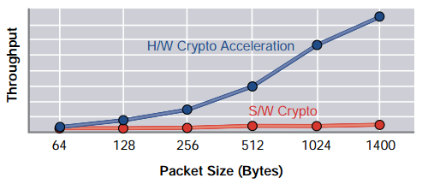
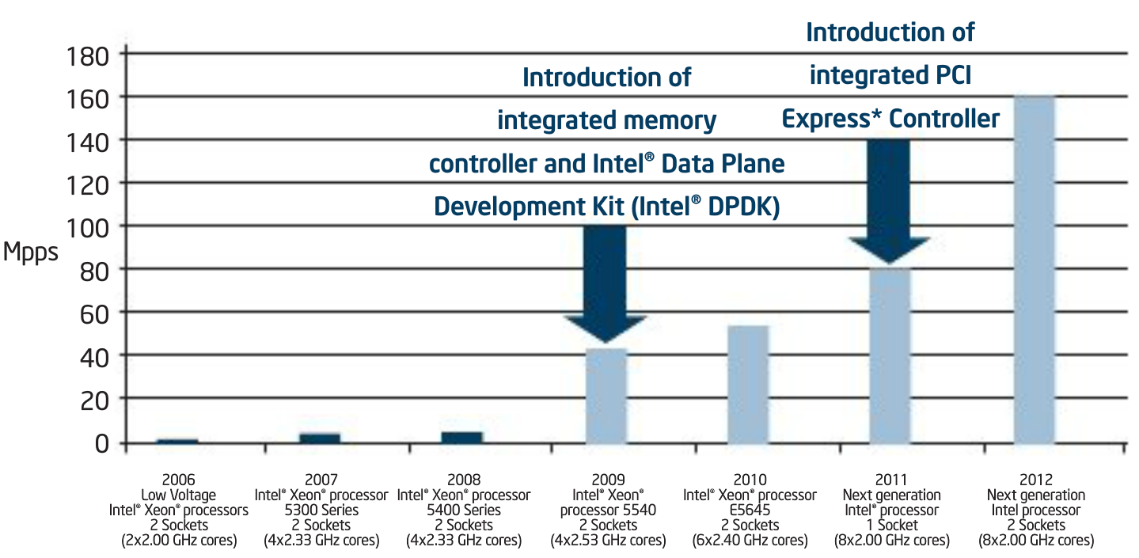
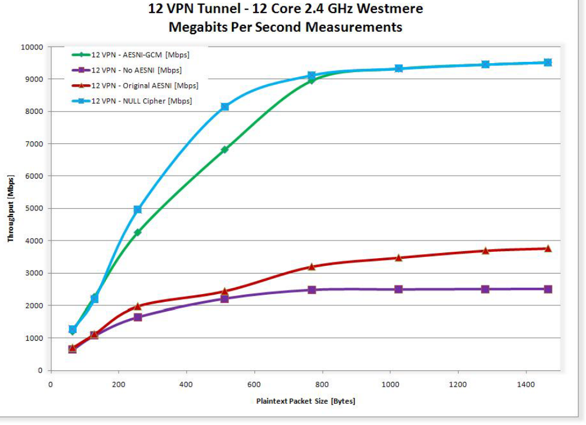
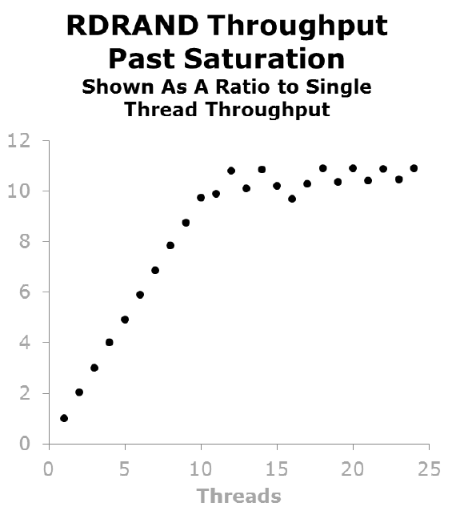
Benefits of Enhanced Platform Awareness
Intel® QuickAssist Accelerator
Intel® Data Plane Development Kit
Intel® AES New Instructions
Intel® Secure Key
Intel® Advanced Vector Extensions 2 (AVX2)
Enabler for Enhanced Cloud Efficiency & Deploying SDN/NFV Workloads
Some features enabled in Havana, more coming in future releases
Notes:
Adrian’s Key Points:
Incredible efficiencies are possible when you leverage advanced capabilities in Intel platforms.
Don’t spend much time on any of the data points.
SDN & NFV workloads are sensitive to performance and latency characteristics and need to leverage platform capabilities.
Expose CPU & platform features to OpenStack Nova scheduler
Use ComputeCapabilities filter to select hosts with required features
Intel® AES-NI or PCI Express accelerators for security and I/O workloads
Mention Neutron extensions for DPDK vSwitch and VPN-as-a-Service optimized with Intel QuickAssist Accelerator.
References:
Top Left: Quick Assist Ref: http://www.intel.ie/content/dam/www/public/us/en/documents/articles/itj-cryptographic-security-article.pdf
Top Right: DPDK Ref: http://www.intel.com/content/www/us/en/communications/communications-packet-processing-brief.html
Bottom Left: AES-NI & IPSec Ref: http://www.intel.com/content/dam/www/public/us/en/documents/white-papers/aes-ipsec-performance-linux-paper.pdf
Bottom Middle: Intel Secure Key Ref: https://intel.activeevents.com/sf13/connect/fileDownload/session/F5D69EE8DC6A4A29309B97176C1121F0/SF13_SECS002_100.pdf
Bottom Right: AVX Ref: https://intel.activeevents.com/sf13/connect/sessionDetail.ww?SESSION_ID=1164 & https://intel.activeevents.com/sf13/connect/fileDownload/session/9E8861F1BA9547056E03A017ACCD9D3F/SF13_SECS005_100.pdf
Enable industry leading manageability by exposing health, state, resource availability for optimal workload placement and configuration
Enables premium flavors
Enhanced capabilities for cloud customers
Enhanced revenue for cloud providers

Slide 27
Linux Kernel Contributions
Source: http://lwn.net

Slide 28
Summary: Key Intel Contributions into OpenStack
Contribution | Project | Release | Comments
Trusted Filter | Nova | Folsom | Place VMs in Trusted Compute Pools
Trusted Filter UI | Horizon | Folsom | GUI interface for Trusted Compute Pool management
Filter Scheduler | Cinder | Grizzly | Intelligent storage allocation
Multiple Publisher Support | Ceilometer | Havana | Pipeline manager; pipelines of collectors, transformers, publishers
Open Attestation SDK |  | To Open Source | Remote Attestation service for Trusted Compute Pools
COSBench |  | To Open Source | Object store benchmarking tool
Enhanced Platform Awareness |  | Havana + future | Leverages advanced CPU and PCIe device features for increased performance
Key Manager |  | Icehouse+ | Makes data protection more readily available via server side encryption with key management
Erasure Code |  | Icehouse | Augments tri-replication algorithm in Swift enabling application selection of alternate storage policies
Notes:
Shout-

Slide 29
Re-architect the Datacenter
Datacenter Today
Software-defined Infrastructure
Private
Public
Idea for
service
IT scopes
needs
Balance
user demands
Idea for
service
Self service catalog & services orchestration
Automated
composition
of resources
Manually
configure
devices
Set up service
components,
assemble software
Service
running
Software
components assembled
Service
running
Time to Provision New Service: Months¹
Time to Provision New Service: Minutes¹
1: Source: Intel IT internal estimate
29
Notes:
Today, how do services get provisioned? Somebody has an idea for a service and then they have to call IT. A number of people in IT go ahead and scope their needs. IT sharpens their pencils, they look at what the requirements are for reliability, for capacity, how much web services access do they need? Then they balance that against the rest of the infrastructure and all of the user demands.
They're having to look at profitability, they're looking at cost, they're looking at the capacity that they know they have based on their archives and databases, to give them a paper estimate of the capacity they really have installed. Once they've got that in place, and procure the needed equipment, they have to manually configure it.
Manually configuring a device means you touch everyone. Whether it is having to actually physically plug in an Ethernet plug and make the connection between different boxes, or whether it's simply having to touch the command line interface of every single box to configure and provision it appropriately there is a human touch at every point along the way.
Once those are connected and configured, then they actually have to set up service. This pulls together the server and the storage and the data store so that the service is actually running and allows the original service requestor to develop the software and services they had in mind in the first place
Then and only then do you have the service running. The service is available & ready for customers to do business. The time to provision there is months, minimally speaking, about eight weeks according to the Intel IT internal estimates.
What should we be moving to? The end state of the future, the vision of re-architecting the data center and the result is something called software-defined infrastructure.
Once there's an idea for a service, the LOB customer can pull together very quickly from private or, public, cloud services, or from their own internal capabilities, using a self-service portal that orchestrates the services they need from an online catalog. Things like location, security, online payments can be pulled together automatically –then the customer can assemble the software components from a list that's available to them, whether from their internal IT department or a repository like GitHub. The service level agreement that the orchestrator creates tells the infrastructure orchestrator what resources do I need? What kind of availability do I need? How much storage do I need? How fast of a connection do I need between the compute and the storage? Then, how do I manage power and how do I manage temperature demands if I'm in a particularly intense workload?
All of this happens automatically. After the services are orchestrated, the infrastructure is orchestrated, the service is running. The time to provision a new service is minutes. Depending on how quickly somebody can put the software together, it should be push button - done

Slide 30
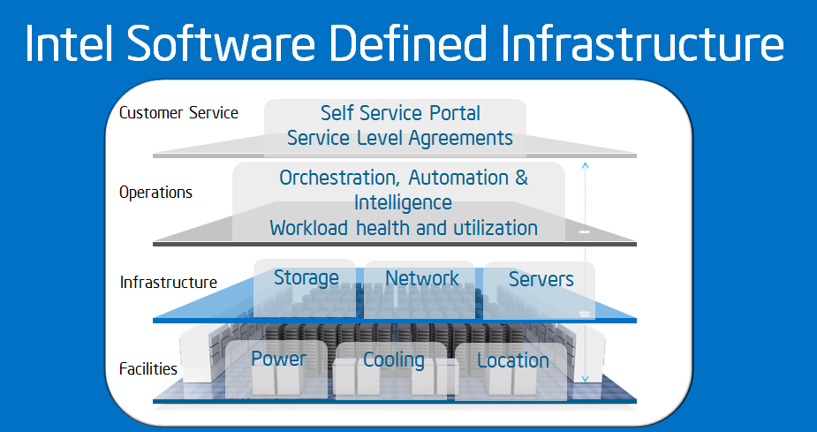
The Intel SDI Vision
Automated provisioning
Orchestrated placement
Composable Resource Pools
Notes:
There are many different versions and levels of the Intel SDI vision – at the highest most abstract level, Intel’s SDI vision is simple . the customer has a self service portal, and the service level agreements are driven automatically. Beneath that, datacenter operations are orchestrated, automated & intelligent about real time workload health and utilization. Beneath the operations is the actual infrastructure itself, storage network and servers. Finally, it all connects seamlessly to the power, cooling, location data provided in an automated ongoing manner whether in a virtualized or non virtualized environment
. The benefits are automated provisioning – the resources needed to meet the requirements of an SLA are assigned and provisioned automatically based on the orchestration layer’s ongoing intelligence about the available and required capacity across the entire datacenter. The orchestrator worries about policy – security, data governance, workload placement, power, energy use, etc. Facilitating all the automation and agility are pools of composable resources – flexible, defined and managed via software on standard high volume servers

