Slide 2
Storage Capabilities in Cinder Xing Yang (Dell EMC), Jay Bryant (Lenovo), Sean McGinnis (Huawei) May 9, 2017 Boston
Notes:
Xing, Jay, Sean intro

Slide 3
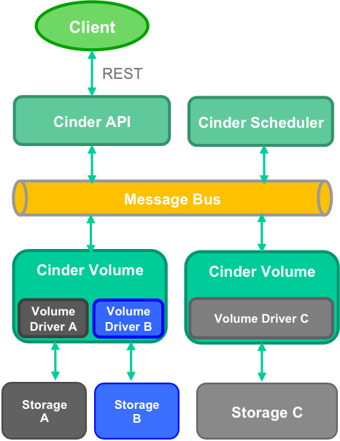
Cinder Overview
Provides persistent block storage resources for an OpenStack cloud.
Supports multiple back-ends. More than 100 volume drivers in tree.
Notes:
Sean

Slide 4
Agenda
Volume migration and retype
Generic image volume cache
Replication V2.1
Generic volume groups
Backup and restore
Notes:
Sean

Slide 5
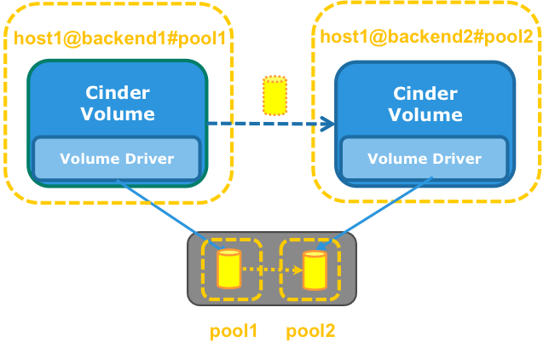
Volume Migration and Retype
Volume migration
Migration between two back-ends with the same volume type, regardless if they are located on the same Cinder volume node or not.
Volume retype
Migration between two back-ends with different volume types, regardless if the back-ends are located on the same Cinder volume node or not.
Notes:
Jay
https://github.com/openstack/cinder/blob/master/doc/source/devref/migration.rst

Slide 6
Volume Migration and Retype - commands
Volume migration
cinder migrate [--force-host-copy [<True|False>]] [--lock-volume [<True|False>]] <volume> <host>
Volume retype
cinder retype [--migration-policy <never|on-demand>] <volume> <volume-type>
Notes:
Jay

Slide 7
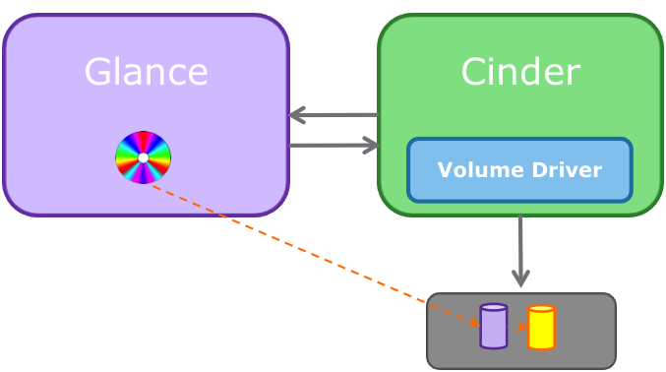
Image Volume Cache
Problem: Create boot volume very slow
Solution: Image volume cache
Create volume cache when image downloaded
Create boot volume will clone volume instead of copying image.
Notes:
Jay

Slide 8
Image Volume Cache - configs and cmds
Configure the internal tenant
cinder_internal_tenant_project_id
cinder_internal_tenant_user_id
Configure the Image-Volume cache
image_volume_cache_enabled = True
image_volume_cache_max_size_gb = SIZE_GB
image_volume_cache_max_count = MAX_COUNT
Create a boot volume and launch a VM from it in two commands
openstack volume create --image IMAGE_ID --size SIZE_IN_GB bootable_volume
openstack server create --flavor 2 --volume VOLUME_ID --block-device source=volume,id=$VOLUME_ID,dest=volume,size=10,shutdown=preserve,bootindex=0 myInstanceFromVolume
Create a boot volume and launch a VM from it in one command
openstack server create --flavor FLAVOR --block-device source=SOURCE,id=ID,dest=DEST,size=SIZE,shutdown=PRESERVE,bootindex=INDEX NAME
Notes:
Jay
https://docs.openstack.org/admin-guide/blockstorage-image-volume-cache.html
https://docs.openstack.org/user-guide/cli-nova-launch-instance-from-volume.html

Slide 9
Volume-Backed Image
Configure the volume-backed image
glance-api.conf
stores = file, http, swift, cinder
show_multiple_locations = True
cinder_store_auth_address
cinder_store_user_name
cinder_store_password
cinder_store_project_name
cinder.conf
glance_api_version = 2
allowed_direct_url_schemes = cinder
image_upload_use_cinder_backend = True
image_upload_use_internal_tenant = True
Create a volume-backed image
openstack image create --volume SOURCE_VOLUME IMAGE_NAME
The disk format and the container format must be raw and bare (default). Otherwise, the image is uploaded to the default store of the Image service.
Notes:
Jay
https://docs.openstack.org/admin-guide/blockstorage-volume-backed-image.html

Slide 10
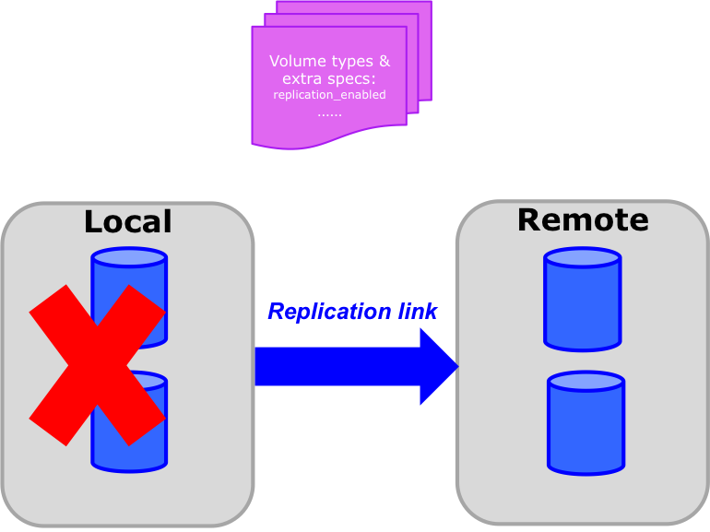
Replication V2.1
Replication API v2.1 (Cheesecake): fail over the whole backend when disaster strikes (Admin API).
Notes:
Xing

Slide 11
Replication V2.1 - configuration
Configuration in cinder.conf under the driver section and through the use of volume types
Specify replication_device (backend_id) in cinder.conf
Volume type extra specs
{‘replication_enabled’: ‘<is> True’}
Capabilities reporting
stats["replication_enabled"] = True|False
stats["replication_targets"] = [<backend-id_1, <backend-id_2>...]
Notes:
Xing

Slide 12
Replication V2.1 - commands
Failover host
cinder failover-host [--backend_id <backend-id>] <hostname>
Freeze host
cinder freeze-host <hostname>
Thaw host
cinder thaw-host <hostname>
Notes:
Xing

Slide 13
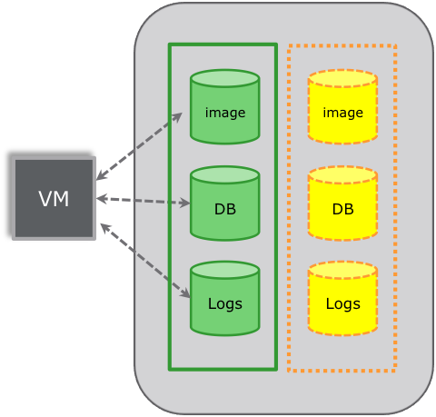
Generic Volume Groups
A grouping construct that allows volumes used in the same application to be managed together.
https://blueprints.launchpad.net/cinder/+spec/generic-volume-group
https://github.com/openstack/cinder/blob/master/doc/source/devref/groups.rst
https://docs.openstack.org/admin-guide/blockstorage-groups.html
May or may not support consistent group snapshot depending on driver implementation and group types.

Slide 14
Generic Volume Groups - group types
Group types and group specs are introduced to describe the characteristics of a group, similar to how volume types and extra specs are applied to a volume.
Minimum microversion: 3.11
cinder --os-volume-api-version 3.11 group-type-create my_test_group
cinder --os-volume-api-version 3.11 group-type-list
cinder --os-volume-api-version 3.11 group-type-show my_test_group
cinder --os-volume-api-version 3.11 group-type-key my_test_group set test_key=test_val
cinder --os-volume-api-version 3.11 group-specs-list
cinder --os-volume-api-version 3.11 group-type-key my_test_group unset test_key
cinder --os-volume-api-version 3.11 group-type-update <group type uuid> --name "new_group" --description "my group type"
cinder --os-volume-api-version 3.11 group-type-delete new_group
Notes:
Xing

Slide 15
Generic Volume Groups - groups
Create, delete, update, show, and list groups
Minimum microversion: 3.13
cinder --os-volume-api-version 3.13 group-create --name my_group <group type uuid> <volume type uuid>
cinder --os-volume-api-version 3.13 group-list
cinder --os-volume-api-version 3.13 create --group-id <group uuid> --volume-type <volume type uuid> <size>
cinder --os-volume-api-version 3.13 group-update <group uuid> --name new_name description new_description --add-volumes <uuid of volume to add> --remove-volumes <uuid of volume to remove>
cinder --os-volume-api-version 3.13 group-show <group uuid>
cinder --os-volume-api-version 3.13 group-delete --delete-volumes <group uuid>

Slide 16
Generic Volume Groups - group snapshots
Create, delete, show, and list group snapshots.
Minimum microversion: 3.14
cinder --os-volume-api-version 3.14 group-snapshot-create --name <name> <group uuid>
cinder --os-volume-api-version 3.14 group-snapshot-list
cinder --os-volume-api-version 3.14 group-snapshot-show <group snapshot uuid>
cinder --os-volume-api-version 3.14 group-snapshot-delete <group snapshot uuid>
Create group from source group or group snapshot.
cinder --os-volume-api-version 3.14 group-create-from-src --name my_group --group-snapshot <group snapshot uuid>
cinder --os-volume-api-version 3.14 group-create-from-src --name my_group --source-group <source group uuid>

Slide 17
Migrate CGs to Generic Volume Groups
Command “cinder-manage db online_data_migrations” needs to be run to migrate existing consistency groups to generic volume groups.
It is required to run data migrations to upgrade to Pike.
All drivers supporting CGs need to add this capability to generic volume groups in Pike.
CG APIs still work in Pike but will be deprecated in Queens.

Slide 18
Create Different Types of Groups
Set the following in group type specs and volume type extra specs when creating a generic volume group that supports consistent group snapshot on a backend that reports “consistent_group_snapshot_enabled=True”:
consistent_group_snapshot_enabled: ‘<is> True’
If {“consistent_group_snapshot_enabled: ‘<is> True’} is not set in the group type, a default group will be created that does not support consistent group snapshot.
Do not set consistencygroup_support key in group types or volume types

Slide 19
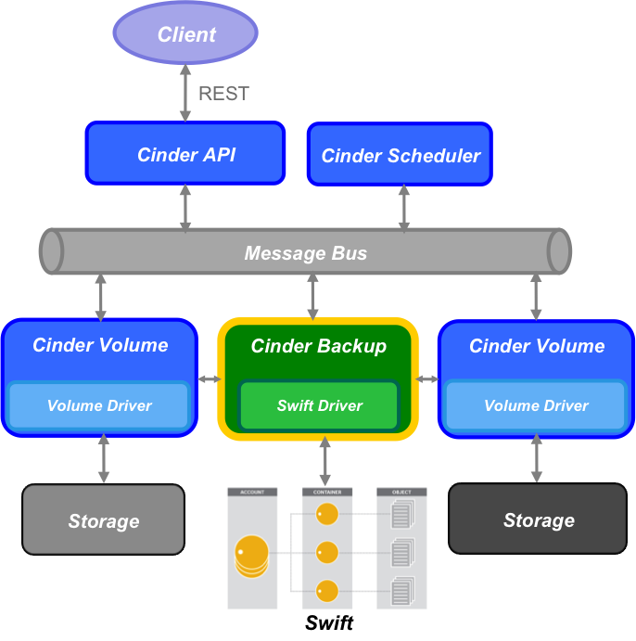
Backup and Restore
Supports full and incremental backup using changed block tracking (sha file).
Supports non-disruptive backup for in-use volumes via temp volume/snapshot.
Supports backup of snapshot.
Supports Swift, Posix, NFS, GlusterFS, Ceph, Google Cloud Storage, and IBM TSM backup drivers.
Notes:
Sean

Slide 20
Cinder backup - commands
Create a backup (full, incremental, in-use)
openstack volume backup create [--incremental] [--force] VOLUME
Restore a backup
openstack volume backup restore BACKUP_ID VOLUME_ID
Create a backup from a snapshot
openstack volume backup create [--incremental] [--force] [--snapshot SNAPSHOT_ID] VOLUME
Export metadata of a backup (admin only)
cinder backup-export BACKUP_ID
Import backup metadata (admin only)
cinder backup-import METADATA
Notes:
Sean

Slide 21
Demos
Volume migration and retype
Generic volume groups
Backup and restore
Notes:
Sean

Slide 22
Demo – Volume Migration and Retype
Environment
Two LVM backends
One NFS backend
Volume Types
One for each backend
One for iSCSI protocol
Demo
lvmdriver-1 retype to iSCSI type
lvmdriver-1 migrate to lvmdriver-2
lvmdriver-2 retype with migrate to nfs
Controller
lvmdriver-1
NAS
lvmdriver-2
nfs-1
Notes:
Jay

Slide 23
https://youtu.be/XYNPTpzE4mk
Notes:
Jay
https://youtu.be/XYNPTpzE4mk

Slide 24
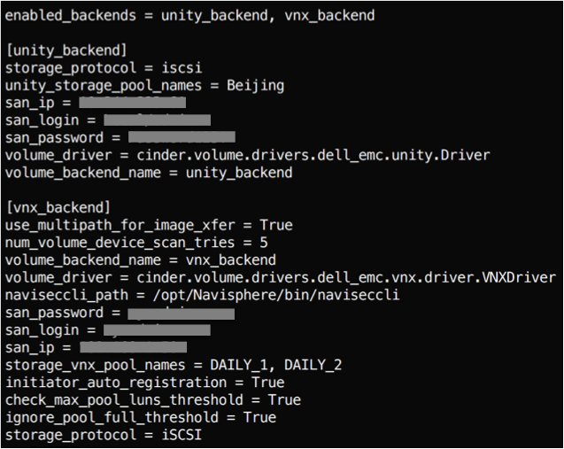
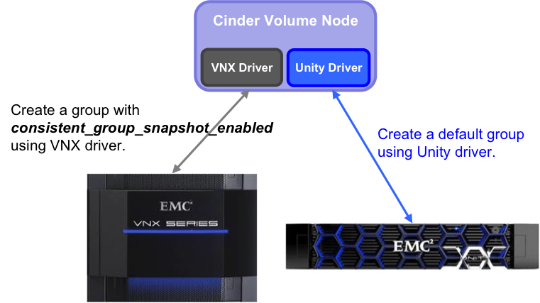
Demo – Generic Volume Groups
Demo setup: 2 Cinder volume backends
Unity 500
VNX7600
Cinder.conf
Notes:
Xing

Slide 25
https://youtu.be/IUcJfL5t3NY
Notes:
Xing
New demo: https://youtu.be/IUcJfL5t3NY

Slide 26
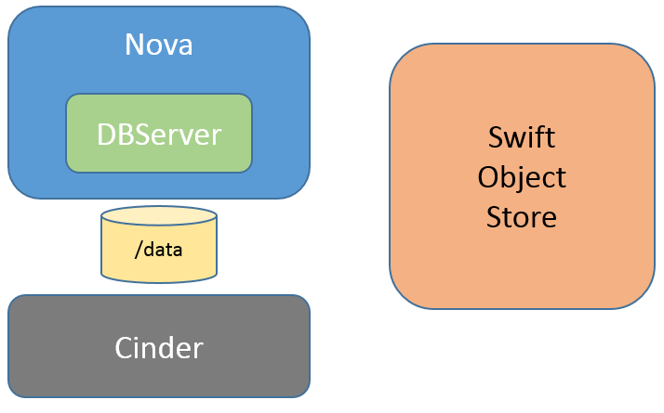
Demo – Backup and Restore
Demo setup:
Cinder-backup configured for Swift target
Database server instance with data on Cinder volume
Notes:
Sean

Slide 27
https://youtu.be/GmPPGB0g-JQ
Notes:
Sean
https://youtu.be/GmPPGB0g-JQ

Slide 28
Reference Links
Volume migration and retype
https://github.com/openstack/cinder/blob/master/doc/source/devref/migration.rst
Generic volume image cache
https://docs.openstack.org/admin-guide/blockstorage-image-volume-cache.html
Volume backed image
https://docs.openstack.org/admin-guide/blockstorage-volume-backed-image.html
Backup and restore
https://docs.openstack.org/admin-guide/blockstorage-volume-backups.html
Replication V2.1
https://github.com/openstack/cinder/blob/master/doc/source/devref/replication.rst
Generic volume groups
https://docs.openstack.org/admin-guide/blockstorage-groups.html
Notes:
Sean

Slide 29
Q & A

