Slide 1
Dynamic SFC from Tacker to incept specific traffic of VM
Yong Sheng Gong
99cloud
Dimitrios Markou
Intracom Telecom
Yan Xing'an
China Mobile

Slide 2
Sessions by Tacker team at Vacouver summit
https://www.openstack.org/summit/vancouver-2018/summit-schedule/global-search?t=tacker
1
2
3
4

Slide 3
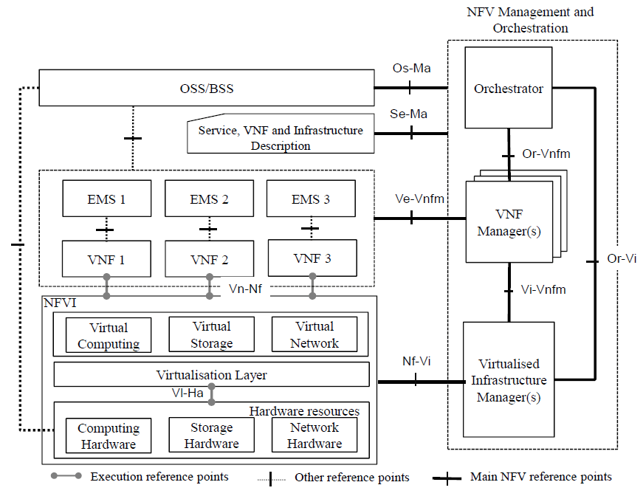
What is Tacker ?
Tacker
Is an official OpenStack project
Is a VNFM and a NFVO
Is based on ETSI MANO architecture

Slide 4
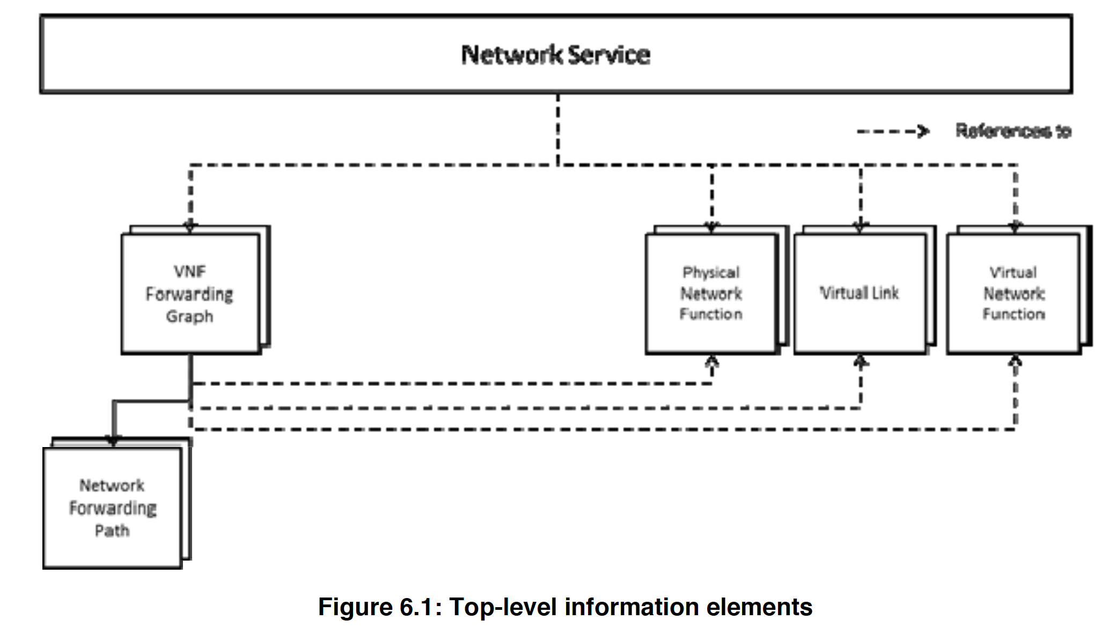
VNNFG steers traffic among VNFs
VNFFG stands for VNF Forwarding Graph，can be contained in a network service
Orchestrates and Manages traffic through VNFs
VNFFG consists of one or multiple NFPs (Network Forwarding Paths)

Slide 5
What is a NFP?
NFP stands for Network Forwarding Path
Describes the path of the actual traffic flows on the virtual links
Consists of one or many classifiers and a path of one or many VNFs.
NFP is a subset of a VNF-FG
E.g :
Control Traffic NFPs:
Handles the control traffic which flows in a datacenter.
User Traffic NFPs:
Handles the User traffic which flows in a datacenter

Slide 6
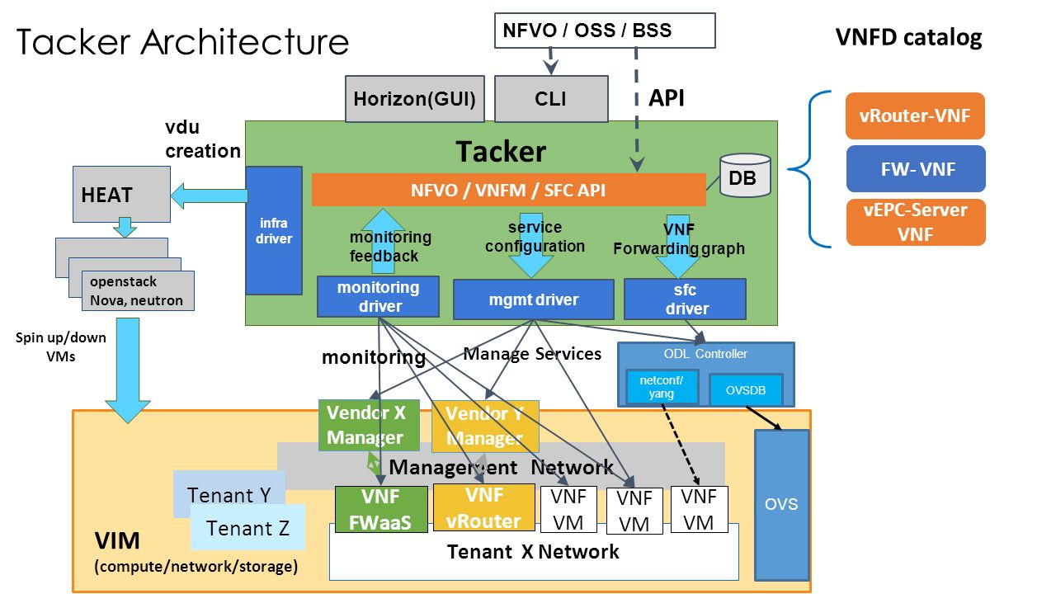
VIM
driver
networking-sfc
OVS driver

Slide 7
How to create VNFFG
Prepare a VNFFGD using your favorite editor
E.g. vim demo-vnffgd.yml
1
upload the VNFFGD to tacker catalogue using openstack tacker command
E.g. openstack vnf graph descriptor create demo-vnffgd --vnffgd-file demo-vnffgd.yml
2
start a VNFFG using the VNFFGD
E.g. openstack vnf graph create demo-vnffg --vnffgd-name demo-vnffgd
3

Slide 8
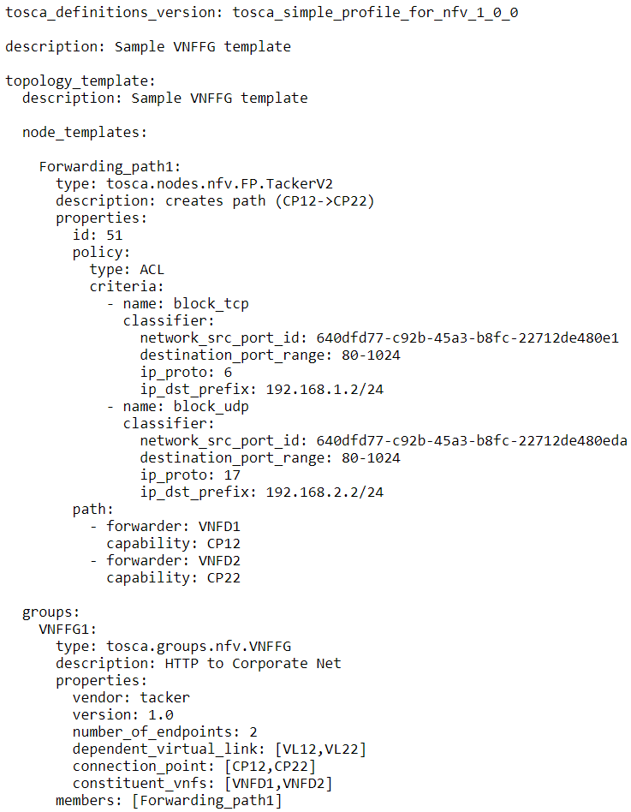
What does a VNFFGD look like in tacker TOSCA template?
VNFFG
Descriptor
Classifiers
NFP
Chain

Slide 9
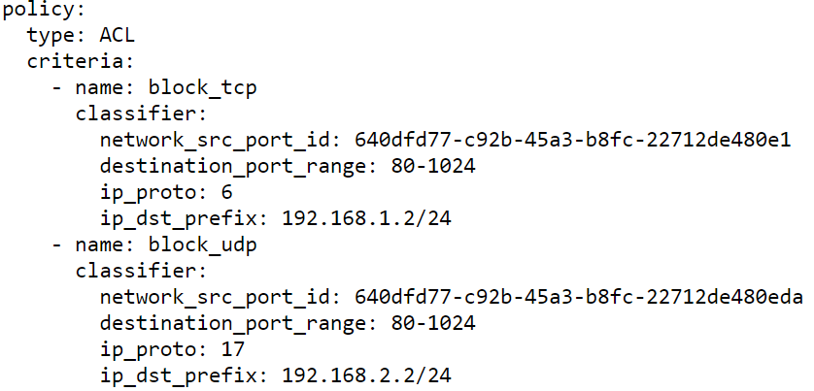
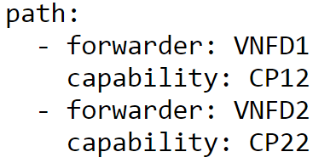
VNFFG classifier-chain
Classifier
Chain

Slide 10
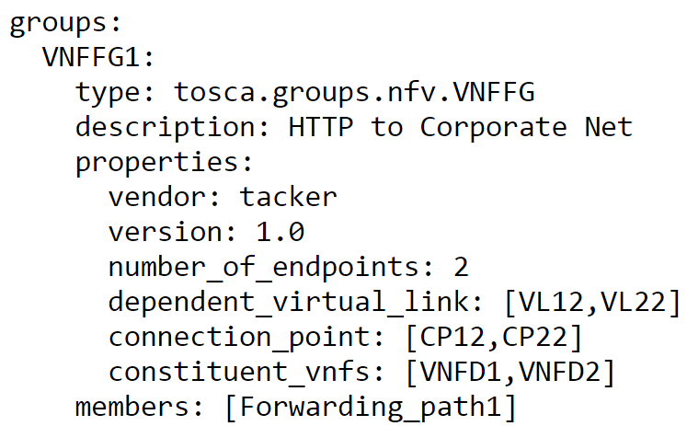
VNF-FG Properties
VNF-FG Properties

Slide 11
Example Topology
VNF1
(mirror)
VNF2
(IDS)
VNF3
(FW)
CP1
CP2
CP1
CP2
CP1
CP2
SRC
Ingress Traffic
DST
VL1

Slide 12
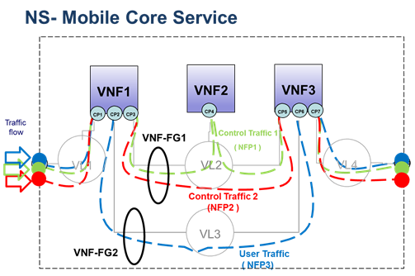
Example Topology
VNF-FG1 contains:
VNFs: VNF1, VNF2, VNF3
CPs: CP1, CP3, CP4, CP5, CP7
VLs: VL1, VL2, VL4
NFPs: NFP1, NFP2
VNF-FG2 contains:
VNFs: VNF1, VNF3
CPs: CP1, CP2, CP6, CP7
VLs: VL1, VL3, VL4
NFPs: NFP3

Slide 13
Networking-sfc OvS driver
OvS driver communicates with the OvS agents to configure the switches
OvS agents install flows to steer chain traffic to the SF instances.
The classification of traffic takes place in the Integration bridge and classifies traffic which is coming from a VM port.
The SF forwarding takes place in the Tunnel bridge which forwards the service chain packets to the next hop Compute node via Tunnels or to the next SF port on the same Compute Node.
MPLS headers will be used for the transport of the chain path identifier and chain hop index.

Slide 14
Networking-sfc ODL driver
ODL driver is responsible to configure the Integration Bridge of OvS
Opendaylight install flows to the OvS to steer the traffic to the SF instances
The classifier classifies the traffic by using ACLs and encapsulates the packet with NSH header
NSH header consists of a NSP -> RSP id and a NSIndex -> Next Hop
The SF Forwarder which is responsible to read the NSH header and send the packet to the appropriate SF
For the above approach NSH aware SFs are required.
Notes:
Without NSH aware Service Functions we need to reclassify to every hop which add huge load to the network when the tenant traffic is too high and we want to use mutiple chains though the same SF

Slide 15
Until Pike
In Queens
Create/Delete VNFFG One NFP One Classifier per Chain No support for Update VNFFG | Empty Classifier Support Update VNFFG support Multiple Classifiers per Chain

Slide 16
Dynamicly steer traffic through VNFs via VNFFG
user has its virtual router’s interface port (will be used a src_port in vnffg’s traffic classier definition) on a virtual network
user deploys some vnfs, such as vFW, vIDS via tacker
user defines a vnffg, with NFP without traffic classifiers
set up a monitor on the target service VM to monitor OS metric or application metric
define a trigger event, and if it is triggered, install traffic classifier to the NFP, so that the traffic can be analized at VNFs

Slide 17
DEMO
Demo setup instructions: https://github.com/dangtrinhnt/DynamicSFCDemo

Slide 18
Demo components
Zabbix monitor
Zabbix is software that monitors numerous parameters of a network and the health and integrity of servers.
Client traffic generator
Client, ICMP and HTTP traffic generator, can be bare metal server or virtual machine
Server VM server provider
Server VM, running simple HTTP server
client
server
Neutron external network
Neutron router
Neutron net1 subnet1
zabbix

Slide 19
Demo components
Suricata VNF
Capable of real time intrusion detection (IDS), inline intrusion prevention (IPS), and network security monitoring (NSM)
OpenWRT VNF
Open source project for embedded operating system based on Linux, primarily used on embedded devices to route network traffic (we are going to use it as FW).
client
Suricata
openwrt
server
Neutron external network
Neutron router
Neutron net1 subnet1
zabbix

Slide 20
Demo overview
BpS too high Drop ICMP
Zabbix Server
Suricata
(IDS)
OpenWRT (FW)
HTTP WORKS
Update VNFFG Action
ICMP WORKS
Client
No Classifier
Web server
+
Zabbix agent
OvS
DevStack

Slide 21
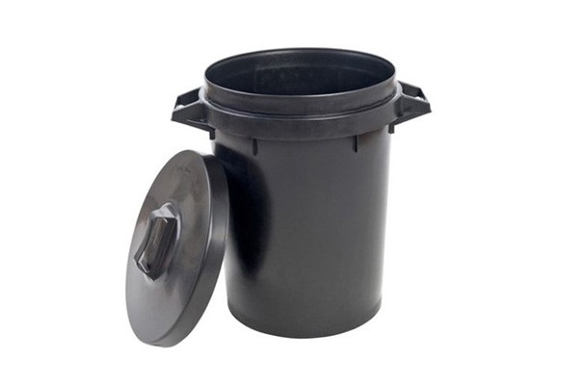
Demo overview
Zabbix Server
Suricata
(IDS)
OpenWRT (FW)
HTTP WORKS
ICMP DROPPED
Client
ICMP Classifier
Web server
+
Zabbix agent
OvS
DevStack

Slide 22
Tacker Update VNFFG command
/usr/local/bin/tacker --os-username admin --os-password devstack --os-project-name admin --os-user-domain-name default --os-project-domain-name default --os-project-domain-id default --os-auth-url http://192.168.122.113/identity/v3 --os-region-name RegionOne vnffg-update --vnffgd-template /home/ubuntu/vnffg_block_icmp.yaml block_icmp

