Slide 1
Kolla On-Boarding Session
May 2018
OpenStack Summit Vancouver
Jeffrey Zhang (Jeffrey4l)
Paul Bourke (pbourke)
Surya Prakash Singh (spsurya)
Notes:
Paul
15 mins for slides, leave 5 mins for Q&A

Slide 2
What is Kolla?
Kolla’s mission is to provide production-ready containers and deployment tools for operating OpenStack clouds.
Reusable images in Kolla
kolla
Deployment mechanisms
kolla-ansible
kolla-kubernetes
Notes:
Paul
Consists of two primary pieces, kolla (images), and kolla-ansible (deployment)
Images are used by other projects, the most visible being tripleo and and openstack-helm

Slide 3
Kolla background
Founded during Kilo cycle
Joined big tent in Liberty cycle
Kolla Queens is the 6th release
“Kolla” is Greek for glue
Notes:
Paul
Next Surya will give overview of Kolla’s architecture

Slide 4
Technology Stack
Kolla
Docker / Dockerfile
Python + Jinja2 + docker-py
kolla-ansible
Ansible
Python + docker-py
Notes:
Surya
Explain the main pieces used in the project
Why these technologies are used: We use jinja2 templating syntax to help manage the volume and complexity that comes with maintaining multiple Dockerfiles for multiple different base operating systems.
docker-py: A Python library for the Docker Engine API.

Slide 5
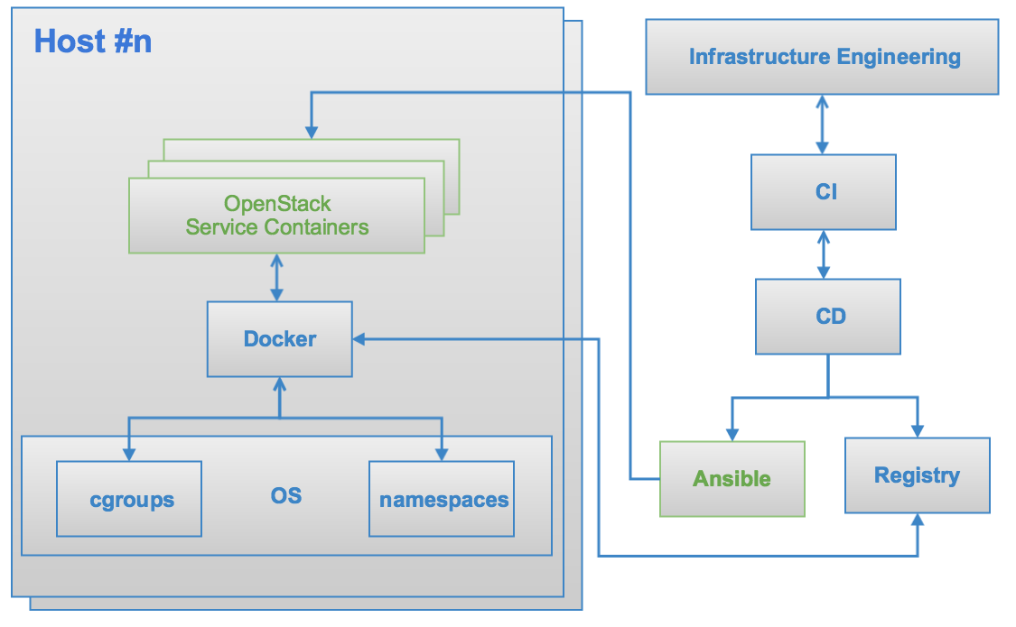
Architecture
Notes:
Surya

Slide 6
Kolla (Images) Highlights
Use Dockerfile + jinja2
Support Binary and Source installation
Support Ubuntu, RHEL/CentOS, OracleLinux as base images
Image Layering
Build faster and smaller size
Notes:
Paul
Jinja2 is the way we allow for complete customisation
Binary and source for all OpenStack services (not infra)
Debian also supported but not yet in CI
Image layering - source of some debate
Could use some refactoring but overall helps reduce network load as reported by users in China

Slide 7
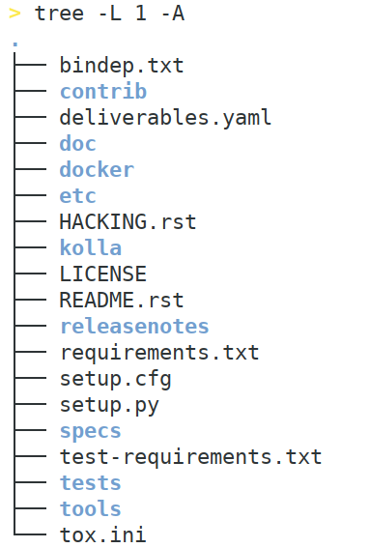
Kolla - Code Structure
Notes:
Paul
For newcomers, these are the two directories you will be interested in

Slide 8
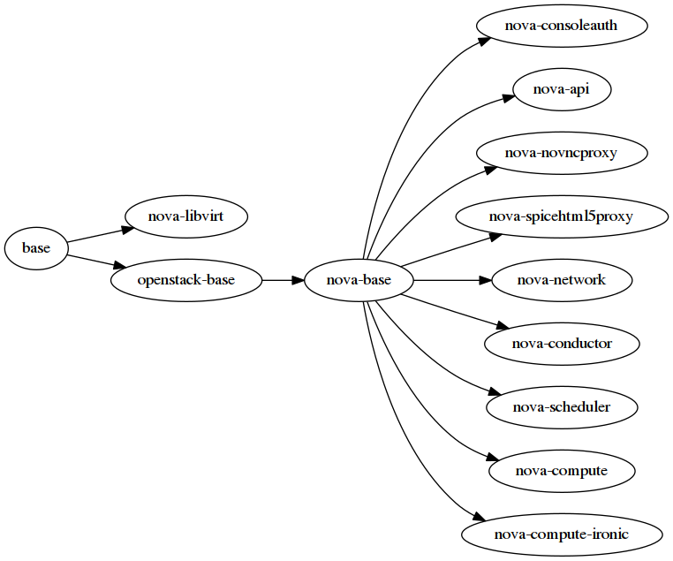
Kolla - Image Dependency
./tools/build.py --save-dependency kolla_images.dot
dot -Tpng kolla_images.dot -o kolla_images.png
Notes:
Paul

Slide 9
Kolla - generic dockerfile.j2
FROM {{ namespace }}/{{ image_prefix }}openstack-base:{{ tag }} LABEL maintainer="{{ maintainer }}" name="{{ image_name }}" build-date="{{ build_date }}" {% block << service >>_header %}{% endblock %} {% import "macros.j2" as macros with context %} << binary specific steps >> << source specific steps >> << common steps >> {% block << service >>_footer %}{% endblock %} {% block footer %}{% endblock %}
Notes:
Paul
This is the format all Kolla Dockerfiles follow
Makes it easy for contributors to add new services
Documented upstream

Slide 10
Kolla - image customization
{% extends parent_template %}
{% block grafana_footer %}
RUN grafana-cli plugins install alexanderzobnin-zabbix-app {% endblock %}
# kolla-build --template-override <template-override-file>
Notes:
Paul
Example showing template-overrides
Can be used for things such as adding additional plugins or packages, setting proxies, etc.
Allows consumers of Kolla to just maintain a single overrides file (e.g. tripleo)
Next up, Surya with overview of kolla-ansible

Slide 11
kolla-ansible highlights
Support all-in-one and multi node deployment
Support community recommended high availability
non-root running
Implement mainly OpenStack projects, ceph, EFK etc.
fewer dependency
only depends on docker engine and docker-py python packages
containerize everything
Notes:
Surya :
AIO for single host deployment and multinode deployment

Slide 12
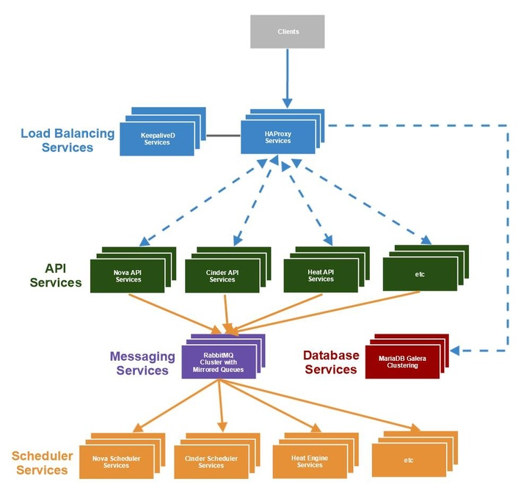
kolla-ansible - high availability
Notes:
Surya

Slide 13
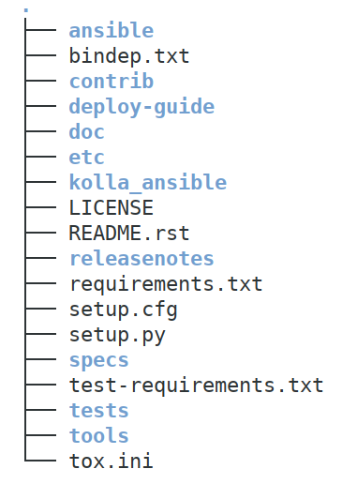
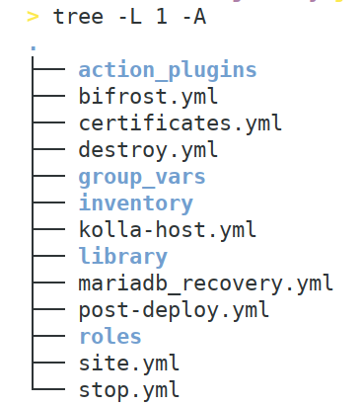
kolla-ansible - Code Structure
Notes:
Surya

Slide 14
kolla-ansible - inventory
[control]
control[1:3]
[compute]
compute[1:5]
[nova:children] control
[nova-api:children]
nova
[neutron-server:children]
control
Notes:
Surya

Slide 15
kolla-ansible - globals.yml
Global switchers and values which is required
# Valid options are [ centos, oraclelinux, ubuntu ]
kolla_base_distro: "centos"
# Valid options are [ binary, source ]
kolla_install_type: "binary"
docker_registry: "172.16.0.10:4000"
docker_namespace: "companyname"
Notes:
Surya: explain about configuration of kolla-ansible

Slide 16
kolla-ansible - passwords.yml
All sensitive value
openstack passwords / DB passwords
Rabbitmq cookies / etcd cluster token
ssh key pairs
Can be encrypted by ansible-vault
Notes:
Surya
Ansible Vault is a feature of ansible that allows you to keep sensitive data such as passwords or keys in encrypted files, rather than as plaintext in playbooks or roles. These vault files can then be distributed or placed in source control.

Slide 17
kolla-ansible - role architecture
Register
keystone service, endpoint and users
Config
configuration files like nova.conf
Bootstrap
Create database and user, run db migrate
Trigger handlers
Start the containers
Notes:
Paul
Similar to the Dockerfile template we showed, roles in kolla-ansible generally follow this pattern
Again makes it easy for contributers to implement new services

Slide 18
kolla-ansible - common role & special container
fluentd
collect logs
cron
log rotate
kolla-toolbox
runtime environment for the target nodes
Notes:
Paul

Slide 19
kolla-ansible - customization configuration
Put every custom configuration in to /etc/kolla/config folder, for example service policy.json file.
Notes:
Paul
Kolla-ansible supports customisation.

Slide 20
kolla-ansible - Containerized everything
Image COMMAND NAMES centos-source-horizon:6.0.0 "kolla_start" horizon centos-source-neutron-metadata-agent:6.0.0 "kolla_start" neutron_metadata_agent centos-source-neutron-l3-agent:6.0.0 "kolla_start" neutron_l3_agent centos-source-neutron-dhcp-agent:6.0.0 "kolla_start" neutron_dhcp_agent centos-source-neutron-openvswitch-agent:6.0.0 "kolla_start" neutron_openvswitch_agent centos-source-neutron-server:6.0.0 "kolla_start" neutron_server centos-source-openvswitch-vswitchd:6.0.0 "kolla_start" openvswitch_vswitchd centos-source-openvswitch-db-server:6.0.0 "kolla_start" openvswitch_db centos-source-nova-compute:6.0.0 "kolla_start" nova_compute centos-source-nova-libvirt:6.0.0 "kolla_start" nova_libvirt centos-source-nova-conductor:6.0.0 "kolla_start" nova_conductor centos-source-nova-scheduler:6.0.0 "kolla_start" nova_scheduler centos-source-nova-novncproxy:6.0.0 "kolla_start" nova_novncproxy centos-source-nova-consoleauth:6.0.0 "kolla_start" nova_consoleauth centos-source-nova-api:6.0.0 "kolla_start" nova_api centos-source-glance-api:6.0.0 "kolla_start" glance_api centos-source-glance-registry:6.0.0 "kolla_start" glance_registry centos-source-keystone:6.0.0 "kolla_start" keystone centos-source-rabbitmq:6.0.0 "kolla_start" rabbitmq centos-source-mariadb:6.0.0 "kolla_start" mariadb centos-source-memcached:6.0.0 "kolla_start" memcached
centos-source-cron:6.0.0 "kolla_start" cron
centos-source-kolla-toolbox:6.0.0 "kolla_start" kolla_toolbox
Notes:
Paul

Slide 21
Q&A
Thank you!
openstack
openstack
OpenStackFoundation

