Slide 1
I’m Having an OpenStack Party, and It’s BYOK!
April 26, 2016
Nathan Reller
26 April 2016
Nathan.Reller@jhuapl.edu

Slide 2
Agenda
What is bring your own key (BYOK)?
Why would I want BYOK?
Key management strategies
Provider key management
Bring your own key (a.k.a. BYOK push model)
Bring your own key manager (BYOKM a.k.a. BYOK pull model)

Slide 3
What is BYOK?
Customer provides keys to cloud provider
Cloud provider maintains key only for duration of operation
Cloud provider manages the key in transient memory

Slide 4
Why BYOK?
Customers
Regulatory compliance?
HIPAA
NIST SP 800-57
PCI DSS
Fear of lost or stolen data
Providers
Customers want it ☺
Feature parity
“Restrict access to cryptographic keys to the fewest number of custodians necessary”
PCI DSS Section 3.5.1

Slide 5
Provider Key Management

Slide 6
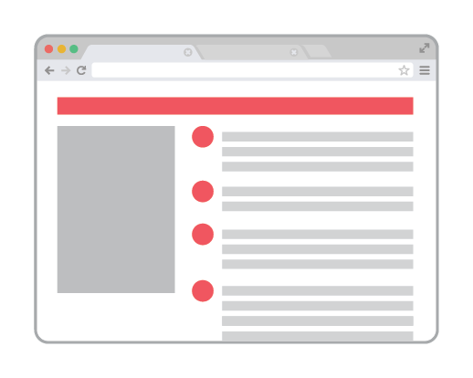
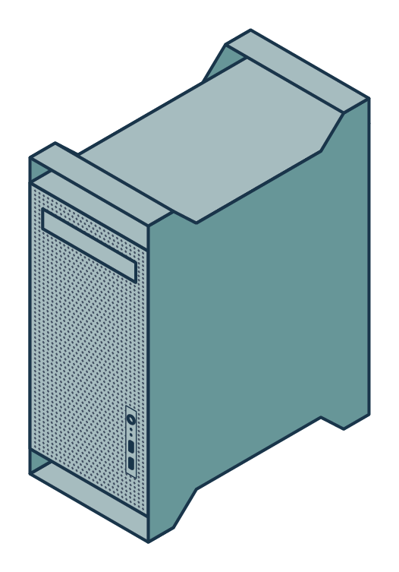
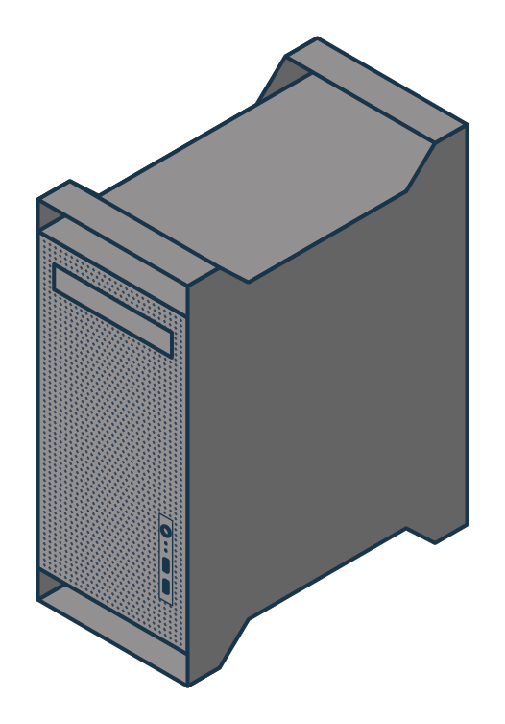
Ephemeral Storage Encryption with Provider Key Management
Horizon Dashboard
Create server {imageId}
Create server {imageId}
Get image {imageId}
Compute Controller
Glance
Create server {imageId}
Create key {“AES-256”}
Compute Node
Barbican

Slide 7
Provider Key Management Issues
Provider responsible for securing keys
Who is managing my keys?
How are they managing my keys?
Credentials management for key manager
What credentials are needed to access the key manager?
How are credentials distributed?

Slide 8
Issue: Credentials Management
Tokens used for authorization
Token strategies
User tokens
Passed to each service in call chain
Service tokens
Any service can access key
Horizon Dashboard
Create server {token, imageId}
Create server {token, imageId}
Compute Controller
Create server {token, imageId}
Compute Node
* Assuming a Barbican key manager

Slide 9
Proposal: Wrapped Tokens
Keys should only be released to services on behalf of users
Wrapped tokens
Service token
User token
Token
UUID: f7a63b41-8ed4
Name: Compute Node
Wrapped Token:
Token
UUID: 31aecb68-225f
Name: Nathan Reller

Slide 10
Key Management with BYOK
(a.k.a. BYOK Push Model)

Slide 11
Ephemeral Storage Encryption with BYOK
Horizon Dashboard
Create server {imageId, key}
Create server {imageId, key}
Compute Controller
Create server {imageId, key}
Glance
Compute Node
Get image {imageId}

Slide 12
BYOK Issues
Plaintext key is exposed
Several services have access to key
Users are key custodians
Service actions must be initiated by customer
Provider can cache key or
Provider can deny certain services
More work for customer
Customer must deploy and maintain key manager

Slide 13
Issue: Plaintext Key is Exposed
Policy implications
NIST SP 800-57 “When a symmetric or private key is available outside a cryptographic module, confidentiality protection shall be provided either by:”
Encryption (e.g., key wrapping)
Use of separate key components
Controlling access to the key via physical means (e.g. storing the keying material in a safe with limited access)
“Restrict access to cryptographic keys to the fewest number of custodians necessary” PCI DSS Section 3.5.1
Proposal: wrap keys before sending
User encrypts key with public certificate of recipient
User sends wrapped key as part of request
Recipient decrypts wrapped key

Slide 14
Issue: BYOK Key Wrapping
Which certificate should wrap the key?
Certificate of service using the key
End point is not always known
Compute service has controller node and many compute nodes
Which compute node will host new VM?
Compute Controller
Compute Nodes

Slide 15
Proposal: Single Provider Certificate
Wrap all keys with same certificate
Easiest solution for key wrapping
Private key distributed to BYOK services
Which services should have the private key?
Horizon Dashboard
Compute Controller
Compute Node
Glance

Slide 16
The Circle of Trust
Limit services that must be trusted
Restrict private key to trusted services
Which services must be trusted?
Which services cannot be trusted?
Focus more security on trusted services
Nova Compute
Neutron
Cinder
Swift
Keystone
Horizon
Glance
Trusted Services
Untrusted Services

Slide 17
Untrusted Service Example
Glance Image signing
Glance stores signed image and compute node verifies
Proposal: Glance image encryption
Glance stores encrypted image and compute node decrypts
Glance
Compute Node

Slide 18
Issue: Users are Key Custodians
Each service call requires user to copy key
openstack server create --key “5616287ace17abf3d517ae23cc94463babcd3565162900c8e3d567b1a2e90be3”
Steps to copying key
User accesses key manager web portal
User copies key into create call form
User invokes call
Key wrapping
How secure is browser and platform?

Slide 19
Key Management with BYOKM
(a.k.a. BYOK Pull Model)

Slide 20
Ephemeral Storage Encryption with BYOKM
Get key manager policy {projectId}
Horizon Dashboard
Keystone
Create server {imageId}
Create server {imageId}
Get image {imageId}
Compute Controller
Glance
Create server {imageId}
Create key {“AES-256”}
Key Manager
Compute Node

Slide 21
Key Managers and Metadata
Current key managers
Barbican
Wrapper for key managers
Supports KMIP, PKCS #11, and DogTag
Key Management Interoperability Protocol (KMIP)
Under current development
Key metadata
Key manager type (KMIP or Barbican)
Key manager URI

Slide 22
BYOKM Issues
Key manager is exposed to Internet
Provider key management and BYOK can hide behind firewall
Credentials management for key manager
Provider services are dependent on customer’s key manager
Key manager is down then services cannot function
More work for customer
Customer must deploy and maintain key manager

Slide 23
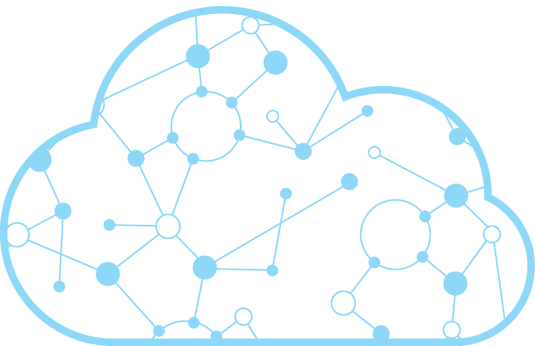
Issue: Key Manager is Exposed to Internet
Cloud provider pulls keys
Key manager must be accessible to cloud provider
Customer provisions key manager
Secure it!
Allow cloud provider access
Key Manager
Compute Node
Internet

Slide 24
Issue: Credentials Management for Key Manager
What credentials are needed?
Barbican uses Keystone tokens
Should work easily
Same credentials management issue as provider key management
KMIP
Options include certificate, username/password, TPM* quote
Want Keystone token support but currently none
* Trusted Platform Module (TPM)

Slide 25
Proposal: Add OpenStack Token Support to KMIP
KMIP with wrapped tokens
KMIP with tokens
Evidence of trusted service
Trusted services provisioned with KMIP authentication certificate
TLS connection uses service certificate
Evidence of user
Token can be used to authenticate user
Key Manager
Compute Node

Slide 26
Key Management Comparison
 | Cloud Provider | BYOK | BYOKM
Client manages keys |  | ✔ | ✔
No client setup required | ✔
Restricted key custodians | ✔ |  | ✔
Support cloud-initiated actions | ✔ |  | ✔
Customer key manager independence | ✔ | ✔
Key manager on intranet | ✔ | ✔
Users are not key custodians | ✔ |  | ✔

Slide 27
Summary and Parting Thoughts
Customers want bring your own key
Provider key management has minimal risks
Must trust them for proper key management
BYOK and BYOKM have added risks
Employees can access keys
Key manager is exposed to Internet
BYOK requires community effort
Cinder, Keystone, Horizon, Neutron, Nova, Swift

