Slide 1
Towards a Platform for Science - Initial Lessons from the Science Accelerator Platform at LBL
Andrew Wiedlea
Gary Jung
LBNL - IT User Support
10 May 2017

Slide 2
Overview
As part of supporting our science mission, LBL is working on establishing the right mixture of capabilities to support scientific data management, data analysis and computation.
This is a complicated problem of socio-technical system design and deployment.
This brief provides an overview of our current efforts and thoughts → this is all very much a work in progress and we are working our way towards OpenStack as we work out major challenges:
What role will OpenStack play in our User Support Infrastructure?
Will the users be end-users or science facilitators?
How will we build our infrastructure and dependencies needed to successfully manage OpenStack provided services?

Slide 3
What is an LBNL?
Established in 1931 in the hills of Berkeley California, LBNL is a multiprogram national laboratory operated by the University of California for the U.S. Department of Energy (DOE). Twelve Nobel Prizes have been awarded for discoveries made at the Lab.
LBNL's role for the DOE is to produce excellent science and advanced technology with the cooperation, support, and appropriate involvement of our scientific and local communities.
LBL performs only unclassified science research, and manages key national User Facilities such as NERSC, Advanced Light Source, and the Molecular Foundry
Notes:
Add photo

Slide 4
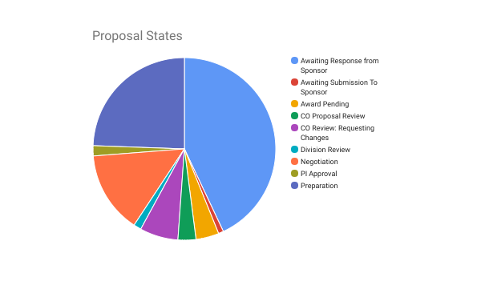
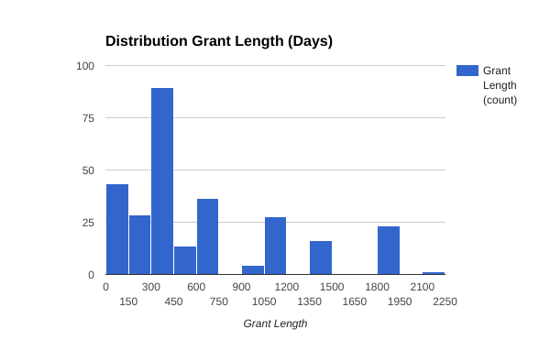
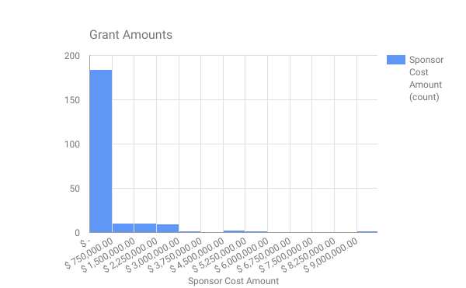
Our Science Users: stressed and not thinking long term
Highly diverse and idiosyncratic
Strong culture of do-it-yourself and infrastructure-by-PI
Decentralization of funding, authorities, mission.
Projects do not have to use IT if they don’t want to
Live on short term money and 80% of grant applications fail

Slide 5
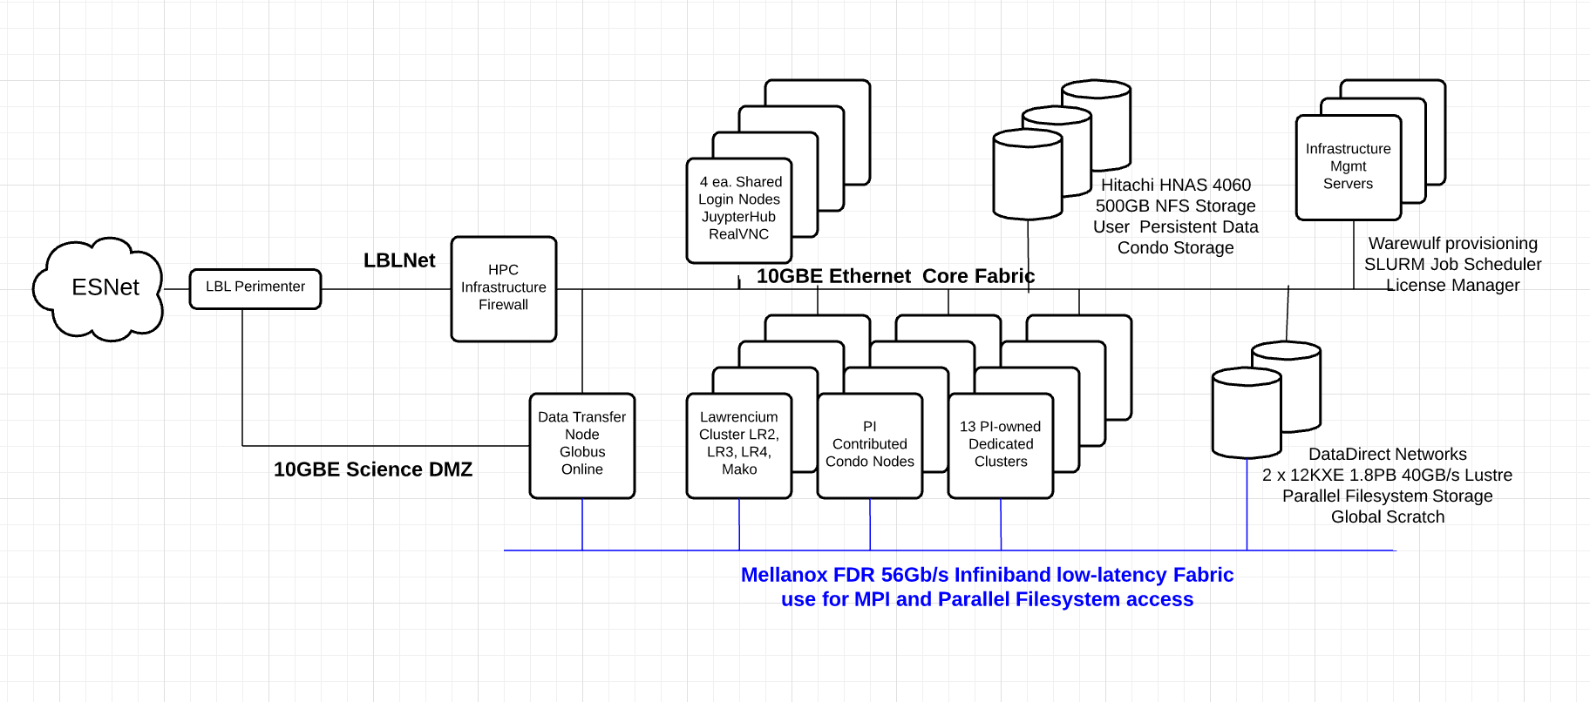
Everything but OpenStack
Compute/Storage/Network

Slide 6
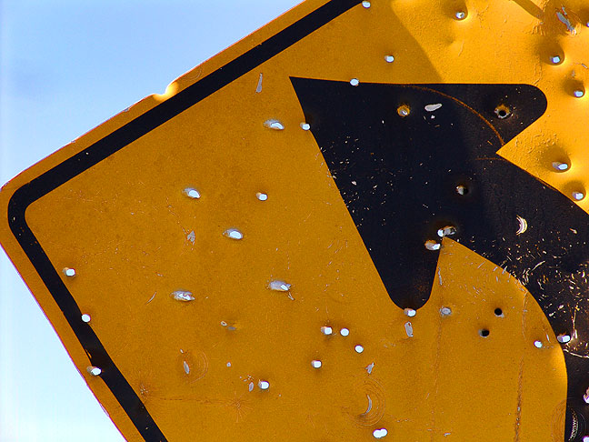
Everything but OpenStack
Other Services
-Software Farm -Wide open software availability
-Singularity -Jupyter Hub/BitBucket
-Science VM (standing up) -Free GSuite and unlimited Drive
-Globus/Druva -Publications/Tons of scientific data holdings etc
-Software Carpentry/Data Carpentry/Training (Arduino, etc)
-Very permissive Cyber and Network management -software distribution
-Access to Commercial Cloud (Master Payer in works)
Notes:
Image of shotgun

Slide 7
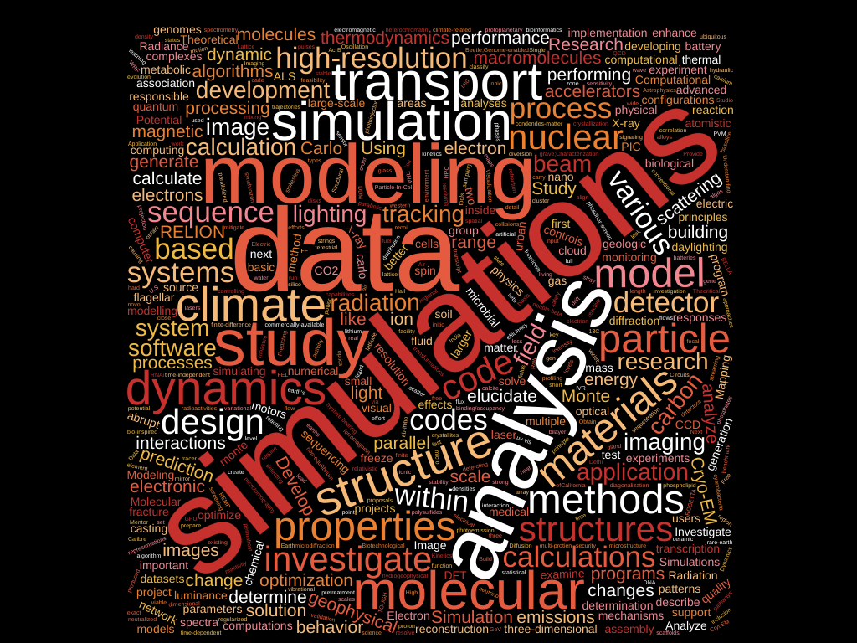
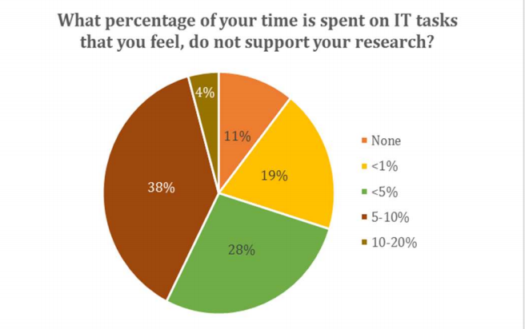
Science Users have driven our current IT posture -- but flexibility has costs
Many short term small projects with very different needs across many disciplines
Larger projects optimize for their own needs
Shadow IT and Post-docs fill many gaps

Slide 8
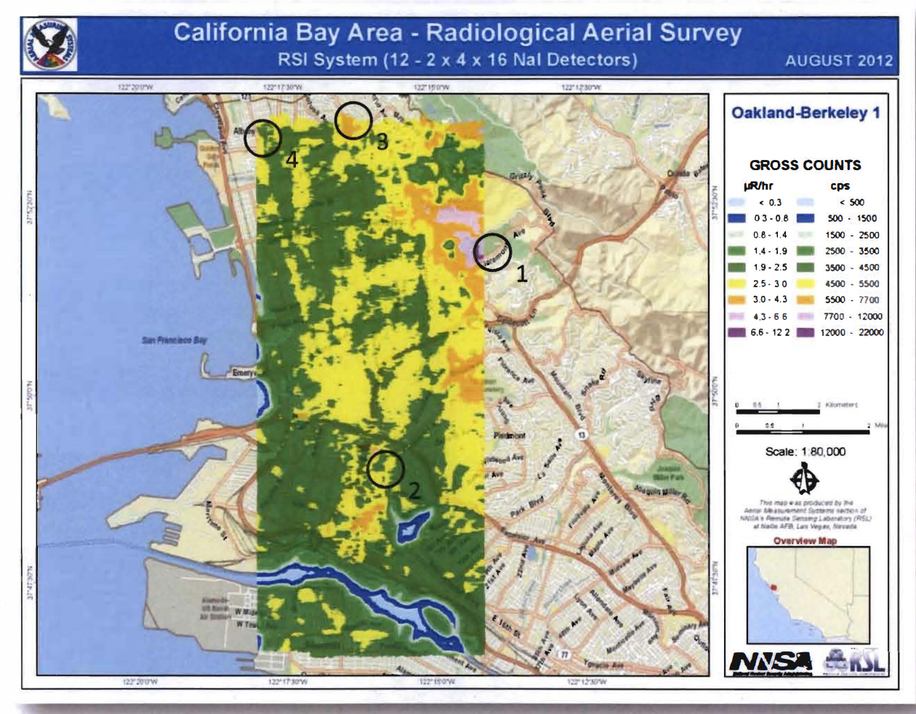
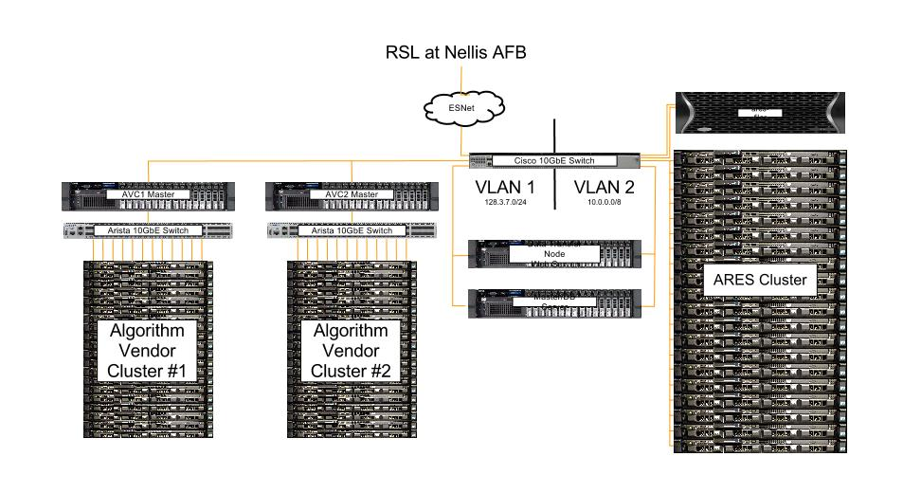
Science Example 1: Airborne Radiological Enhanced Sensor Data Pipeline
Computed on PI-owned Dell R410 cluster in LBL Condo Research: Evaluate algorithms for real time gamma ray detection
Data Pipeline 6-8 TB/day Gamma, high speed photography, hyperspectral, lidar Data transferred from Nellis AFB to LBNL via Globus Data stored in HDF5 format. Fastbit query Transfer node simulates quasi-real time delivery Two vendor clusters for analysis
Notes:
Hand build and an opportunity to automate workflow

Slide 9
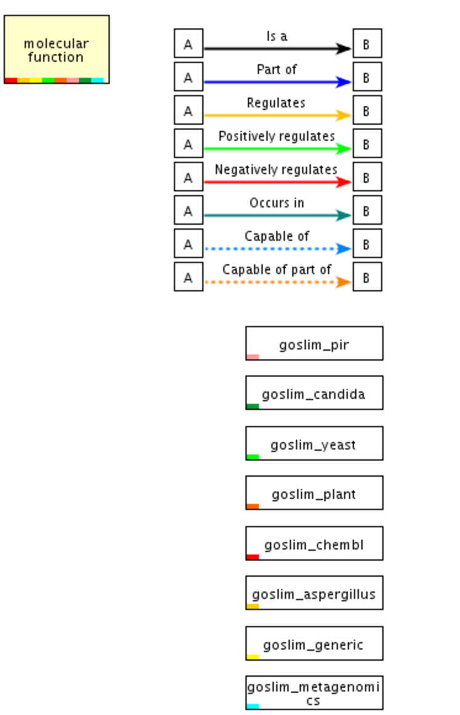
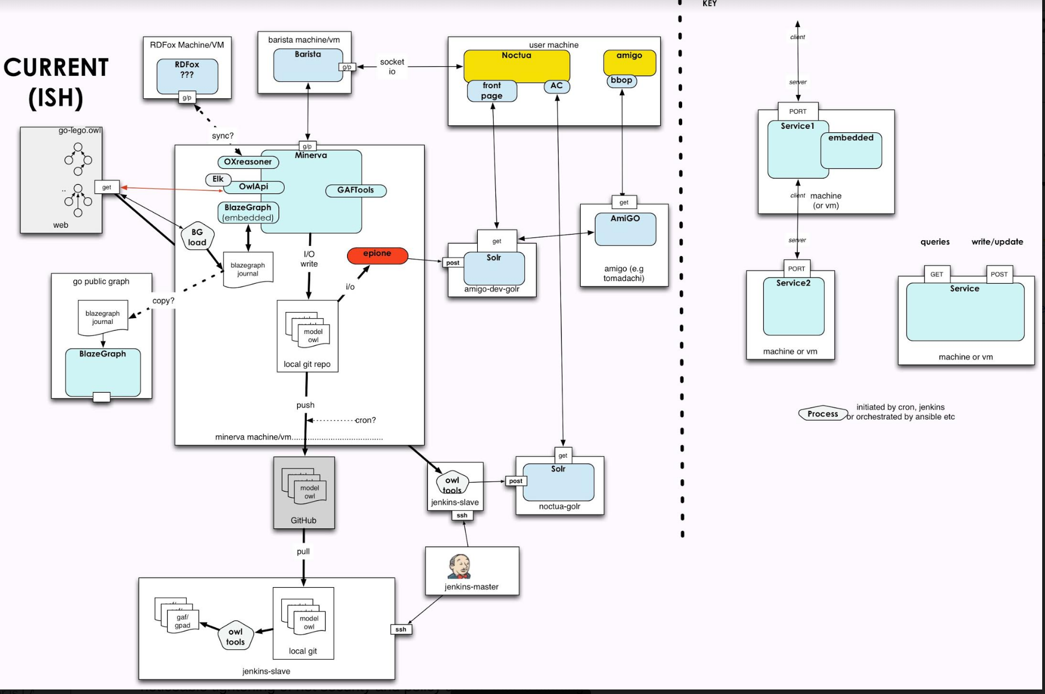
Science Example 2: Noctua and Linked Expressions using the Gene Ontology (LEGO)
Web-based collaborative editing system used to create LEGO models
Examples spun up and down on AWS quickly for different users
Data populates a central DB--GB tops

Slide 10
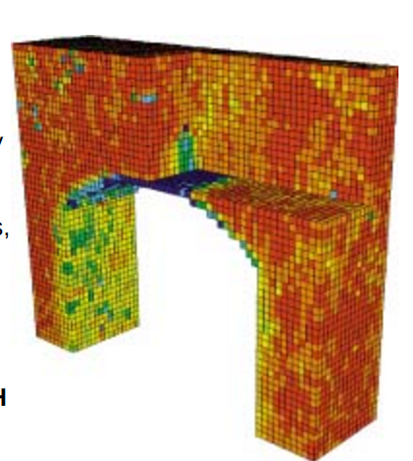
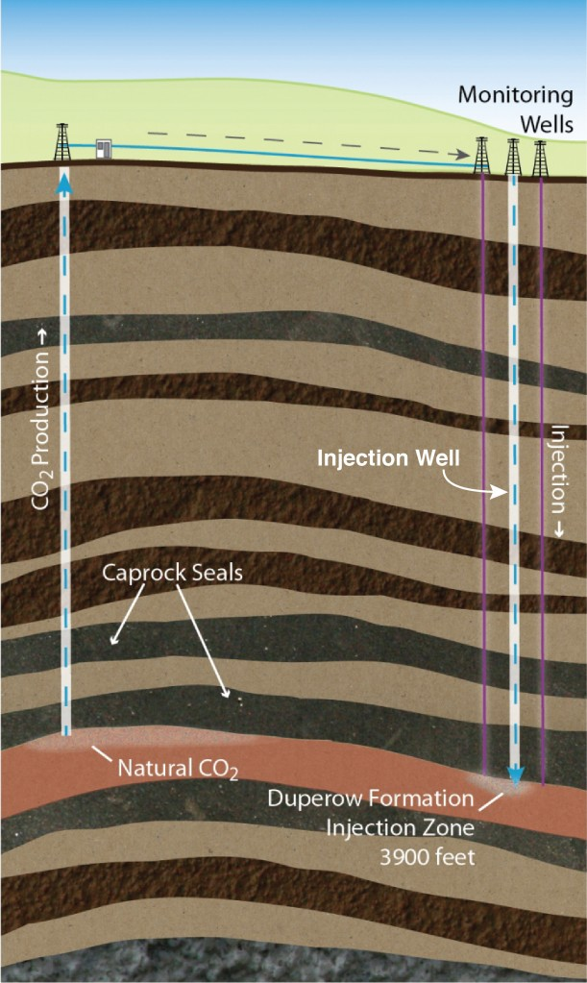
Science Example 3: Carbon Geosequestration
Carbon Geosequestration Computed on Lawrencium Condo nodes. Research: CO2 underground sequestration $85M project with Montana State University Kevin Dome site in Montana Inject 1M tons of CO2 into the ground Uses TOUGH2 codes to model physics process Pressure, CO2 saturation, temp, salinity Geomechanical stress in 3D 3 phases over 8 years: -Drill wells and model plume -Transport, inject CO2 -Monitoring and analysis
Notes:
Transport Of Unsaturated Groundwater and Heat

Slide 11
Finding the niche for OpenStack
We see the that there is an important role for on-prem/non vendor architectures...
...but we have already developed (organically) a wide set of capabilities for data movement, computation, service provision, training.
...and our user base runs the gamut in sophistication and desire for services AND is neither incentivised nor interested in centralization of capabilities or methods.
So getting there is working out a bit in reverse than from many of our OS colleagues--is IT the customer or the science user?
Notes:
What role should OS play?

Slide 12
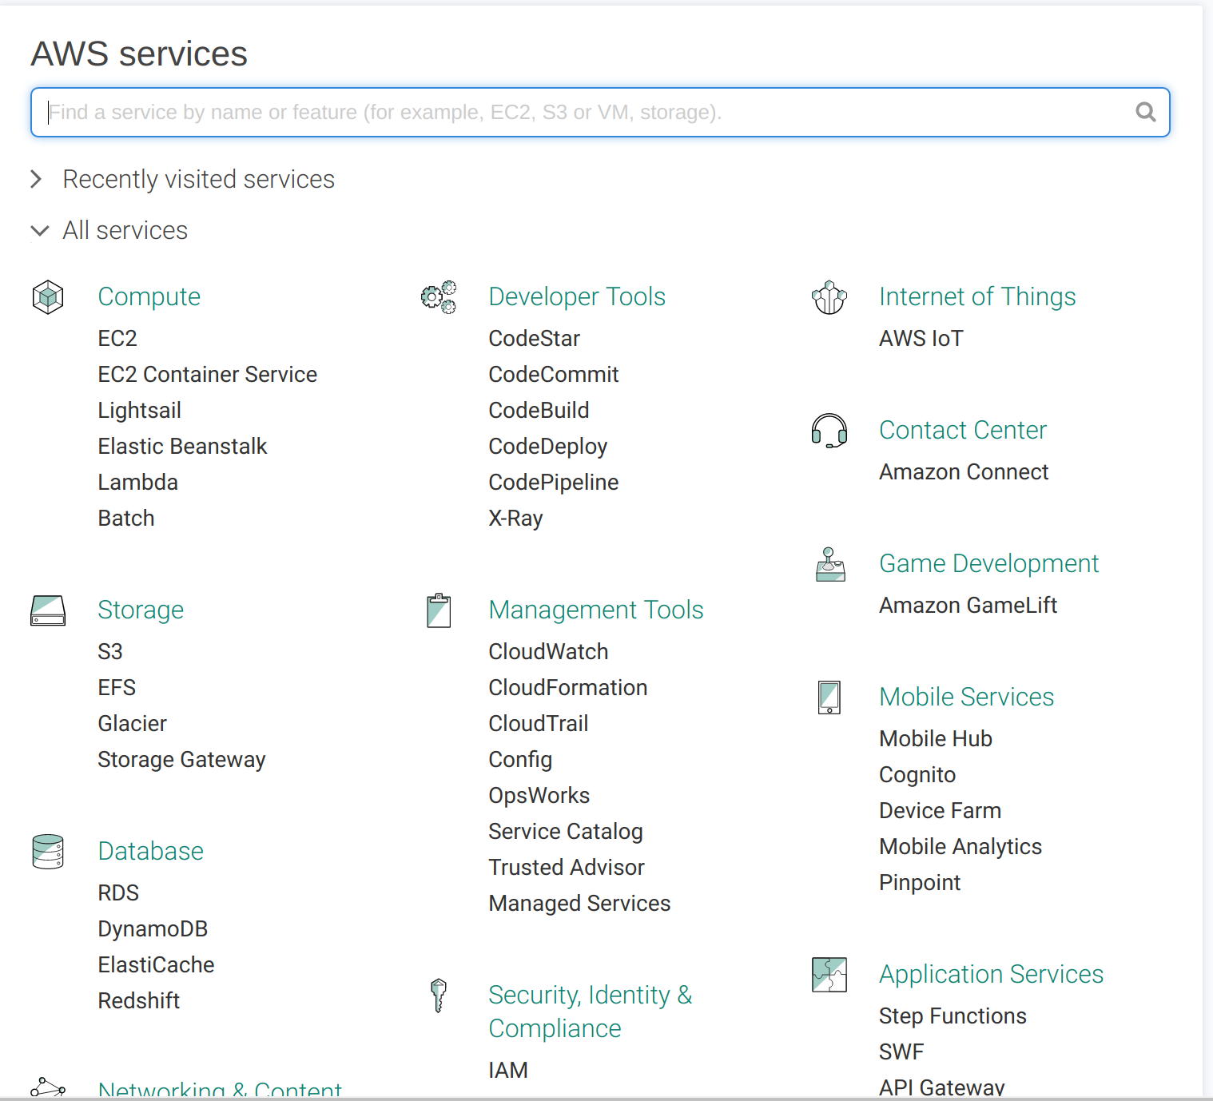
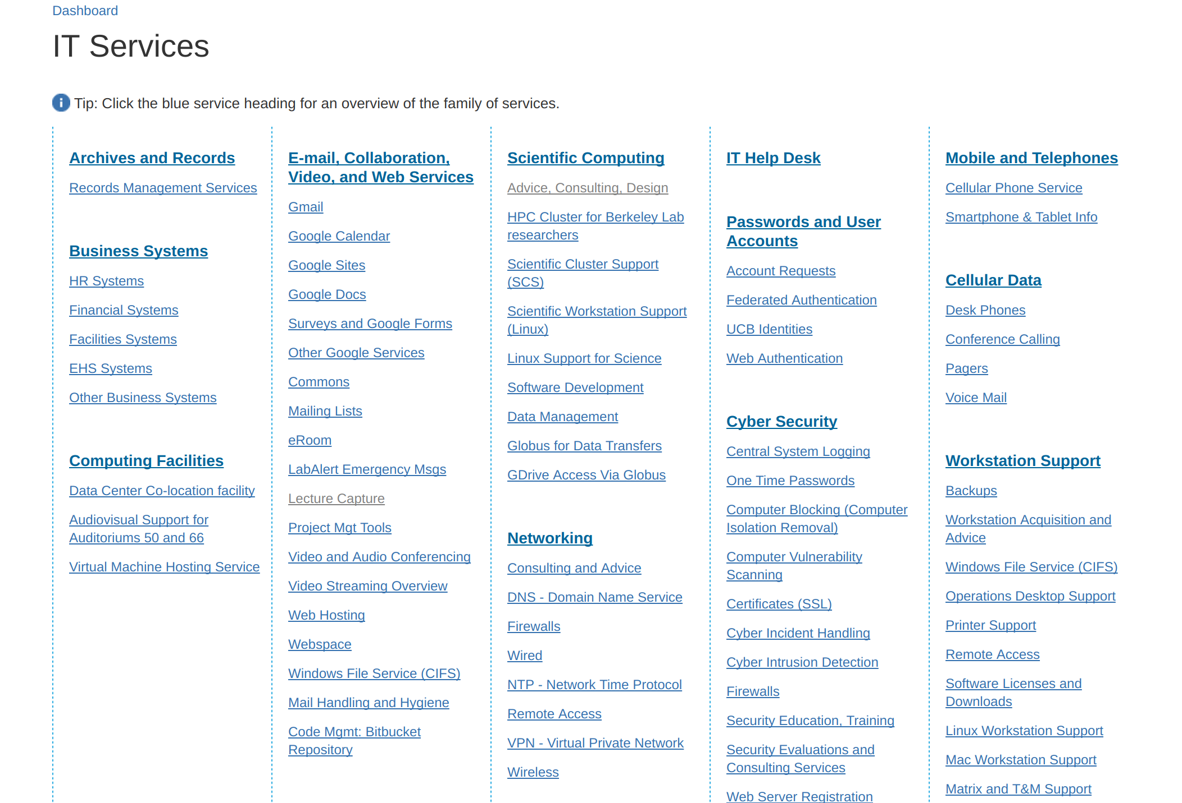
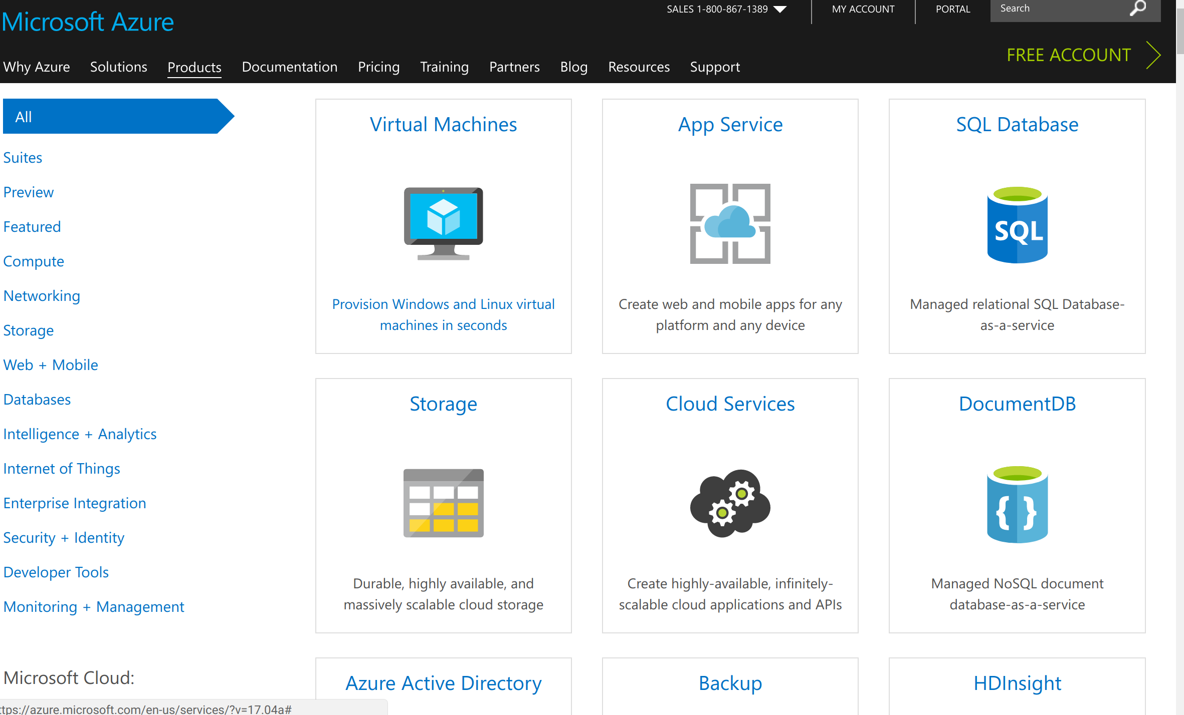
What model for OS?
Our customers are the scientists, PI, post-docs
We are engaged in a detailed study of our customers -- we don’t offer/model our capabilities against their project logic.
That is not a special fault of our Lab-IT.
Public cloud offerings are a hodge podge from the standpoint of a non-”data/compute” trained scientist.

Slide 13
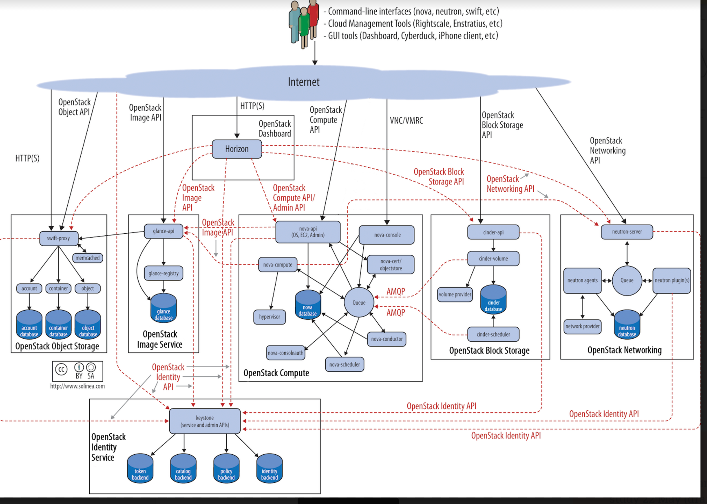
Envisioned Future Use Cases
If we build options they may not come.
We will have more success with designing user interface first.
From problem defined web presence to OS developed portal.

Slide 14
Design Models (partial)
University of Monash and Australia’s NECTAR
CERN
UCSD and the National Data Service
PNNL PiC Open Stack Deployment
Compute Canada / Simon Frasier University

Slide 15
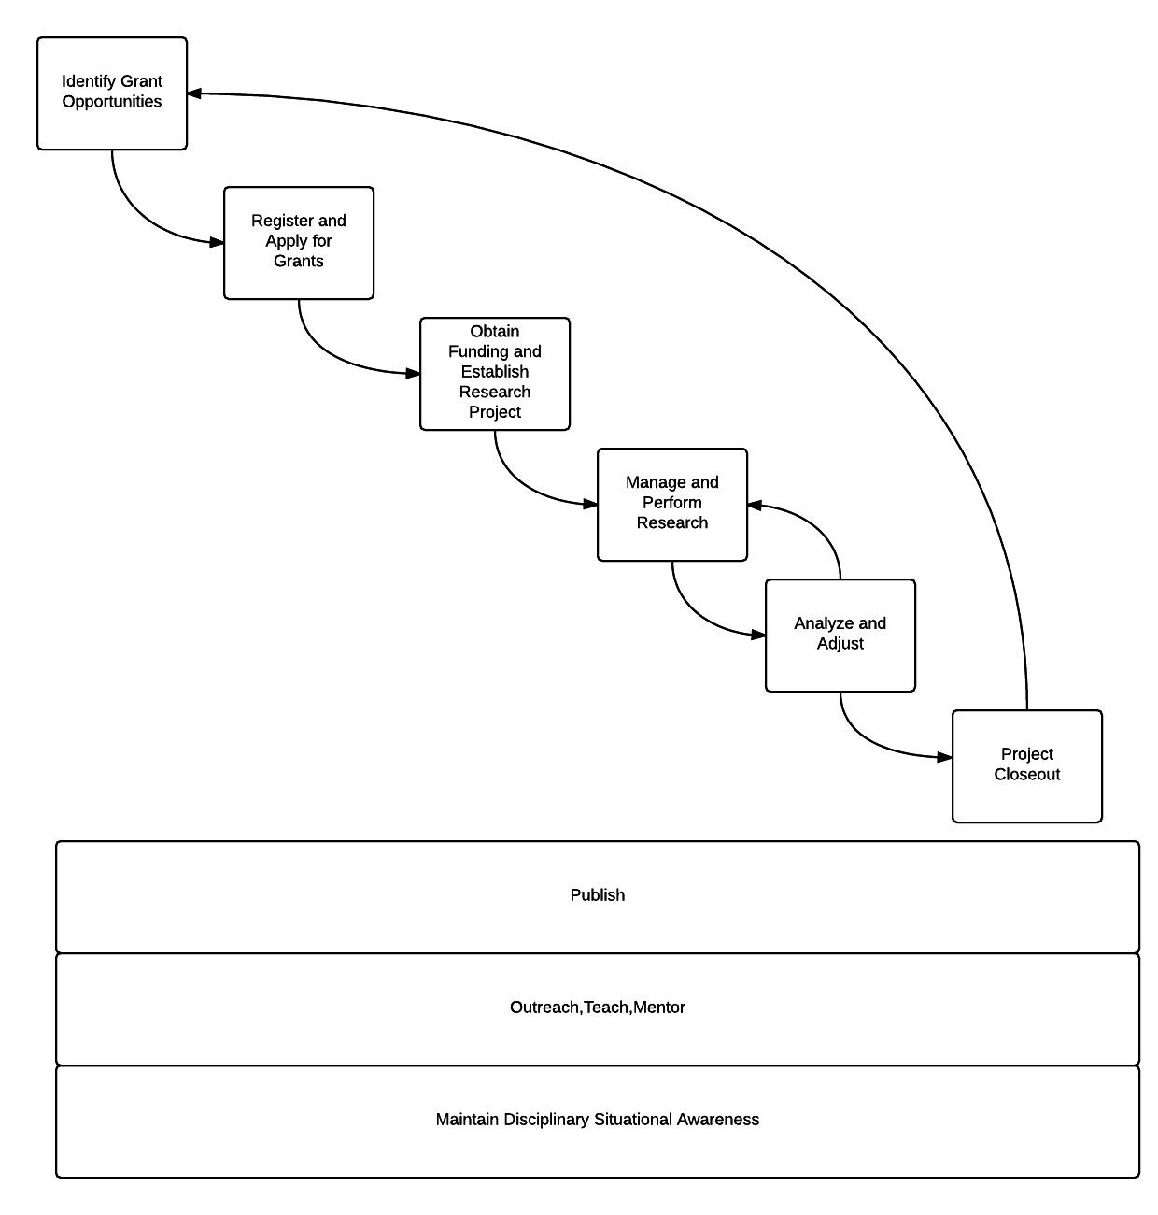
Science Accelerator: Using OS to tie together the Science Workflow

Slide 16
Science Accelerator Functional Description
I want to: Run a Project
BeV Bot and KB
AODocs and BPIP
Slack/Zoom/Meeting
Gantt/Kanban
FMS, etc
Help@lbl.gov
I want to: Find Grants
Log in to my Grant Watcher Dashboard
OSF/Grants.us etc
Library resources
I want to: Apply for Grants
-Log in to Grant Appl. Dash
-eSRA
-CDL DASH and RDM Plan

Slide 17
Science Accelerator Functional Description
I want to do science:
-Science Execution Dashboards
-Research Data Ingest pipelines
-Disciplinary data models
-Medium scale VM computation testing and prototyping environment
-JupyterHub/Singularity
-Lawrencium compute
-Off-ramps to commercial cloud
-Globus and data transfer
-Hosting, network, identify management support
-Data archiving
-Support for lab controls, monitoring and telemetry

Slide 18
Science Accelerator Functional Description
I want to be a part of the Global Science Commons:
-Science Communications Dashboards
-Slack, other social media consolidation displays
-Library and paid content by discipline
-LBL Publication registry
- LBL Performance Management Plan and other team tools
-Latex, Overleaf, etc.
-LBL WordPress, other content hosting--OSF, etc.

Slide 19
What will drive OS at LBL?
So far it is not direct user demand -- users are not asking for OS. OS by itself will not eliminate shadow-IT / not clear it will make user project needs simpler
BUT
Some are asking for private cloud and we want to control costs, control data, better couple our existing services, and better provide federated data and compute services within the UC and National Lab systems.

Slide 20
Conclusion
OS adoption in our case will be driven by derived requirements versus direct customer input or cost/benefits.
As such, LBL may not decide to “go-it-alone” rather we may seek to combine efforts as UC and DOE Office of Science Labs begin to explore improvements for common science infrastructure needs.
Uptake will be organic as computational, storage, networking services and skillsets are upgraded.

