Slide 1
Is OpenStack* ready for app developers?
The journey of application developers in public clouds
Marcela Bonell
Intel
*Other names and brands may be claimed as the property of others.

Slide 2
Marcela Bonell
Cloud Software Engineer - Intel
OTC Data Center DX Engineering
OpenStack* contributor
@mbonell
*Other names and brands may be claimed as the property of others.

Slide 3
Agenda
Where is OpenStack* in terms of developer experience?
Cloud comparison
Process
Providers
Findings
Results
Recommendations
Call to action
*Other names and brands may be claimed as the property of others.
3
Notes:
In this session you will understand the current state of OpenStack related to the application developer experience and what is needed to do to provide the proper resources that application developers need to succeed in OpenStack.

Slide 4
Where is OpenStack* in terms of developer experience?
*Other names and brands may be claimed as the property of others.
Notes:
In order to drive efforts in the App Ecosystem Working Group to make OpenStack more efficient for application developers, we decided to analyze the most popular public clouds such as AWS,CGP, Azure; and compare them against OpenStack

Slide 5
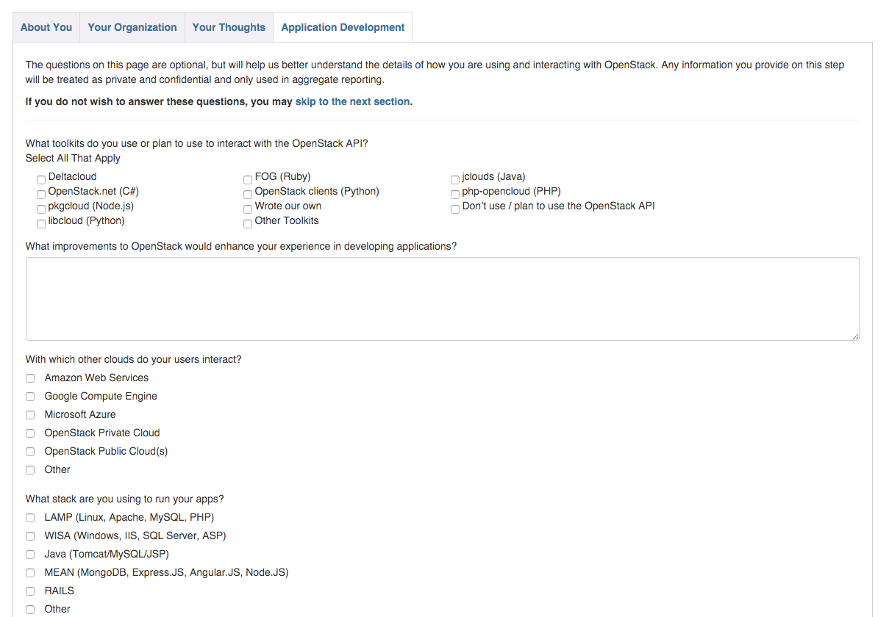
OpenStack* User Survey 2016 Q1
Application Development section:
Toolkits/SDKs
OpenStack improvements
Other clouds
Stacks
Source: http://tiny.cc/user-survey (https://www.openstack.org/user-survey/survey-2016-q1/application-development)
OpenStack User Survey - March 2016 : Application Development
*Other names and brands may be claimed as the property of others.
Notes:
How are they packaging and deploying apps?
What about monitoring the applications?
Do they have a failure notification system?
What have been the major hiccups while developing apps using OpenStack?

Slide 6
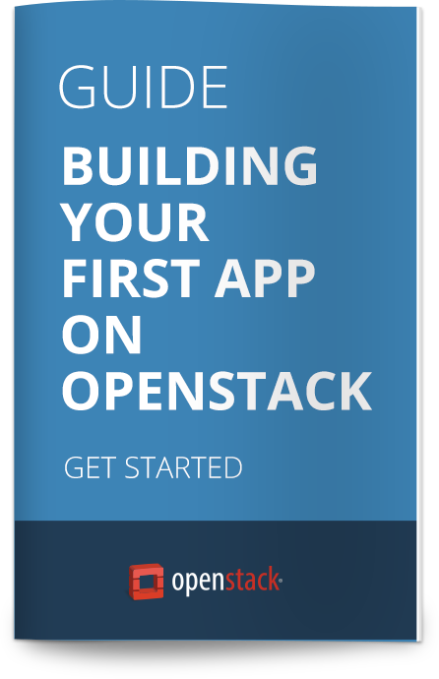
Development resources for OpenStack* clouds
OpenStack API
cURL, CLI clients, REST clients
SDKs
~ 37 known SDK’s
None official
Multi-cloud/OpenStack only
OpenStack First App Guide
Available for one SDK (libcloud)
Source: http://developer.openstack.org/
*Other names and brands may be claimed as the property of others.
Notes:
These are the development resources offered by OpenStack in its developer portal.

Slide 7
Cloud comparison
App developers on-boarding experience
Notes:
If we want to make OpenStack more efficient for application developers, first it’s necessary to take a look to its current application development experience.
Our goal was to discover best practices and gaps in app development for OpenStack against other cloud providers.

Slide 8
Cloud providers
OpenStack*
Popular public clouds
Rackspace*
OVH*
Amazon Web Services (AWS)*
Google Cloud Platform (GCP)*
Microsoft Azure*
*Other names and brands may be claimed as the property of others.

Slide 9
Cloud comparison process
Detailed report: http://tiny.cc/full-cloud-report
Notes:
This picture represents the process that we followed to create our cloud analysis.
At the bottom of the slide there is the link to the detailed report that I shared in the App Ecosystem WG.

Slide 10
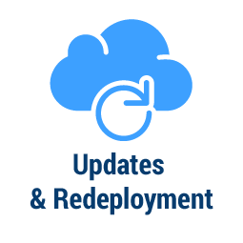
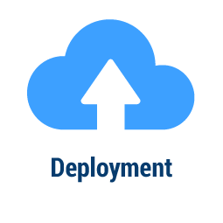
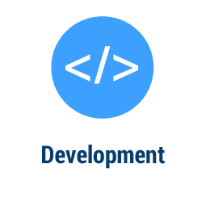
Developer’s journey
Notes:
The developer‘s journey represents all the stages that are part of the application development life cycle.
For our cloud analysis, Ivan and Angel went through this full journey as a common process for each provider.
Now, I will start presenting the findings and results of our cloud comparison. The findings are classified in critical issues (red color), gaps (yellow color) and best practices (green color).

Slide 11
Sign up
AWS* activates an account through a phone call, but the process was not clear for the app developers.
Rackspace* and OVH* requires only an email and password to create and activate an account.
“The activation process is not clear, because it doesn't explain how we have to put the phone number.” – Ivan about AWS
Critical issues
Gaps
Best practices
*Other names and brands may be claimed as the property of others.
Notes:
At this stage the developers created and activated their accounts.
Rackspace and OVH were the easiest ones..
For Azure and GCP…

Slide 12
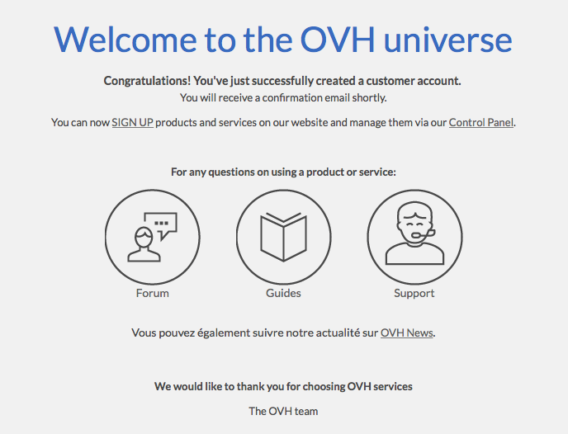
Welcome pack
Azure* provides too much information (is overwhelming) and there is not a clear path to follow.
All providers (except OVH*) send welcome packs (emails) with links to start guides, code samples and pricing.
“OVH doesn’t provide documentation for developers.” – Ivan about OVH welcome pack
Critical issues
Gaps
Best practices
*Other names and brands may be claimed as the property of others.
Notes:
We called welcome pack to the email that developers received after the account activation.

Slide 13
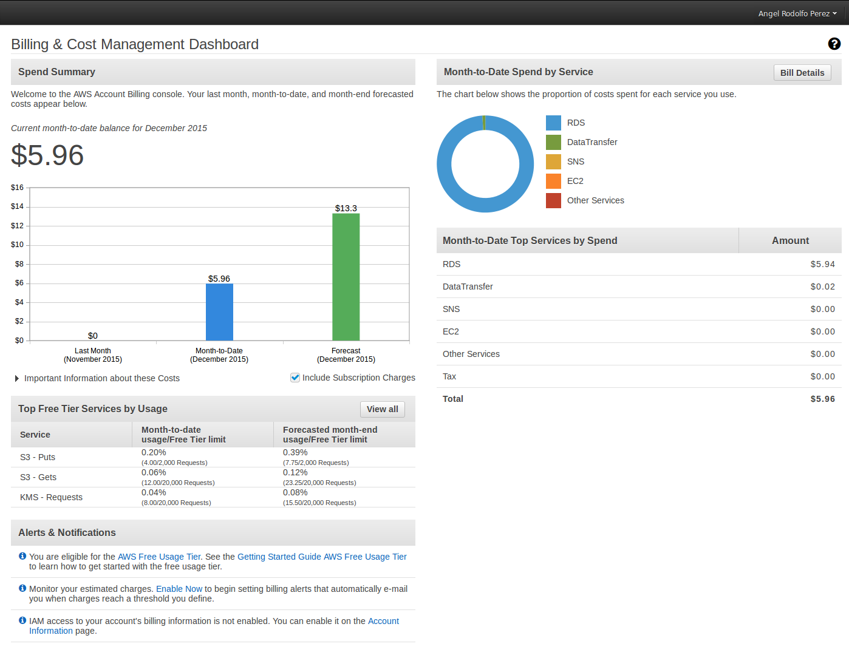
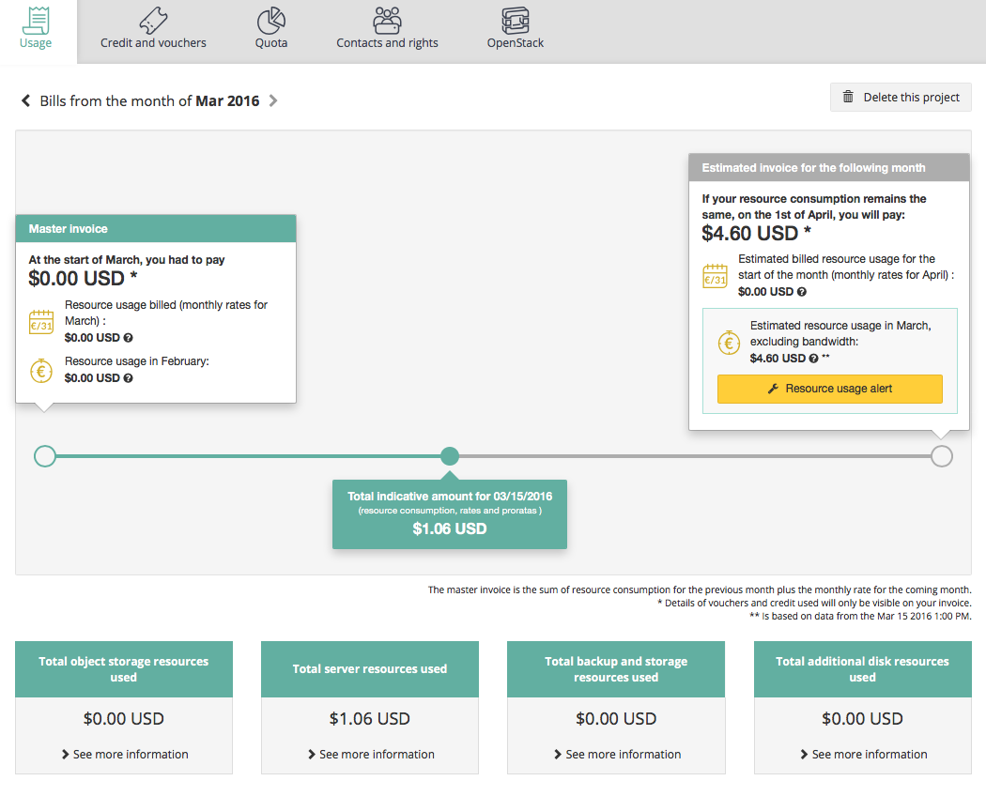
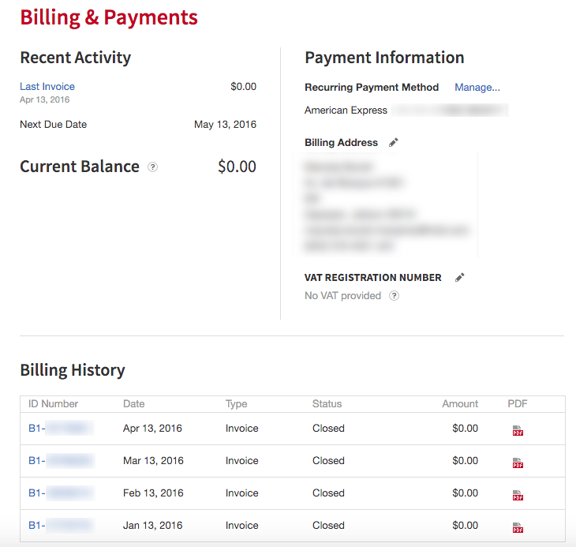
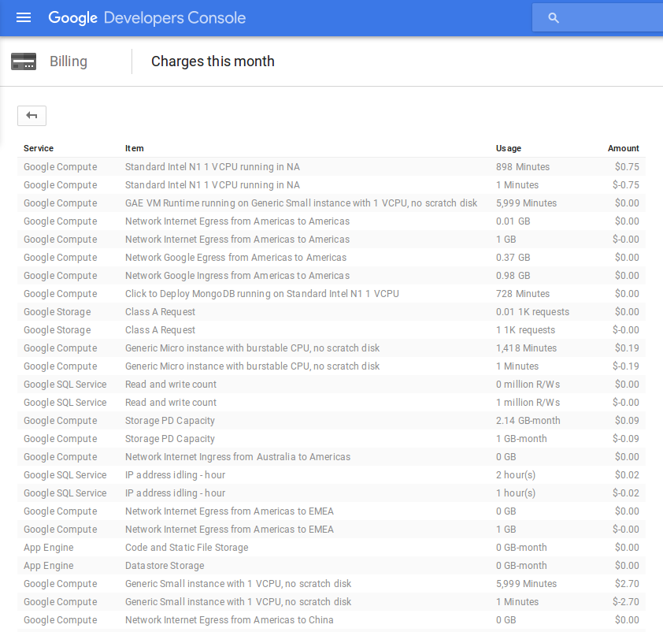
Billing
AWS*
OVH*
Rackspace*
GCP*
Critical issues
Gaps
Best practices
*Other names and brands may be claimed as the property of others.
13
Notes:
Being aware of billing information is very important for developers. They want to know how their resources are spending their money and forecast future charges.

Slide 14
Infrastructure
OVH* and Rackspace* instances cannot be created through libcloud because it uses nova-network.
Rackspace does not expose the neutron API.
Floating IPs are not available yet on Rackspace.
Security groups are not enabled by default on Rackspace.
OVH doesn’t provide database services ready to use.
On AWS*, Azure* and GCP* networking is seamless for the app developers.
Critical issues
Gaps
Best practices
*Other names and brands may be claimed as the property of others.
Notes:
At this stage app developers need to create all the infrastructure required for their apps such as: application servers, databases, storage services, networking setup and security.
This was the hardest stage for app developers on OpenStack providers.
So if your OpenStack cloud uses neutron and your app will interact with it…

Slide 15
Development
On Rackspace* and OVH* app developers didn't find how to solve a SDK 404 error through the documentation.
The OpenStack* shade’s first app tutorial is nearly complete but is still considered to be a draft.
AWS* has the most complete developer portal.
App developers didn't need to learn a new programming language to develop their apps.
Critical issues
Gaps
Best practices
*Other names and brands may be claimed as the property of others.
Notes:
Here the developers followed the app tutorial per provider, choosing an available language on the cloud.

Slide 16
Deployment
On Rackspace* app developers weren’t able to deploy their app.
The OpenStack* first app tutorial uses cloud-init to run the bash script that installs the app.
AWS*, GCP* and Azure* offer their own deployment tools and provide integration with external services.
‘‘I used Git to push my code to Azure.” – Angel about Azure continuous deployment integration
Critical issues
Gaps
Best practices
*Other names and brands may be claimed as the property of others.
Notes:
AWS and GCP provide their own deployment tools and they’re very easy to use.
You need to create automatization scripts to deploy apps in OpenStack.

Slide 17
Updates and redeployment
On Rackspace* app developers weren’t able to deploy their app due to libcloud deficiencies, and no neutron API was available for shade*.
These tasks can be automated on OpenStack* only if projects like Heat, Murano and Solum are available.
With AWS*, GCP* and Azure* whenever new code is pushed into them, their tools automatically update the apps.
Critical issues
Gaps
Best practices
*Other names and brands may be claimed as the property of others.
Notes:
In case that you app requires an update…
For OpenStack these tasks could be automated only if projects like Heat, Murano and Solum are available on the cloud.

Slide 18
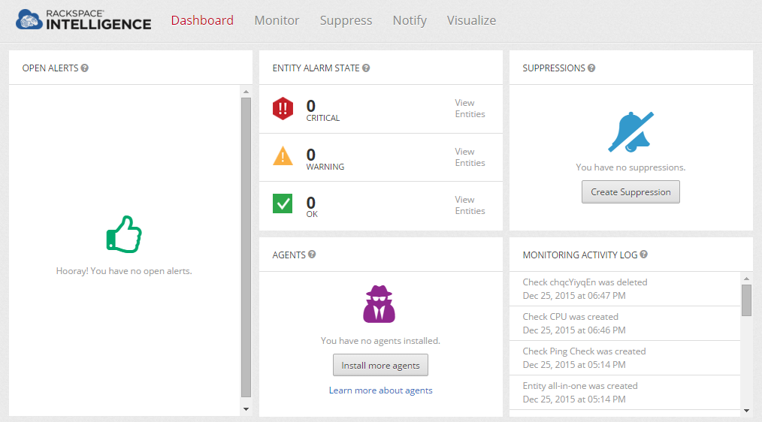
Monitoring and clean up
Azure* has a very basic monitor.
OVH* uses Horizon and its Control Panel as monitors.
Rackspace*, AWS* and GCP* offer dashboards to monitor their clouds.
Developers were mostly satisfied with all the proposed methods for destroying the infrastructure.
‘‘It's has a complete dashboard, it shows alerts, agents installed and an activity log. Very easy to understand.” – Angel about Rackspace Intelligence
Critical issues
Gaps
Best practices
*Other names and brands may be claimed as the property of others.
Notes:
Rackspace, AWS and GCP offers as part of their developer tools, dashboards to monitor their clouds (Rackspace Intelligence, CloudWatch and Google Cloud Monitoring).
And now, the most important slide of my presentation.

Slide 19
Experience satisfaction rate per provider (results)
Sign up
From 1 to 5, 5 being very satisfied.
Our developers graded their experience on every stage. The chart shows the average grade.
5
Clean up
Welcome pack
4
3
2
Rackspace
Monitoring
Billing
1
OVH
AWS
Azure
GCP
Updates and redeployment
Infrastructure
Deployment
Development
Notes:
This graphic is the visual representation of the developer experience lived by our app developers during this cloud analysis.
The two main gaps found in OpenStack clouds when comparing to other cloud providers were:
The SDKs available are incomplete or outdated against latest OpenStack APIs.
The APIs are improved every release and the SDKs are not moving as fast as they do.
It this particular case we experiment this with the networking API (libcloud still using nova-network as networking API instead of neutron), but it can happen with all the rest of the APIs as well.
The tremendous lack of development documentation.

Slide 20
Recommendations
To ensure OpenStack* increases its adoption rate, it’s important to improve its development experience through:
Delivering a better developer portal.
Driving the development/enhancement on its SDKs.
Promoting hackathons/training sessions for app developers.
*Other names and brands may be claimed as the property of others.
Notes:
So, what are our recommendations to change this situation?
What we need to do as community to help app developers?

Slide 21
Call to action
Notes:
I’m looking for support from the OpenStack community to improve the development experience in OpenStack.

Slide 22
SDKs improvement
There is a desperate need of functional SDKs… Join us to change it!
Number of SDKs per programming language
Status of the available SDKs
Source: http://tiny.cc/sdks-status
Notes:
What criteria is used to determine whether or not an SDK can be considered an OpenStack SDK has not been formalized.
The current SDKs available are incomplete or outdated against the latest OpenStack APIs
The 59% percent correlates to SDKs with issues, incompleted or death

Slide 23
First app completion
We need volunteers to complete the First App tutorial for each SDK!
SDK | Language | Getting started | Introduction | Scaling out | Make it durable | Block Storage
libcloud | Python
OpenStack* SDK | Python
shade | Python
jclouds | Java
fog | Ruby
pkgcloud | Node.js
php-opencloud | PHP
OpenStack.NET | .NET
gophercloud | Go
Published
Ready for test
In progress
Not done
Source: http://tiny.cc/firstapp-status
*Other names and brands may be claimed as the property of others.
Notes:
Only 9 SDKs have try to create at least a section for My First App. We need volunteers to complete at least those tutorials!

Slide 24
Conduct your own cloud comparison
Share with the community your developer experience using your clouds and helping us to improve OpenStack*!
Script to reproduce this study
http://tiny.cc/cloud-comparison
Application Ecosystem Working Group
user-committee@lists.openstack.org prefix the subject line with [app]
*Other names and brands may be claimed as the property of others.
24

Slide 25
App Ecosystem WG
Working session!
Please come join us to review progress in past cycle and define Newton priorities and goals.
When: Today, 4:30 pm – 6:00 pm
Where: Hilton Austin - Level 6 - Salon F
Join us: https://wiki.openstack.org/wiki/Application_Ecosystem_Working_Group

Slide 26
Q&A
Thank you!
Notes:
Please, provide me feedback on my talk using the "FEEDBACK" button on the mobile app.

